Slide 1


Slide 2

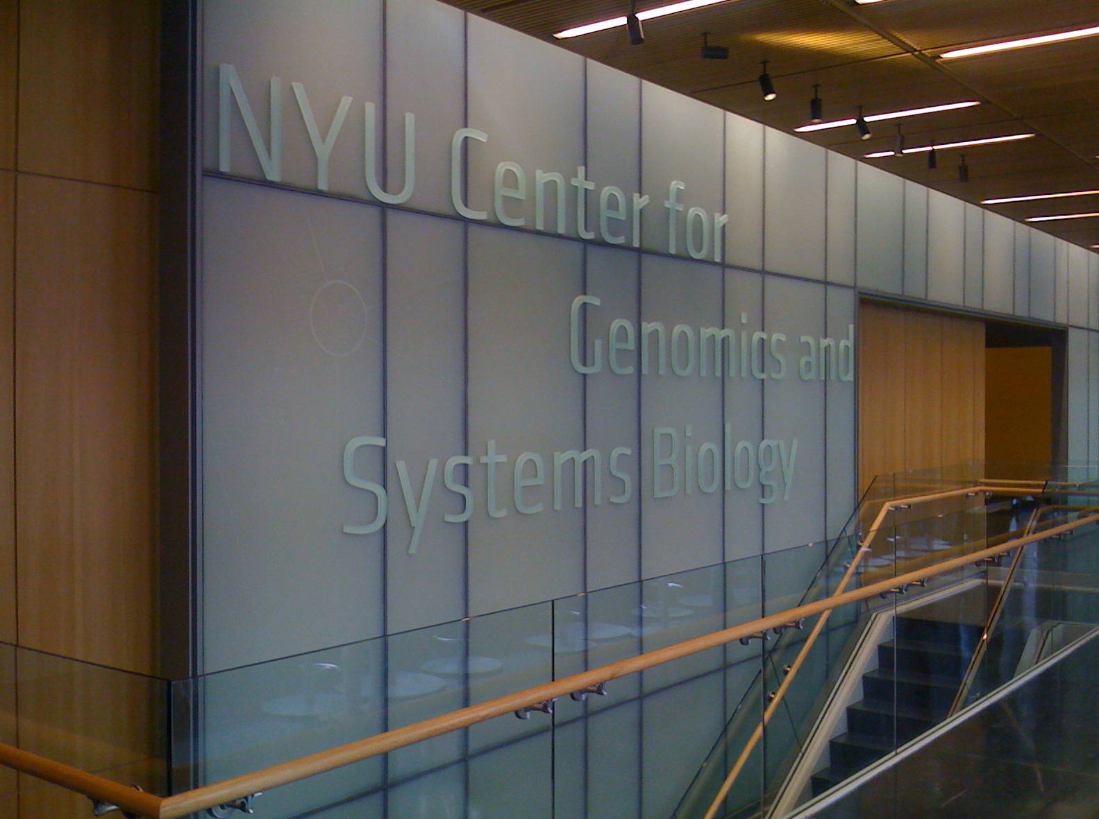
Notes:
2

Slide 3
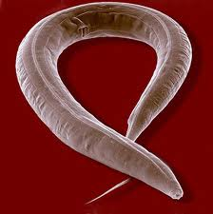
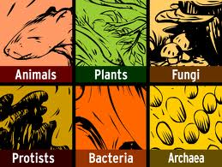
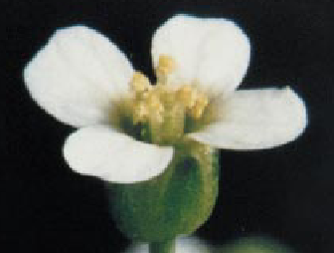
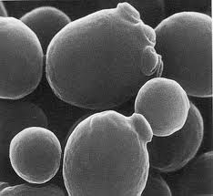
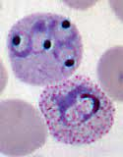
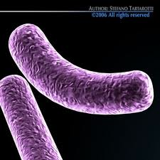
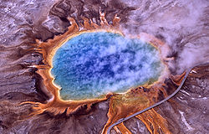
The mission of NYU’s Center for Genomics & Systems Biology
How do regulatory networks operate?
How they have evolved to generate diversity across species and the six kingdoms of life?
Approaches: Systems Biology & Networks, Comparative Functional Genomics & Bioinformatic Pipelines
Focus: Model organisms and phylogenetically related species.

Slide 4


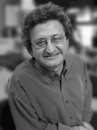
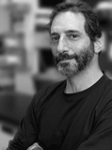
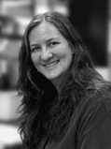
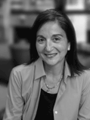
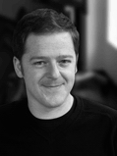


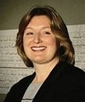
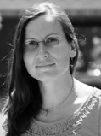

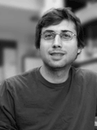


Robustness
Adaptation
Embryogenesis
Stem Cells
Networks
Gresham
Networks
Siegal
Birnbaum
Piano
Gunsalus
DIRECTOR
DIR. CORE
Coruzzi
DIR. BIOINFORMATICS
FUNGI
Diversity
Diversity
ANIMALIA
PLANTAE
Purugganan
Rockman
Epigenetics
Malaria/Parasites
ARCHAEA
PROTISTA
Carlton
Ercan
BACTERIA
DIR. SEQUENCING
Human Proteome
Biofuels/Metabolic Engineering
Networks & Proteome
Environment Sensing
Microbial Development
Salehi-Ashtiani
Vogel
Bonneau
Eichenberger
Kussell
(NYU AD)
(Bio/Courant)
(Bio/Physics)
Notes:
6 Kingdoms of Life – Center for Genomics & Systems Biology

Slide 5
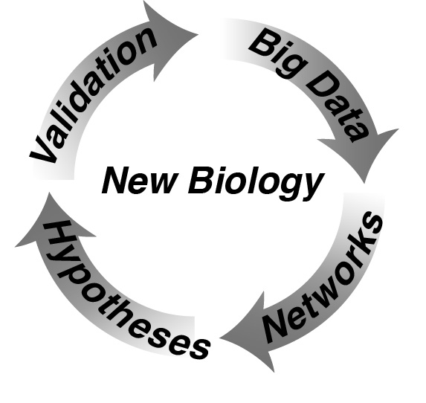
Big Data→ Integration→ New Biology

Slide 6
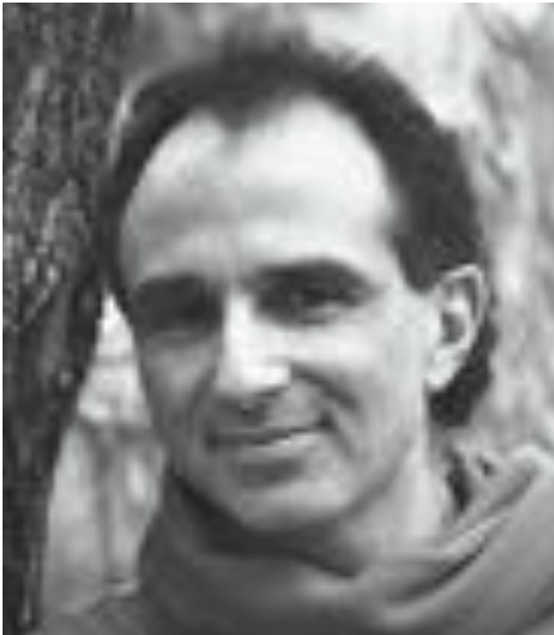
MICROBES
PLANTS
ANIMALS
HUMANS
Malaria/Parasites
Networks
Networks
Networks & Proteome
Carlton
Coruzzi
Gunsalus
Bonneau
DIR. SEQUENCING
DIR. BIOINFORMATICS
(Bio/Courant)
Microbes/Protists
Jane Carlton
A. thaliana/Crops
Coruzzi/Shasha
C. elegans
Gunsalus/Piano
Microbes/Humans
Bonneau
Inferrelator &
Human Proteome
Embryogenesis
Piano
Microbiome
Plant Networks
DIRECTOR
Animal Development
Networks
COMPUTATION
Shasha
Juliana Freire
NYU Poly
Computational Provenance
(Sharing Data and Workflows)
NYU Courant

Slide 7

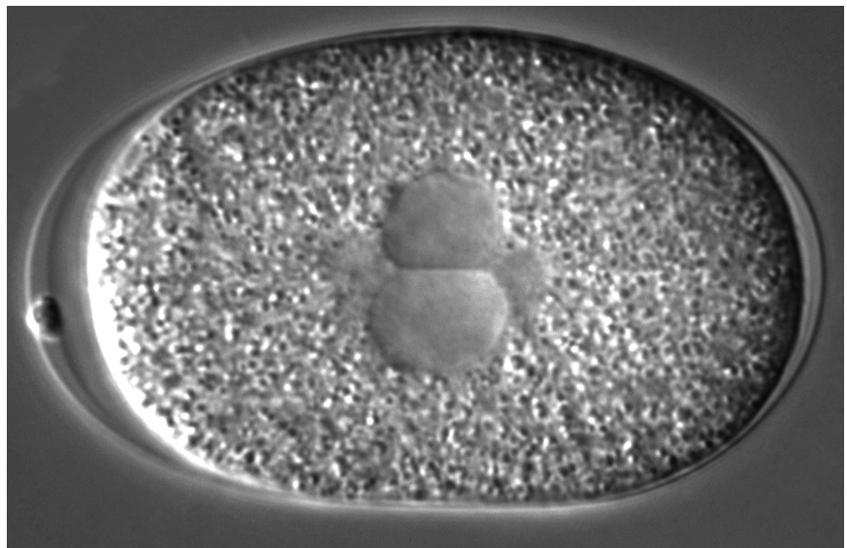

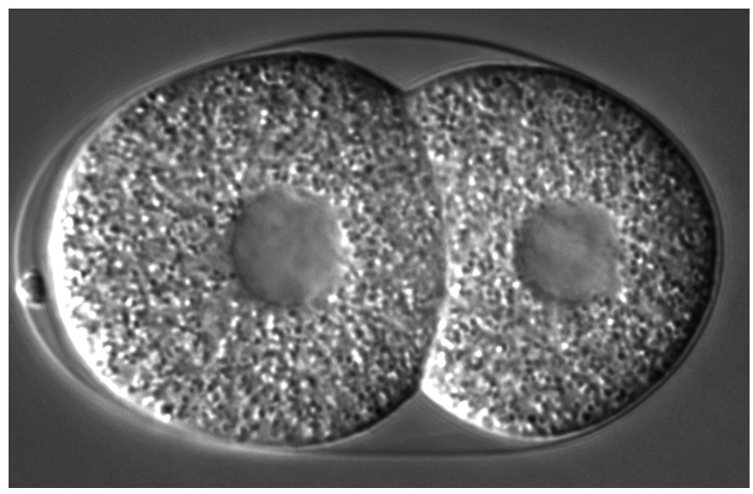
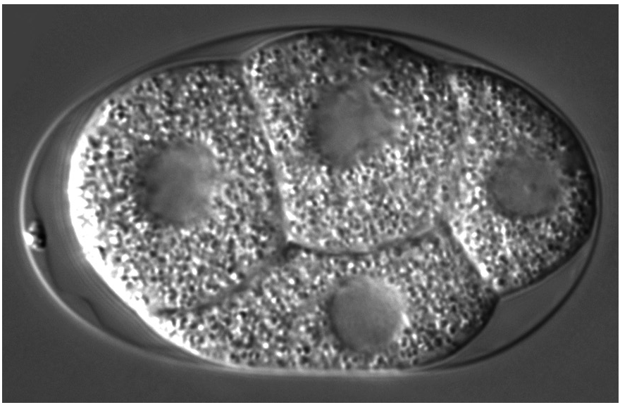
Expression
profiling
Binary interactome
Mapping
Phenotypic
profiling
Kim et al., Science (2001)
Li et al., Science (2004)
Giot et al., Science (2003)
Sönnichsen et al., Nature (2005)
Conditions
Phenotypes
Correlations
Correlations
Genes
Tr_PCCa
Genes
Ph_PCCi
Tr_PCCb
Ph_PCCj
Tr_PCCa > threshold x
Ph_PCCi > threshold y
Molecular machine models
Notes:
The approach we took was to create a graph representation of genes or proteins and the functional links between them based on a compendium of microarray data, protein interaction mapping projects, and our phenotypic profiles.
We represent genes or proteins as nodes, and edges as functional links between them.
- For protein interaction data, we used the C. elegans protein interaction map supplemented with interologs from Drosophila.
- For expression data, we used a compendium of microarray data (from the Kim lab). We calculated a correlation coefficient between genes across many experimental conditions, and drew a functional link between gene pairs whose correlation coefficient was above a chosen threshold level.
For phenotypic data, we use an analogous approach based on phenotypic similarity above a chosen threshold.
We then combine these graphs to derive models of the molecular machinery underlying events in the early embryo. So while each of these data types provides one level of functional information, by combining all three data types we gain an integrated view of the physical and logical organization of functional modules,

Slide 8
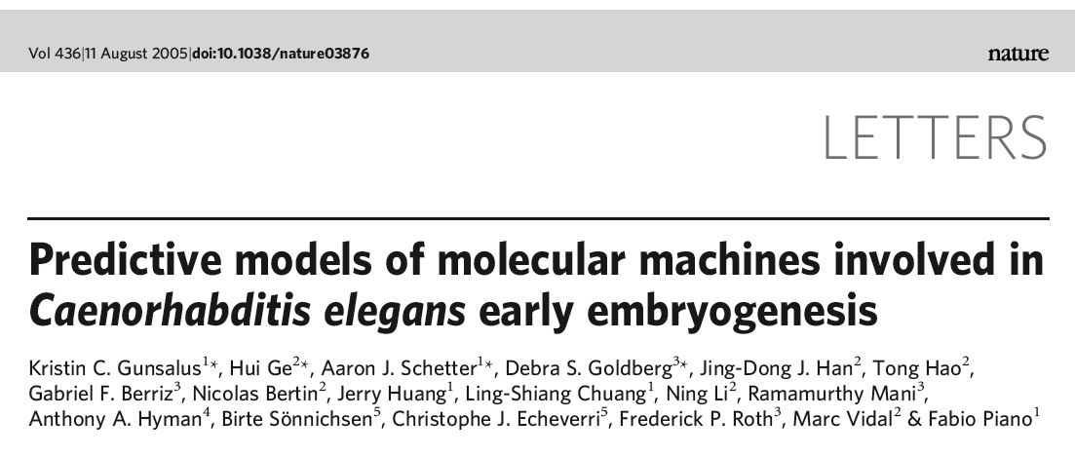

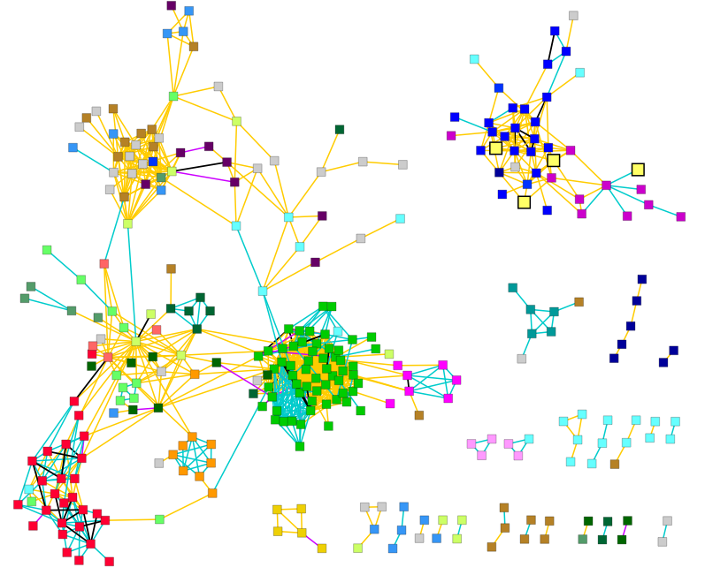
Networks Analysis reveals “Molecular Machines” required for embryogenesis in C. elegans.
Histone
DNA Synthesis/Replication
Nucleocytoplasmic transport
Cell cycle
Other
Unknown
Kris Gunsalus
Translational Control
Ribosome
Protein Synthesis
Microtubule
cytoskeleton
Proteasome
“Molecular Machines”

Slide 9
Mapping molecular networks across species
human
mouse
C. elegans

Slide 10
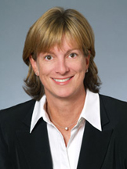
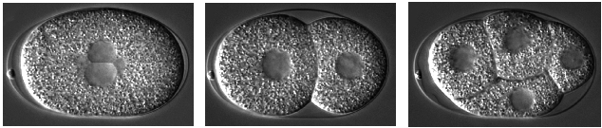
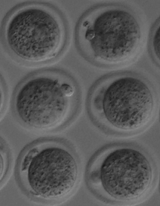
A systems biology approach mammalian early embryogenesis
C. elegans
NIH Grant Awarded: 2008-2012
Gunsalus
(NYU-CGSB)
Noyes
(NYU-Med)
Human
Mouse

Slide 11


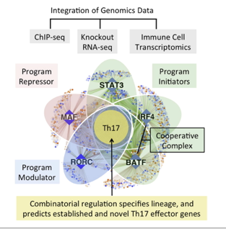

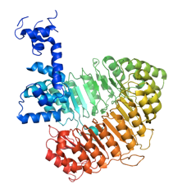


Systems Biology: Network Inference (Inferrelator) & Folding the Proteome
Halobacterium
(Salt tolerant bacteria)
Humans
Richard Bonneau
Biology & Courant (Computer Science)
Folding the Human Proteome
IBM & the world community GRID

Slide 12
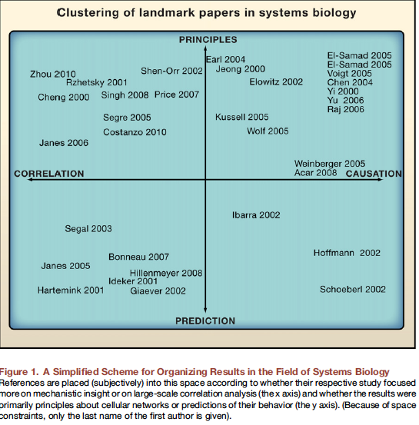
Cell (2011) March 18:
Network News: Innovations in 21 Century Systems Biology
NYU CGSB Faculty Cited for Landmark Papers in Systems Biology
Bonneau (2007) (Biology/Courant)
Kussell (2005) Biology/Physics
Raj, Peskin, Tranchina (2006) (NYU Courant/Biology)
Cell

Slide 13
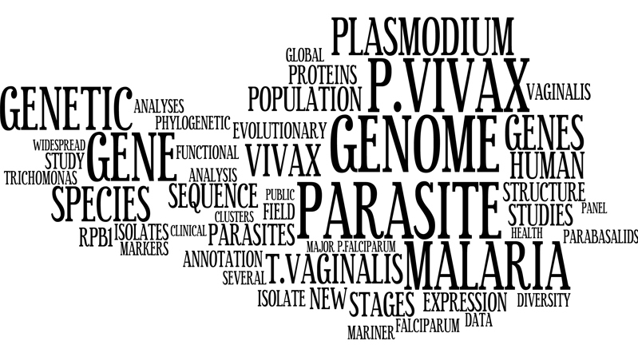
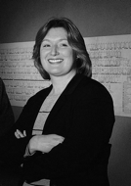
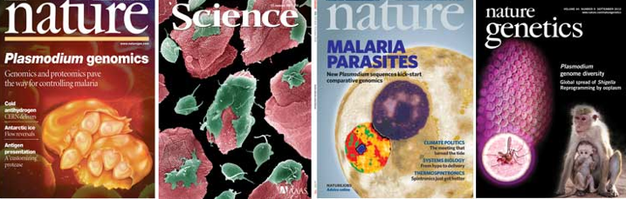
Jane Carlton
Biology & Global Public Health

Slide 14

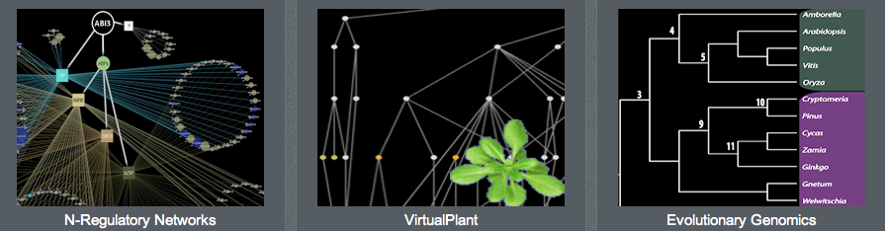
Gloria Coruzzi
CGSB/Biology
Dennis Shasha
NYU Courant
PLANT SYSTEMS BIOLOGY
VirtualPlant v1.3
Arabidopsis
www.virtualplant.org
Multinetwork
(~19,000 connected genes)
BigPlant v1.0
Phylogenomic Database
150 Plant Genomes
Translational Genomics
Crops/Ag-Biotech
http://nypg.bio.nyu.edu/bigplant/

Slide 15
Desplan: Kussel, Purugganan(CGSB)
Blau: Gunsalus (CGSB)
Scicchitano: Gunsalus,(CGSB)
Fitch: Piano (CGSB)
Shasha: Coruzzi, Birnbaum, Bonneau (CGSB)
LeCun: Piano, Gunsalus, Coruzz (CGSB)
Geiger: Gunsalus, Gresham (CGSB)
Littman: Bonneau (CGSB)
NYU
Biology
Skirball
Computer
Science
Noyes (In Vitro) – Gunsalsus CGSB)
NYU
Courant
NYU SOM
Math
SOM
Tranchina: Coruzzi (CGSB)
Shelley: Piano (CGSB)
Blaser (Microbiome)-
Carlton, Eichenberger (CGSB)
NYU
Physics
NYU
CUSP
Grossberg, Brujic: Kussell (CGSB)
NYU
Chemistry
NYC
Institutions
NYU
Poly
Kirshenbaum, Arora: Bonneau, Piano (CGSB)
Geacintov: Gunsalus (CGSB)
Freire: Shasha (Courant)
CSHL
AMNH
McCombie/Martienssen (CSHL):
Coruzzi (CGSB)
DeSalle (AMNH): Coruzzi,Purugannan (CGSB)
NYBG
Stevenson (NYBG): Coruzzi (CGSB)

Slide 16
Summary
Approach: We generate big data, integrate data sources, generate networks through analytical tools that we and others develop, generate testable hypotheses.
Common Themes: Data → Analysis → Prediction → More Data
Applications: You have seen applications in microbes, plants, animals.
How does the microbiome affect health and disease?
How can agriculture become environmentally sound?
How does animal development work?
How does the human immune system work?

Slide 17
Summary
Common Technical Themes:
Big Data. Generation and analysis of primary data, data integration, large storage, workflows, and visualization.
Common Future Goals:
Data Integration: Integrate big data knowledge base across different kingdoms of life.
Data and Platform Sharing: Develop principled infrastructure that allows the world scientific community to share data and analysis workflow in a reproducible way.

