Slide 1
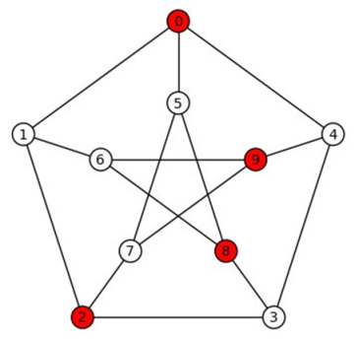
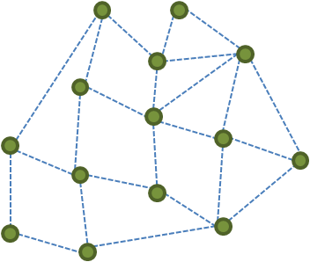
Hardness of Approximation
From the PCP Theorem to the 2-to-2 Games Theorem
x₁ – x₇ = 11 (mod 17)
x₂ – x₃ = 13 (mod 17)
…
….
x₇ - x₉ = 15 (mod 17)
Subhash Khot
Courant Institute of Mathematical Sciences
New York University

Slide 2
Where it Fits
Theoretical Computer
Science
Discrete Math,
Combinatorics
Analysis, Geometry

Slide 3
Where it Fits
Theoretical Computer
Science
Discrete Math,
Combinatorics
Complexity
Algorithms
Optimization
Analysis, Geometry

Slide 4
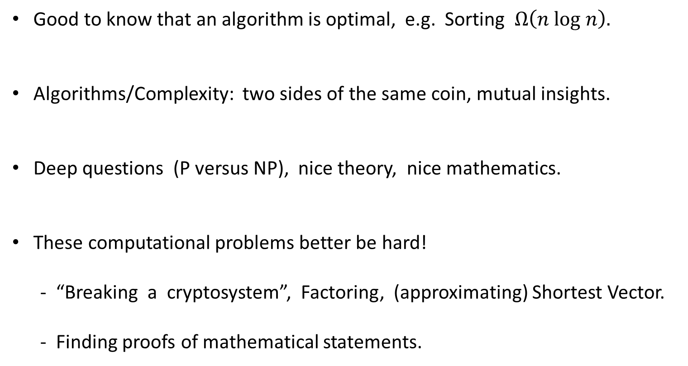
Why Computational Complexity ?
Good to know that an algorithm is optimal, e.g. Sorting $Ω\left(n log n\right).$
Algorithms/Complexity: two sides of the same coin, mutual insights.
Deep questions (P versus NP), nice theory, nice mathematics.
These computational problems better be hard!
- “Breaking a cryptosystem”, Factoring, (approximating) Shortest Vector.
- Finding proofs of mathematical statements.

Slide 5
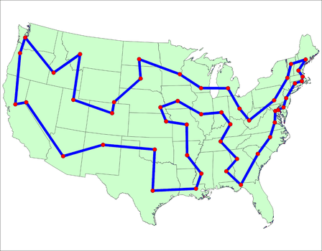
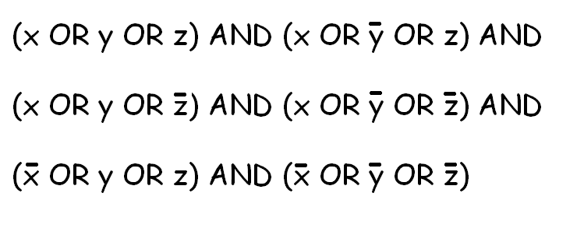

NP-hard Problems
Traveling Salesperson
3-SAT
Everywhere, look under your chair! All equivalent to each other.
P ≠ NP $≡$There is no fast (polynomial time) algorithm.
Can we compute approximate solutions fast? (practice, theory, math).

Slide 6

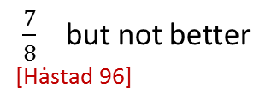
NP-hard Problems
How well can we approximate?
Traveling Salesperson
3-SAT
Within 1%
[Arora, Mitchell 98]
$\frac{7}{8}$ but not better
[Hȧstad 96]
Focus of this talk: Hardness of approximation
Amazing progress so far. Many challenges remain.
Exact versus Approximate: a different ballgame.

Slide 7
Hardness of Approximation: Historically ……
1970 NP-hardness [Cook, Karp, Levin]
1990 PCP Theorem [Arora, Babai, Feige, Fortnow, Goldwasser, Papadimitriou, Karloff]
[Lund, Motwani, Nisan, Safra, Shamir, Sudan, Szegedy, Yannakakis]
1995- Multi-Prover Games, [Bellare, Chan, Dinur, Feige, Goldreich, Guruswami, Hȧstad, K]
Boolean Function Analysis [Kindler, Moshkovitz, Mossel, O’Donnell, Raz, Regev]
[Raghavendra, Safra, Samorodnitsky, Sudan, Steurer, Trevisan]
2018 2-to-2 Games Theorem [Dinur, K, Kindler, Minzer, Safra]
?? Unique Games Conjecture [K]
?? Small Set Expansion Conjecture [Raghavendra, Steurer]

Slide 8
Hardness of Approximation: Historically ……
1970 NP-hardness [Cook, Karp, Levin]
1990 PCP Theorem [Arora, Babai, Feige, Fortnow, Goldwasser]
[Karloff, Lund, Motwani, Nisan, Safra, Shamir, Sudan, Szegedy]
1995- Multi-Prover Games, [Bellare, Chan, Dinur, Feige, Goldreich, Guruswami, Hȧstad, K]
Boolean Function Analysis [Kindler, Moshkovitz, Mossel, O’Donnell, Raz, Regev]
[Raghavendra, Safra, Samorodnitsky, Sudan, Steurer, Trevisan]
2018 2-to-2 Games Theorem
Halfway to Unique Games Conjecture [Dinur, K, Kindler, Minzer, Safra]
?? Unique Games Conjecture [K]
?? Small Set Expansion Conjecture [Raghavendra, Steurer]

Slide 9
Overview of the Talk
Independent Set Problem
Checking a proof without looking at it.
Maximum Cut Problem
Majority vote, isoperimetry, spherical cubes.
2-to-2 Game Problem
- NP-hard despite all the evidence otherwise.
- Cart before the horse.

Slide 10
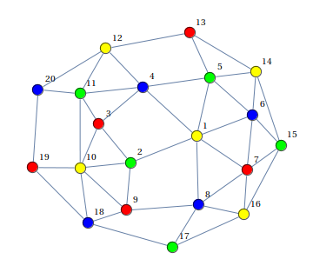


Independent Set Problem
Problem
Given: A graph with N vertices that contains an independent set of size $\frac{N}{4}$
Goal: Find a large independent set.
Can do:
[Alon Kahale ‘96] Finds independent set of size N^{3/4} (via Lovász $Θ$-function, Shannon Cap.).

Slide 11

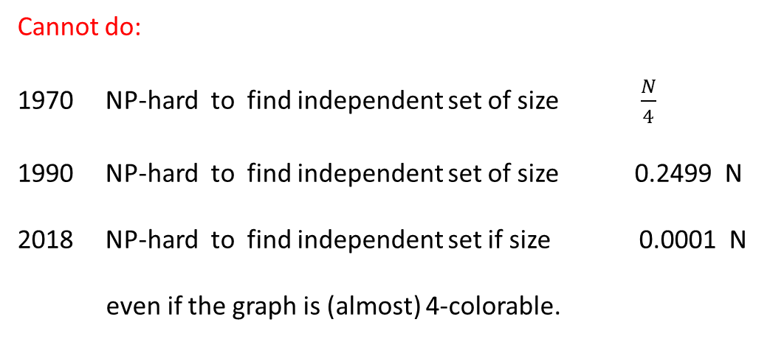
Independent Set Problem
Problem
Given: A graph with N vertices that contains an independent set of size $\frac{N}{4}$
Goal: Find a large independent set.
Cannot do:
NP-hard to find independent set of size $\frac{N}{4}$
NP-hard to find independent set of size 0.2499 N
NP-hard to find independent set if size 0.0001 N
even if the graph is (almost) 4-colorable.

Slide 12
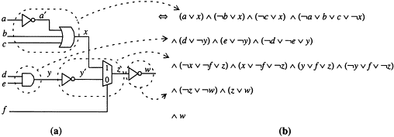
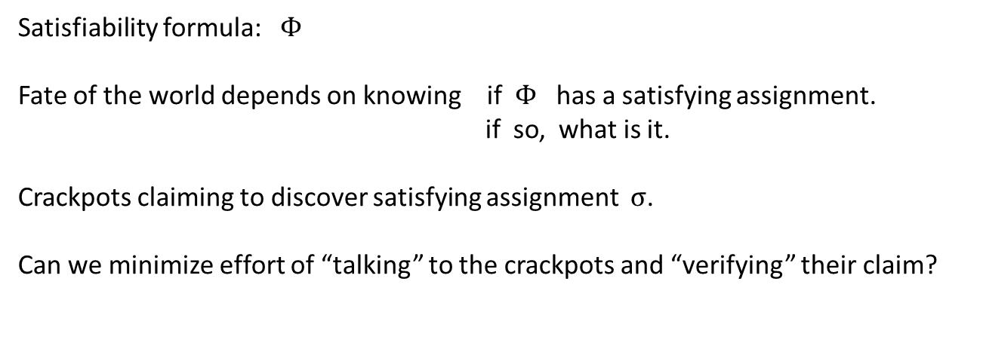
Checking Proofs of Satisfiability
Satisfiability formula: $Φ$
Fate of the world depends on knowing if $Φ$ has a satisfying assignment.
if so, what is it.
Crackpots claiming to discover satisfying assignment $σ$.
Can we minimize effort of “talking” to the crackpots and “verifying” their claim?

Slide 13

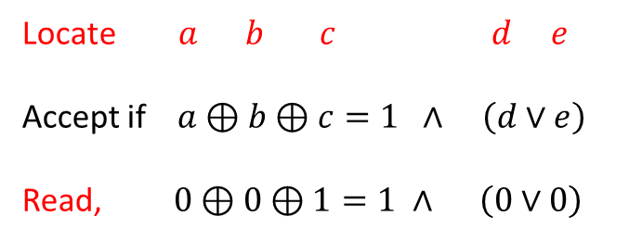
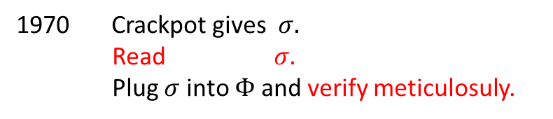
Checking Proofs of Satisfiability
Crackpot gives $σ.$
Read $σ.$
Plug $σ$ into $Φ$and verify meticulosuly.
1990 Probabilistically Checkable Proofs (PCP) Theorem
11
1 0 0 1 0 1 1 0 1 1 0 0 1 0 0 1 1
0 0 0 1 1 0 0 1 0 1 0 1 0 0 0 1 0
0 1 1 0 0 1 0 0 1 1 0 0 1 0 1 1 0
1 0 1 1 0 1 0 0 0 1 1 1 0 0 0 0 1
1 0 1 1 0 1 0 0 0 1 0 0 0 1 1 1 0
0 0 0 1 1 1 0 0 1 0 1 0 1 1 0 0 1
1 0 0 1 0 1 0 1 0 1 1 0 1 0 0 0 1
1 1 0 1 1 0 1 0 0 0 1 1 1 0 0 0 1
0 1 0 1 0 1 1 0 1 0 1 0 1 1 1 1 1
1 0 0 1 0 1 0 1 0 1 1 0 1 0 0 0 1
$$\left(Φ, σ\right)$$
deterministic
Compiler
Probabilistic, 25 probes
Locate $a b c d e$
Accept if $a⊕b⊕c=1 ∧ \left(d∨e\right)$
Read, $0⊕0⊕1=1 ∧ \left(0∨0\right)$
Reject!

Slide 14

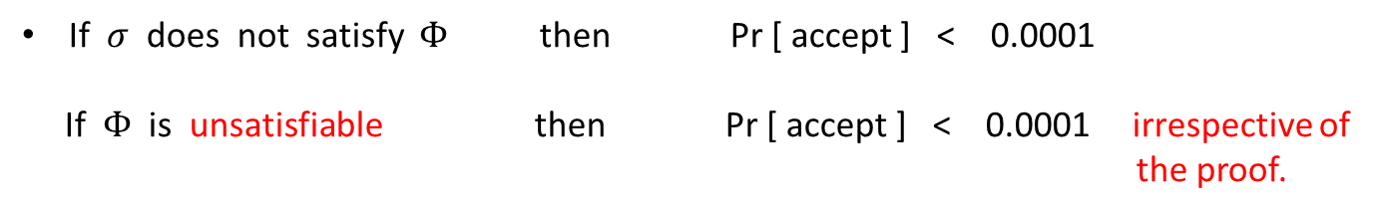

Checking Proofs of Satisfiability
If $σ$ does not satisfy $Φ$then Pr [ accept ] < 0.0001
If$Φ$ is unsatisfiable then Pr [ accept ] < 0.0001 irrespective of
the proof.
If $σ$ does satisfy $Φ$then Pr [ accept ] = 1
11
1 0 0 1 0 1 1 0 1 1 0 0 1 0 0 1 1
0 0 0 1 1 0 0 1 0 1 0 1 0 0 0 1 0
0 1 1 0 0 1 0 0 1 1 0 0 1 0 1 1 0
1 0 1 1 0 1 0 0 0 1 1 1 0 0 0 0 1
1 0 1 1 0 1 0 0 0 1 0 0 0 1 1 1 0
0 0 0 1 1 1 0 0 1 0 1 0 1 1 0 0 1
1 0 0 1 0 1 0 1 0 1 1 0 1 0 0 0 1
1 1 0 1 1 0 1 0 0 0 1 1 1 0 0 0 1
0 1 0 1 0 1 1 0 1 0 1 0 1 1 1 1 1
1 0 0 1 0 1 0 1 0 1 1 0 1 0 0 0 1
$$\left(Φ, σ\right)$$
deterministic
Compiler
Probabilistic, 25 probes
Locate $a b c d e$
Accept if $a⊕b⊕c=1 ∧ \left(d∨e\right)$
Read, $0⊕0⊕1=1 ∧ \left(0∨0\right)$
Reject!

Slide 15



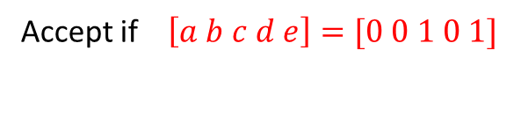


Checking Proofs without Looking
2018 2-to-2 Games Theorem
11
1 0 0 1 0 1 1 0 1 1 0 0 1 0 0 1 1
0 0 0 1 1 0 0 1 0 1 0 1 0 0 0 1 0
0 1 1 0 0 1 0 0 1 1 0 0 1 0 1 1 0
1 0 1 1 0 1 0 0 0 1 1 1 0 0 0 0 1
1 0 1 1 0 1 0 0 0 1 0 0 0 1 1 1 0
0 0 0 1 1 1 0 0 1 0 1 0 1 1 0 0 1
1 0 0 1 0 1 0 1 0 1 1 0 1 0 0 0 1
1 1 0 1 1 0 1 0 0 0 1 1 1 0 0 0 1
0 1 0 1 0 1 1 0 1 0 1 0 1 1 1 1 1
1 0 0 1 0 1 0 1 0 1 1 0 1 0 0 0 1
$$\left(Φ, σ\right)$$
deterministic
Compiler
Probabilistic, 10000 probes
Accept if $\left[a b c d e\right]=[0 0 1 0 1]$
Reject!
If $σ$ does not satisfy $Φ$then Pr [ accept ] < 0.0001
If$Φ$ is unsatisfiable then Pr [ accept ] < 0.0001 irrespective of
the proof.
1/4
If $σ$ does satisfy $Φ$then Pr [ accept ] = 1 ?

Slide 16
Overview of the Talk
Independent Set Problem
Checking a proof without looking at it.
Maximum Cut Problem
Majority vote, isoperimetry, spherical cubes.
2-to-2 Game Problem
- NP-hard despite all the evidence otherwise.
- Cart before the horse.

Slide 17
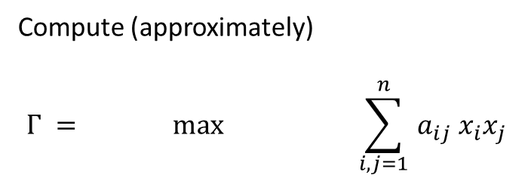





Maximum Cut Problem
$$\begin{matrix} 0 & −1 & 0 \\ −1 & 0 & 0 \\ 0 & 0 & 0\end{matrix}$$
$$\begin{matrix}−1 & 0 & 0 \\ 0 & −1 & −1 \\ −1 & 0 & 0\end{matrix}$$
Compute (approximately)
$$Γ = max \sum_{ i,j=1 }^{n}{a_{ij} x_{i}x_{j}}$$
$\begin{matrix}−1 & 0 & −1 \\ 0 & −1 & 0 \\ 0 & −1 & 0\end{matrix}$
$$\begin{matrix}0 & 0 & 0 \\ 0 & 0 & −1 \\ 0 & −1 & 0\end{matrix}$$
$$x_{1},…, x_{n}∈\{−1,1\}$$

Slide 18

Goemans-Williamson Algorithm ‘90
High dimensional
spherical embedding
Semidefinite Programming Relaxation
Unique / 2-to-2 Games Conjecture $⇒$ [Goemans Williamson] is optimal!
- Majority is Stablest.
- Isoperimetric problems.

Slide 19


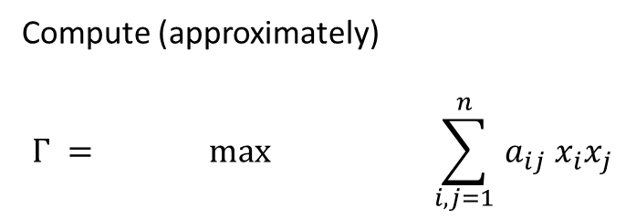



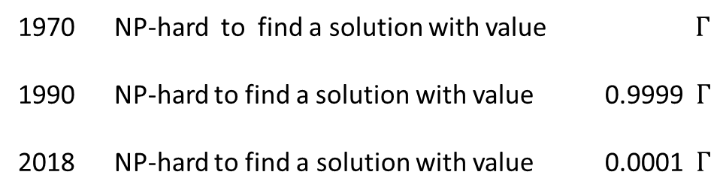
Maximum Cut Problem
$$\begin{matrix} 0 & −1 & 0 \\ −1 & 0 & 0 \\ 0 & 0 & 0\end{matrix}$$
$$\begin{matrix}−1 & 0 & 0 \\ 0 & −1 & −1 \\ −1 & 0 & 0\end{matrix}$$
Compute (approximately)
$$Γ = max \sum_{ i,j=1 }^{n}{a_{ij} x_{i}x_{j}}$$
$\begin{matrix}−1 & 0 & −1 \\ 0 & −1 & 0 \\ 0 & −1 & 0\end{matrix}$
$$\begin{matrix}0 & 0 & 0 \\ 0 & 0 & −1 \\ 0 & −1 & 0\end{matrix}$$
$$x_{1},…, x_{n}∈\{−1,1\}$$
NP-hard to find a solution with value $Γ$
NP-hard to find a solution with value 0.9999 $Γ$
2018 NP-hard to find a solution with value 0.0001 $Γ$

Slide 20
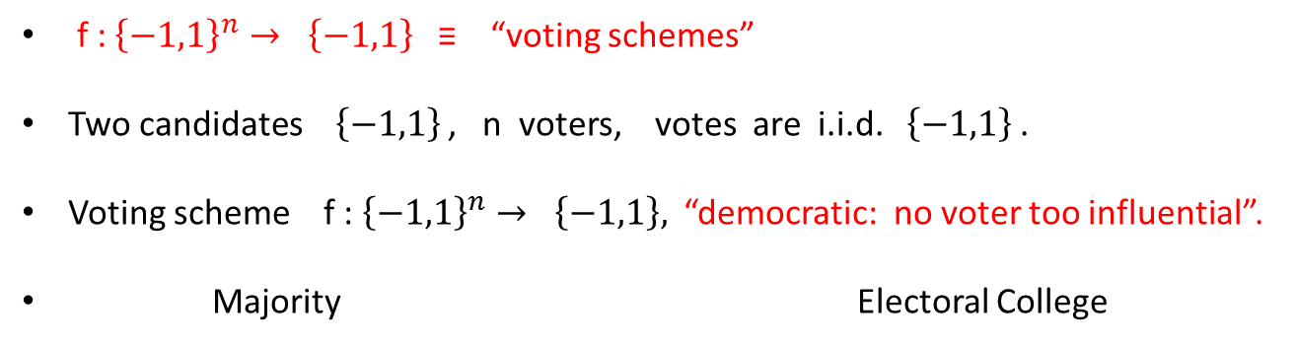
Reduction, Majority Is Stablest Theorem
x₁ – x₇ = 11 (mod 17)
x₂ – x₃ = 13 (mod 17)
…
….
x₇ - x₉ = 15 (mod 17)
Unique /2-to-2 Game instance
Reduction
Majority Is Stablest
Theorem
Graph G(V,E)
f : ${\left\{−1,1\right\}}^{n}→ \left\{−1,1\right\}$ ≡ “voting schemes”
Two candidates ${\left\{−1,1\right\}}^{ }$, n voters, votes are i.i.d. ${ \left\{−1,1\right\}}^{ }$.
Voting scheme f : ${\left\{−1,1\right\}}^{n}→ \left\{−1,1\right\},$ “democratic: no voter too influential”.
Majority Electoral College
MAJ
MAJ
MAJ
MAJ
MAJ
x₁ x₂ … x_{m}
x_{m+1} …. x_{2m} …..
x_{n-m} x_{n}
x₁ x₂ ….. x_{n}

Slide 21
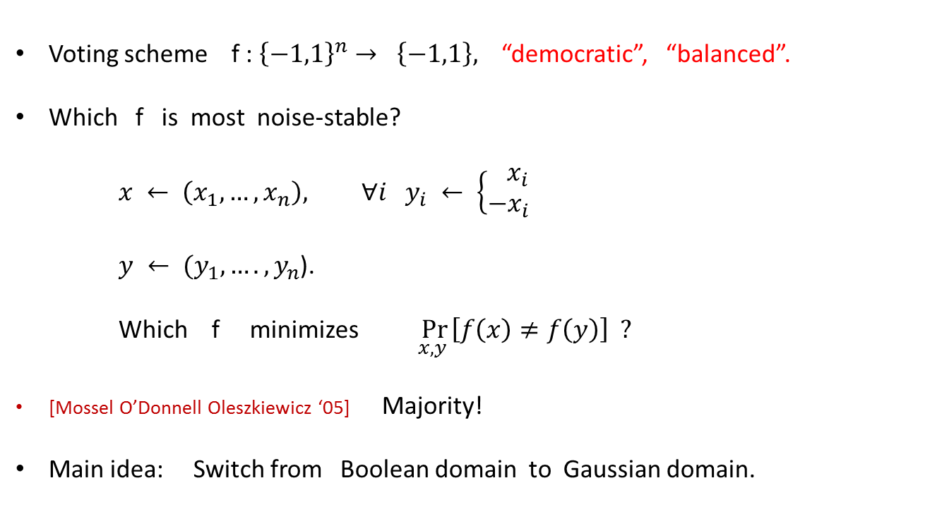


Majority Is Stablest Theorem
Voting scheme f : ${\left\{−1,1\right\}}^{n}→ \left\{−1,1\right\},$ “democratic”, “balanced”.
Which f is most noise-stable?
$x ← \left(x_{1}, …, x_{n}\right), ∀i y_{i} ← \left\{\begin{aligned} x_{i} \\ −x_{i}\end{aligned}\right.$
$y ← (y_{1}, …., y_{n}$).
Which f minimizes $\underset{x, y }{Pr}\left[f\left(x\right)≠f\left(y\right)\right] ?$
[Mossel O’Donnell Oleszkiewicz ‘05] Majority!
Main idea: Switch from Boolean domain to Gaussian domain.
with probability $1−ε$
with probability $ε$

Slide 22
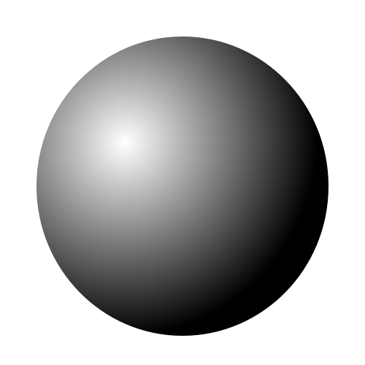
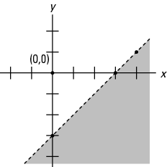
Isoperimetry
In R^{n}, which “shape” with a fixed volume has least surface area?
Standard case:
[Borell ‘85]
Gaussian case:

Slide 23
Punchline
x₁ – x₇ = 11 (mod 17)
x₂ – x₃ = 13 (mod 17)
…
….
x₇ - x₉ = 15 (mod 17)
Unique /2-to-2 Game Problem
Reduction
Maximum CUT
Problem
Majority Is Stablest Theorem
Gaussian Isoperimetry

Slide 24
Spherical Cubes: Hardness Amplification Fails
Problem: Tiling R^{n} using a “shape” of unit
volume and minimum surface area.
[Raz, Kindler O’Donnell Rao Wigderson, Alon Klartag ‘08]
There exists a tiling shape with unit volume and surface area O(√n )!
Great for tiling:
Surface area = 2n
Not good for tiling:
Surface area ≈ √n

Slide 25
Overview of the Talk
Independent Set Problem
Checking a proof without looking at it.
Maximum Cut Problem
Majority vote, isoperimetry, spherical cubes.
2-to-2 Game Problem
- NP-hard despite all the evidence otherwise.
- Cart before the horse.

Slide 26
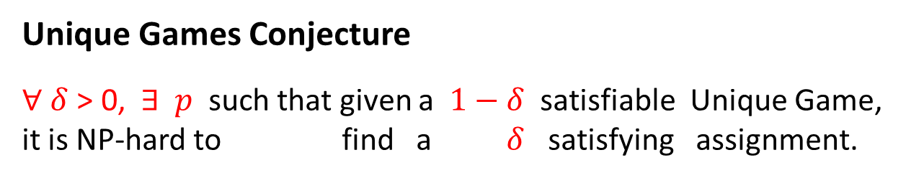

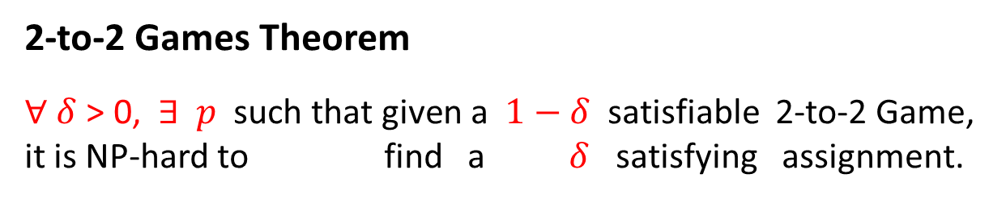
Unique Game 2-to-2 Game
x₁ – x₇ = 5 (mod p)
x₂ – x₃ = -2 (mod p)
….
x_{i} – x_{j} = c_{ij} (mod p)
…..
x₇ – x_{n} = 11 (mod p)
x₁ – x₇ = 5, -1 (mod p)
x₂ – x₃ = -2, 0 (mod p)
….
x_{i} – x_{j} = c_{ij,} b_{ij} (mod p)
…..
x₇ – x_{n} = 11, 3 (mod p)
Unique Games Conjecture
$∀ δ$ > 0, $∃ p$ such that given a $1−δ$satisfiable Unique Game,
it is NP-hard to find a $δ$ satisfying assignment.
2-to-2 Games Theorem
$∀ δ$ > 0, $∃ p \text{such} \text{that} \text{given} \text{a} 1−δ$satisfiable 2-to-2 Game,
it is NP-hard to find a $δ$ satisfying assignment.
$$\frac{1}{2}$$
Unique Game

Slide 27
Simplest Hard Problem
Many other problems are hard to approximate.
Many more …….
Max Acyclic Subgraph
Unique / 2-to-2 Games Conjecture
All CSPs
Independent Set
Max Cut
Algorithms, Optimization.
Computational complexity.
Analysis and Geometry.

Slide 28
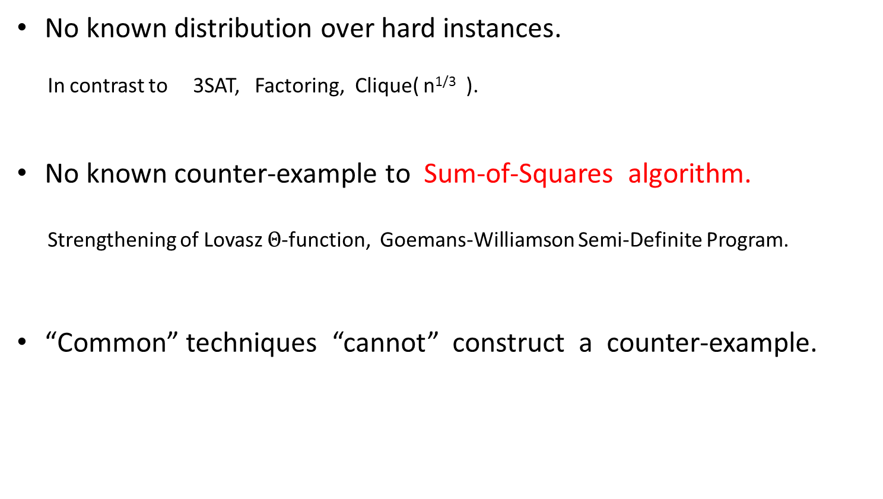
“Evidence” Against Unique Games Conjecture
No known distribution over hard instances.
In contrast to 3SAT, Factoring, Clique( n^{1/3} ).
No known counter-example to Sum-of-Squares algorithm.
Strengthening of Lovasz $Θ$-function, Goemans-Williamson Semi-Definite Program.
“Common” techniques “cannot” construct a counter-example.
[ Arora Barak Brandão Harrow Kelner Kolla Makarychev² Steurer Zhou ]

Slide 29
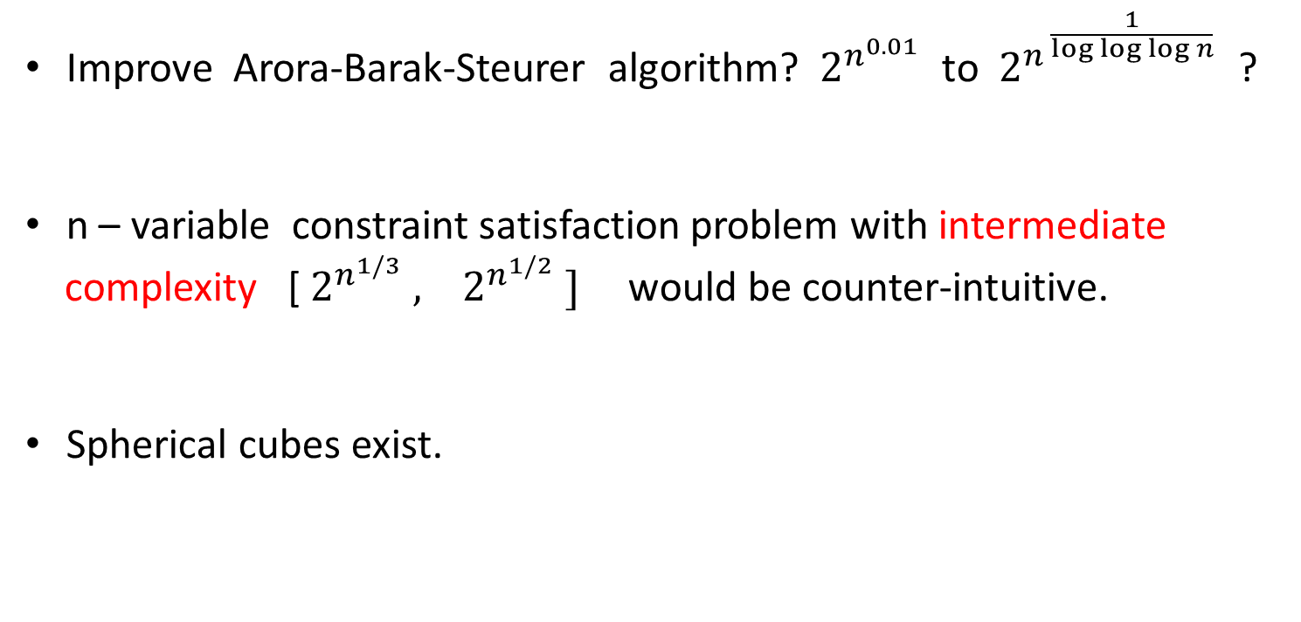
“Evidence” Against Unique Games Conjecture
Improve Arora-Barak-Steurer algorithm? $2^{n^{0.01} }$to $2^{{n }^{\frac{1}{log log log n}} }$?
n – variable constraint satisfaction problem with intermediate
complexity [ $2^{n^{1/3}} , 2^{n^{1/2}} ]$ would be counter-intuitive.
Spherical cubes exist.
2-to-2 Games Conjecture
correct nevertheless!

Slide 30
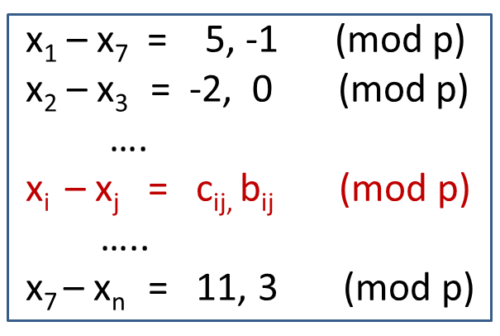
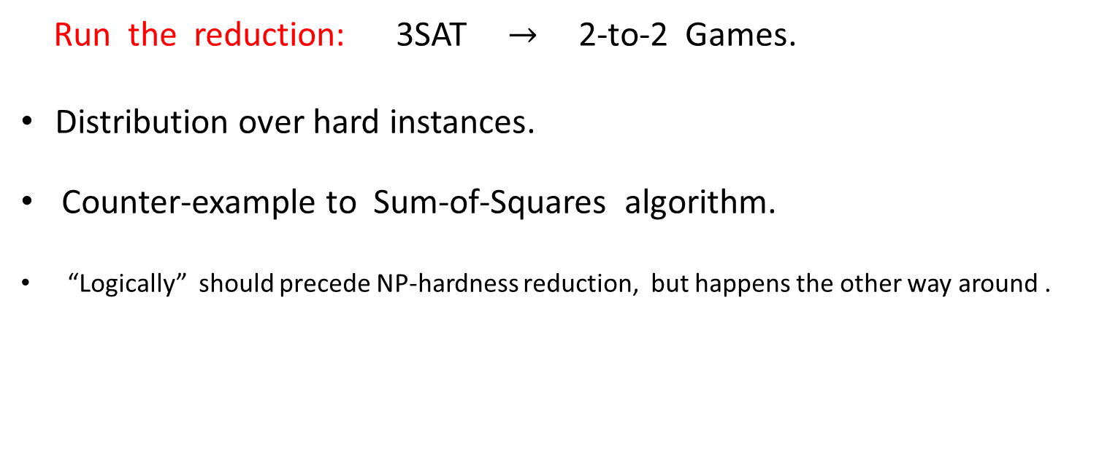
Cart Before the Horse
Run the reduction: 3SAT $→$2-to-2 Games.
Distribution over hard instances.
Counter-example to Sum-of-Squares algorithm.
“Logically” should precede NP-hardness reduction, but happens the other way around .
[Barak, Windows on Theory]
One way to resolve this conundrum is that while the unique games problem may well be hard in the worst case, it is extremely hard to come up with actual hard instances for it.
While it is theoretically still possible for the unique games conjecture to be false (as I personally believed would be the case until this latest sequence of results) the most likely scenario is now that the UGC is true, ………

Slide 31
Outline of Proof
Reduction
3-LIN / 3-SAT
2-to-2 Game
(Grassmann) Linearity Testing Theorem
(Grassmann) Expansion Theorem

Slide 32
Conclusion
Approximability of NP-hard problems: interesting and challenging.
Several connections to topics in computer science and mathematics.
Unique Games Conjecture: are we close or still far?
Many more interesting questions: e.g. Traveling Salesperson.
Talks/surveys/lecture-notes: [Barak, K, O’Donnell, Trevisan]

