Slide 1
Commonsense Reasoning about Chemistry Experiments:
Ontology and Representation
Ernest Davis
Commonsense 2009

Slide 2
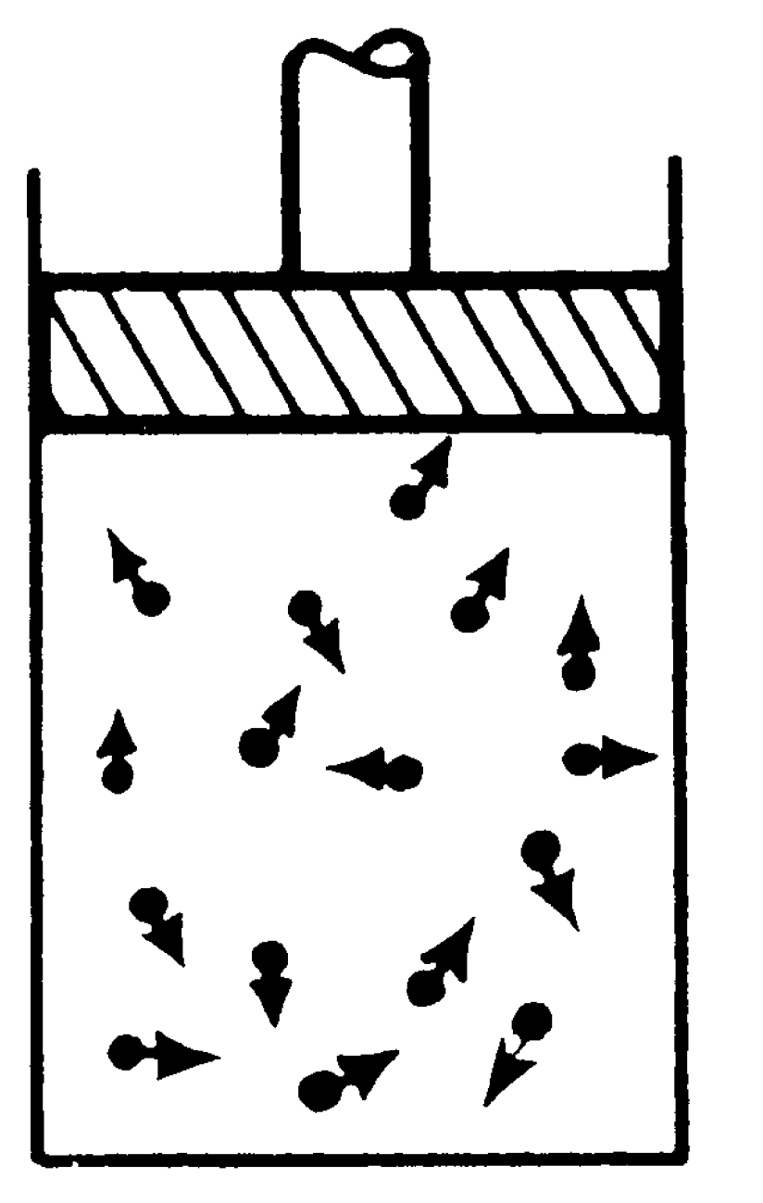
Gas in a piston
Figure 1-3 of The Feynmann Lectures on Physics.
The gas is made of molecules.
The piston is a continuous chunk of stuff.

Slide 3
What is the right ontology and representation for reasoning about simple physics and chemistry experiments?
Goal: Automated reasoner for high-school science. Use commonsense reasoning to understand how experimental setups work.
Manipulating formulas is comparatively easy.
Commonsense reasoning about experimental setups is hard.

Slide 4
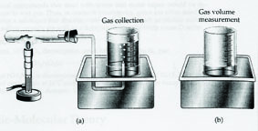
Simple experiment: 2KClO₃ → 2KCl + 3O₂
Understand variants:
What will happen if:
The end of the tube is outside the beaker?
The beaker has a hole at the top?
The tube has a hole?
There is too much potassium sulfate?
The beaker is opaque?
A week elapses between the collection and measurement of the gas?

Slide 5
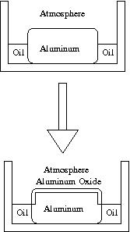
Passivization of Aluminum:
2Al+3O₂ ⟶ 2AlO₃
Variants: What happens if:
You slowly rotate the aluminum bar?
After waiting, you cover the bar with oil?
You scrape off the layer of oxide?
You replace the atmosphere by nitrogen in a closed container?
You replace the atmosphere by nitrogen in an open container?
You bore a hole into the bar at the top?
You bore a hole into the bar below the level of the oil?

Slide 6
Evaluation of representation scheme
Present a sheaf of 11 benchmark rules.
Evaluate representational schemes for matter in terms of how easily and naturally they handle the benchmarks.

Slide 7
Related work
Philosophical: Lots, mostly distant. E.g. Rea (ed.) Material Constitution: A Reader
Some closer work in philosophy of chemistry. E.g. Needham, “Chemical Substances and Intensive Properties”
KR: Pat Hayes, Antony Galton, Brandon Bennett

Slide 8
Scope and limits
1st order logic, set theory, standard math constructs as needed.
No quantum theory
Ignore electron interactions
Assume real-valued time, Euclidean space
Explicit representation of time instants. (Could also consider interval-based repns, but enough is enough.)
Reasoning with partial specifications.

Slide 9
Benchmarks
Part/whole relations among bodies of matter.
Additivity of mass.
Motion of a rigid solid object
Continuous motion of fluids
Chemical reactions: spatial continuity and proportion of mass in products and reactants.
Gas attains equilibrium in slow moving container
Ideal gas law and law of partial pressures
Liquid at rest in an open container
Carry water in slow open container
Oxydation in atmosphere: Availability of oxygen.
Passivization of metals: Surface layer

Slide 10
Theories
Atoms and molecules with statistical mechanics
Field theory: (a) points; (b) regions; (c) histories; (d) points + histories ✓-
Chunks of material (a) just chunks; (b) with particloids.
Hybrid theory: Atoms and molecules, chunks, and fields. ✓+

Slide 11
For each theory I will:
  Describe the theory
  Say which benchmarks are easy and hard
  Give some examples of formal representations

Slide 12
Outline
Atoms and molecules with statistical mechanics
Field theory: (a) points; (b) regions; (c) histories; (d) points + histories
Chunks of material (a) just chunks; (b) with particloids.
Hybrid theory: Atoms and molecules, chunks, and fields.

Slide 13
Atoms and molecules with statistical mechanics: The good news
Matter is made of molecules. Molecules are made of atoms. An atom has an element.
Chemical reaction = change of arrangement of atoms in molecules.
Atoms move continuously.
For our purposes, atoms are eternal and have fixed shape.
chunk(C) ⇒ massOf(C) = Σ_{A∈C} massOf(A)
The theory is true.

Slide 14
Atoms and molecules with stat mech:
The bad news
Statistical definitions for:
Temperature, pressure, density
The region occupied by a gas
Equilibrium
Van der Waals forces for liquid dynamics.
Language must be both statistical and probabilistic.

Slide 15
Benchmark evaluation
Part/whole: Easy
Additivity of mass: Easy. (Isotopes are a nuisance.)
Rigid motion of a solid object: Medium
Continuous motion of fluids: Easy
Chemical reactions: Easy
Contained gas at equilibrium: Hard
Gas laws: Hard
Liquid behavior: Murderous
Availability of oxygen: Hard
Surface layer: Easy

Slide 16
Examples
PartOf(ms1,ms2: set[mol]) ≡ ms1 ⊂ ms2
MassOf(ms:set[mol]) = ∑_{m∈ms} MassOf(m)
MassOf(m:mol) = ∑_{a|atomOf(a,m)} MassOf(a)
f=ChemicalOf(m) ^ Element(e) ⟹
Count({a|AtomOf(a,m)^ElementOf(a)=e)}) =
ChemCount(e,f).
MolForm(f:Chemical,e1:Element,n1:Integer… ek,nk) ≡
ChemCount(e1,f)=n1 ^ … ^ ChemCount(ek,f)=nk ^
∀_{e} e≠e1^…^e≠ ek ⟹ ChemCount(e,f)=0.
MolForm(Water,Oxygen,1,Hydrogen,2)

Slide 17
Outline
Atoms and molecules with statistical mechanics
Field theory: (a) points; (b) regions; (c) histories; (d) points + histories
Chunks of material (a) just chunks; (b) with particloids.
Hybrid theory: Atoms and molecules, chunks, and fields.

Slide 18
Field theory
Matter is continuous. Characterize state with respect to fixed space.
Based on points / regions / Hayes’ histories (= fluents on regions)
Density of chemical at a point/mass of chemical in a region.
Flow at a point vs. flow into a region. Strangely, flow is defined, but nothing actually moves.
(Avoids cross-temporal identity issue)

Slide 19
Outline
Atoms and molecules with statistical mechanics
Field theory: (a) points; (b) regions; (c) histories; (d) points + histories
Chunks of material (a) just chunks; (b) with particloids.
Hybrid theory: Atoms and molecules, chunks, and fields.

Slide 20
Field theory: Point based
Lots of things here becomes non-standard PDEs (i.e. PDE with both spatial and temporal discontinuities). Hard to use with partial geometric specs.
Part/whole and additivity of mass: N/A
Conservation of mass: ∂𝜌/∂𝑡 = 𝛁⋅𝐹 (nonstandard)
Rigid solid object: Non-standard PDE.
Continuous motion of fluids: Non-standard PDE

Slide 21
Point based field theory: Cntd.
Chemical reactions:
  𝜌_{f} (x) = density of chemical f at x
  𝛼_{w} (x) = rate of reaction w at x
  𝛽_{w,q} = fractional production of q by reaction w
  ∂𝜌_{q} /∂𝑡 = 𝛁⋅𝐹 + ∑_{w} 𝛽_{w,q} 𝛼_{w}
Alternative solution: Define density of elements.
Contained gas equilibrium: Murderous
Gas laws: Easy
Liquid at rest: Fairly easy
Liquid being carried: Murderous
Availability of oxygen: Easy
Surface layer: Problematic.

Slide 22
Examples
Ideal gas law:
HoldsST(t,p,Equilibrium) ^ Value(t,p,Phase)=Gas ⟹
HoldsST(t,p,PressureOf(f:Chemical) =#
DensityOf(f)⋅Temperature⋅GasFactor(f))
Law of partial pressures:
ValueST(t,p,PressureAt) =
∑_{f :Chemical} ValueST(t,p,PressureOf(f))

Slide 23
Outline
Atoms and molecules with statistical mechanics
Field theory: (a) points; (b) regions; (c) histories; (d) points + histories
Chunks of material (a) just chunks; (b) with particloids.
Hybrid theory: Atoms and molecules, chunks, and fields.

Slide 24
Field theory with static regions
Characterize total quantities in regions.
Part/whole: Easy
Additivity of mass: Easy but annoying
holds(T,DS(r1,r2)) ⟹
holds(T,MassOf(r1∪r2) =# MassOf(r1)+MassOf(r2) ^#
MassIn(r1∪r2,f:chemical) =# MassIn(r1,f)+MassIn(r2,f))
Rigid motion of a solid object: Murderous

Slide 25
Fields with regions: Chemical reactions
Chemical reaction and fluid flow:
Value(t2,MassIn(r,f)) – Value(t1,MassIn(r,f)) = =NetInflow(f,r,t1,t2) +
∑_{w} 𝛽_{w,f}NetReaction(w,r,t1,t2)
If throughout t1,t2 there is no f at the boundary of r, then NetInflow(f,r,t1,t2)=0.
Again, with MassIn(r,e) for element E, you only need flow constraint.

Slide 26
Flow rule
Holds(t,NoChemAtBoundary(f,r)) ≡
[∀_{r1} TPP(r1,r) ^ Value(t,MassIn(r1,f)) > 0 ⟹
∃_{r2} NTPP(r2,r) ^ PP(r2,r1) ^
Holds(t,MassIn(r2,f) =# MassIn(r1,f))] ^
[∀_{r1} EC(r1,r) ^ Value(t,MassIn(r1,f)) > 0 ⟹
∃_{r2} DC(r2,r) ^ PP(r2,r1) ^
Holds(t,MassIn(r2,f) =# MassIn(r1,f))]

Slide 27
Region based field theory (cntd)
Equilibrium state: Easy but annoying
Contained gas: Murderous with moving container
Gas laws: Easy
Liquid dynamics: Murderous
Availability of oxygen: Easy
Surface layer: Allow oxygen to interpenetrate aluminum to depth “veryThin”.
Better grounded cognitively/philosophically?

Slide 28
Outline
Atoms and molecules with statistical mechanics
Field theory: (a) points; (b) regions; (c) histories; (d) points + histories
Chunks of material (a) just chunks; (b) with particloids.
Hybrid theory: Atoms and molecules, chunks, and fields.

Slide 29
Hayesian Histories
Constraint: History must be continuous.
Part/whole and additivity of mass: As above
Rigid solid object: Easy. Solid object is a type of history.
Chemical reactions: As above.
Contained gas equilibrium: Easy.
Gas laws: Easy.
Liquid dynamics: Easy but annoying
Availability of oxygen: Easy
Surface layer: As above
Existence of histories (comprehension axiom or specific categories).

Slide 30
Example: Liquid Dynamics
Holds(t,CuppedReg(r)) ≡
∀_{r1} EC(r1,r) ⟹
[∃_{r2} P(r2,r1) ^
Holds(t,ThroughoutSp(r2,Solid V# Gas))] ^
[Holds(t,ThroughoutSp(r2,Gas)) ⟹
Above(r2,r1)]

Slide 31
Liquid dynamics (cntd)
Holds(t1,ThroughoutSp(r1,Liquid) ^#
CuppedReg(r1) ^# P#(r1,h2))
Continuous(h2) ^ SlowMoving(h2) ^
Throughout(t1,t2,CuppedReg(h2) ^#
VolumeOf(h2) ># VolumeOf(r1)) ⟹
∃_{h3} Throughout(t1,t2,P(h3,h2) ^#
VolumeOf(h3) ≥ # VolumeOf(r1)) ^#
ThroughoutST(t1,t2,h3,Liquid)

Slide 32
Outline
Atoms and molecules with statistical mechanics
Field theory: (a) points; (b) regions; (c) histories; (d) points + histories
Chunks of material (a) just chunks; (b) with particloids.
Hybrid theory: Atoms and molecules, chunks, and fields.

Slide 33
Histories + points
Combination involves defining spatial integral:
Value(t,MassIn(R)) =
Value(t,IntegralOf(DensityAt))
ThroughoutSp(r, f≤#𝜌) ⟹
IntegralOf(f) ≤ 𝜌⋅VolumeOf(r)
ThroughoutSp(r, f≥#𝜌) ⟹
IntegralOf(F) ≥ 𝜌⋅VolumeOf(r)
Then many things that were “easy but annoying” without points become “easy and not annoying”.

Slide 34
Example:
Cupped region, with points
Holds(t,CuppedReg(r)) ≡
∀_{p} p ∈ Bd(r) ⟹
[[HoldsST(t,p,Solid) V HoldsST(t,p,Gas)] ^
[HoldsST(t,p,Gas) ⟹ p ∈ TopOf(r)]]

Slide 35
Outline
Atoms and molecules with statistical mechanics
Field theory: (a) points; (b) regions; (c) histories; (d) points + histories
Chunks of material (a) just chunks; (b) with particloids.
Hybrid theory: Atoms and molecules, chunks, and fields.

Slide 36
Chunks of matter
Matter is characterized in terms of chunk: a quantity of matter (essentially a set of molecules). A chunk has non-zero time-varying volume, non-zero constant mass (constant) and a constant chemical mixture. It is created continuously over time, and destroyed likewise in chemical reactions, and persists from the end of its creation to the beginning of its destruction.
Philosophically or cognitively well-grounded?

Slide 37
Benchmarks
Part/whole relations and additivity of mass: Easy but annoying.
Solid rigid object: Easy.
Continuous motion of fluids: Somewhat awkward (Hausdorff continuous)
Mass proportion at chemical reactions: Easy
Spatial continuity at chemical reactions: Very difficult. (Unless you accept “chunks of element”)

Slide 38
Example: Mass proportion at chemical reaction
Reacts(cr,cp:chunk; r:reaction) ⟶ event
WaterDecomp ⟶ reaction
Occurs(t1,t2,react(cr,cp,WaterDecomp)) ⟹
∃_{co,ch,n} PureChem(cr,Water) ^
PureChem(co,DiOxygen) ^
PureChem(ch,DiHydrogen) ^
ChunkUnion(co,ch,cp) ^
MolesOf(cr) = MolesOf(ch) = 2n ^
MolesOf(co) = n.

Slide 39
Chemical reaction (cntd)
Occurs(t1,t2,react(cr,cp,r)) ⟹
Holds(t1,Extant(cr) ^# NonExtant(cp)) ^
Holds(t2,NonExtant(cr) ^# Extant(cp))

Slide 40
Benchmarks cntd
Gas equilibrium: Easy but annoying
Liquid dynamics: Easy
Availability of oxygen: Easy
Surface layer: Again, accept slight interpenetration of oxygen into metal.

Slide 41
Outline
Atoms and molecules with statistical mechanics
Field theory: (a) points; (b) regions; (c) histories; (d) points + histories
Chunks of material (a) just chunks; (b) with particloids.
Hybrid theory: Atoms and molecules, chunks, and fields.

Slide 42
Chunks with moleculoids and atomoids
Motivation: Combine continuous chunks with particles.
A moleculoid is a particle with a chemical composition occupying a geometrical point.
Each moleculoid contains however many atomoids located at the same point.
At a reaction W+X → Y+Z, moleculoids of W,X,Y,Z are all at the same point (W and X at T, Y and Z just after T).
If chemical f has density > 0 at point p, then there are infinitely many “moleculoids” of f at p.
Note: mass etc. still defined in terms of chunks.
Wildly non-intuitive, but something like this is the implicit model of Laplacian fluid dynamics.

Slide 43
Benchmarks
Major advantage: Spatial continuity at chemical reactions becomes the simple constraint that the position of an atomoid is continuous.
Minor advantage: Surface layer is less problematic, though still somewhat problematic.
Future problem: Spatial configuration of atoms in molecule.

Slide 44
Outline
Atoms and molecules with statistical mechanics
Field theory: (a) points; (b) regions; (c) histories; (d) points + histories
Chunks of material (a) just chunks; (b) with particloids.
Hybrid theory: Atoms and molecules, chunks, and fields.

Slide 45
Hybrid theory:
Atoms, molecules, fields, chunks
A chunk is a fluent whose value at T is a set of molecules (can be empty).
Center of atoms and molecules move continuously. Center of an atom is close to the center of its molecule.
The region occupied by chunk C is a fluent place(C).
Value(T,Centers(C)) = { Center(P) | Holds(T,P ∈# C) }.
Holds(T,Centers(C) ⊂# Place(C) ⊂# Expand(Centers(C),SmallDist1).

Slide 46
Hybrid theory: Relation of density field to mass of molecules
If c is a solid object, a pool of liquid, or a contained body of gas,
Value(t,MassOf(c)) = Value(t,Integral(Place(c),DensityAt)).
Let r be a region, f a chemical not very diffuse in r, re=Expand(r,SmallDist), rc=Contract(r,SmallDist).
Then
Integral(rc,DensityOf(f)) ≤ MassOf(ChunkOf(f,r)) ≤ Integral(re,DensityOf(f)).

Slide 47
Inherent difficulties of hybrid theory
Complexity
Consistency?
  The dynamic theory combines spatio-temporal constraints on particles, chunks, and density.
  Not literally consistency but consistency with an open-ended set of significant scenarios. Hard to prove.
  Logical approach: Sound w.r.t. class of models. What class?
  Standard math approach: Prove that every well-posed problem has a solution. What is “well-posed’’?

Slide 48
Benchmarks
Part/while and additivity of mass: Easy in terms of particles. (Isotopes are still a nuisance.)
Rigid solid object: Easy in terms of chunks.
Continuous motion of fluids: Easy in terms of particles.
Conservation of mass and continuity at chemical reaction: Easy in terms of particles.
Gas equilibrium restored with small delay. Easy to assert, combining chunk with fields. (Proving consistency is an issue.)
Gas laws: Easy, combining chunk with fields.

Slide 49
Benchmarks continued
Liquid dynamics: Easy in terms of chunks. Consistency is a worry.
Surface layer: Easy in terms of particles.
Availability of oxygen: Easy in terms of chunks and fields. Consistency is a worry.

Slide 50
Conclusion
The two best suited theories are Hayesian histories (with or without points, with or without elements) and the hybrid theory. Each has points of substantial difficulty, but the alternatives are way worse.

Slide 51
My Biggest Worries
Scalability. Covering all the labs in Chemistry I involves a very wide range of phenomena.
Consistency again
Mechanism. Many chemical reactions involve a complex chemical/physical mechanism (e.g. a candle burning). Can the reactions be represented without specifying the mechanism? Can the theory be proven consistent?
Small numbers. Negligible quantities, short periods of time, small distances, are pervasive.

