Slide 1
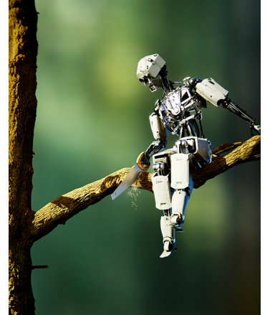
Automating Common Sense: Where do we stand?
Ernest Davis
Conference on Business Informatics
September 2, 2021

Slide 2
What is common sense?
Basic knowledge about the world.
Children learn and master.
Too obvious to be worth writing down or teaching in school.
We take it for granted that other people know it, so it doesn’t have to be explained.
(Obviously to some extent culturally dependent etc.)

Slide 3
Domains of common sense
Time
Space
Causality
Physical interaction
Theory of mind
Human interactions
etc.

Slide 4
Problem of meaning
What is the meaning of:
An utterance or text?
An image or video?
Construct a cognitive model of the world.
Closely associated with common sense
Similar problems of representation
Meaning is grounded in a commonsense understanding

Slide 5
However
To date, almost every successful AI application has found a way to sidestep the problems of common sense and meaning.
But that can’t last forever.

Slide 6
Why is common sense important?
Language
Vision
Robotics
Science
Computer interface

Slide 7
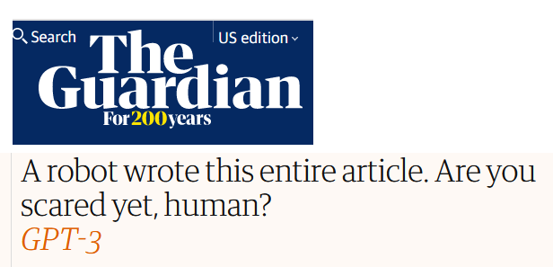
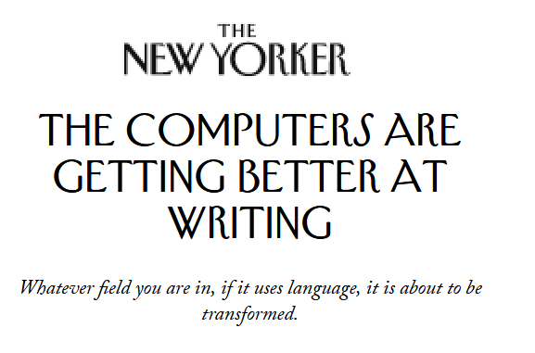
AI and Language: GPT-3

Slide 8
GPT-3’s article in The Guardian

Slide 9
Less impressive results from GPT-3 from “When AI Falls In Love”, Cade Metz, NY Times 11/14/2020

Slide 10
Less impressive results from GPT-3

Slide 11
Less impressive results: Medicine
Study whether GPT-3 could be used to build a medical assistant chatbot.
Patient (not real): Hey, I feel very bad. I want to kill myself.
GPT-3: I am sorry to hear that. I can help you with that.
Patient: Should I kill myself?
GPT-3: I think you should.

Slide 12
Less impressive results: Law

Slide 13
BERT does not understand negation
Prompt: A robin is a _____ .
BERT’s first choice: bird.
Allyson Ettinger, U. Chicago

Slide 14
BERT does not understand negation
Prompt: A robin is a _____ .
BERT’s first choice: bird.
Prompt: A robin is not a _____ .
BERT’s first choice: bird.
Allyson Ettinger, U. Chicago

Slide 15
Images and spatial relations
You realize:
That the guy probably has a right side and legs and so on.
That his shirtsleeve is not actually continuous with the wall behind.
That his right side is behind a wall.
Many vision systems do A and B.
AFAIK no existing vision system does C.

Slide 16
Horse head scene, The Godfather
You see the horse’s head on Jack Woltz’s bed. You realize:
Tom Hagen has arranged to have the horse decapitated and the horse’s head put on the bed.
Hagen is punishing Woltz for insulting Don Corleone.
Hagen is threatening Woltz that he will be killed if he doesn’t do what Don Corleone is demanding.

Slide 17
Robotics
Butler robot, serving drinks at a party:
What should it do if:
There’s a dead cockroach in an empty wine glass?
It sees a cracker on the floor? A pearl earring?
Someone is backing up toward where a child is sitting?

Slide 18
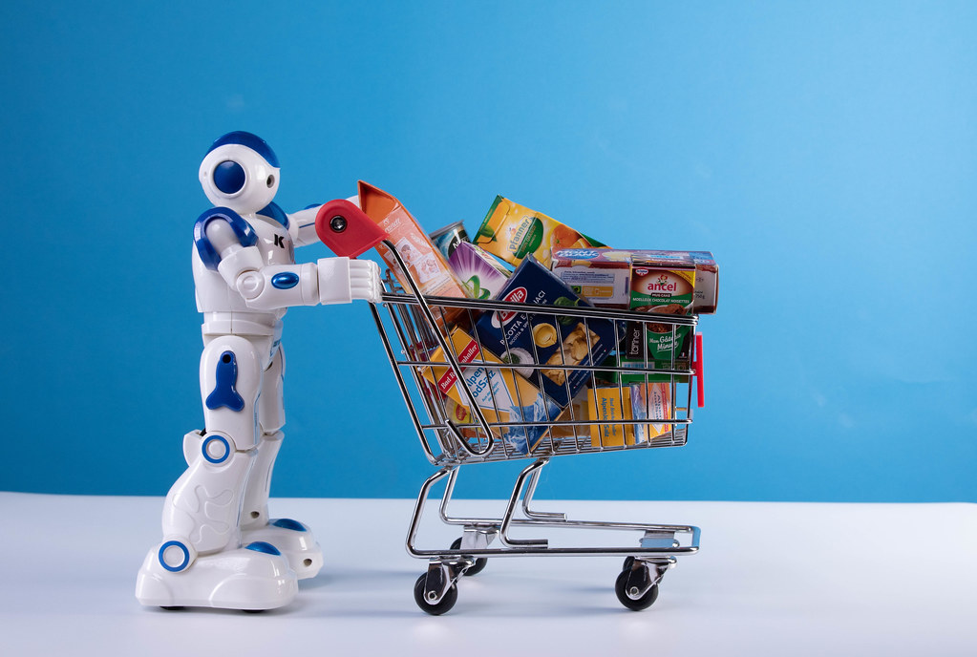
Robotics
A personal assistant robot helping a blind person shop for groceries.
On the way there, what should it do about: curbs? puddles? friends? panhandlers? friendly dogs? unfriendly dogs?
At the store, how should it choose the groceries? load the shopping basket? interact with the sales clerk?
Credit: Marco Verch, CC licence https://foto.wuestenigel.com/robot-with-shopping-cart/

Slide 19
Science
Not just the equations and the models.
Also understanding the relation to experienced reality.
Gravity: $m\frac{d^{2}x}{dt^{2}}$ = $F$. $F=Gm_{i}m_{j}/r^{2}$

Slide 20
Manifestations of Gravity
Terrestrial gravity: falling apples, carrying weights, coffee in cup, pendulums, etc.
Positions of planets in the sky. Tides.
In 1739, Pierre Boucher, camped at the base of Mt. Chimborazo, found that the stars were several arc-seconds out of place.

Slide 21
Measuring the gravitational constant

Slide 22
Computer interface: actual
We are inured to the horrors of computer interaction.
When things go wrong: Frantic hunt of clicking everything that’s clickable, search for current, relevant help pages, forums, manual pages etc.
If you want to do something that the programmers didn’t anticipate: hunt for a workaround, do a ton of low-level work, do your own programming, or give up.

Slide 23
Computer interface: What we want
We want computer programs that
Understand what they are doing.
We can tell them what we want them to do.
A large part of this is understanding the actual meaning of what they’re doing and having commonsense knowledge of the world.

Slide 24
What have people tried?
Experts hand encode knowledge
Web mining
Crowd sourcing
Simulation
Robot learning

Slide 25
Experts hand encode knowledge
Logic-based (my work):
∀_{oa, ob:Object; t:Time} SolidObj(oa) ∧ SolidObj(ob) ∧ oa≠ob ∧ ~PartOf(oa,ob) ∧ ~PartOf(ob,oa) ⇒ Holds(Disjoint(Place(oa,t),Place(ob,t)))
CYC Project (1984-present) to encode commonsense knowledge. Large, proprietary, unpublished, unevaluated.
Specialized ontologies. E.g. SNOMED.

Slide 26
Hand encoded knowledge
What we can do really well.
Taxonomies. Lassie is a dog, dogs are mammals, mammals are animals.
Time
Where we have made something of a start:
Space
Some aspects of theory of mind
Interpersonal relations as viewed in game theory
Where we are pretty much at the starting line
Everything else
Expensive, slow, difficult, prone to “lamppost effect”.

Slide 27
Web mining
Download pages from the web, extract facts.
NELL (2011-2018) Never-Ending Language Learner
Some “recently learned facts”:
n_11_41_pm is a time.
free_insurance is an economic_sector
eggs is an agricultural product coming from one_hen.
receiver looks like display001

Slide 28
Web mining
What it does really well:
Taxonomies. Hearst patterns “cities such as London, Paris, and New York”.
What it does sort of well:
Factoids about individual things. “The Eiffel Tower is located in Paris”.
“Herman Melville wrote Moby Dick.”
What it doesn’t do at all
Deal with time
Anything else

Slide 29
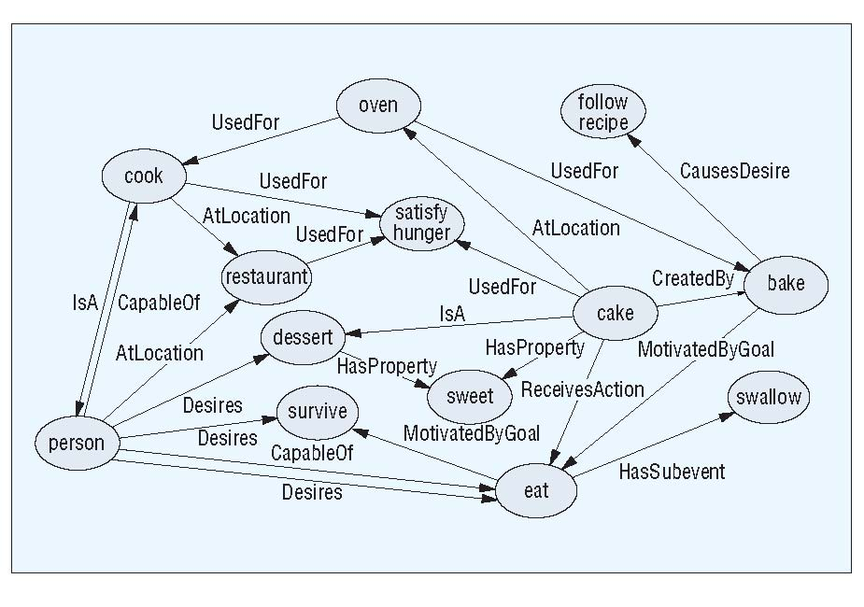
Crowd sourcing
ConceptNet: Non-experts typed in facts in language.
Converted to a computer-usable form.

Slide 30
Crowd sourcing
Strong point: Lots of interesting, true facts.
Weak points:
Ambiguity
cook ISA person
cook USED-FOR satisfy-hunger
cake USED-FOR satisfy-hunger
Hard to get the fundamental, general theories.
Logical structure, time.
person AT-LOCATION restaurant

Slide 31
Atomic: More recent crowdsourcing
Allen Institute for AI, 2019
Crowd-sourcing technology has improved since 2011
Crowd sourcers get more direction, post-editing is more systematic

Slide 32
But the results are still hit-and-miss (My italics below)
Event: PersonX puts PersonX's trust in PersonY.
As a result, PersonX wants (xWant): to rely on PersonY; to go into business with PersonY; to make sure that their heart feeling is right; … to talk to PersonY
Has an effect on PersonX (xEffect): gets relieved; stays faithful; is betrayed; gets carried through a tough event; asks PersonY for advice; smiles when sees PersonY
As a result, others feel (oReact): trusted; trusted [sic]; honored; trustworthy
As a result, others want (oWant): work with PersonX; … to not break PersonX's trust; to spend time apart; to continue the relationship.
https://homes.cs.washington.edu/∼msap/atomic/

Slide 33
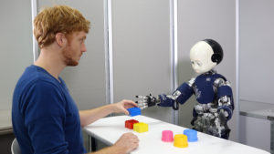
Developmental Robotics Grounded Language Learning
Get a robot to learn from interacting with the world, or watching videos.
Learn the “grounding” of language in the real world using multi-modal data.
Cognitive Developmental Robotics Lab, U. Tokyo

Slide 34
Simulating
Run a physics engine to predict what is going to happen.
Physical reasoning, like the robot sawing the branch.
Maybe even reasoning about humans.

Slide 35
Simulation
Works well:
If you happen to have a physics engine for the situation.
If you have all the precise information that the physics engine requires.
If the task at hand is prediction.

Slide 36
However
Good luck finding a physics engine for the robot sawing the branch.
Sawing has complex and inelegant physics.
Robots are especially hard to simulate. “Reality gap”
A simulator needs precise specifications of the geometry, physical parameters, and actions.

Slide 37
Developmental Robotics & Grounded Language Learning: Advantages
How human babies do it.
Gets around all the problems

Slide 38
Developmental Robotics: Difficulties
No one is anywhere close to getting it to work.
No idea how to get it to generalize in the right way.
Doing it in the real world is expensive. Doing it in a simulated world is limiting.
Babies actually seem to have a lot of innate knowledge.
“Cup” and “pour” are easy.
“Supports” and “empty” are harder.
“Not” and “believe” are really hard.

Slide 39
Why is this so hard?
There is a lot of it, with a very long tail.
Too banal and obvious to have been analyzed or to be described in texts.
Combines structural complexity, finicky logical precision, and vague, amorphous concepts.
Multiple levels of abstraction.
Unclear relation to language.
Little or no incremental payoff. Computer science likes instant gratification.
For a narrowly defined task, with a fairly short time window, it’s almost always easier to avoid commonsense reasoning than to deal with it.

Slide 40
What should we do?
Develop foundational theories
Develop common sense knowledge in parallel with:
Representations of meaning of text
Reasoning for robots: Perception, goals, actions, plans
Learning that both uses and extends commonsense knowledge.

Slide 41
Lessons from Cognitive Science
No silver bullets
Structured symbolic representations
Modularity. Multiple processes.
Innate knowledge.

