Slide 1
History of Artificial Intelligence: Highlights and Trends
Fall 2025
Ernest Davis
.

Slide 2
Topics discussed in detail in course are marked with asterisks.
Dates should be taken with a grain of salt.
Organized (more or less) topically by starting date.
Personal choice of items to include.
Not discussing prehistory --- intellectual accomplishments important to AI prior to electronic computers.
See chap 1 of Russell and Norvig or Eugene Charniak, AI and I for more.

Slide 3
Milestones in Computer Science

Slide 4
Early Electronic Computers: 1940s
ENIAC (1945-1956)
First use was a study of the feasibility of a thermonuclear weapon.
18,000 vacuum tubs, 7,200 diodes, 1,500 relays, 70,000 resistors, 10,000 capacitors, and approximately 5,000,000 hand-soldered joints.
Running it on a new problem essentially involved building “a special-purpose computer out of ENIAC component parts.”

Slide 5
High-level programming languages: FORTRAN (1958), COBOL (1959), LISP (1962)
Commercial mainframe: IBM 360. 8 to 64 Kbytes of RAM. 34 KHz processing speed (1964).
Operating system: OS/360 (1964)
NP-completeness: 1971-2 (Cook, Levin, Karp)
Apple 1 (1976). 1 MHz, 4-8 Kbytes, $666 = $3700 in 2025 dollars
RSA encryption: 1976 (Rivest, Shamir, Adelman)
Internet (1989). Web (1992). Web search (1994). More below.
iPhone (2007).

Slide 6
Milestones In AI

Slide 7
Ups and Downs
1st AI Summer: 1960-1970 (Dates approximate)
1st AI Winter: 1970-1980
2nd AI Summer: 1980-1990
2nd AI Winter: 1990-2005
3rd AI Summer: 2005-present
In fall 2007, the enrollment in this course was 14. The CS dept didn’t offer it again until Spring 2014.

Slide 8
Alan Turing and the Turing Test (1950)
A computer is “intelligent” if you can engage it in a conversation, and you will think that it must be human.
The test is no longer well-regarded in AI. Humans are easy to fool. Deceit is not a good feature of a test.
Key insight: The intelligence of a machine is judged in terms of what it can do, not how it works.
Universal among AI researchers, contested among philosophers.

Slide 9
Other things Alan Turing did
Invented “the Turing machine”, key model of computation (1935)
Led the Ultra project, to break the German Enigma code.
Involved in building early British computer.
Wrote a chess-playing program before there was a computer to run it on.

Slide 10
Natural Language Processing 1955-2016
Machine translation project (1955-1965), Lavish funding, no results.
SHRDLU (Terry Winograd, 1972), Execute commands, answer questions in simulated blocks world.
LUNAR (BBN, 1973). Answer questions about moon rocks from database.
Late 1990’s: Useful speech transcription.
Google Translate launched: 2005.

Slide 11
Logic*
Logic Theorist, (1955) by Allen Newell and Herbert Simon found shorter proofs for theorems in Whitehead and Russell Principia Mathematica
DPLL (1962) (Martin Davis, Hilary Putnam, George Logemann, and Donald Loveland) finds solutions to problems in propisitional logic.
Resolution theorem proving (1965, John Allan Robinson). Automatic theorem proving for predicate calculus.
SAT-solvers (from early 1990s). Powerful extensions of DPLL used for complex combinatorics and problem solving, especially finding bugs in complex (100,000 line) programs.

Slide 12
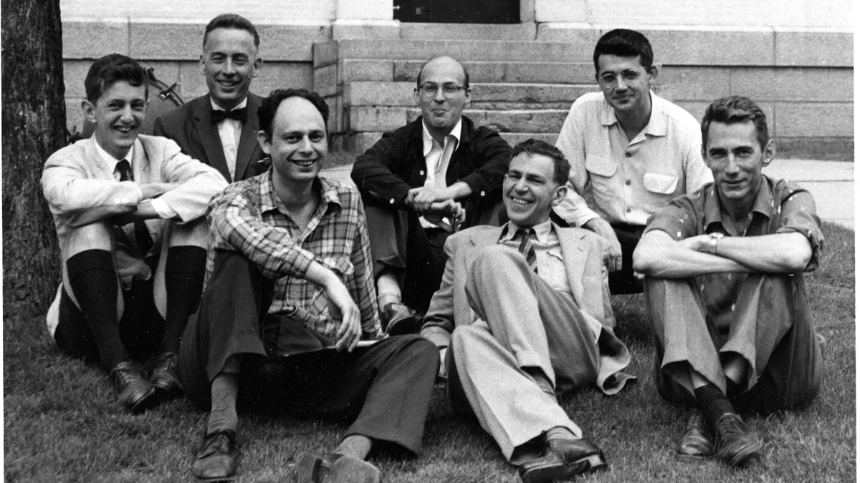
Dartmouth Workshop: 1956
Brought together young (mostly) American scientists excited about the prospect. Claude Shannon, John McCarthy. Marvin Minsky, Allen Newell, Herbert Simon etc.
McCarthy coined the term “Artificial Intelligence”

Slide 13
Frank Rosenblatt: Perceptron* (1958)
Learning a classifier from data.
“Neuronal model”
Ancestor of deep learning
"Perceptrons … will be able to recognize people, and call out their names.. Only one more step of development, a difficult step, is needed for the device to hear speech in one language and instantly translate it to speech or writing in another language.“ NY Times, July 13, 1958

Slide 14
AI Educations and Institutions
1958: Marvin Minsky teaches a course “Automata and Artificial Intelligence” in MIT Math Dept.
Late 1960s; U. Edinburgh creates a “School of Artificial Intelligence”.
1969: First meeting of IJCAI
1970 Artificial Intelligence Journal
1971 First AI textbook: Nils Nilsson's Problem-solving methods in AI.
MIT 1958 course catalogue:
Automata and Artificial Intelligence:
Discussion of the problem of making machines behave intelligently. Theory of automata, neural nets, and other computing structures. Application of such machines to learning, induction, pattern recognition, game playing, theorem proving, and other areas where problems can be solved by heuristic programming.

Slide 15
Art Samuels: Checkers (1959)
Adversary search
Learning from experiment
Got to be good enough to beat Samuels

Slide 16
Programs with Common Sense
John McCarthy identified common sense as a central issue in planning (1959)
Yehoshua Bar-Hillel: Common sense needed for accurate language translation (1960)
CYC (1984-present). Doug Lenat. Project to encode all of commonsense knowledge in logic-like representation. Proprietary.

Slide 17
Math
Symbolic integration: (Slagle,1961). AI program passes exam in MIT math course
Four-color theorem: (Appel and Haken, 1976). First use of computer program to prove a significant theorem.
Proof assistant. Isabelle (1986), HOL-Lite, Lean, etc.
Robbins conjecture (McCune, 1995): To date, only completely autonomous proof of a moderately important theorem by an AI.
Results in knot theory and abstract algebra (Davies and DeepMind, 2022). First cutting-edge math proof assisted by deep learning.
Systems by DeepMind and OpenAI achieve gold-medal performance in International Math Olympiad (2025)

Slide 18
ELIZA (Joe Weizenbaum,1965)
Created as a parody of Rogerian (non-directive) psychotherapy.
Small rule-based program that transformed and echoed user input, or used stock phrases.
Users thought it was intelligent, sympathetic and helpful. “ELIZA effect”
Computer Power and Human Reason, 1976

Slide 19
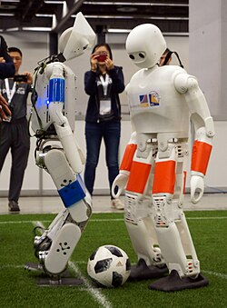
Non-vehicle robots
SHAKEY (1966-1972). Robot with high-level reasoning.
Boston Dynamics founded 1992.
RoboCup. 1996-present
Roomba (2002)
RoboCup 2018

Slide 20
1970s-80s: Heyday of Knowledge-Based AI
Logic-based “neat” approaches (John McCarthy)*
“Scruffy” approaches, with connections to cognitive science. (Marvin Minsky, Roger Schank)
Expert systems: DENDRAL, MYCIN

Slide 21
Optical Character Recognition Kurzweil Reading Machine (1976)
First important practical application of AI
Originally reading for blind; then page image to character string.
Machine learning of rules from examples.

Slide 22
Autonomous vehicles
Navlab. CMU autonomous vehicle project begun 1984.
Navlab 5 (1995). Drove from Pittsburgh to San Diego, with the AI driving all but 50 miles of 2850.
Mars Rover (1997).
DARPA Grand Challenge (2004). Autonomous vehicles driving off-road along track in Mojave Desert. In 2004, no car got more than 7 of 150 miles. Later competitions had greater success.
2011: Predictions that autonomous vehicles would put large numbers of human drivers out of a job by 2016.
Waymo (Alphabet) 2022). Robotaxi service in Phoenix. Currently (July. 2025) service in 7 cities.

Slide 23
Neural Networks and Back Propagation* Parallel Distributed Processing, 1985
Extends perceptron model to multi-layer network.
Back propagation had been independently discovered several times since 1962, but this was the one that mattered.
Basis of deep learning and 95%+ of current AI.
CNN: Convolutional neural networks (Yann LeCun, 1989) incorporate translational invariance.

Slide 24
Judea Pearl, Probabilistic Reasoning in Intelligent Systems,* 1987
Emphasized the importance of probabilistic reasoning in AI. (In the early 1980s other techniques for plausible reasoning were more popular.)
Bayesian networks: architecture for combining causal and evidential reasoning.
Graphical models

Slide 25
Internet
Internet (1989)
World Wide Web (1992)
First web search engines (1994)
Google (1998)
Flickr (2004)
Wikipedia (2005)
YouTube (2005)

Slide 26
Games (1993-)
Backgammon: TDGammon (IBM,1993). Slightly below top human players. Trained with 1.5M games of self-play. Combination of reinforcement learning and neural networks.
Chess: DeepBlue (IBM,1997), Beat world champion Garry Kasparov. Extensive search guided by machine learning. Search with evaluation function trained by ML.
Jeopardy. Watson (IBM, 2011). Probabilistic reasoning. Hodgepodge of techniques.
Go. AlphaGo. (DeepMind,2016). Beat Lee Sedol. Monte Carlo search, reinforcement learning, deep learning, Trained on human games and self-play.

Slide 27
Games (cntd.)
Go, Chess, Shogi. AlphaZero (DeepMind,2017. Similar architecture to AlphaGo. Trained purely on self-play.
Texas Hold ‘Em Poker. Libratus (Noam Brown, Tuomas Sandholmd, 2017). Beat top human players at. Complex, specialized architecture involving game theory, probability theory, reasoning about other minds, and ML.
Diplomacy. Cicero. (Meta, 2022). High quality play, though not champion-level. Complex, specialized, multi-modular system

Slide 28
Fei-Fei Li: ImageNet (2007). Crowd-sourcing
Huge (15M labelled images), high-quality dataset.
Created using web mining and crowd sourcing.
Standard benchmark for computer vision.

Slide 29
AlexNet Deep Learning success on ImageNet (2012)
First huge success for deep learning and immense corpora.
Trained and tested on ImageNet.
Alex Krizhevsky, Ilya Sutskever and Geoffrey Hinton
Huge advance in state of the art. Previously, AI had mostly made slow, incremental progress.
Dawn of “modern” AI.

Slide 30
Awareness of negative social consequences*
Latanya Sweeney (1997) Deanonymizing personal medical data
Sweeney, (2013) Racial discrimination in online ad delivery.
Cathy O’Neil (2016) Weapons of Math Destruction
Joy Buolamwini, (2018) Gender and racial inequalities in face recognition.
Palantir/New Orleans scandal (2018)
Clearview AI scandal (2020)

Slide 31
AlphaFold (DeepMind, 2018)
Custom-built system based on Deep Learning to predict protein folding.
½ Nobel Prize in Chemistry, 2025 for Demis Hassabis and John Jumper.

Slide 32
Generative AI
Transformer model*,
BERT (Google AI, 2018).
GPT (OpenAI, 2018)
ChatGPT (OpenAI, 2022)
Text-to-image: DALL-E (OpenAI, 2022)

