Slide 1
Building AI We Can Trust
Ernest Davis
Columbia University February 12, 2020

Slide 2
AI So Far
Marquee successes: Backgammon, chess, Jeopardy, Go.
Important successes: Optical character recognition, hand-written digits, speech transcription, web search, machine translation, image tagging.
Disappointments (thus far): Self-driving cars. Useful chatbots. “Cognitive computing” (i.e. Watson for medical information).

Slide 3
Hype

Slide 4
Reality
Reads a text and a question whose answer is given in some phrase in the text and finds the phrase.
E.g.
Chloe and Alexander went for a walk. They both saw a dog and a tree. Alexander also saw a cat and pointed it out to Chloe. She went to pet the cat.
Q: Who went for a walk? A: Chloe and Alexander.
But not
Q: What did Alexander see. A: A dog, a tree, and a cat (Not consecutive).
Q: Was Chloe frightened by the cat? A. No. (Inferred)

Slide 5
Hype

Slide 6
Reality
"Synopsis of Lord of the Rings“
Bilbo travelled to the cave. Gollum dropped the ring there. Bilbo took the ring. Bilbo went back to the Shire. Bilbo left the ring there. Frodo got the ring. Frodo journeyed to Mount Doom. Frodo dropped the ring there. Sauron died. Frodo went back to the Shire. Bilbo travelled to the Grey Havens. The End.

Slide 7
Hype

Slide 8
Reality

Slide 9
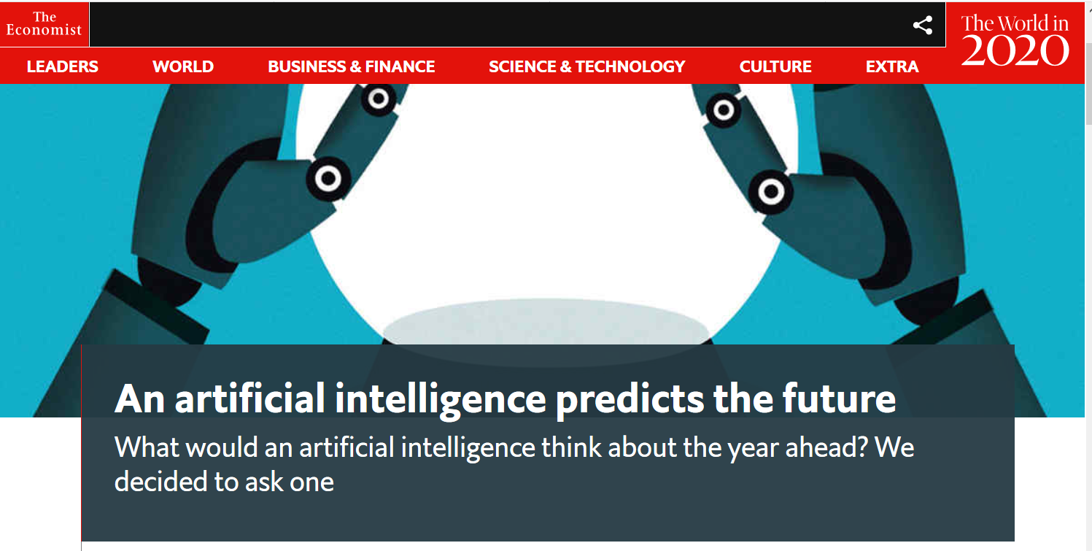

Slide 10
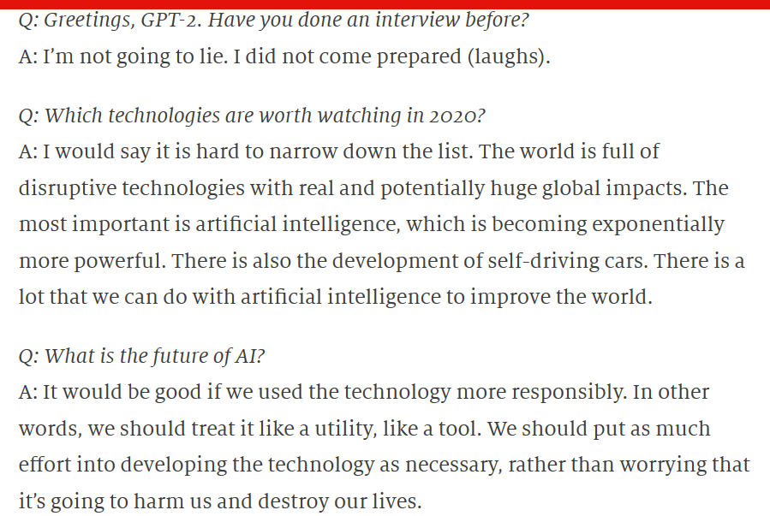

Slide 11
I left my keys at a booth in the back of the pub at the army base near the old mill town. I went home. My keys are now on that old genie on a little tower in England somewhere.
If you drop an anvil on your foot, your foot will tend to cramp up, so it’s a good idea to do these slowly.
5. Do a few sets of 10-15 reps. to start. You can progress the weight or time by adding or removing exercises. Just like squats, if you feel that you have the hang of them, then you can start adding weight.
6. Once you have your groove on a set, add a little more.
7. Make it an extra workout, so you can continue to work through your quads after work.
--- Gary Marcus

Slide 12
Skeptical questions to ask about any hyped AI advance
What does the system actually do?
How general is the result?
Can I test my own examples?
If someone claims that this is “better than people”, what people under what circumstances?
Is this an advance toward general AI?
How robust is the system?

Slide 13
Dangers of trusting AI Unwarranted confidence
“A lot can go wrong when we put blind trust in big data.”
--- Cathy O’Neil
Tesla crashes because drivers trusted Autopilot. Police relied on Google Translate. Trusting to AutoCorrect. Trusting to iPhone app that reads email and makes appointments.

Slide 14
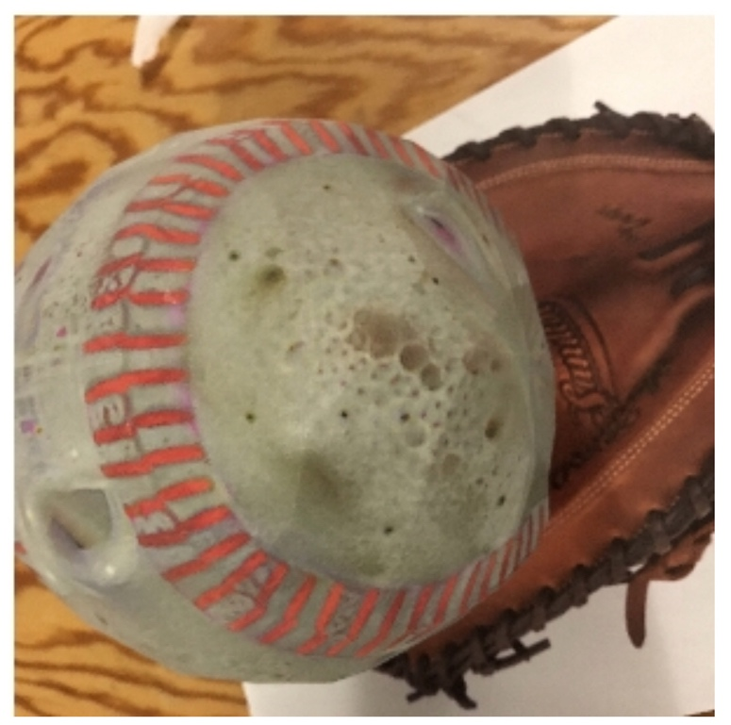
AI systems are not robust
Question answering programs can be fooled by sticking irrelevant sentences at the end.
Adversarial examples fool vision systems. E.g. A vision system labelled this “expresso”.

Slide 15
Systems do not generalize past training set
Print reading systems trained with black on white do not work with white on black.
Self-driving cars trained in one city can be unreliable when used in another.

Slide 16
AIs incorporate societal biases
African-Americans tagged in images as gorillas.
Google image search for “Professional hairstyle for Work” vs. “Unprofessional hairstyle for work.”
Amazon’s job recruiting software was so biased against women, and found such subtle ways to detect gender, that they eventually gave up on it.

Slide 17
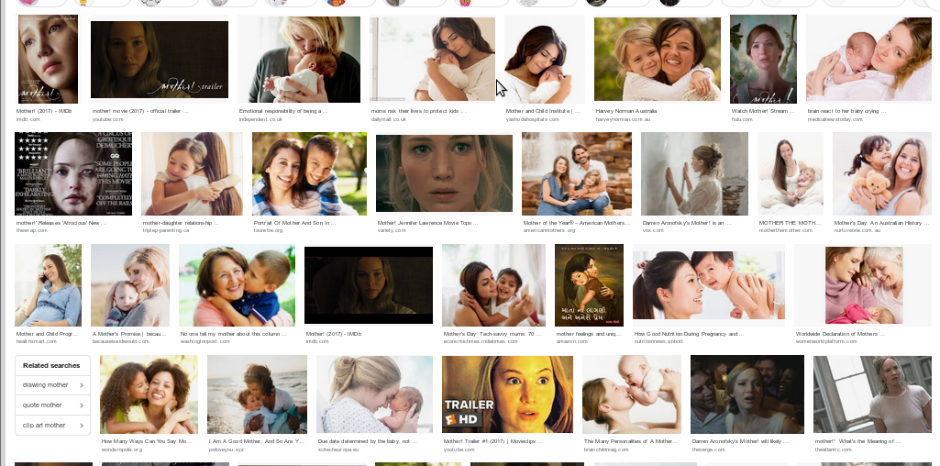
AIs incorporate social biases
Google image search for “mother”:

Slide 19
AI programs reinforce societal biases
A policing programs sends police to neighborhoods where many arrests have been made in the past.
A child services program takes children away from poor parents.
A job recruiting program compares photos of applicants to “professional” vs. “unprofessional” images.
Cathy O’Neil, Weapons of Math Destruction Virginia Eubanks, Automating Inequality

Slide 20
“Black patients incurred about $1,800 less in medical costs per year than white patients with the same number of chronic conditions; thus the algorithm scored white patients as equally at risk of future health problems as black patients who had many more diseases.”

Slide 21
AIs feed on their own output, creating echo chamber
Machine translation programs are trained on bitexts (pairs of parallel texts). However, in some under-resourced languages, a large fraction of the bitexts were created by translation programs.
AI projects use crowd sourcing to provide human interpretations (e.g. label images). However, crowd workers use AI bots to do their work for them.

Slide 22
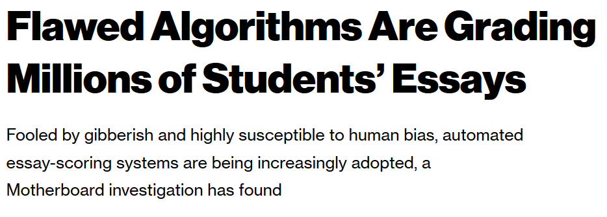
AI systems can be gamed
Google bombs.
Essays on standardized tests are graded automatically, but reward long sentences and nineteen-cent words rather than coherent thought.

Slide 23
Wrong goals
A robot being taught from images how to grasp something instead learned to position its hands so that, from its angle, it looked like it was grasping the object.
A soccer robot which was given the goal of frequently making contact with the ball developed the strategy of standing next to the ball and vibrating.

Slide 24
Wrong goals

Slide 25
Be careful how you use AI
Artificial Intelligence Makes Bad Medicine Even Worse
--- Christie Aschenden, WIRED
“The recent Google paper [is] trying to replicate, and then exceed, human performance on what is at its core a deeply flawed medical intervention. In case you haven’t been following the decades-long controversy over medical screening, it boils down to this: When you subject symptom-free people to mammograms and the like, you’ll end up finding a lot of things that look like cancer but will never threaten anyone’s life.”

Slide 26
That’s why the famous Mark Zuckerberg motto, “Move fast and break things” might be fine for Facebook, but it’s not great for medicine, AI-assisted or not. ... “In a culture that’s used to immediacy and inflated claims, it’s difficult to have humility and patience."

Slide 27
Bad Actors misuse AI
Criminals
Cybercrime
Cyberterrorism
Fake news, deep fakes
Governments
Surveillance
Smart weapons

Slide 28
Currently dominant approach to AI
Deep learning (neural network)
End-to-end, blank slate learning

Slide 29
Problems with Deep Learning
Data greedy
Opaque. If things go wrong, there is no way to know why.
Brittle
No model of the situation
No knowledge of the world
Generalizes the wrong way. In vision, it puts more emphasis on surface texture than on shape.

Slide 30
Machine Reading
Almanzo turned to Mr. Thompson and asked, “Did you lose a pocketbook?”
Mr. Thompson jumped. He slapped his hand to his pocket and fairly shouted.
“Yes, I have! Fifteen hundred dollars in it, too! What about it? What do you know about it?”
“Is this it?” Almanzo asked.
“Yes, yes, that’s it!” Mr. Thompson said, snatching the pocketbook.
Laura Ingalls Wilder, Farmer Boy

Slide 31
Comprehension questions
Why did Mr. Thompson slap his pocket with his hand?
Before Almanzo spoke, did Mr. Thompson know that he had lost the wallet?
What is Almanzo referring to when he asks “Is this it?”
Who almost lost $1500?
Will Mr. Thompson return the wallet to Almanzo?

Slide 32
Knowledge used in understanding
People can drop things without realizing it.
People often carry their wallets in their pockets.
People often carry money in their pockets.
If people assume that something important to them is true, and they find out it might not be true, then they often urgently try to verify it.
You can often feel whether something is in your pocket by feeling the outside of the pocket.

Slide 33
Limits of Q/A systems

Slide 34
Wolfram Alpha, “The world’s first computational knowledge engine”
Q: How far is the border of Mexico from San Diego? A: 1144 miles

Slide 35
Translation program
French: Les clés sont à ma mère. English: The keys are my mother’s.
Google Translate: The keys are mine.
English: The dog is pregnant. French: La chienne est enceinte. Google Translate: Le chien est enceinte.

Slide 36
Translation programs

Slide 37
Translation programs make the same mistake
English: Your wife says you never buy her flowers.
German: Ihre Frau sagt, Sie kaufen ihr nie Blumen. (“ihr”: indirect object)
Google Translate: Ihre Frau sagt, Sie kaufen ihre Blumen nie. (“ihre”: possessive)

Slide 38
Insights from the Human Mind
AI design should draw on lessons of cognitive science:
cognitive psychology, linguistics, epistemology.

Slide 39
No silver bullets
What magical trick makes us intelligent? The trick is that there is no trick. The power of intelligence stems from our vast diversity, not from any single, perfect principle.
--- Marvin Minsky.

Slide 40
Internal symbolic representations
“Mentalese” representations in the head.
For facts: “There is $1500 in the wallet.” “Almanzo talked to Mr. Thompson.”
For rules: “People are generally averse to losing money.” “People carry money in wallets.”

Slide 41
Abstraction and generalization
“X is a sister of Y” is a relation that holds between pairs of people. <Shasha Obama, Malia Obama>, <Laura Ingalls, Mary Ingalls> …
It can be inferred: From “Sasha Obama is a daughter of Barack and Michelle Obama” and “Malia Obama is a daughter of Barack and Michelle Obama”.
It has consequences: “Sasha and Malia Obama are probably acquainted. Sasha and Malia Obama probably share hereditary traits.”

Slide 42
Multiple structures and tools
Large scale Different activities --- vision, motor control, language, reasoning, etc. --- are handled differently in the brain and in different parts of the brain.
Small scale Past tense formation can be regular --- act/acted, handle/handled or irregular --- are/were, can/could. Regular past tense is handled by rules. Irregular past tense is learned by example.

Slide 43
Compositionality
In language, words combine to form phrases, which combine to form sentences, which combine to form text/discourse.
“Yesterday, all my troubles seemed so far away.”
“all my troubles” and “so far away” are phrases. “all my” and “troubles seemed so” are not phrases. The meaning of the sentence is likewise a combination of the meanings of the words.
Likewise (presumably) for mental representations.

Slide 44
Interpretation in context

Slide 45
Interpretation in context

Slide 46
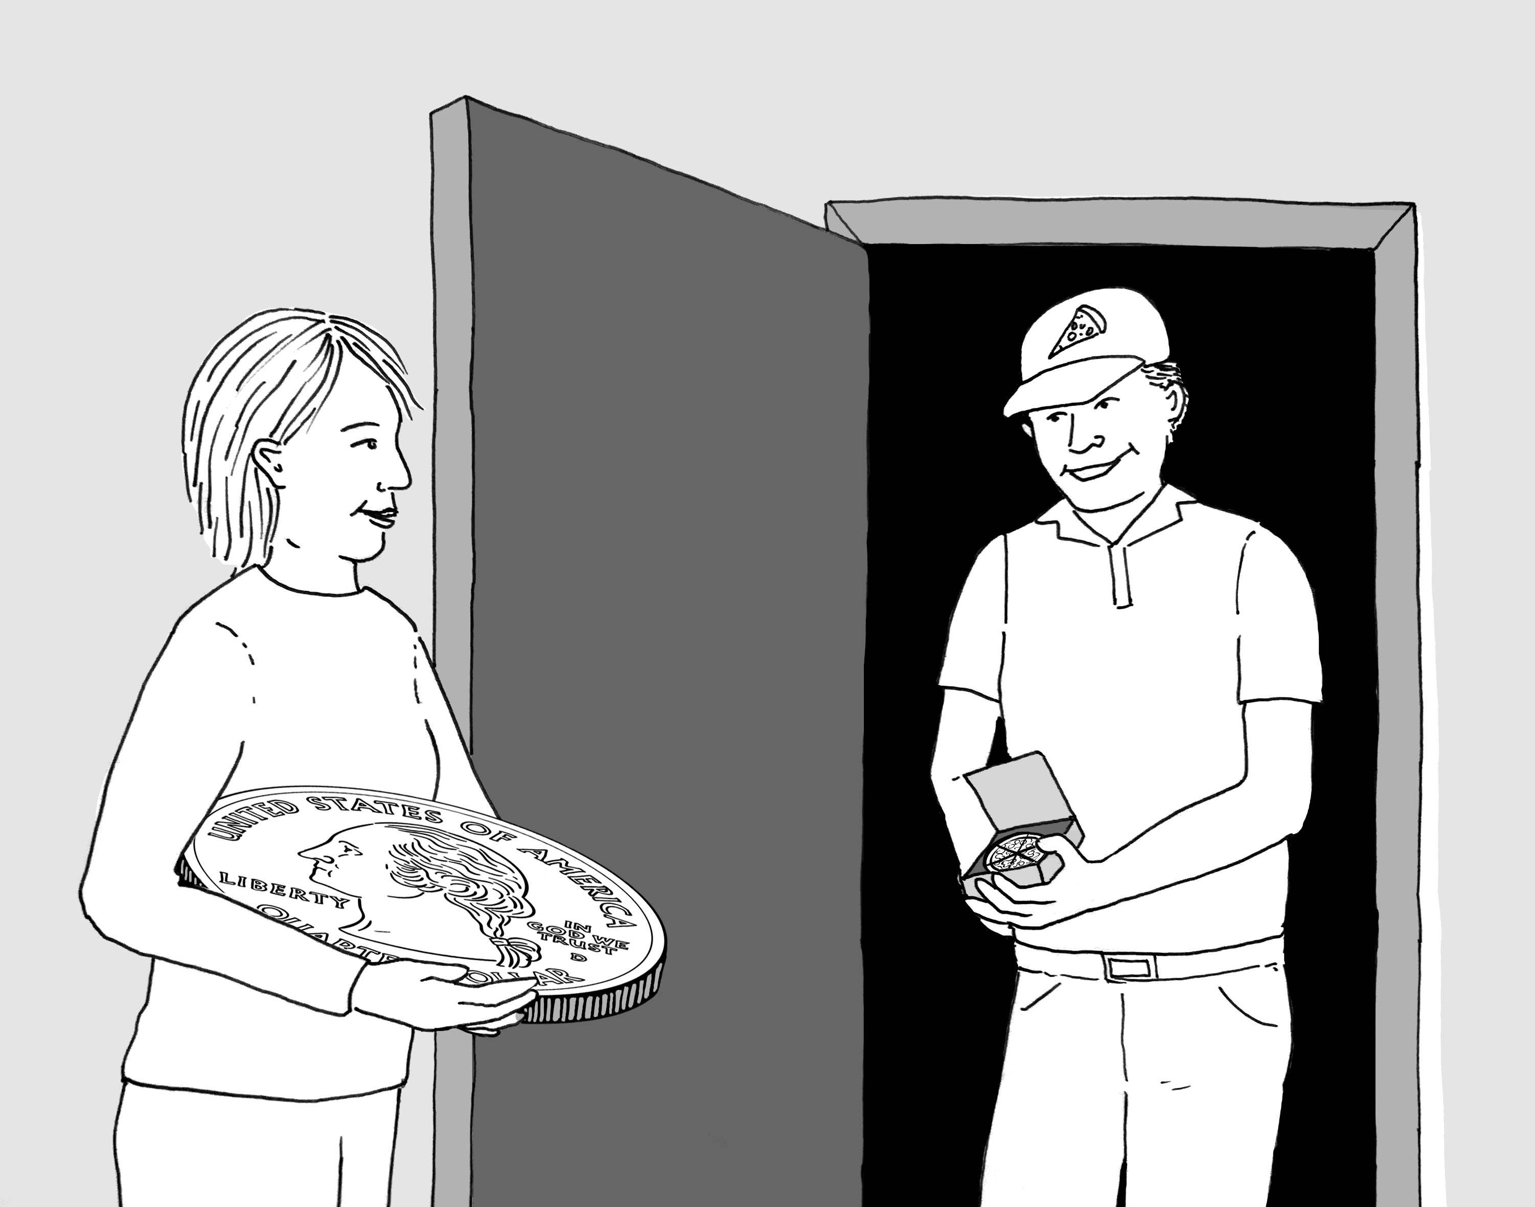
Concepts are imbedded in theories.
A quarter-sized pizza is food; a pizza-sized quarter is not currency (Lance Rips)

Slide 47
Concepts are embedded in theories
A child who sees a photograph of an iguana for the first time knows:
How to tell an iguana from a kangaroo
Iguanas eat and breathe, are born, grow larger, and die.
There is presumably a population of iguanas, more or less similar in their features and behaviors.

Slide 48
Causality
Judea Pearl and Dana Mackenzie, The Book of Why
Tyler Vigen, Spurious Correlations

Slide 49
Tracking individuals
One keeps track of individual entities (people, objects, social constructs) over time and remembers their histories.
A deep learning system can learn to recognize pictures of Siamese cats. It can also learn to recognize pictures of Derek Jeter.
But it never realizes that a photo that shows two Siamese cats is fine, whereas a photo that shows two Derek Jeters is problematic.

Slide 50
Innate knowledge
Machine learning researchers increasingly boast of the small amount of knowledge built into their system.
“Mastering the game of Go without human knowledge” (title of AlphaZero paper in Nature)
Training self-driving systems “end-to-end”: mapping images directly to actions at the steering wheel and brakes, with no theory of what’s out there.
First, it isn’t as true as they claim.
Second, it’s not a good idea, to the extent that it is true.

Slide 51
Innate knowledge in infants
Exactly what knowledge infants are born with is hard to determine.
But there is not much doubt that there is a fair amount of it.
E.g. Basic knowledge of time, space, persistent objects.
Basic knowledge of human relations.
Some universal properties of language.

Slide 52
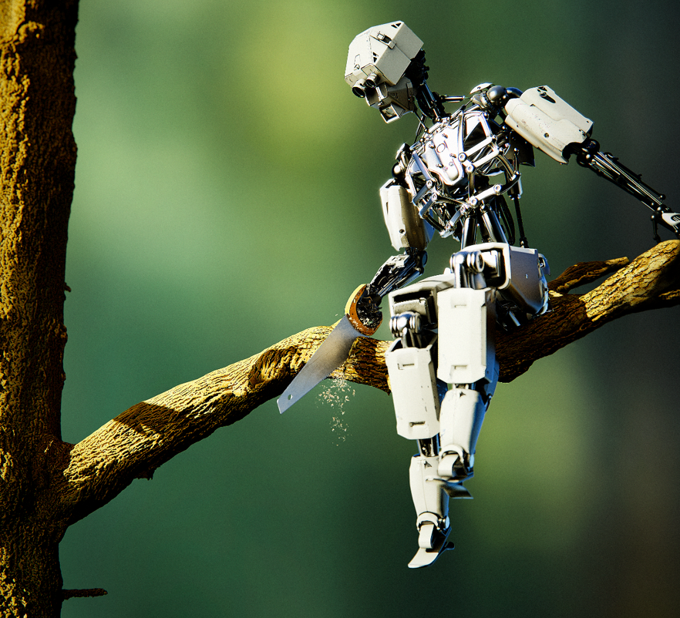
Common Sense

Slide 53
What is common sense?
Basic knowledge about the world.
Children learn and master.
Too obvious to be worth writing down or teaching in school.
We take it for granted that other people know it.

Slide 54
Domains of common sense
Time
Space
Causality
Physical interaction
Theory of mind
Human interactions
etc.

Slide 55
Why is common sense important?
Vision
Language
Robotics
Science
Computer interface

Slide 56
Vision: Images and spatial relations
You realize:
That the guy probably has a right side and legs and so on.
That his right side is behind a wall.
Any good vision system does A.
AFAIK no existing vision system does B.

Slide 57
Horse head scene, The Godfather
You see the horse’s head on Jack Woltz’s bed. You realize:
Tom Hagen has arranged to have the horse decapitated and the horse’s head put on the bed.
Hagen is punishing Woltz for insulting Don Corleone.
Hagen is threatening Woltz that he will be killed if he doesn’t do what Don Corleone is demanding.

Slide 58
Science
Not just the equations and the models.
Also understanding the relation to experienced reality.
Gravity: $m\frac{d^{2}x}{dt^{2}}$ = $F$. $F=Gm_{i}m_{j}/r^{2}$

Slide 59
Manifestations of Gravity
Terrestrial gravity: falling apples, carrying weights, coffee in cup, pendulums, etc.
Positions of planets in the sky. Tides.
In 1739, Pierre Boucher, camped at the base of Mt. Chimborazo, found that the stars were several arc-seconds out of place.

Slide 60
Computer interface: actual
We are inured to the horrors of computer interaction.
When things go wrong: Frantic hunt of clicking everything that’s clickable, search for current, relevant help pages, forums, manual pages etc.
If you want to do something that the programmers didn’t anticipate: hunt for a workaround, do a ton of low-level work, do your own programming, or give up.

Slide 61
Computer interface: What we want
We want computer programs that
Understand what they are doing.
We can tell them what we want them to do.
A large part of this is understanding the actual meaning of what they’re doing and having commonsense knowledge of the world.

Slide 62
Trust
“Gods always behave like the people who made them.”
Zora Neale Hurston

Slide 63
Good engineering practice
Margin of safety
Design for failure
Fail safes

Slide 64
Good software engineering
Modular design
Debugging
Machine learning makes it impossible to “debug” in the conventional way; all you can do is to play with the training regimen or change the training set.

Slide 65
Adding values to AI
Build AIs that incorporate human values and are constrained by human norms.
Formulating rules that are good enough is Getting the AI to understand concepts like “harm” is the hard part.

Slide 66
If you want to worry about computers
Worry about the dismal level of security on all kinds of devices with embedded computers connected to the Internet:
Cars, helicopters, elevators, the power and water systems, household appliances.
Or worry about the almost unbounded degree of surveillance now possible through ubiquitous devices.

Slide 67
What not to do
Build AIs that can self-replicate in the wild.
Build AIs that you have reason to think might be “self-aware” (raises all kinds of ethical problems best avoided).
Put AIs whose properties are not well understood in control of critical systems. (Special case of, “Don’t use inadequately tested, new software for really important things, like the Iowa caucus.”)

Slide 68
What not to worry about
The Skynet scenario. “Suddenly the network attained self-awareness, and within a few microseconds had enslaved the human race.” No reason to think this can happen.
Nick Bostrom’s paper-clip maximizer. (Posits an AI smart enough to defeat any effort to stop it but so stupid that it doesn’t realize that there is no point in turning the world into paper clips.)

Slide 69
Best case scenario
While Humanity will be amusing itself, or enjoying cultivated leisure—which, and not labour, is the aim of man—or making beautiful things, or reading beautiful things, or simply contemplating the world with admiration and delight, machinery will be doing all the necessary and unpleasant work.
Oscar Wilde, The Soul of Man under Socialism (1891)
If we are wise and smart, we may be able to get there.

