Slide 1
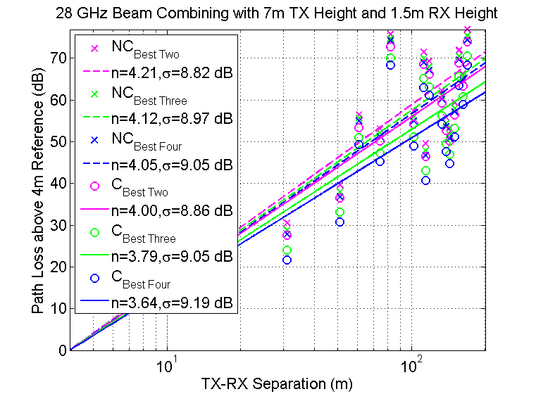
Beamforming (Angular Search) &
Statistical Models
Given access to an environment: what is the fastest way to …
  Determine the angle of strongest received power
  Determine the overall “Goodness of Signal”
Benefits ...
Approach …
  Statistical Simulation
  Use driver to test
  adaptive algorithms

Slide 2


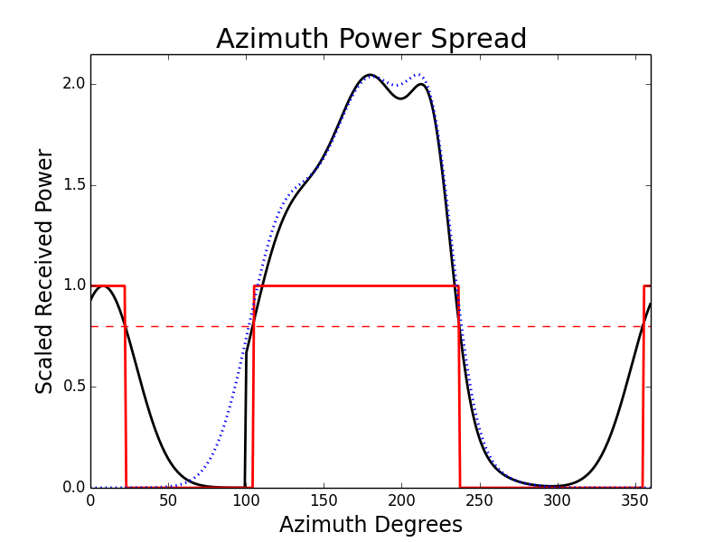

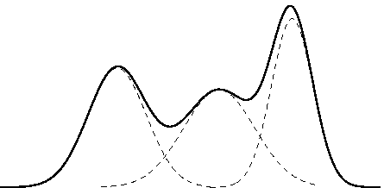
Statistical Model & Algorithms
Statistics …
  Store
Algorithm …
  SCALINGS
  ROTATIONS
GUESS = vector(36)
KNOWN = vector(36)
while (RUNNING) do
p,theta = query_channel(optimize(GUESS,KNOWN))
KNOWN[theta]++
KNOWN[:]--
smart_rotate(guess,theta – nearest_max(guess,theta))
smart_scale(guess, (p-guess[theta])/guess[theta] )
end

