Slide 1
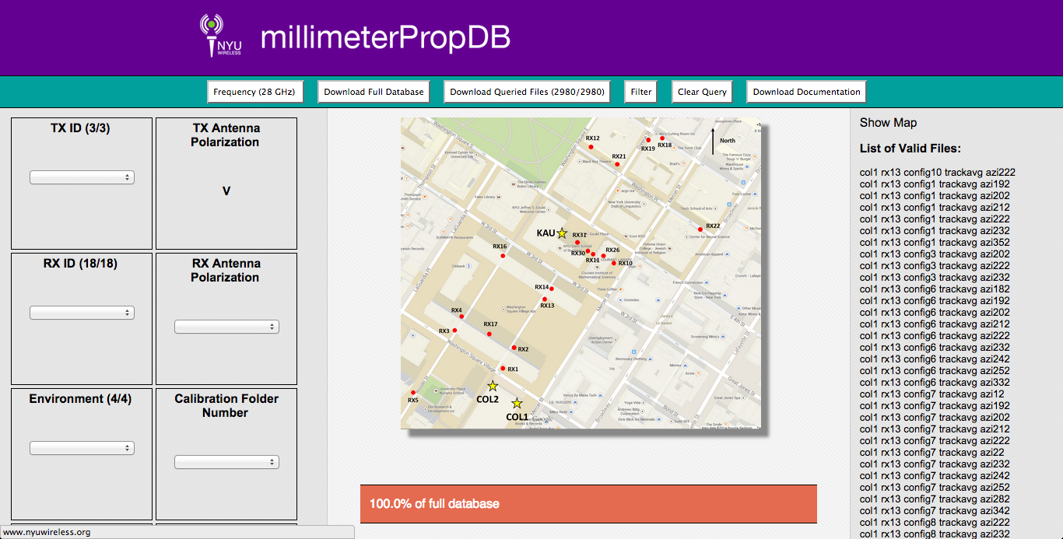
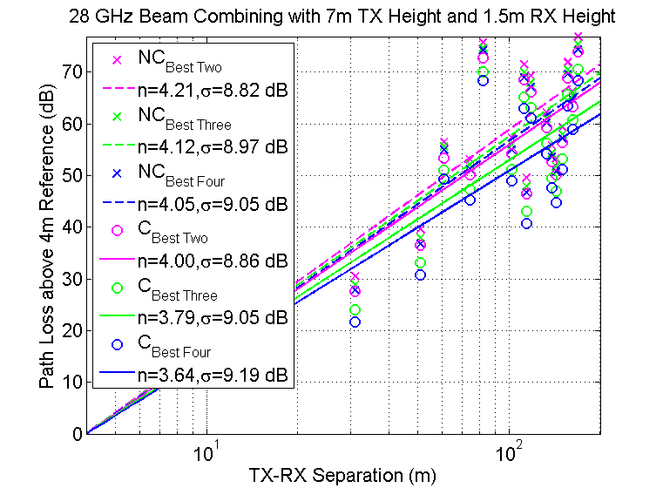
mmW Propagation Database

Slide 2
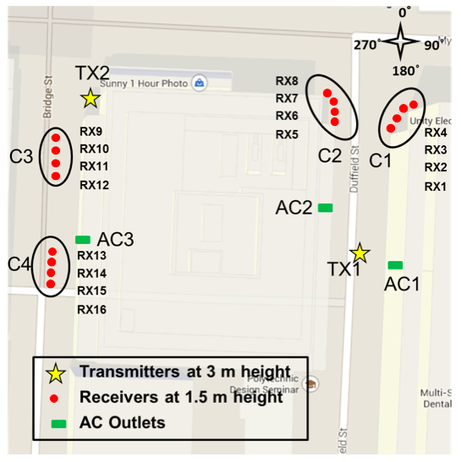
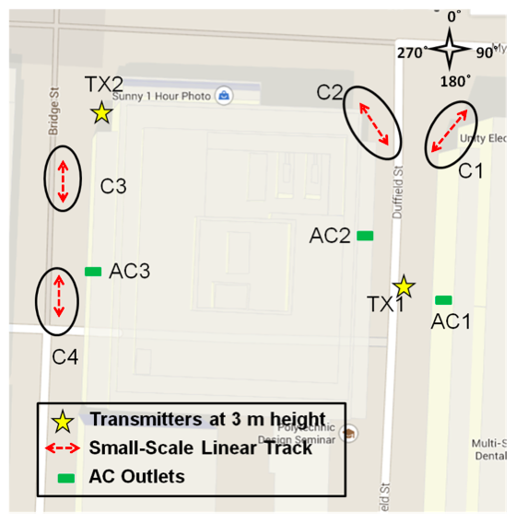
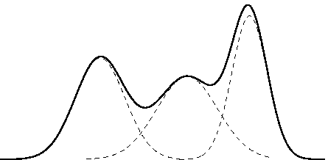
Statistical Model & Algorithms
Future Measurements
28 GHz
One TX location
Four clusters of four RX locations
Linear track measurements in same positions
Current Online Data
Current Online Data
28 GHz
73 GHz
73 GHz Indoor
73 GHz Foliage
28 GHz
73 GHz
73 GHz Indoor
73 GHz Foliage
Future Measurements
Future Measurements
28 GHz
One TX location
Four clusters of four RX locations
Linear track measurements in same positions
28 GHz
One TX location
Four clusters of four RX locations
Linear track measurements in same positions

