Slide 1


Provenance for Reproducibility and Beyond
Juliana Freire and Dennis Shasha
juliana.freire@nyu.edu shasha@cs.nyu.edu

Slide 2
Science Today: Data Intensive
Big and small data, complex computations
Trial-and-error process to formulate and test hypotheses
Easy to get lost---derive a result and not remember how you got there
Data
Computation
Data
Product
Perception &
Cognition
Knowledge
Specification
Exploration
Manipulation
User
Figure modified from J. van Wijk, IEEE Vis 2005
Notes:
Science has become data rich. The abundance of data opens up new opportunities but also brings many challenges. In particular, making sense of data is difficult. To analyze data, scientists need to go through a long, iterative process. As they formulate and test hypotheses, they often have to manipulate multiple data sets and use a plethora of tools. As a result, it is easy for them to get lost: arrive at a promising result and not remember exactly how they got there, e.g., the exact version of the input data or the combination of values for configuration parameters.
Notes:
Data-intensive is the 4th paradigm of science (Jim Gray), after experimentation, theory, and computer simulation
Although empirical, analytical, and simulation methods have provided answers to many questions, a new scientific methodology driven by data- intensive problems is now emerging—the “fourth paradigm.”

Slide 3
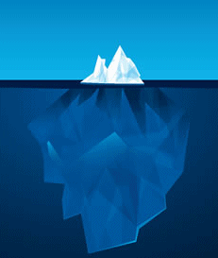







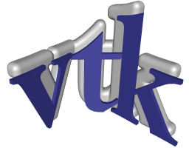

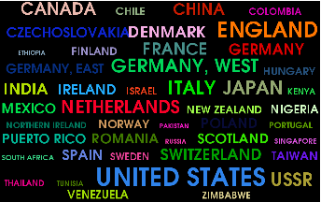
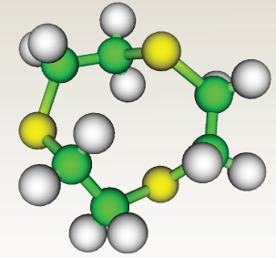
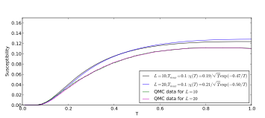
Science Today: Incomplete Publications
Scientific record is incomplete
Can’t (easily) reproduce or re-use
results
Notes:
This problem is propagated to publications. Currently publications that include computational results are often incomplete – they show just the tip of the iceberg and lack details of how the results were generated. Consequently, there is little hope that others will be able to reproduce, verify, or re-use these results. And this greatly hinders scientific progress.

Slide 4
Computational Provenance
Essential for science: systematically track how data is created and transformed during its life cycle
Interpret and reproduce results: Understand the trail followed to produce a result, assess its quality
More easily extend/modify previous work
“If I have seen further, it is by standing on the shoulders of giants.”
Isaac Newton
Data
Manipulation
Data
Product
Exploration
Provenance
Notes:
To address these problems, it is crucial that provenance be at the center of the scientific process. Provenance of scientific explorations must be systematically captured. And once you have provenance, not only you can reproduce the results, but you can also reason about the trail followed to obtain them and assess their quality. Furthermore, it becomes easier (and possible!) to extend and modify previous work.

Slide 5
Our Proposal: Capture Data and Workflows
Storage and Indexing
Capture
Models
Querying
Analytics and Visualization
Provenance Management
Basic Research
Teaching
Computational Reproducibility
Scientific Exploration
Applications
ReproZip
Provenance SDK
VisTrails
Systems
Notes:
My group has worked on many different aspects of provenance management, from automatic capture mechanisms and provenance models, to query languages and efficient storage. We have also introduced novel uses of provenance, including how to use this information to streamline scientific, to enrich science education, and to support the publication of reproducible results.
Last but not least, we have developed a number of systems, including VisTrails, an open-source data exploration system that has been downloaded 1000s of times and has been adopted in many different scientific domains, from climate data analysis and quantum physics to ornithology.
---------
New provenance models: change-based provenance, OPM (Open Provenance Model)
Querying and reusing provenance
Support for collaborative data exploration and visualization
Mining and analytics: knowledge discovery and re-use
[Freire et al., IPAW 2006; Scheidegger et al., TVCG 2007; Scheidegger et al., CCPE 2008; Moreau et al., FGCS 2011; Lins et al., IPAW 2008; Koop et al., TVCG 2008]
Reproducible Publications
Infrastructure to enable the creation and sharing of reproducible results
Teaching: Leverage provenance to improve the way we teach data-intensive science
VisTrails: open-source data exploration system http://www.vistrails.org
Support for data analysis and visualization, and a comprehensive provenance infrastructure
Ten’s of thousands of downloads
Adopted in many different scientific domains, e.g., climate data analysis, biology, quantum physics, astronomy, psychiatry, habitat modeling.
[Chirigati et al. SIGMOD 2013; Silva & Freire, CISE 2012; Freire et al., SIGMOD 2012; Silva et al., CGF 2011; Freire et al., VLDB 20011]

