Slide 1
SIGMOD Reproducibility
Each paper was reviewed in Fall/Winter 2017 by a database group. Participation is voluntary. Authors package their code, data, scripts and reviewers work with the authors to independently verify all results: http://db-reproducibility.seas.harvard.edu
Program Committee
Chair: Stratos Idreos, Harvard
University of Buffalo, USA: Oliver Kenedy
UMass Dartmouth, USA: David Koop
TU Dresden, Germany: Wolfgang Lehner, Thomas Kissinger
University of Glasgow, UK: Peter Triantafillou
Harvard University, USA: Abdul Wasay Wilson Qin
EPF Lausanne, Switzerland: Anastasia Ailamaki
Oxford, UK: Dan Olteanu, Haozhe Zhang
Sungkyunkwan University, Korea: Sang Won Lee
ETH Zurich, Switzerland: Lefteris Sidirourgos
NYU Abu Dhabi, UAE: Azza Abouzied

Slide 2


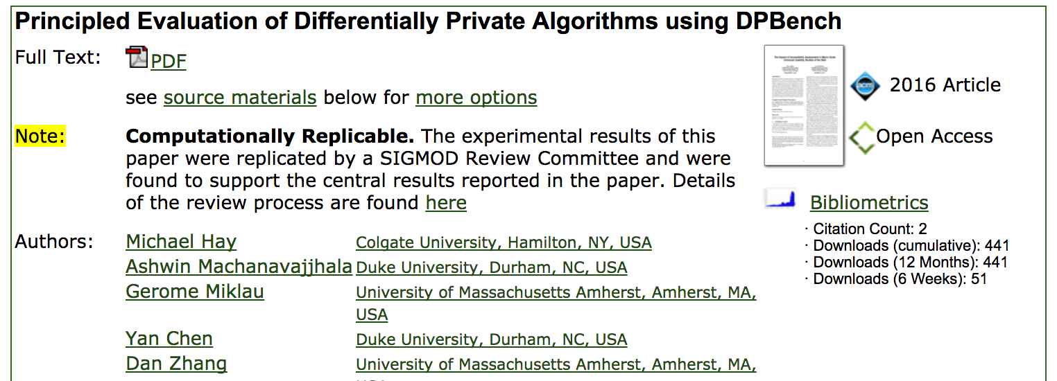
ACM DL: Reproducibility Badges

Slide 3
Most Reproducible Paper Award
Awards Chair: Dennis Shasha
Top three papers; $750 each paper
Criteria (reviewer survey/comments):
  Coverage (ideal: all results can be verified)
  Ease of reproducibility (ideal: just works)
  Flexibility (ideal: can change workloads, queries, data)
  Portability (ideal: linux, mac, windows)
Thanks to IBM and SAP!

Slide 4
Winners
Transaction Repair for Multi-Version Concurrency Control
Mohammad Dashti (EPFL), Sachin Basil John (EPFL), Amir Shaikhha (EPFL), Christoph Koch (EPFL)
Data Canopy: Accelerating Exploratory Statistical Analysis
Abdul Wasay (Harvard), Xinding Wei (Harvard), Niv Dayan (Harvard), Stratos Idreos (Harvard)
Debunking the Myths of Influence Maximization: An In-Depth Benchmarking Study
Akhil Arora (Xerox Research Centre India), Sainyam Galhotra (University of Massachusetts, Amherst), Sayan Ranu (Indian Institute of Technology, Delhi)

