Slide 1

BugDoc: Algorithms to Debug Computational Processes
Raoni Lourenço
Juliana Freire
Dennis Shasha
06/16/2020

Slide 2

Motivation
Computational pipelines are widely used in many domains.
A particular execution of a pipeline is characterized by a set of parameter-values (e.g. instances of files, machine learning hyperparameters).
When an execution fails, it’s not clear why.
BugDoc will use an iterative approach to find minimal root causes.

Slide 3
BugDoc Contribution
Naive Solution:
  Try all possible parameter-value combinations.
  Exponential in the number of parameters.
BugDoc Approach:
  Combinatorial design to flush out failures
  ”Shortcut” approach to find root causes in time linear in the number of parameters.

Slide 4






Opportunity
Analyze provenance and automatically execute different configurations of computational pipelines.

Slide 5
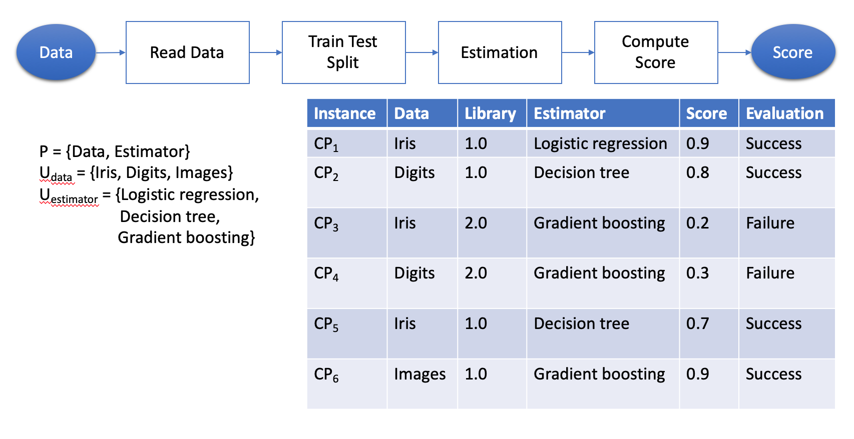
Example
Parameters = {Data, Library, Estimator}
Evaluation = Score > 0.6

Slide 6
Challenges
How to identify root causes of errors?
  Many properties may appear in failing configurations …
  … but which ones are decisive for a failure?

Slide 7
Challenges
Previous work can identify common information among failing configurations.
But patterns can change with more instances.

Slide 8
Challenges
(2) How to select new configurations to test?
  Executing pipelines is expensive, new configurations should
  be carefully selected to avoid non–informative executions.
  This is algorithmically related to works on parameter tuning,
  but such works focus on finding good configurations, not on
  explaining them.

Slide 9
Our Approach
Using provenance, identify the parameter-values used for each component and then iteratively execute and test to identify minimal root cause(s).

Slide 10
Contributions
We propose BugDoc, an autonomous tool that
(i) reports minimal failure root causes
by
(ii) iteratively selecting instances to test
property-value combinations unseen
in provenance
and
(iii) is able to run instances in parallel.
Challenge 1
Challenge 2
Challenge 2

Slide 11
Related Work – Root Cause Identification
Explaining relational query results.
  Meliou et al. [VLDB 2014]
  Roy and Suciu [SIGMOD 2014]
  Wang et al. [SIGMOD 2017]
  Wu and Madden [VLDB 2013]
Discovering relationships between attribute values.
  Bailis et al. [SIGMOD 2017]
  Chirigati et al. [SIGMOD 2016]
Finding common features among defective tuples.
  El Gebaly et al. [VLDB 2014] – Explanation Tables
  Wang et al. [SIGMOD 2015] – Data X-Ray
Challenge 1

Slide 12
Related Work – Configuration Selection
Tuning machine learning hyperparameters.
  Bergstra et al. [NIPS 2011]
  Snoek et al. [NIPS 2012]
Tuning databases with Bayesian Optimization.
  Dalibard et al. [WWW 2017]
  Van Aken et al. [SIGMOD 2017]
Configuring algorithms with Bayesian Optimization.
  Hutter et al. [LION 2011] - SMAC
Challenge 2
Notes:
.

Slide 13
Definitions – Pipeline, Parameters, Instances
A computational pipeline CP is a procedure consisting of a set of parameters P, we denote CP_{i} an instance of CP that defines values for the parameters for a particular run of CP.
Thus, a pipeline instance CP_{i} is associated with a list of parameter-value pairs containing the assignments (p,v) for all p ∈ P.

Slide 14
Definitions – Evaluation
Let E be a procedure that evaluates the results of a pipeline instance such that:
E(CP_{i} )=success if the results are acceptable, and
E(CP_{i} )=failure otherwise.

Slide 15
Definition - Definitive root cause
A definitive root cause is a set D_{f} consisting of Boolean conjunctions of parameter-comparator-value triples (e.g., A > 5 and B = 7) that represent a sufficient condition for a pipeline to fail.
Hence, if the parameter-value pairs of an instance, (p,v) ∈ CP_{i} , satisfy D_{f} , we have:
E(CP_{i} ) = failure.

Slide 16
Problem Definition
Given a computational pipeline, a history of previously-run instances and an evaluation function, we set two goals:
(i) Finding at least one minimal definitive root cause;
(ii) Finding all minimal definitive root causes.

Slide 17
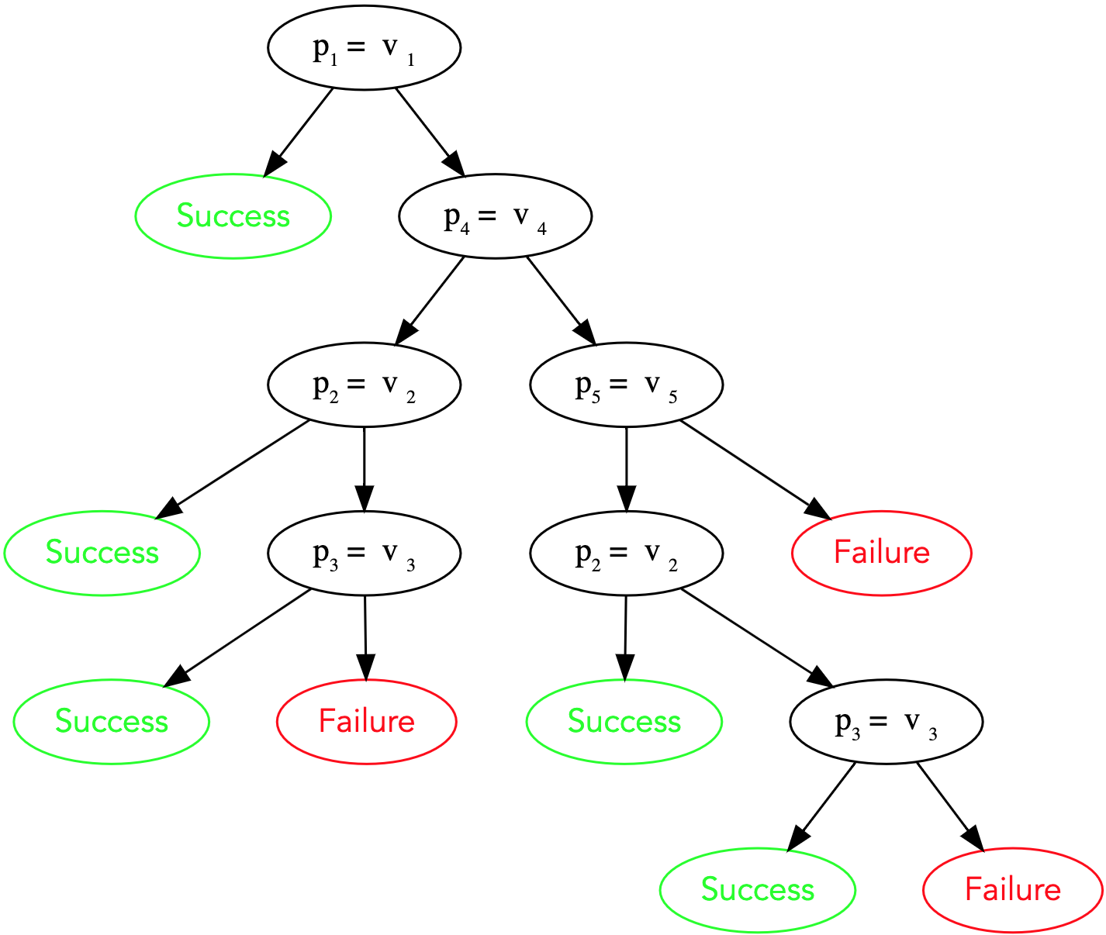
Previous work:
Debugging Decision Trees
Represent the parameter-values associated with each instance as the input.
The result of the evaluation function (success or failure) is the output.
Construct a decision tree.
The path leading to any “pure” failing leaf is a candidate explanation.
Iterate on that.
17
Debugging Machine Learning Pipelines. Raoni Lourenço, Juliana Freire, and Dennis Shasha. In ACM SIGMOD Workshop on Data Management for End-to-End Machine Learning, 2019.

Slide 18
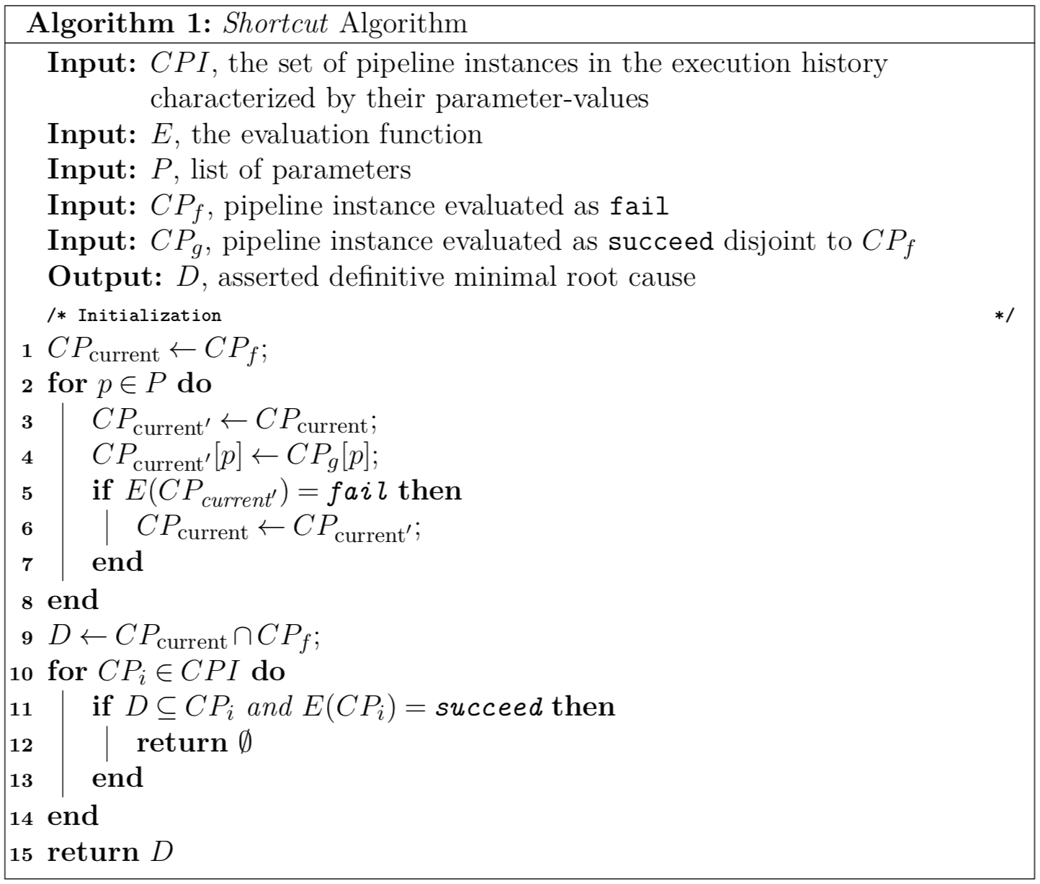
Shortcut Algorithm
The Shortcut Algorithm relies on disjoint instances and generates precisely as many new configurations as the same number of parameters.

Slide 19
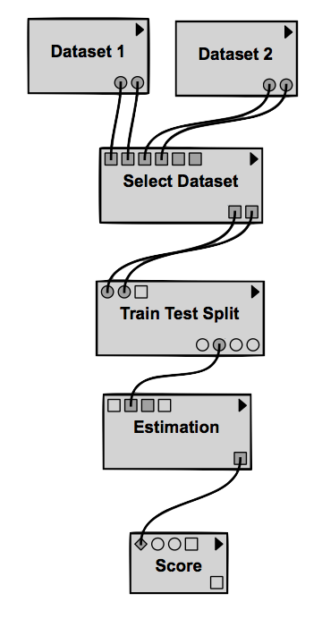
Shortcut Algorithm
Parameters:
  Dataset
  Library Version
  Estimator
Evaluation function:
  Score >= 0.6

Slide 20
Shortcut Algorithm
CP_{g} = {
(Dataset, Dataset 2),
(Estimator, Decision Tree),
(Library Version, 1.0)
}
CP_{f} = {
(Dataset, Dataset 1),
(Estimator, Gradient Boosting),
(Library Version, 2.0)
}
1.0
1.0
2.0
Logistic Regression
Decision Tree
Gradient Boosting
0.9
0.8
0.2

Slide 21
Shortcut Algorithm
Dataset | Estimator | Library Version | Evaluation
Dataset 1 | Logistic regression | 1.0 | Success
Dataset 2 | Decision tree | 1.0 | Success
Dataset 1 | Gradient boosting | 2.0 | Failure
Dataset 2 | Gradient boosting | 2.0 | Failure
CP_{g} = {
(Dataset, Dataset 2),
(Estimator, Decision Tree),
(Library Version, 1.0)
}
CP_{f} = {
(Dataset, Dataset 1),
(Estimator, Gradient Boosting),
(Library Version, 2.0)
}
2.0
Gradient Boosting
0.2

Slide 22
Shortcut Algorithm
Dataset | Estimator | Library Version | Evaluation
Dataset 1 | Logistic regression | 1.0 | Success
Dataset 2 | Decision tree | 1.0 | Success
Dataset 1 | Gradient boosting | 2.0 | Failure
Dataset 2 | Gradient boosting | 2.0 | Failure
Dataset 2 | Decision tree | 2.0 | Failure
CP_{g} = {
(Dataset, Dataset 2),
(Estimator, Decision Tree),
(Library Version, 1.0)
}
CP_{f} = {
(Dataset, Dataset 1),
(Estimator, Gradient Boosting),
(Library Version, 2.0)
}
2.0
Decision Tree
0.3

Slide 23
Shortcut Algorithm
Dataset | Estimator | Library Version | Evaluation
Dataset 1 | Logistic regression | 1.0 | Success
Dataset 2 | Decision tree | 1.0 | Success
Dataset 1 | Gradient boosting | 2.0 | Failure
Dataset 2 | Gradient boosting | 2.0 | Failure
Dataset 2 | Decision tree | 2.0 | Failure
CP_{g} = {
(Dataset, Dataset 2),
(Estimator, Decision Tree),
(Library Version, 1.0)
}
CP_{f} = {
(Dataset, Dataset 1),
(Estimator, Gradient Boosting),
(Library Version, 2.0)
}
1.0
Decision Tree
0.8
Discard (Library Version, 1.0).

Slide 24
Shortcut Algorithm
CP_{g} = {
(Dataset, Dataset 2),
(Estimator, Decision Tree),
(Library Version, 1.0)
}
CP_{f} = {
(Dataset, Dataset 1),
(Estimator, Gradient Boosting),
(Library Version, 2.0)
}
2.0
Decision Tree
0.2
The algorithm yields the following root cause: (Library Version , 2.0).

Slide 25
Shortcut Algorithm - Limitation
What if there were two root causes as follows?
  D₁ = {(Library Version , 2.0) , (Estimator, Gradient Boosting)}
  D₂ = {(Library Version , 2.0) , (Estimator, Decision Tree)}

Slide 26
Shortcut Algorithm
The Shortcut Algorithm may yield a root cause that is too short, a truncated assertion. However, it is never too long.
Theorem. The Shortcut algorithm never asserts a superset of a minimal root cause.

Slide 27
Shortcut Algorithm
But how to avoid truncated assertions?
Let’s first see the cases when they do not occur!

Slide 28
Shortcut Algorithm
Two definitive root causes are sufficiently different if they have at least two parameters in common and are disjoint.
Example:
      D₁ = {(Library Version , 2.0) , (Estimator, Gradient Boosting)}
      D₂ = {(Library Version , 2.0) , (Estimator, Decision Tree)}
      D₃ = {(Dataset , Dataset 1) , (Estimator, Decision Tree)}
      D₄ = {(Dataset , Dataset 2) , (Estimator, Logistic Regression)}
Theorem. If all root causes are pairwise sufficiently different, then
the shortcut algorithm will never produce a truncated assertion.

Slide 29
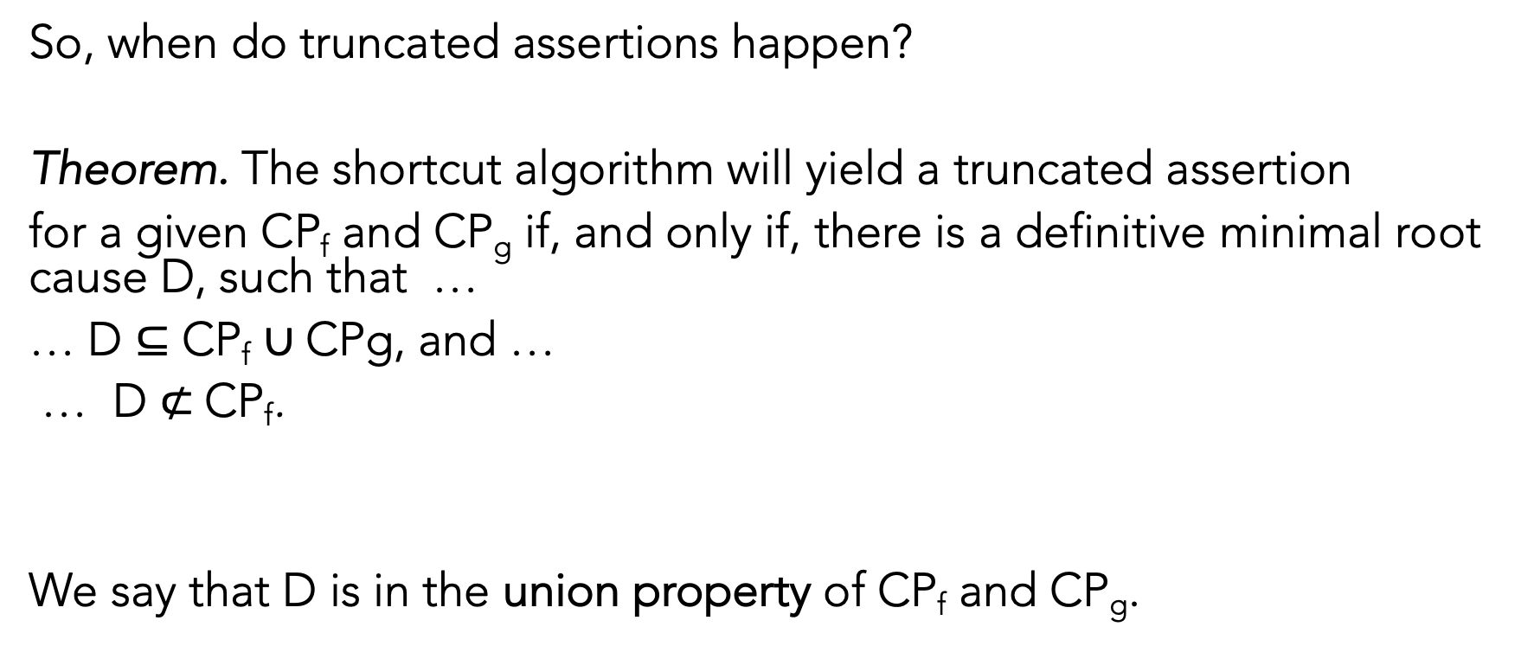
Shortcut Algorithm
So, when do truncated assertions happen?
Theorem. The shortcut algorithm will yield a truncated assertion
for a given CP_{f} and CP_{g} if, and only if, there is a definitive minimal root cause D, such that …
… D $⊆$ CP_{f} $∪$CPg, and …
… D $⊄$CP_{f}.
We say that D is in the union property of CP_{f} and CP_{g}.

Slide 30
Shortcut Algorithm
  D₁ = {(Library Version , 2.0) , (Estimator, Gradient Boosting)}
  D₂ = {(Library Version , 2.0) , (Estimator, Decision Tree)}
CP_{g} = {
(Dataset, Dataset 2),
(Estimator, Decision Tree),
(Library Version, 1.0)
}
CP_{f} = {
(Dataset, Dataset 1),
(Estimator, Gradient Boosting),
(Library Version, 2.0)
}

Slide 31
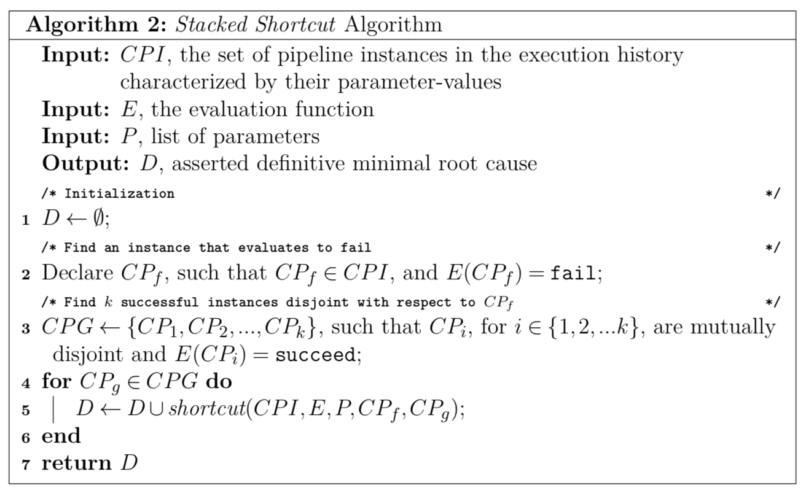
Stacked Shortcut Algorithm
We generalize the shortcut algorithm to the Stacked Shortcut Algorithm.

Slide 32
Stacked Shortcut Algorithm
Theorem. The Stacked Shortcut Algorithm is guaranteed to produce a correct solution if we can find k mutually disjoint successful instances, …
… and there are at most k distinct minimal root causes.

Slide 33
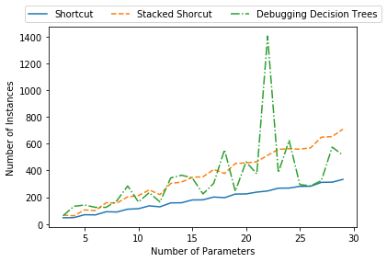
Experiments - Scalability
Shortcut and Stacked Shortcut increase the number of instances linearly as the number of parameter grows.
Debugging Decision Trees could grow exponentially, depending on the root cause.

Slide 34

Experiments - Baselines
Data explanation
Data X-Ray
Explanation Tables
Configuration selection
BugDoc
SMAC

Slide 35
Experiments - Scenarios
Synthetic pipelines.
  Different number of parameters and value ranges.
  Categorical and numerical parameters.
  Root causes with equalities, inequalities and negations.
Various budgets (Maximum number of instances).
Two debugging goals.
  Find one root cause.
  Find all root causes.
Three different cases of root causes.
  Single parameter-value pair.
  Conjunction of parameter-value pairs.
  Disjunction of conjunctions of parameter-value pairs.

Slide 36
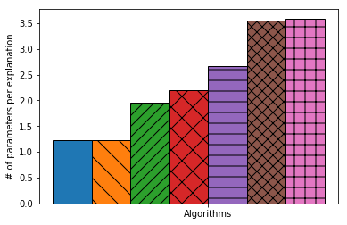
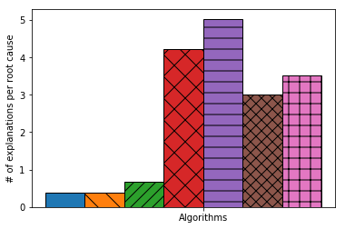
Experiments - Conciseness
Notes:
Our algorithms generate concise explanations. We give both shorter and fewer answers.

Slide 37

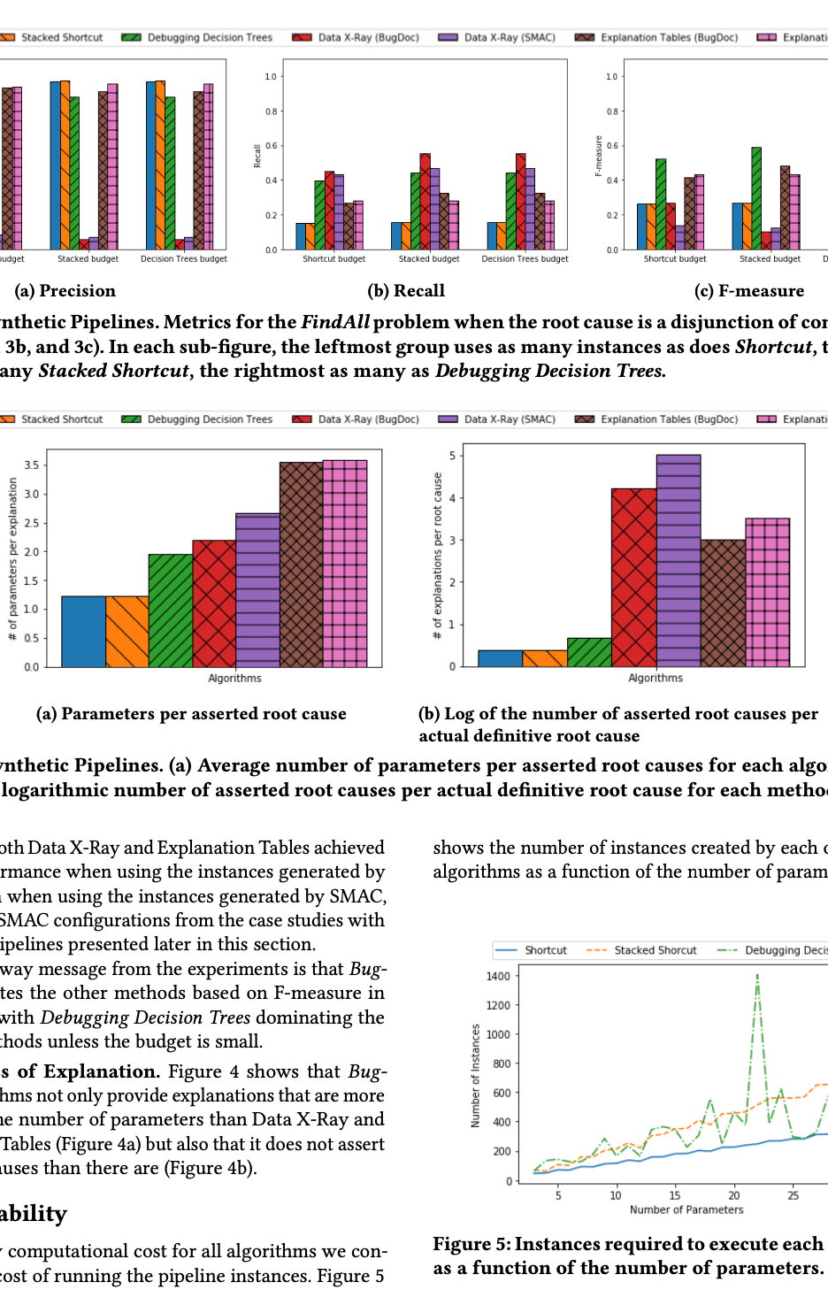
Summary of Results
All our algorithms have perfect precision and recall when there is a single parameter-value pair as root cause.
Shortcut algorithms have comparable performance to Debugging Decision Trees for the Find One goal.
Our algorithms combined dominate all other scenarios.
Our approach produces more concise explanations

Slide 38
Conclusion
We developed BugDoc, a framework to discover minimal root causes from provenance and test them by generating new instances.
We evaluated BugDoc across different types of pipelines, and over a variety of sources of errors.
Instances can run in parallel, enabling the exploration of large parameter spaces.
Our approach makes no statistical assumptions and achieves better precision and recall than the state of the art.

Slide 39
Future Work
Data debugging.
  Dataset profiling.
  Outlier detection.
  Group testing.
Observable variables.
Causality.
  Lee et al. [IEEE TSP 2015]
  El Gebaly et al. [VLDB 2014]
  Fariha et al. [SIGMOD 2020]

Slide 40
Thank You!
Contact Information:
raoni@nyu.edu
https://github.com/VIDA-NYU/BugDoc
Acknowledgements:
CNPq (Brazil), DARPA, National Science Foundation and NYU Wireless.
VIDA Lab.

