Slide 1
Wireless Database, MRI, et al
Dennis Shasha

Slide 2
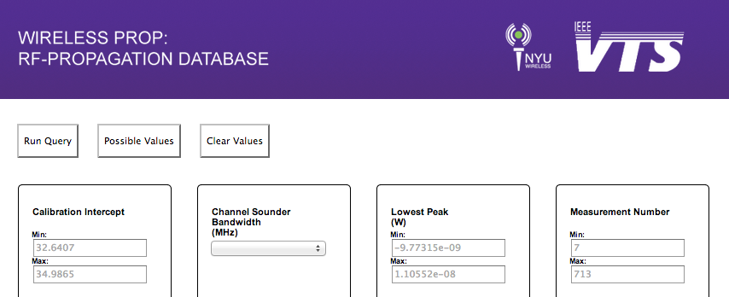
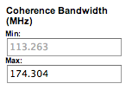
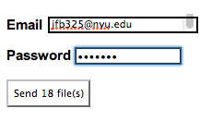
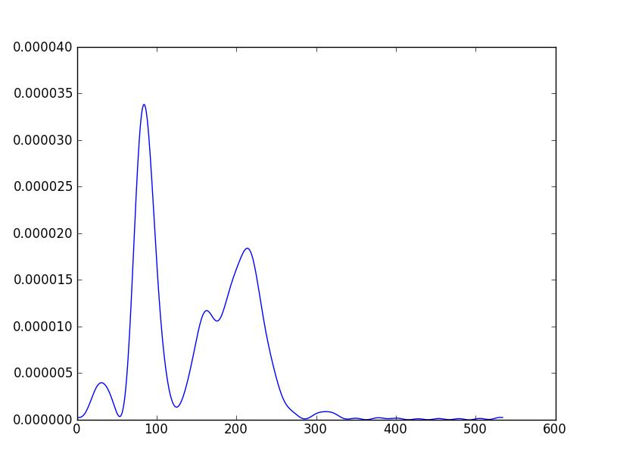
Choose Parameters
Authenticate
Receive Data

Slide 3
Current System
28.8GB of Data
37 Query Parameters
6000 Experiments (and counting)
Processing backend in Python
Database migrating to MySQL
3
Notes:
XXXXXXXXX

Slide 4
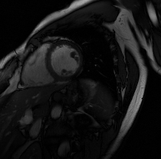
MRI Reconstruction
Fully-sampled
Reconstruction - GPU
Zero-filled FFT
Reconstruction - CPU

Slide 5
MRI Reconstruction
Device | Single-slice | Speed-up | Multiple-slices | Speed-up
CPU Intel E5506 | 308s | 1 x | 2860 s | 1 x
GPU AMD V7800 | 2.54s | 121 x | 42 s | 68 x
GPU GeForce GTX 680 | 0.8s | 385 x | 14 s | 204 x

