Slide 1
Towards Robotic Identification of Base Station Strength
Cole Smith, Eric Lin, Dr. Dennis Shasha

Slide 2
Use Case
Millimeter waves are very sensitive to obstacles.
Helpful to understand whether a certain set of base stations would cover some area.
Sending around people to accomplish this is too expensive and time-consuming.
Robots might do better.
In our use case, millimeter waves were simulated by light sources of different colors.

Slide 3
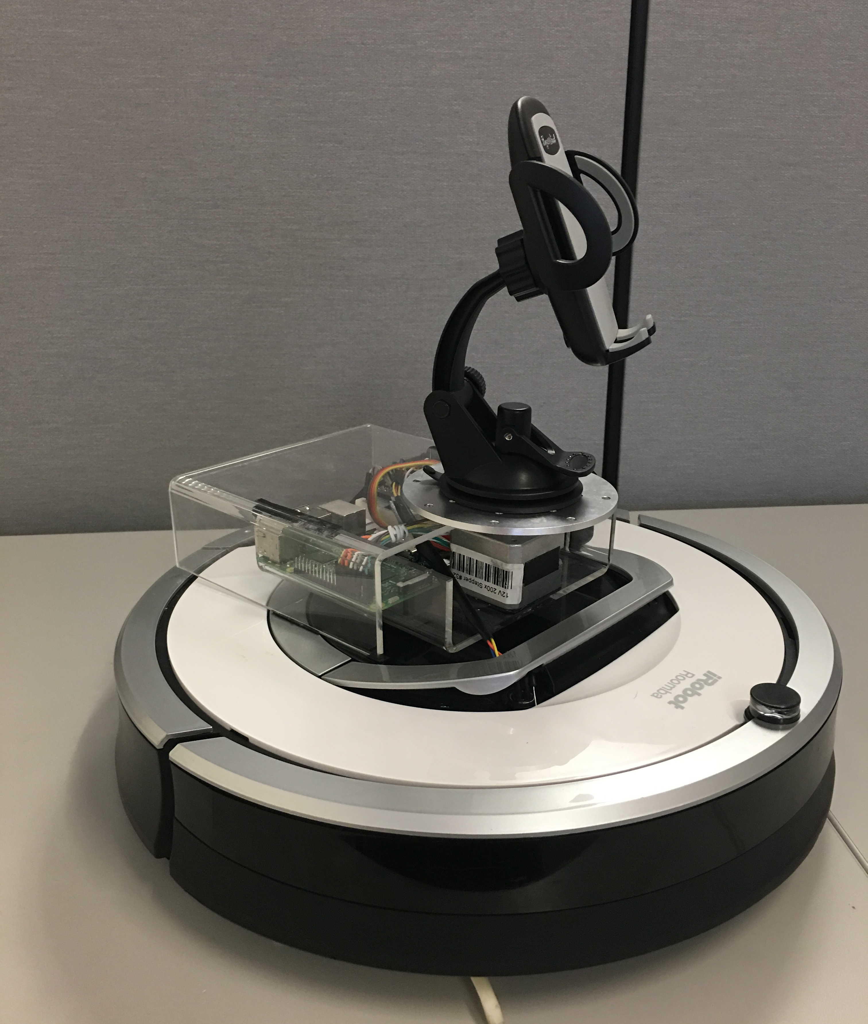
Roomba Platform Room Traversal
An iPhone’s camera buffer is streamed to a Raspberry Pi over TCP
The iphone detects light of various colors (like millimeter waves from different base stations).
A room profile indicates over-coverage and dead zones.

Slide 4
Show room traversal and coverage profile

Slide 5
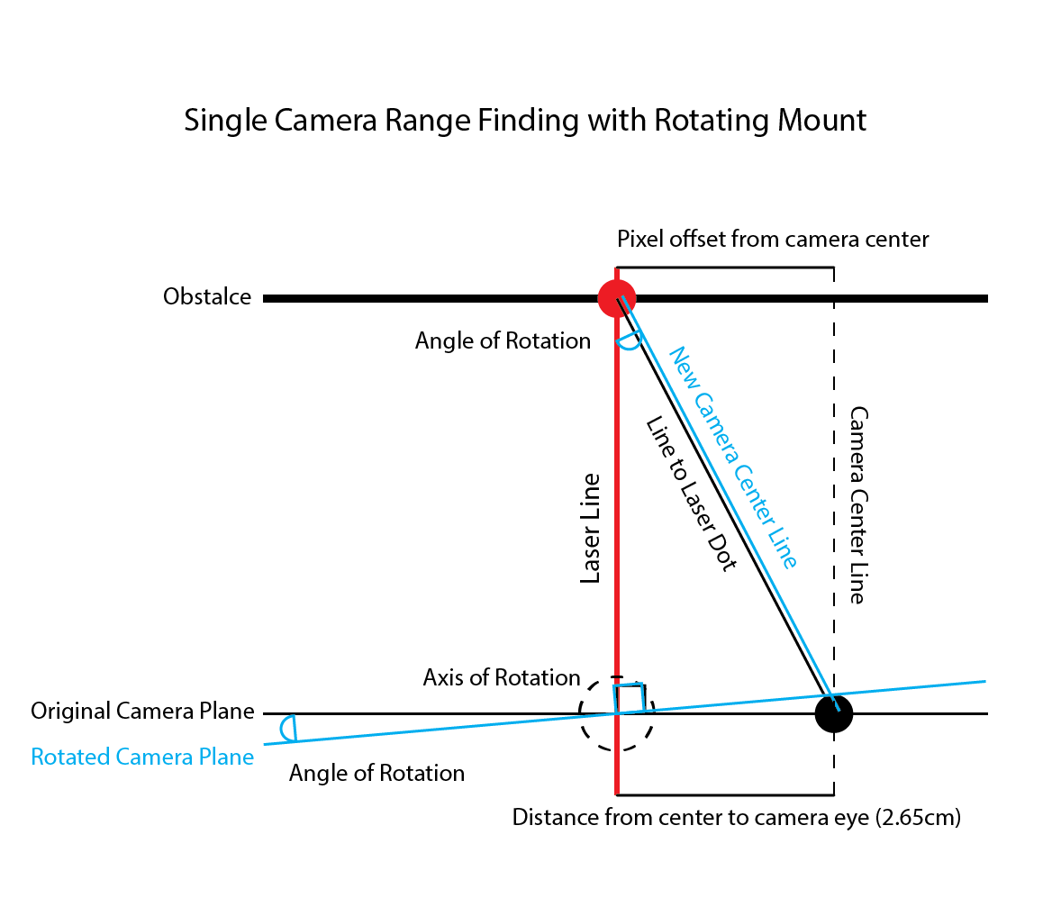
Range Finding Model
The Distance of the laser line is found by solving the triangle.
The Angle of Rotation is measured by rotating the camera until the laser dot is in the center of the camera plane.
We know the length from center to camera eye, and every angle, thus we can solve each side.
Can be calibrated to any distance with accuracy of rotating mount.

Slide 6
Navigation
Navigation is achieved by
Maintaining constant speed
Tracking exact time of travel
Tracking exact angle changes
This data can be coupled with the wireless sensor payload data for channel sounding.

