Slide 1



Computational Reproducibility:
State-of-the-art, challenges, database research opportunities
Juliana Freire | Philippe Bonnet | Dennis Shasha
juliana.freire@nyu.edu | phbo@itu.dk | shasha@courant.nyu.edu
Notes:
While computational experiments have become an integral part of the scientific method, it is still a challenge to repeat such experiments, because often, computational experiments require specific hardware, non-trivial software installation, and complex manipulations to obtain results. To address this problem, we are building infrastructure to support the life-cycle of 'reproducible publications': their creation, review and re-use. This infrastructure makes it easier to generate and share repeatable results by making provenance a central component in scientific exploration, and the conduit for integrating data acquisition, derivation, and analysis as executable components throughout the publication process. Besides giving authors the ability to link results to their provenance, it enables reviewers to assess the correctness and the relevance of the experimental results described in a submitted paper; and, upon publication, it also allows readers to repeat and utilize the computations embedded in the papers. In this talk, we give an overview of this infrastructure and present case studies that show how this infrastructure has been used. We also discuss its limitations and open problems that require further research.

Slide 2
Creating Reproducible Experiments
You can do this after the fact: just package your results
  Command line, input data, virtual machine
But there are advantages to plan for reproducibility from the beginning: do reproducible research
Use tools that help manage the process
  Simplify publication of results
  Support the exploration process
Example we know best: VisTrails
Notes:
I will describe other tools later, now I will give a concrete example of how to use a specific system, VisTrails to support reproducible research

Slide 3

The VisTrails System
Combines features of visualization, data analysis, and scientific workflow systems
  Integrate multiple libraries (e.g., VTK, R, matplotlib, *)
Tracks provenance as users generate and test hypotheses (e.g. different parameter settings)
Focus on usability—build tools for scientists, even computer scientists
These demos aim to convince you of the usability.
Notes:
With the goal of managing provenance for exploratory computational tasks, and provide support for reflective reasoning, at Utah, we have build a new system called VisTrails.
Focus on provenance, designed with provenance—unlike other systems, where provenance was an add-onOur
goal is building VisTrails was to provide the necessary data management infrastructure to streamline, the creation, execution and sharing of complex com. I.e., VisTrails manage the data+metadata, scientists can focus on the science. To quote Bill Gates, we would like to reduce the time to insight.
I should note that it is not our goal to have VisTrails replace visualization systems or sci flow systems, instead, we are building infrastructure that can be combined with and enhance these systems.
Computers are notoriously good at repetitive processes that require precise attention to details, humans are notoriously good at getting insight from incomplete information, dealing with contradictory and open-ended situations. VisTrails provides a simple, general solution to the problem of data exploration through workflows: it allows humans to spend time at what they do best, while the computer transparently tracks of the trails followed to solve a particular problem. These trails are a powerful tool that can significantly reduce the time to insight. Not only do they allow results to be reproduced, but they also simplify the exploration of the parameter spaces of applications. In addition, by mining and querying the information in these trails a better understanding problem-solving strategies can be obtained, and expert knowledge involved in solving complex problems can be extracted and re-used.

Slide 4
Demos
Notes:
1
See tutorial-demo-script.txt

Slide 5
Demo: Part 1
Studying weather, looking at temperatures and precipitation over time
Creating and refining plots using matplotlib
Now publish

Slide 6
Demo: Part 2
Adding your own code
  Use CLTools to include the simulation script into VisTrails
Run simulation that predicts temperature values
Compare simulation results with actual data
Explore different values for simulation parameter
Persistent files: connecting data and provenance
  Manage input and intermediate files
Using global variables

Slide 7
Demo: Part 3
Publishing results
  Include results in LaTeX
  Create mashup
  Results on the Web

Slide 8
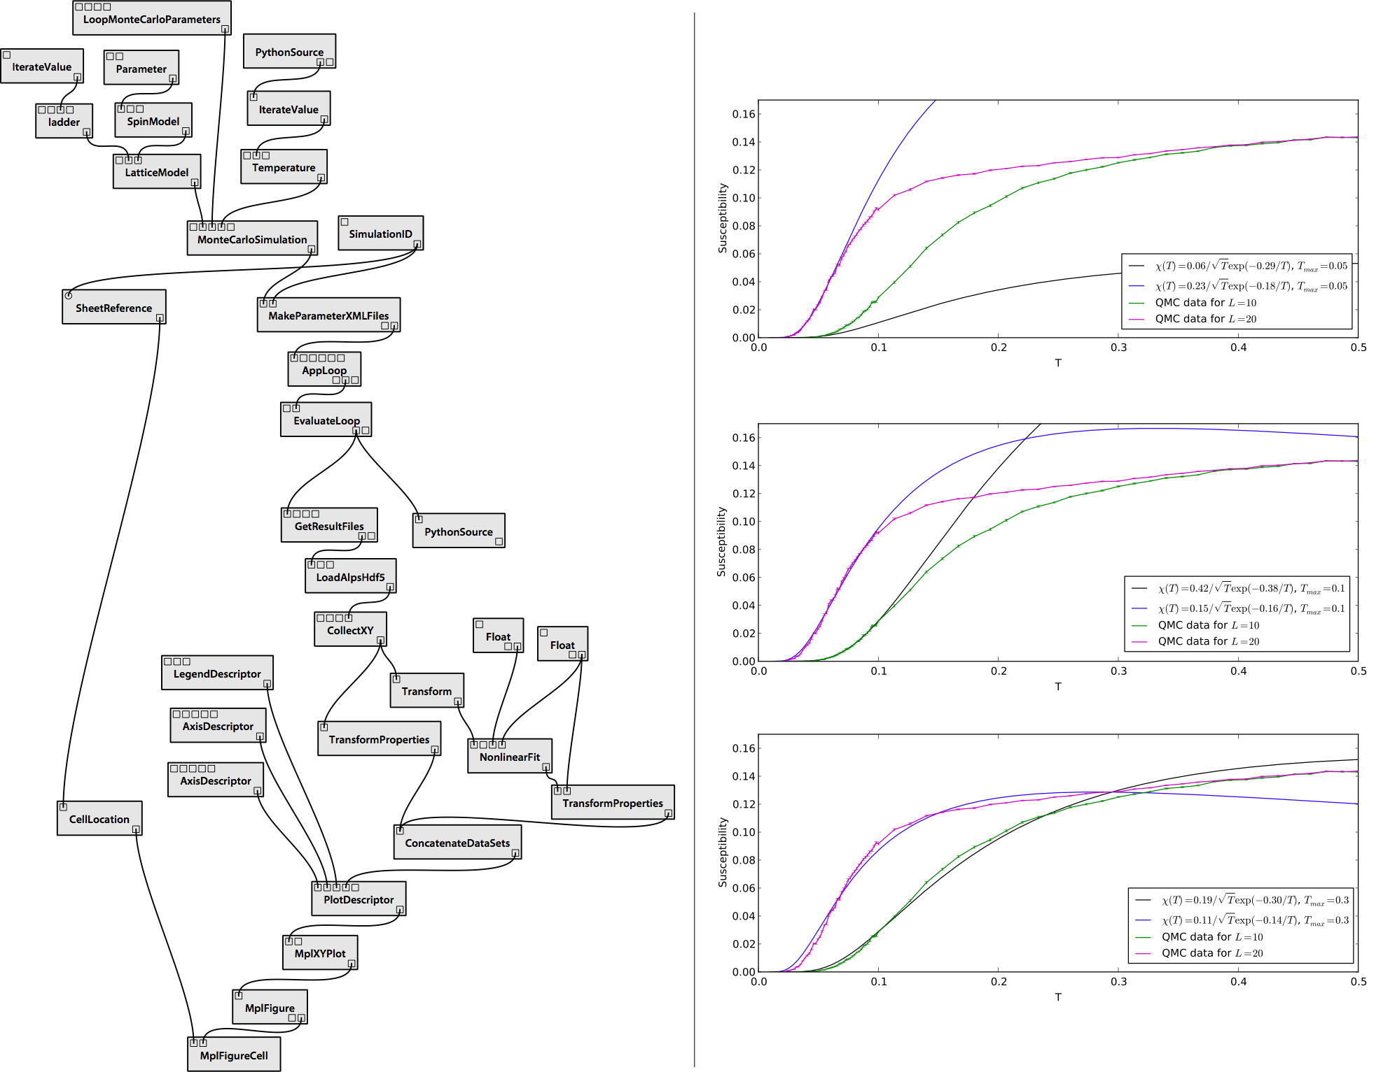

Issue: Linking Provenance to Data
input.txt
Has the input data changed?
SIMULATION
FIGURE
Which workflow derived the file?
results.txt
FIGURE
ANALYSIS
Which parameters were used?
FIGURE
figure.png
8
Notes:
retrieve the lineage of a data product, specifically what input data and computations contributed to the result [8]. With only the provenance of the execution, a user may find the path to an input but even if a file still exists at that location, there is no guarantee it has not been modified.

Slide 9
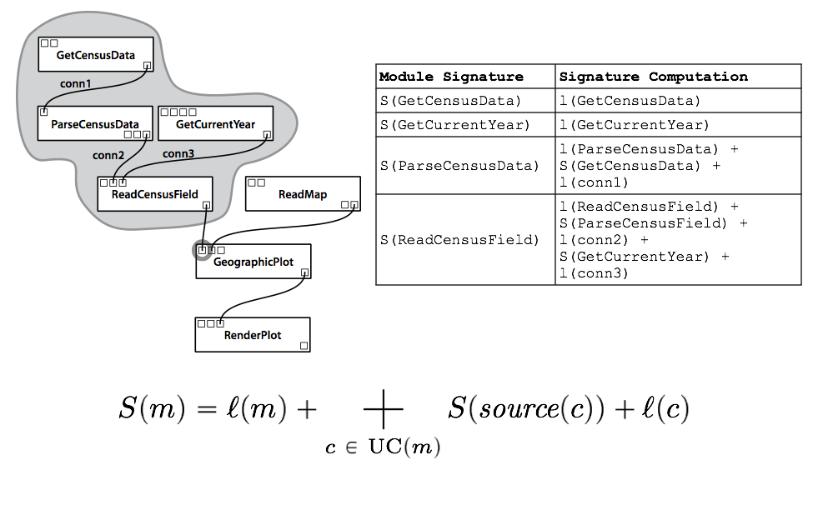
Solution: Strong Links between
Workflows and Outputs
[Koop@SSDBM2010]
  Also useful for caching
  Identify computational steps and parameters that had an effect on the output
Notes:
as the subgraph induced by all modules u P W for which there exists a path from u to m in W (including m itself). Note that the existence of such a path implies that the results of u may have an effect on the computation of m.
L(m) – depends on the actual module name and its parameters
L(c), is the serialization of the types of the ports c connects.
Signature is the SHA1 hash of the serialization

Slide 10
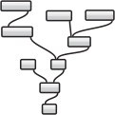


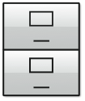
Linking Computations to Data
QUERY
PROVENANCE
OBTAIN
INPUT REFS
12ab3-45ef2...
12ab3-45ef2...
12ab3-45ef2...
QUERY
FILE STORE
OBTAIN
INPUT FILES
input files
Notes:
TODO: mention persistence package – add a slide on that; show sample pipelines

Slide 11
Issue: Longevity
Workflow is not enough
Need provenance of the computational environment, e.g., OS, library versions, etc.
  Use virtual machines, CDEPack (http://www.pgbovine.net/cde.html)
Maintenance and longevity
  Workflows need to be run in different environments
  Software evolves: need to upgrade workflows/experiments [Koop@IPAW2010]
Notes:
Adoption will only happen if this is easier and better integrated with the environments people already have
How to represent and query experiments?
Workflows, source code, data

Slide 12
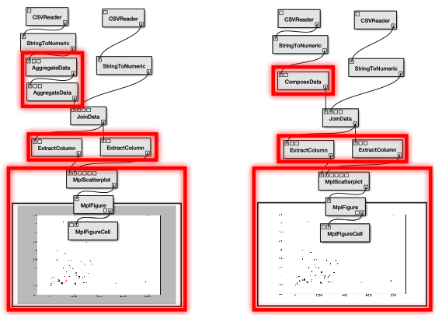
Software Changes
matplotlib 1.0, csv 0.1
matplotlib 1.1, csv 1.0

Slide 13





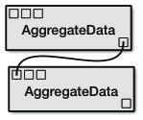

Workflow Upgrades
Implementation Change
Interface Change
Deprecation, Addition, or Replacement
def compute(self):
fig = pylab.figure()
...
pylab.scatter(x_data, y_data)
...
def compute(self):
fig = pylab.figure()
pylab.setp(fig, facecolor=′w′)
...
pylab.scatter(x_data, y_data)
...
13
Notes:
Some changes may not be noticed in a workflow, some are just modifications to an interface, some are much more involved.

Slide 14
Solution: Support Workflow Upgrades
Maintain information about library versions
Identify all incompatible modules in the workflow
Group all incompatible modules by package
For each module group:
  If developer added logic for upgrades, use those routines
  Otherwise try to perform automatic upgrades on all modules
  On failure, show the incompatible workflow, notify the user, and allow the user to make changes
Learn from ‘fixes’
  VisTrails keeps provenance of workflow evolution
  Use provenance of manual upgrades to automatically patch other workflows
[Koop@IPAW2010]
14
Notes:
We process changes by package. Start with developer, default to automatic, and fail by showing the user what’s wrong.

Slide 15
Issue: Supporting Reviewers
Support for reviewers
  Explore parameters and configurations, keep provenance of this too!
  Provenance can serve as means of communication between reviewers and authors
Publish using different media, not just documents
http://www.crowdlabs.org/vistrails/medleys/details/26/
[Koop et al., ICCS 2011]
Notes:
More later… or show high-level examples using pipelines
e.g., use persistent files for intermediate results produced from large raw data, hw or sw
E.g., use a web-based interface to give other access to software, hw, …Large input files or long running computations: cache intermediate results (show workflow)
Proprietary hardware/software: provide web-based access
Etc
Adoption will only happen if this is easier and better integrated with the environments people already have
How to represent and query experiments?
Workflows, source code, data

Slide 16
Issue: Show how to make provenance serve as a means of communication
[Koop et al., ICCS 2011]
Notes:
More later… or show high-level examples using pipelines
e.g., use persistent files for intermediate results produced from large raw data, hw or sw
E.g., use a web-based interface to give other access to software, hw, …Large input files or long running computations: cache intermediate results (show workflow)
Proprietary hardware/software: provide web-based access
Etc
Adoption will only happen if this is easier and better integrated with the environments people already have
How to represent and query experiments?
Workflows, source code, data

Slide 17
Companion Reproducibility Tools
Scientific workflow systems
  Describe experiments at different levels of abstraction
  Support reproducibility
  Few support portability
Many other tools, different foci in terms of area and level of reproducibility
Sweave: embed R code in LaTeX documents
  Create dynamic reports that are updated automatically if data or analysis change
Madagascar: Geophysics
  Scripting with Python and the Scons build manager
GenePattern: genomic analysis
CDE: create portable Linux applications
Notes:
Swift, Taverna, Kepler, VisTrails
Portability and sharing can be problematic
Sharing a workflow to run on a different machine, different libraries, local files – it will break
http://www.statistik.lmu.de/~leisch/Sweave/
http://www.reproducibility.org/
http://www.broadinstitute.org/cancer/software/genepattern/desc/reproducible.html
Published research, particularly in silico research, should contain sufficient information to completely reproduce the research results. By capturing the analysis methods, parameters, and data used to produce the research results, GenePattern pipelines enable reproducible research. By versioning every pipeline and its methods, GenePattern ensures that each version of a pipeline (and its results) remain static, even as your research and the pipeline continue to evolve.GenePattern uses Life Science Identifiers (LSIDs) to uniquely identify objects, such as analysis methods and pipelines. When you create an object, GenePattern automatically assigns the object an LSID with a version number of one (1). When you update an object, GenePattern automatically updates the version number of the object’s LSID. This careful versioning process allows you to accurately reproduce analysis results by rerunning the precise version of the pipeline that previously generated those results.
http://www.pgbovine.net/cde.html
CDE implements a form of lightweight application virtualization that allows you to easily distribute portable software, to deploy applications to the cloud, to make computational experiments reproducible, and to run software on non-native Linux distros without conflicts.
Madagascar is an open-source software package for multidimensional data analysis and reproducible computational experiments. Its mission is to providea convenient and powerful environmenta convenient technology transfer toolfor researchers working with digital image and data processing in geophysics and related fields. Technology developed using the Madagascar project management system is transferred in the form of recorded processing histories, which become "computational recipes" to be verified, exchanged, and modified by users of the system.

Slide 18
Discussion
VisTrails is one tool among several that makes it reasonably easy to create reproducible experiments.
A good tool provides workflow features, bookkeeping/provenance features to find the source of each experimental result, and provenance to be able to do time travel on a workflow over time.
Bottom line: such a tool can help you manage your software over time without requiring that much effort.
Notes:
Different domain, and even different scientists in the same domain, have different requirements

Slide 19
Dennis suggests you end here
I know there is a lot more you can say. Let that come from questions.

Slide 20





Acknowledgments
Thanks to: David Koop, Philip Mates, Matthias Troyer, Emanuele Santos, Claudio Silva, Joel Tohline, Huy T. Vo, and the VisTrails team
This work is partially supported by the National Science Foundation, the Department of Energy, and IBM Faculty Awards.

Slide 21
Additional Information
The VisTrails System http://www.vistrails.org
An infrastructure to support the creation, review and re-use of reproducible papers
http://www.vistrails.org/index.php/RepeatabilityCentral
Some videos:
Editing an executable paper written using LaTeX and VisTrailshttp://www.vistrails.org/download/download.php?type=MEDIA&id=executable_paper_latex.mov
Exploring a Web-hosted paper using server-based computation
http://www.vistrails.org/download/download.php?type=MEDIA&id=executable_paper_server.mov
An interactive paper on a Wiki
http://www.vistrails.org/index.php/User:Tohline/CPM/Levels2and3
http://vistrails.sci.utah.edu/index.php/User:Tohline/IVAJ/Levels2and3

Slide 22
VisTrails: The System
Open-source, freely downloadable system (www.vistrails.org)
Multi-platform: Mac, Linux, and Windows
Python + Qt for the interface
Over 35,000 downloads since 2007
User’s guide, wiki, and mailing list
Many users in different disciplines and countries:
Visualizing environmental simulations (CMOP STC)
Simulation for solid, fluid and structural mechanics (Galileo Network, UFRJ Brazil)
Quantum physics simulations (ALPS, ETH Switzerland)
Climate analysis (CDAT)
Habitat modeling (USGS)
Open Wildland Fire Modeling (U. Colorado, NCAR)
High-energy physics (LEPP, Cornell)
Cosmology simulations (LANL)
Study on the use of tms for improving memory (Pyschiatry, U. Utah)
eBird (Cornell, NSF DataONE)
Astrophysical Systems (Tohline, LSU)
NIH NBCR (UCSD)
Pervasive Technology Labs (Heiland, Indiana University)
Linköping University (Sweden)
University of North Carolina, Chapel Hill
UTEP
22

Slide 23
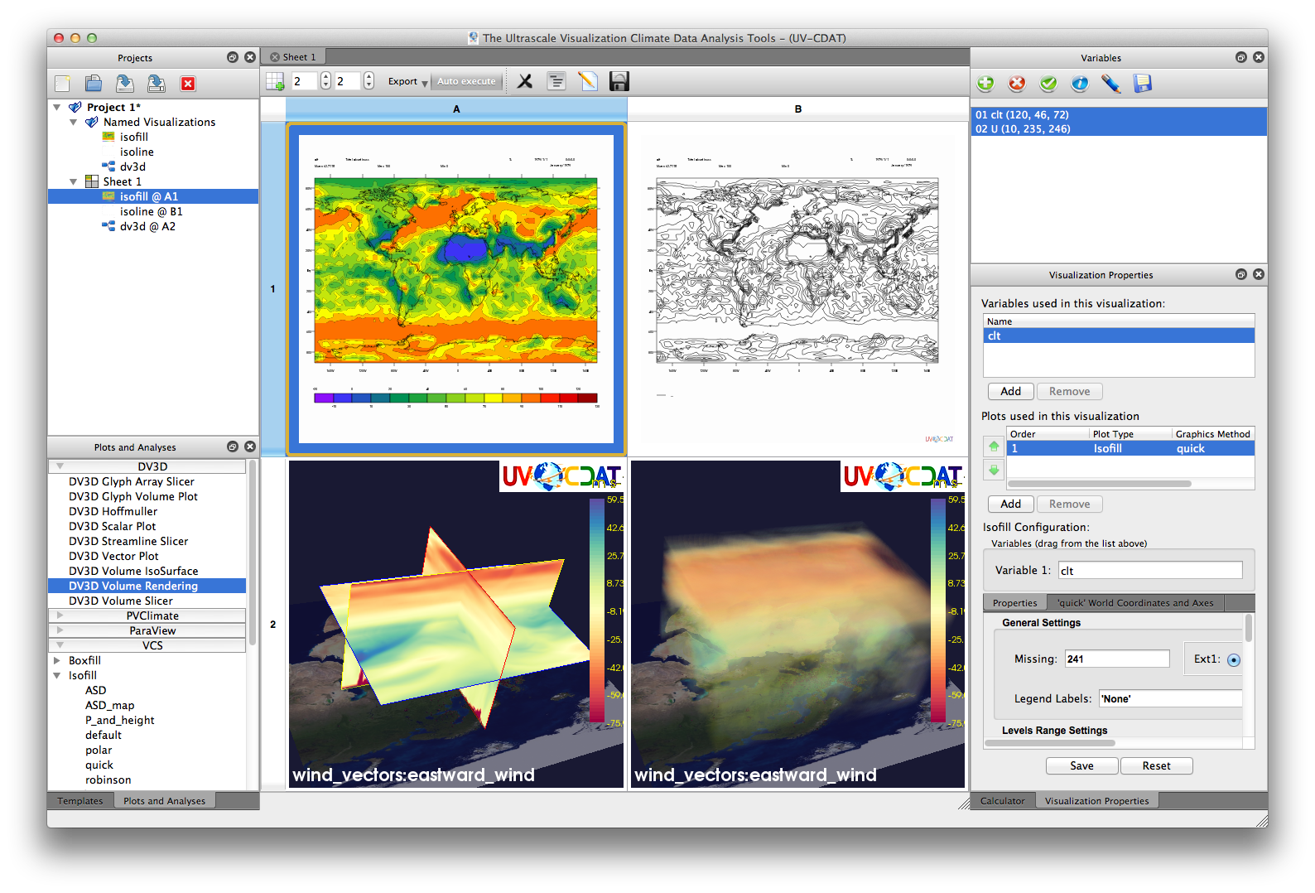
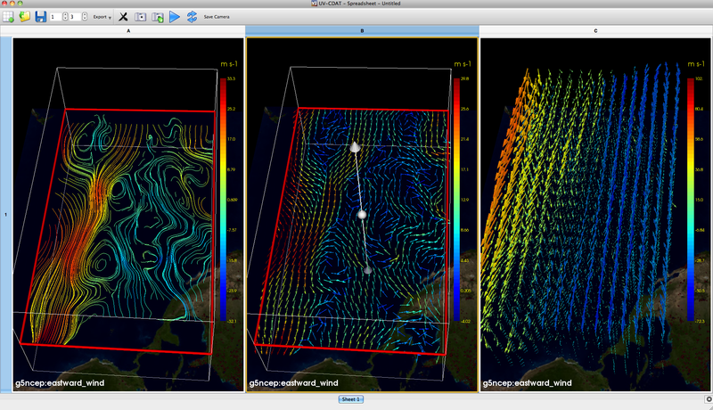
UV-CDAT and Climate Data Analysis
http://uvcdat.llnl.gov
LLNL
NASA
Notes:
With the goal of managing provenance for exploratory computational tasks, and provide support for reflective reasoning, at Utah, we have build a new system called VisTrails.
Focus on provenance, designed with provenance—unlike other systems, where provenance was an add-onOur
goal is building VisTrails was to provide the necessary data management infrastructure to streamline, the creation, execution and sharing of complex com. I.e., VisTrails manage the data+metadata, scientists can focus on the science. To quote Bill Gates, we would like to reduce the time to insight.
I should note that it is not our goal to have VisTrails replace visualization systems or sci flow systems, instead, we are building infrastructure that can be combined with and enhance these systems.
Computers are notoriously good at repetitive processes that require precise attention to details, humans are notoriously good at getting insight from incomplete information, dealing with contradictory and open-ended situations. VisTrails provides a simple, general solution to the problem of data exploration through workflows: it allows humans to spend time at what they do best, while the computer transparently tracks of the trails followed to solve a particular problem. These trails are a powerful tool that can significantly reduce the time to insight. Not only do they allow results to be reproduced, but they also simplify the exploration of the parameter spaces of applications. In addition, by mining and querying the information in these trails a better understanding problem-solving strategies can be obtained, and expert knowledge involved in solving complex problems can be extracted and re-used.

Slide 24
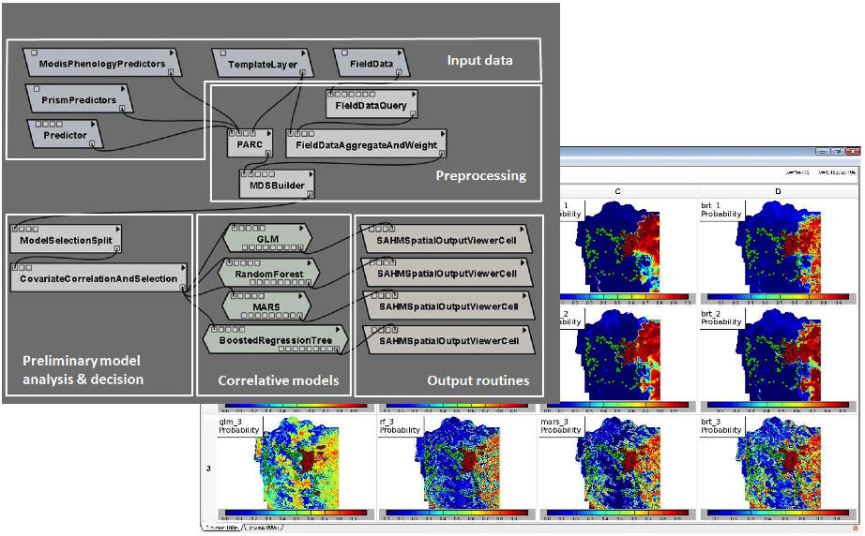
Habitat Modeling (SAHM)
USGS
http://www.mesc.usgs.gov/products/software/sahm/
Notes:
With the goal of managing provenance for exploratory computational tasks, and provide support for reflective reasoning, at Utah, we have build a new system called VisTrails.
Focus on provenance, designed with provenance—unlike other systems, where provenance was an add-onOur
goal is building VisTrails was to provide the necessary data management infrastructure to streamline, the creation, execution and sharing of complex com. I.e., VisTrails manage the data+metadata, scientists can focus on the science. To quote Bill Gates, we would like to reduce the time to insight.
I should note that it is not our goal to have VisTrails replace visualization systems or sci flow systems, instead, we are building infrastructure that can be combined with and enhance these systems.
Computers are notoriously good at repetitive processes that require precise attention to details, humans are notoriously good at getting insight from incomplete information, dealing with contradictory and open-ended situations. VisTrails provides a simple, general solution to the problem of data exploration through workflows: it allows humans to spend time at what they do best, while the computer transparently tracks of the trails followed to solve a particular problem. These trails are a powerful tool that can significantly reduce the time to insight. Not only do they allow results to be reproduced, but they also simplify the exploration of the parameter spaces of applications. In addition, by mining and querying the information in these trails a better understanding problem-solving strategies can be obtained, and expert knowledge involved in solving complex problems can be extracted and re-used.

Slide 25
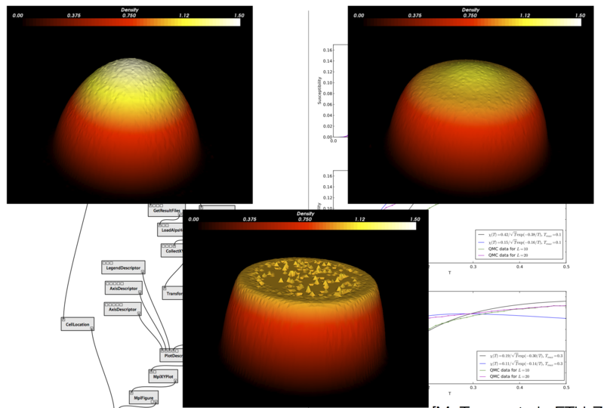
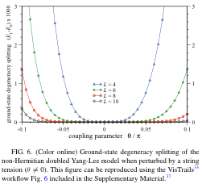
Physics Simulations
Freedman et al. 2012
ETH
http://alps.comp-phys.org
Notes:
With the goal of managing provenance for exploratory computational tasks, and provide support for reflective reasoning, at Utah, we have build a new system called VisTrails.
Focus on provenance, designed with provenance—unlike other systems, where provenance was an add-onOur
goal is building VisTrails was to provide the necessary data management infrastructure to streamline, the creation, execution and sharing of complex com. I.e., VisTrails manage the data+metadata, scientists can focus on the science. To quote Bill Gates, we would like to reduce the time to insight.
I should note that it is not our goal to have VisTrails replace visualization systems or sci flow systems, instead, we are building infrastructure that can be combined with and enhance these systems.
Computers are notoriously good at repetitive processes that require precise attention to details, humans are notoriously good at getting insight from incomplete information, dealing with contradictory and open-ended situations. VisTrails provides a simple, general solution to the problem of data exploration through workflows: it allows humans to spend time at what they do best, while the computer transparently tracks of the trails followed to solve a particular problem. These trails are a powerful tool that can significantly reduce the time to insight. Not only do they allow results to be reproduced, but they also simplify the exploration of the parameter spaces of applications. In addition, by mining and querying the information in these trails a better understanding problem-solving strategies can be obtained, and expert knowledge involved in solving complex problems can be extracted and re-used.

Slide 26
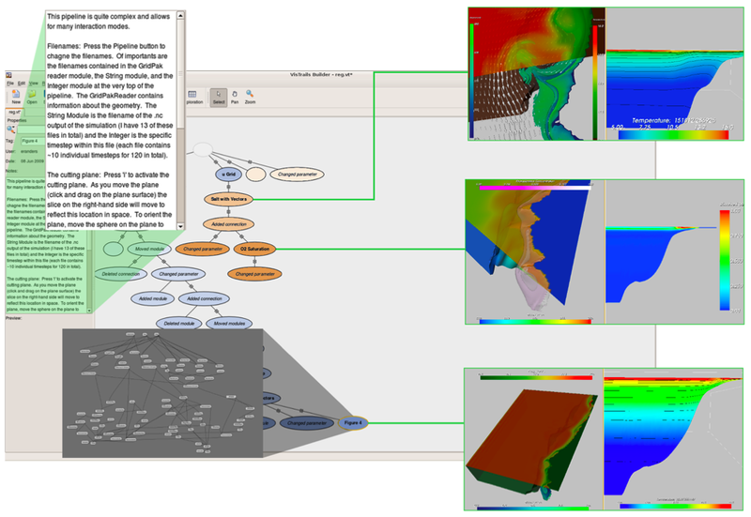
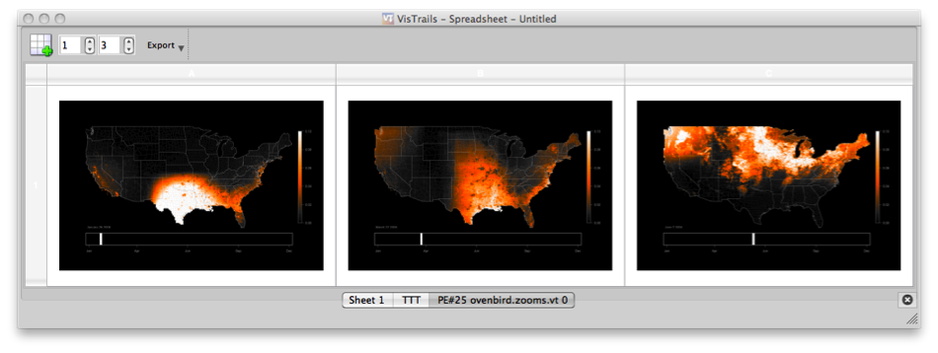
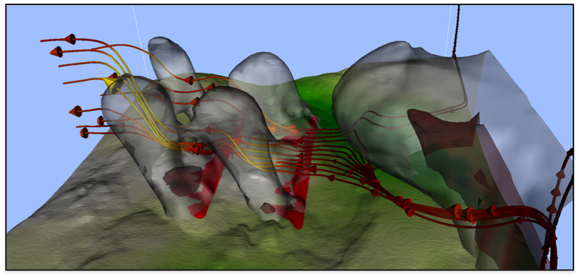
Environment and Biology
Coastal Margin
Observation (OHSU)
Bird Migration
(Cornell, DataONE)
Wild Fire Simulations
(UC Denver)
Notes:
With the goal of managing provenance for exploratory computational tasks, and provide support for reflective reasoning, at Utah, we have build a new system called VisTrails.
Focus on provenance, designed with provenance—unlike other systems, where provenance was an add-onOur
goal is building VisTrails was to provide the necessary data management infrastructure to streamline, the creation, execution and sharing of complex com. I.e., VisTrails manage the data+metadata, scientists can focus on the science. To quote Bill Gates, we would like to reduce the time to insight.
I should note that it is not our goal to have VisTrails replace visualization systems or sci flow systems, instead, we are building infrastructure that can be combined with and enhance these systems.
Computers are notoriously good at repetitive processes that require precise attention to details, humans are notoriously good at getting insight from incomplete information, dealing with contradictory and open-ended situations. VisTrails provides a simple, general solution to the problem of data exploration through workflows: it allows humans to spend time at what they do best, while the computer transparently tracks of the trails followed to solve a particular problem. These trails are a powerful tool that can significantly reduce the time to insight. Not only do they allow results to be reproduced, but they also simplify the exploration of the parameter spaces of applications. In addition, by mining and querying the information in these trails a better understanding problem-solving strategies can be obtained, and expert knowledge involved in solving complex problems can be extracted and re-used.

Slide 27
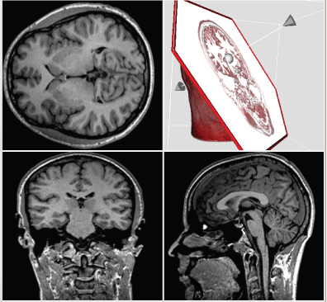
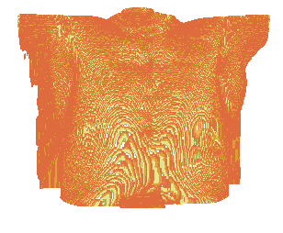
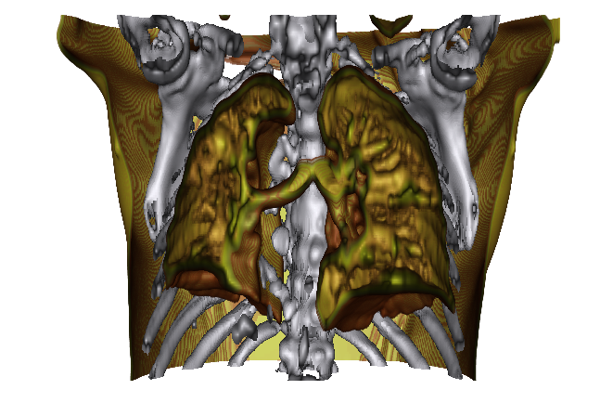
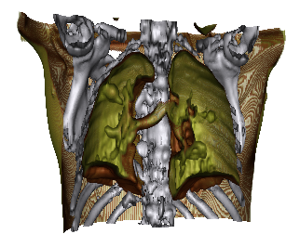
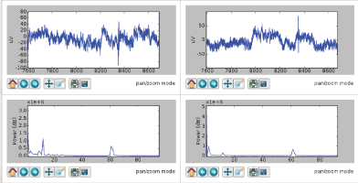
Medical Studies
Memory
and tms
(U. Utah)
Radiation Oncology
(U. Utah, Harvard)
Notes:
With the goal of managing provenance for exploratory computational tasks, and provide support for reflective reasoning, at Utah, we have build a new system called VisTrails.
Focus on provenance, designed with provenance—unlike other systems, where provenance was an add-onOur
goal is building VisTrails was to provide the necessary data management infrastructure to streamline, the creation, execution and sharing of complex com. I.e., VisTrails manage the data+metadata, scientists can focus on the science. To quote Bill Gates, we would like to reduce the time to insight.
I should note that it is not our goal to have VisTrails replace visualization systems or sci flow systems, instead, we are building infrastructure that can be combined with and enhance these systems.
Computers are notoriously good at repetitive processes that require precise attention to details, humans are notoriously good at getting insight from incomplete information, dealing with contradictory and open-ended situations. VisTrails provides a simple, general solution to the problem of data exploration through workflows: it allows humans to spend time at what they do best, while the computer transparently tracks of the trails followed to solve a particular problem. These trails are a powerful tool that can significantly reduce the time to insight. Not only do they allow results to be reproduced, but they also simplify the exploration of the parameter spaces of applications. In addition, by mining and querying the information in these trails a better understanding problem-solving strategies can be obtained, and expert knowledge involved in solving complex problems can be extracted and re-used.

Slide 28
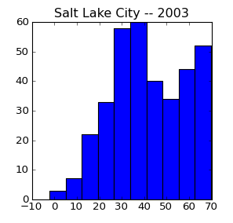
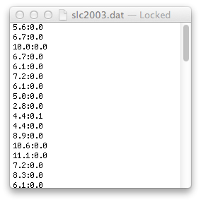
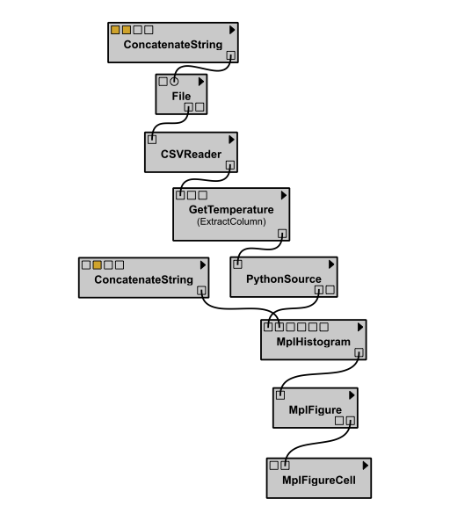
Depth of Reproducibility
Workflow that
produced
the plot
Data
Plot
matplotlib
csvpkg
Libraries used
by the workflow
Virtual machine
Libraries used
by the workflow
Portability
VM
Workflow that
produced
the plot
VM
Guest OS
Data
Plot
Workflow system
Reproducibility Depth
Notes:
Virtual machine includes everything, including the workflow system to run the pipeline
Eg., csvpkg is specific to unix

Slide 29
Reproducibility and Coverage
Sometimes it is not possible (or necessary) to completely reproduce an experiment
  Raw data is too large or proprietary (e.g., the whole Wikipedia, a Web crawl)
  Special hardware was used
  Special (or proprietary) software used
  Very long running computations
Design experiments around these restrictions: share parts that are reproducible

Slide 30
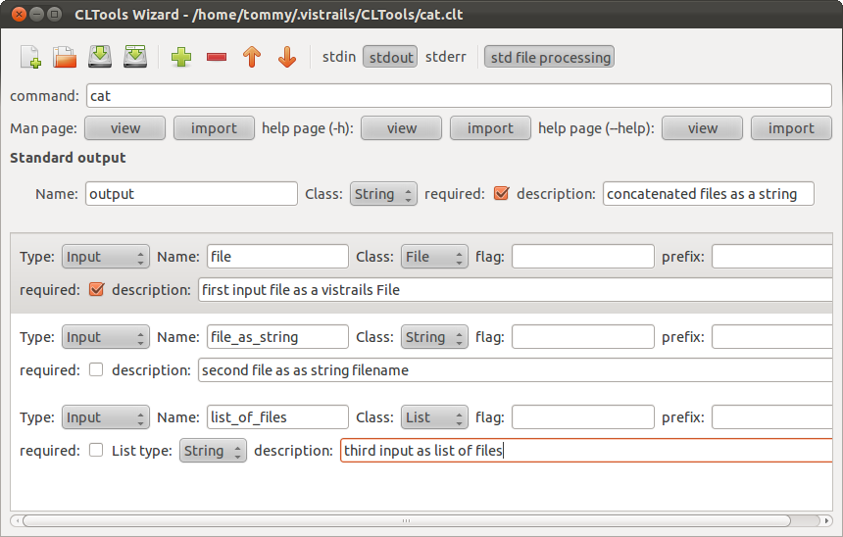
Integrating your code: CLTools
http://www.vistrails.org/usersguide/dev/html/cltools.html?highlight=cltools
Notes:
This python package contains a python translation for two Matlab user contributed toolboxes. (1) the seawater (EOS-80) and (2) the gibbs seawater (TEOS-10).
calculating the properties of sea water
functions for evaluating the thermodynamic properties of pure water (using IAPWS-09) and seawater

Slide 31
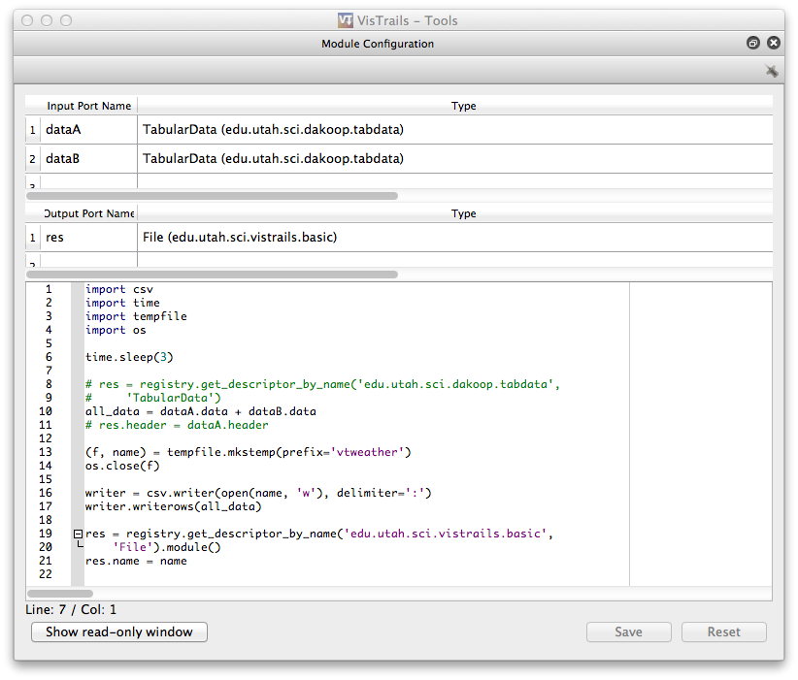
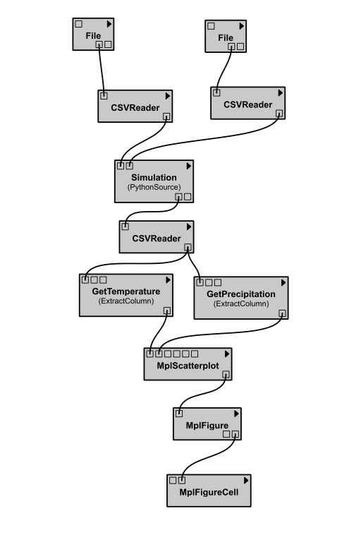
Integrating your code: PythonSource
http://www.vistrails.org/usersguide/dev/html/example_guide.html

Slide 32
Integrating your code: Using Packages
Package infrastructure
  Wrap python libraries, command-line calls, or use other interfaces (jpype, rpy, etc.)
  Need to specify:
  Package identification information
  Module structures: input & output ports
  Compute method for each module
  http://www.vistrails.org/usersguide/dev/html/packages.html

Slide 33
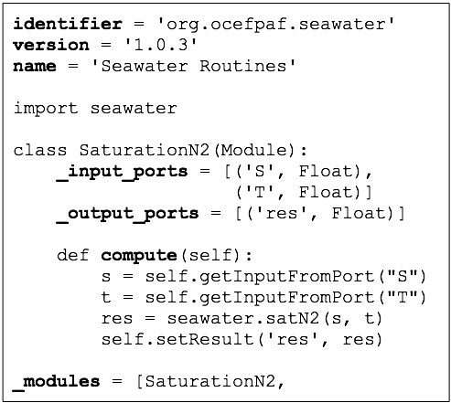
Using Packages: An Example
http://pypi.python.org/pypi/seawater/1.0.3
Notes:
This python package contains a python translation for two Matlab user contributed toolboxes. (1) the seawater (EOS-80) and (2) the gibbs seawater (TEOS-10).
calculating the properties of sea water
functions for evaluating the thermodynamic properties of pure water (using IAPWS-09) and seawater

Slide 34
Package Metadata
Defined in the __init__.py file for backward compatibility
name: string, required, for display purposes
  “seawater”
identifier: string, required, used internally, unique, like java
  “org.vistrails.dakoop.seawater”
version: string, required, digits separated by dots
  “1.0.3”
package_dependencies: function, optional, returns list of package identifiers
package_requirements: function, optional, checks for python modules
configuration: ConfigurationObject object, key-value pairs
Notes:
SKIP

Slide 35
Package Definition
Defined in the init.py file to facilitate faster metadata inspection
_modules: list, optional, classes that inherit from base Module
_subworkflows: list, optional, filename strings that point to vistrails that represent subworkflows stored in a local file
initialize: function, optional, does any initialization when loading
finalize: function, optional, does any cleanup when unloading
handle_module_upgrade_request: function, optional, given old module, returns translation of module to current version
menu_items: function, optional, returns tuple of (string, function) tuples that will be shown in the package menu
handle_all_errors, handle_missing_module, contextMenuName, callContextMenu
Notes:
SKIP

Slide 36
Different Levels of Reproducibility
Virtual machine
Libraries used
by the workflow
Portability
Workflow that
produced
the plot
Data
Plot
Reproducibility
Notes:
Virtual machine includes everything, including the workflow system to run the pipeline
Eg., csvpkg is specific to unix

Slide 37
Running Experiments
Show examples of pipeline (or just a script) that and outputs results to a fixed filename – lose connection between setting and results (can lead to confusion and errors)
As pipeline changes, lose track of which ‘version’ was run
  Cmd1, cmd 2, cmd 3
  Cmd1, cmd 2’, cmd 3
Systematic parameter exploration and result comparison: compare apples to apples

Slide 38
Identification Methods
Upstream signature
  Identify workflow outputs by the computational steps and parameters that (may have) had an effect on the output
Content hashing
  Identify files by their content
  Mirrored by version information from version control systems
Universally Unique Identifiers (UUID)
  Serve as “filenames”
  Could use some other scheme here

Slide 39
Linking Data to Computations
Content hashing: Identify files by their content
HASH
CONTENTS
QUERY
FILE STORE
newfilename.dat
0ab678cd...
OBTAIN
FILE REFERENCE
OBTAIN
WORKFLOWS
QUERY
PROVENANCE
12ab3-45ef2...
Universally Unique Identifiers (UUID) serve as file names
39
Notes:
With our file management scheme, we can store the id, version, and content hash of any input as part of the provenance. Then, for lineage queries, we can return references that can be accessed from the provenance store using the id and version and verified using the content hash.
content hash also gives us a way to locate the provenance of files that are un-managed and may have been moved to a different location or had their names changed. We begin by hashing the contents of the file, then query the managed store for this content hash. The resulting entries have ids and versions for which we can then search our provenance for.

Slide 40
Issue: Coverage
If it is not possible to reproduce the whole experiment, publish the subset that is reproducible
Some common issues and solutions:
  Long-running computations → cache intermediate results
  Special hardware → support remote execution
  Proprietary data → remote execution, cache intermediate results
  Data collection is not reproducible → provide data
Notes:
More later… or show high-level examples using pipelines
e.g., use persistent files for intermediate results produced from large raw data, hw or sw
E.g., use a web-based interface to give other access to software, hw, …Large input files or long running computations: cache intermediate results (show workflow)
Proprietary hardware/software: provide web-based access
Etc
Adoption will only happen if this is easier and better integrated with the environments people already have
How to represent and query experiments?
Workflows, source code, data

Slide 41
Publishing Reproducible Results
Connect results to their provenance
  Support LateX, Word, Powerpoint, HTML, wiki
\begin{figure}
\vistrail[filename=ladder_dyl_gap_theta-2.xml,version=5,pdf, buildalways, getvtl, embedworkflow, execute]{width=8cm}
\caption{(color online) Ground-state degeneracy splitting of the
non-Hermitian doubled Yang-Lee model when perturbed by a string
tension (θ ̸= 0).}
\label{fig:figure}
\end{center}
\end{figure}
Local
\vistrail[host=alps.ethz.ch,db=vistrails,vtid=10,version=169,pdf]{width=8cm}
[Koop et al., ICCS 2011]
Remote
Notes:
More later… or show high-level examples using pipelines
e.g., use persistent files for intermediate results produced from large raw data, hw or sw
E.g., use a web-based interface to give other access to software, hw, …Large input files or long running computations: cache intermediate results (show workflow)
Proprietary hardware/software: provide web-based access
Etc
Adoption will only happen if this is easier and better integrated with the environments people already have
How to represent and query experiments?
Workflows, source code, data

Slide 42
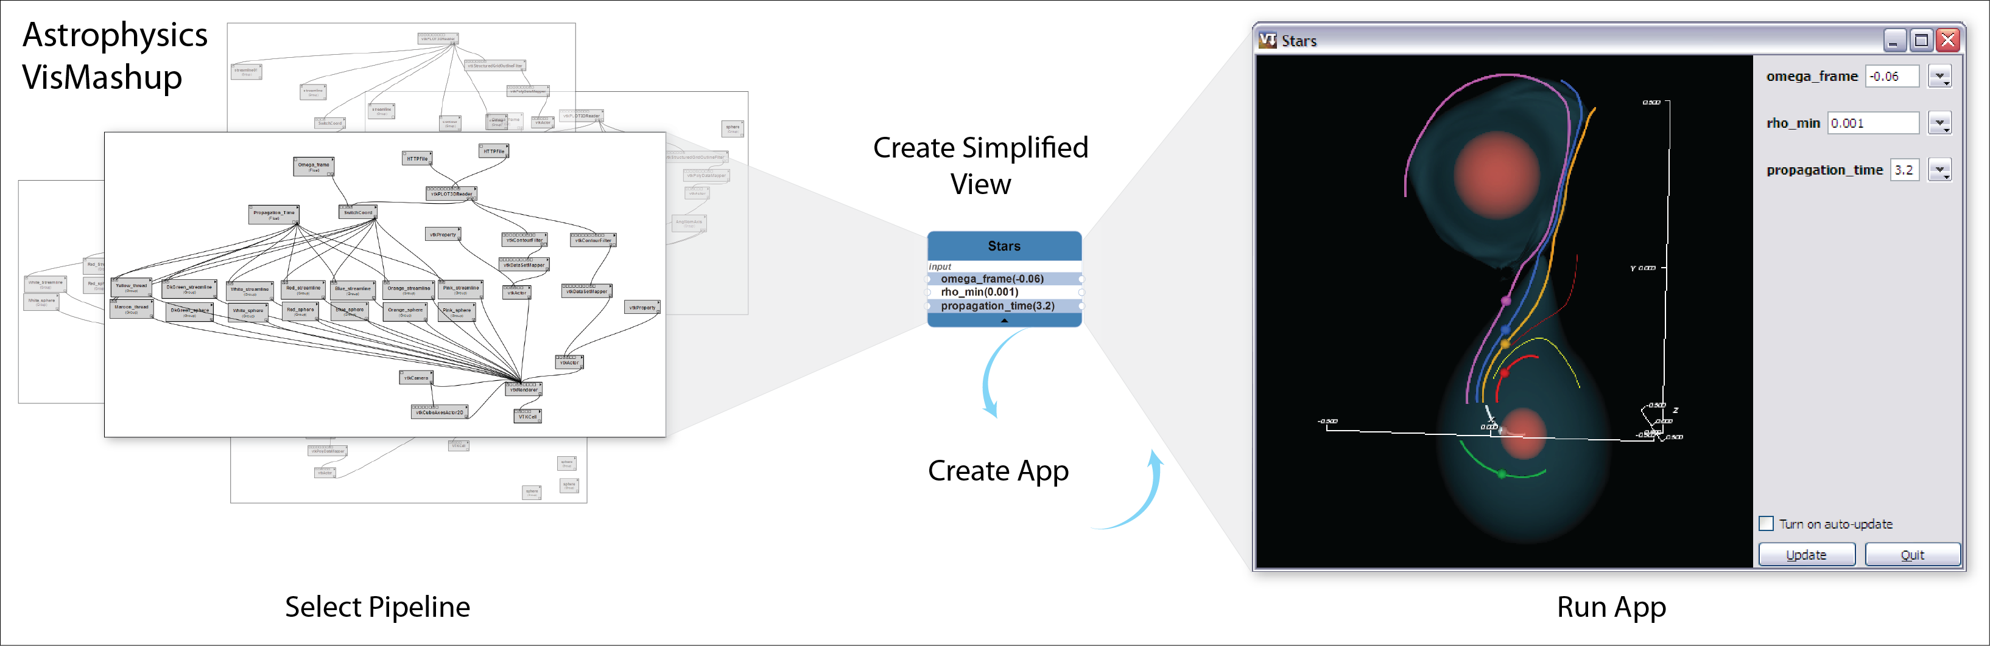
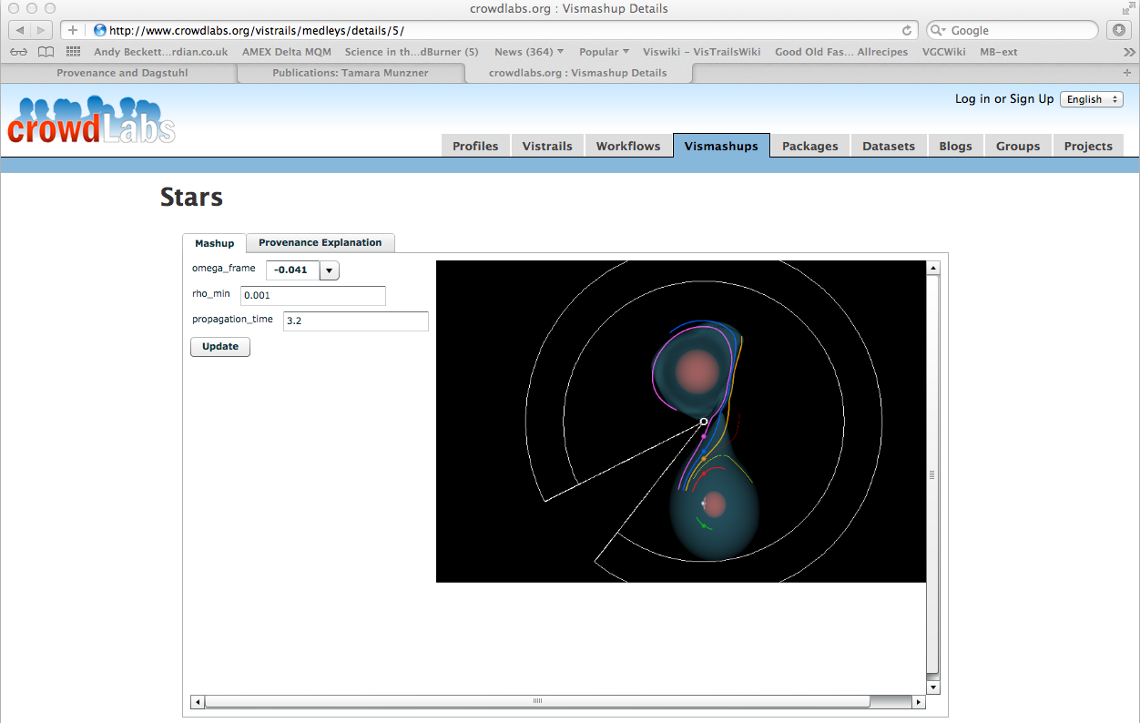
Workflow Mashups
[Santos@TVCG2009]

Slide 43
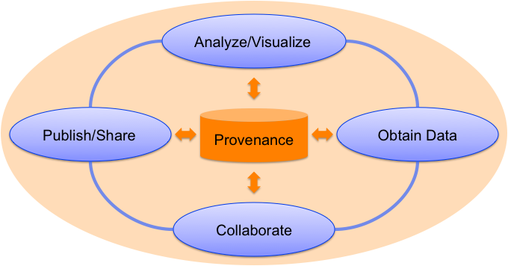
Vision: Provenance-Rich Science
Some tools cannot be wrapped and integrated with a workflow system…
All tools should capture and store provenance

Slide 44
Vision: Provenance-Rich Science
Some tools cannot be wrapped and integrated with a workflow system…
All tools should capture and store provenance
  GenePattern: reproducible computational genomics in Word documents [Jill Mesirov, Science 2010]
  Oracle Total Recall
  Non-linear history for GIMP [Chen et al., Siggraph 2011]
Simplify the addition of provenance to existing tools [Callahan et al., IPAW 2008]

Slide 45
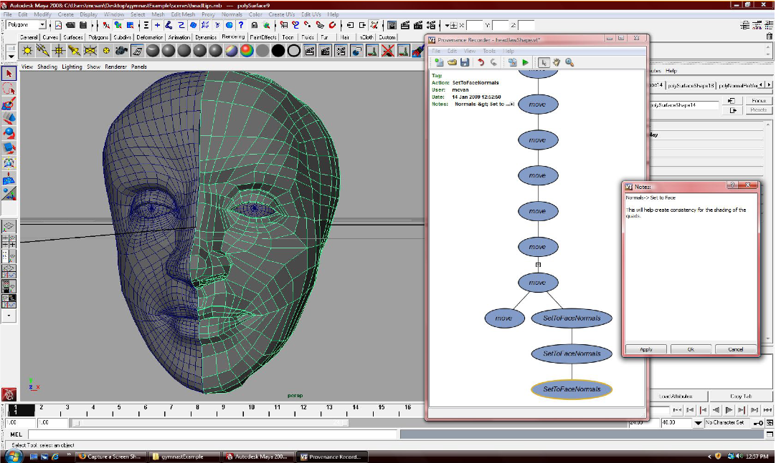
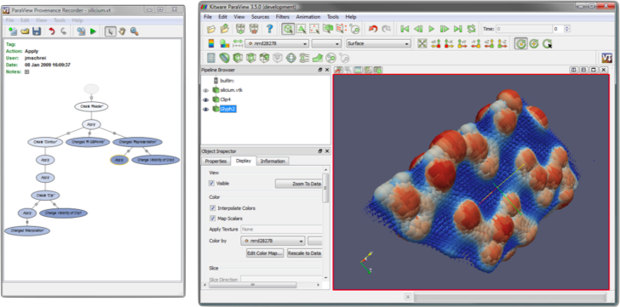
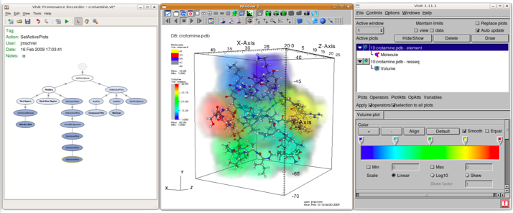
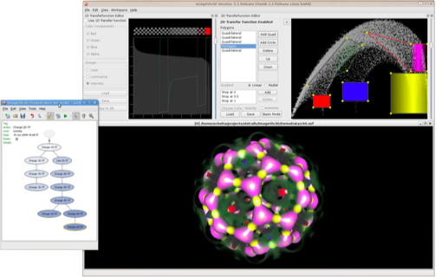
Provenance Enabling 3rd-Party Tools
Autodesk Maya
ParaView
VisIt
ImageVis3d
[Callahan et al., IPAW 2008]

Slide 46
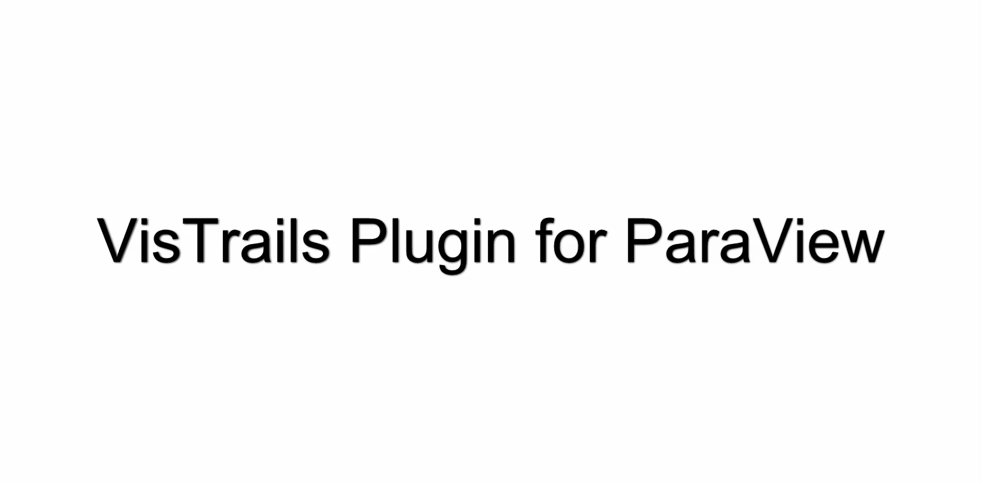
Provenance Plugin for ParaView

Slide 47
Vision: Provenance-Rich Science
All tools should capture and store provenance
  GenePattern: reproducible computational genomics in Word documents [Jill Mesirov, Science 2010]
  Oracle Total Recall
  Non-linear history for GIMP [Chen et al., Siggraph 2011]
Simplify the addition of provenance to existing tools [Callahan et al., IPAW 2008]
Provenance SDK in beta
  General provenance framework for interactive applications
Research challenge: integrate provenance from multiple tools
Research challenge: explore experiments published in shared repositories (more later…)

