Slide 1
Confronting Concept Drift by Refusing to Guess
Mustafa A. Kocak¹, Jing Leng, Elza Erkip¹ Dennis Shasha^{2,3}
¹NYU Tandon SoE, ²Courant Institute ³ 7Chord

Slide 2
Motivation
Making a bad decision can be costly
  an unnecessary medical operation,
  a bad trade in finance.
Most of medicine is i.i.d. (independent identically distributed). One patient has same causal factors as other.
Finance is not, causal factors can change: concept drift.

Slide 3
Concept Drift in Several Domains
Recommender systems must change over time, e.g. if I go to a movie recommendation system, it should not recommend Casablanca if I’m looking for a recent release.
Epidemic spreads can change as the epidemic evolves.
Financial decisions can be independent of politics often, but what about around election time?

Slide 4
Tools at Our Disposal
(i) Machine learning methods that adapt over time.
(ii) Multi-armed bandit style algorithms that can weight different algorithms.
(iii) SafePredict to refuse to predict sometimes.
(iv) Experiments

Slide 5
Neural Nets – adaptive by design
Neural nets use an updating algorithm called gradient descent: each prediction is compared with the correct answer and weights are adjusted if there are errors.
Thus feedback is continuous.
So, neural nets are adaptive to concept drift by design.
However…. Not always the most accurate choice.

Slide 6
Random Forests – can be made adaptive
A random forest is a collection of decision trees (or if we want a continuous outcome, classification and regression trees), each on randomly chosen subset of data features.
Normally (for i.i.d. data), train once and use forever.
Adaptation strategy idea: If a tree is often wrong, rebuild it based on recent data.

Slide 7
Tools at Our Disposal
(i) Machine learning methods that adapt over time.
(ii) Multi-armed bandit style algorithms that can weight different algorithms.
(iii) SafePredict to refuse to predict sometimes.
(iv) Experiments

Slide 8
Adjusting Weights Among Machine Learning Algorithms
Suppose you have several machine learning algorithms, e.g. different neural nets, several random forests, others.
Evaluate predictions of each machine learning method.
Adaptation strategy (bandit idea): If one method does better than others, then give it more weight.
Similar to adaptive random forests except that one adjusts weights given to algorithms rather than changing the algorithms themselves.

Slide 9
Tools at Our Disposal
(i) Machine learning methods that adapt over time.
(ii) Multi-armed bandit style algorithms that can weight different algorithms.
(iii) SafePredict to refuse to predict sometimes.
(iv) Experiments

Slide 10
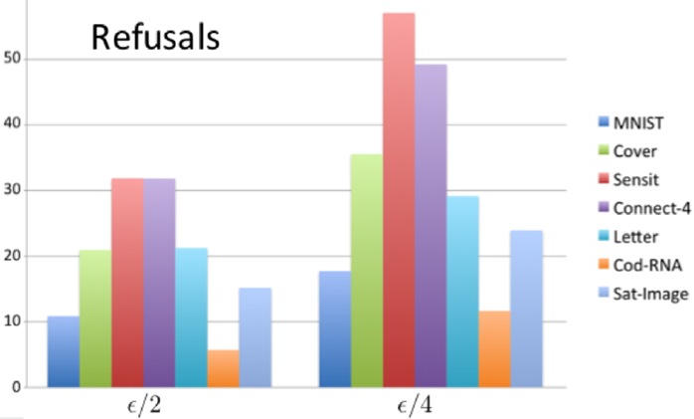
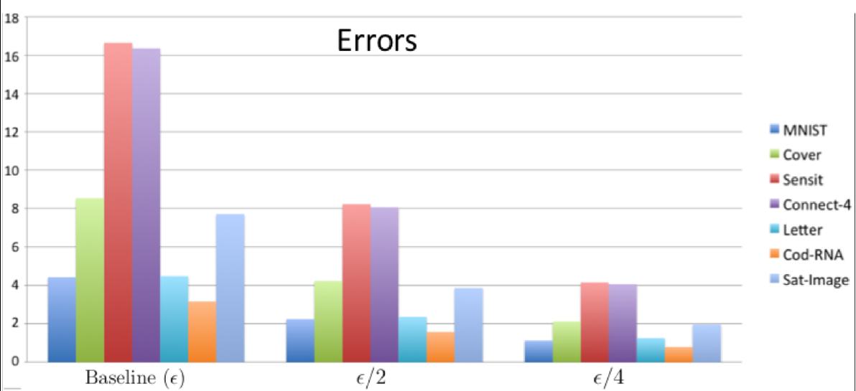
Accuracy refusal tradeoff
Can cut the error rate for iid
(independent identically distributed)
in half by refusing 6 -32% of the time.
to a quarter by refusing 12-57% of the time.

Slide 11
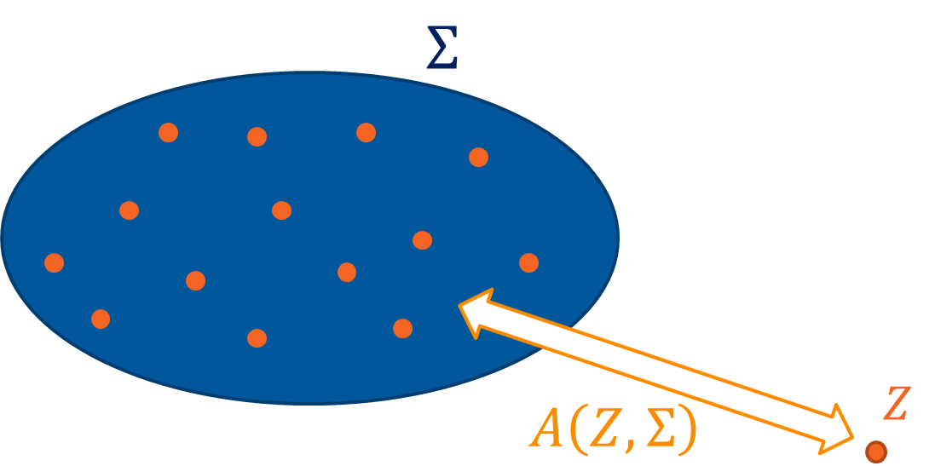
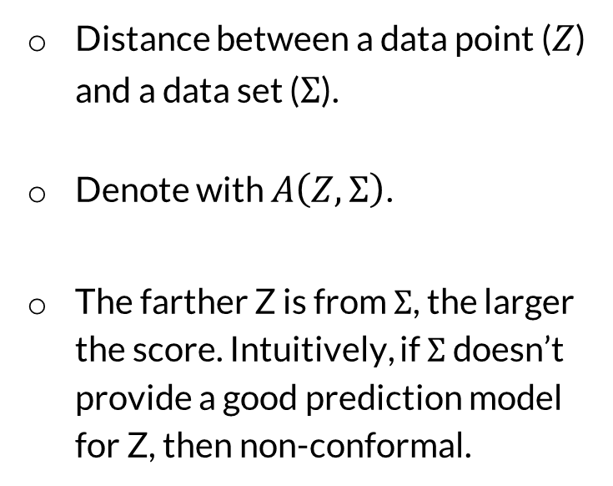
Non-conformity Score of Data Point to a Set
Distance between a data point ($Z$) and a data set ($Σ$).
Denote with $A\left(Z,Σ\right)$.
The farther Z is from $Σ$, the larger the score. Intuitively, if $Σ$ doesn’t provide a good prediction model for Z, then non-conformal.

Slide 12

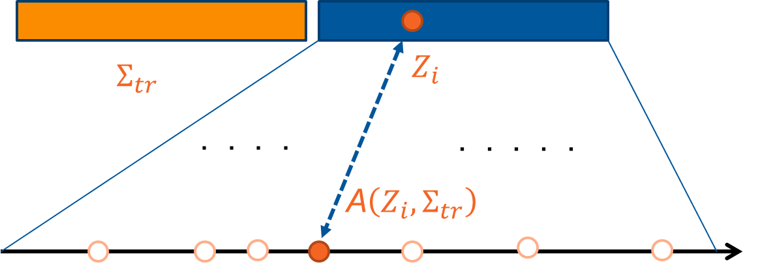
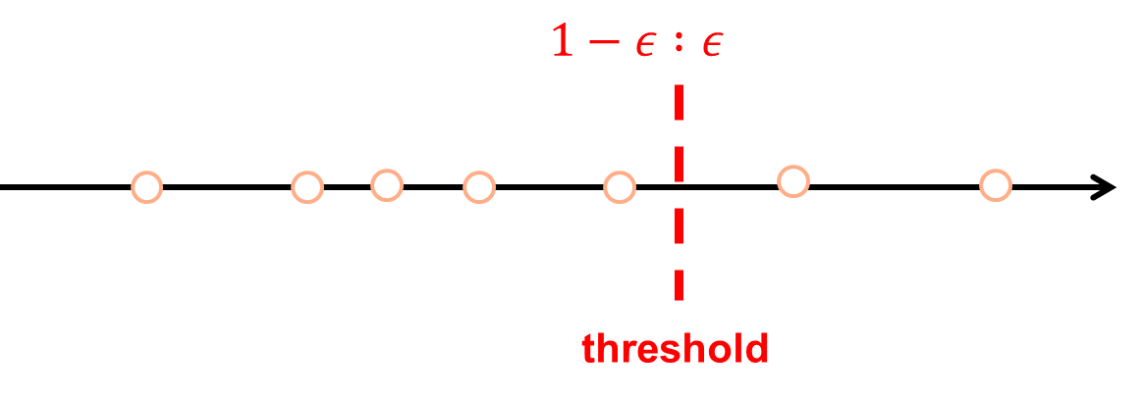
Conformal Prediction – Train & Calibration
Split training set into core and calibration sets.
In calibration set, find fraction of trees that must agree to make prediction that exceeds correctness target (e.g. 90%).
If a given data point gets insufficient votes, refuse.
Conforming Non-conforming

Slide 13
What if not Independent Identically Distributed (iid)?
Idea is to look at the non-refused output of conformal prediction.
If that has high error rate, then refuse even more.
Issue: get into a regime in which you are always refusing.
Resolution: (i) “weight-shifting” make guesses on occasion even if things are looking bleak. (ii) Re-calibrate conformal prediction.

Slide 14
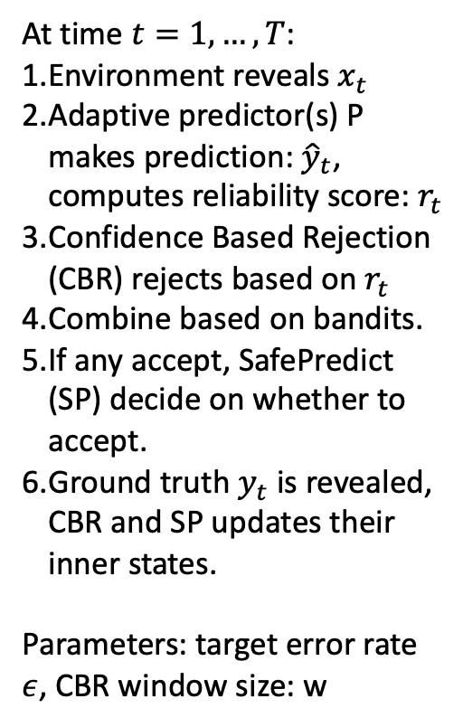
Algorithm
At time $t=1,…, T$:
Environment reveals $x_{t}$
Adaptive predictor(s) P makes prediction: ${\hat{y}}_{t}$, computes reliability score: $r_{t}$
Confidence Based Rejection (CBR) rejects based on $r_{t}$
Combine based on bandits.
If any accept, SafePredict (SP) decide on whether to accept.
Ground truth $y_{t}$ is revealed, CBR and SP updates their inner states.
Parameters: target error rate $ε$, CBR window size: w
Notes:
Problems:
Font in model graph is too small.
Bar graph too small font. Lacking x-axis name.
Bar graph no explanation: error rate and efficiency? Explain model names (arf, hat). Change sp to sf.
Include only one dataset (wireless): include plot of error rate.
Stashed text: dataset 2: Input variables are prices and demands in New South Whales and Victoria, and the amount of power transferred between the states.
The class label identifies the change of the transfer price relative to a moving average of the last 24 hours (increase or decrease).

Slide 15
SafePredict Implementation (Shantanu Jain)
SafePredict is implemented as a meta-estimator in the popular Python framework scikit-learn.
It works out-of-the-box with the same familiar scikit-learn API with methods like .fit(), .partial_fit(), .predict() and can be directly integrated into existing analysis pipelines.
The implementation acts like a wrapper around scikit-learn estimators, just adding the possibility to refuse predictions.

Slide 16
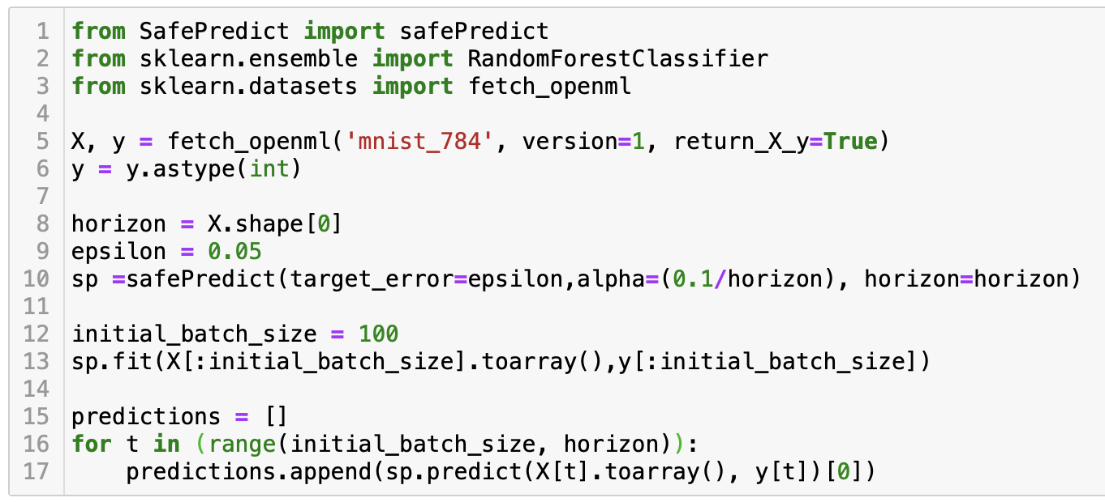
Notes:
Problems:
Font in model graph is too small.
Bar graph too small font. Lacking x-axis name.
Bar graph no explanation: error rate and efficiency? Explain model names (arf, hat). Change sp to sf.
Include only one dataset (wireless): include plot of error rate.
Stashed text: dataset 2: Input variables are prices and demands in New South Whales and Victoria, and the amount of power transferred between the states.
The class label identifies the change of the transfer price relative to a moving average of the last 24 hours (increase or decrease).

Slide 17
SafePredict Parameters
Target error: Required upper bound on error rate.
Horizon: Total number of data points to be predicted
Alpha: Strict lower bound on probability that SafePredict accepts a prediction. (Validity of SafePredict is probabilistically guaranteed when alpha is on the order of 1/Horizon)
Beta: Strict upper bound on probability that SafePredict accepts a prediction
Refusal class: The required output indicating that a prediction is refused
Calibration: Addition of calibration method (Platt/Isotonic) for confidence-based refusals in addition to SafePredict

Slide 18
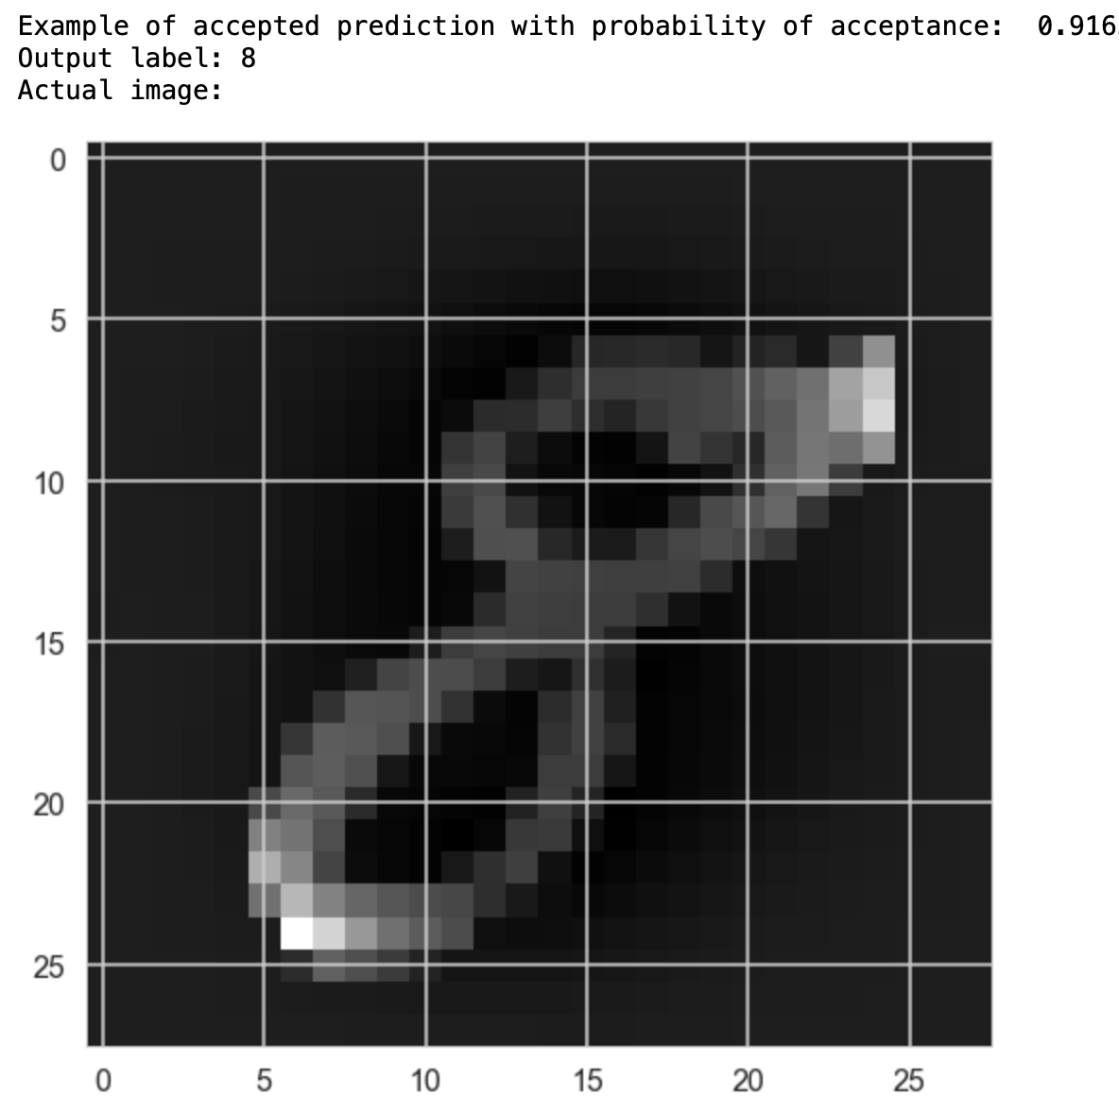
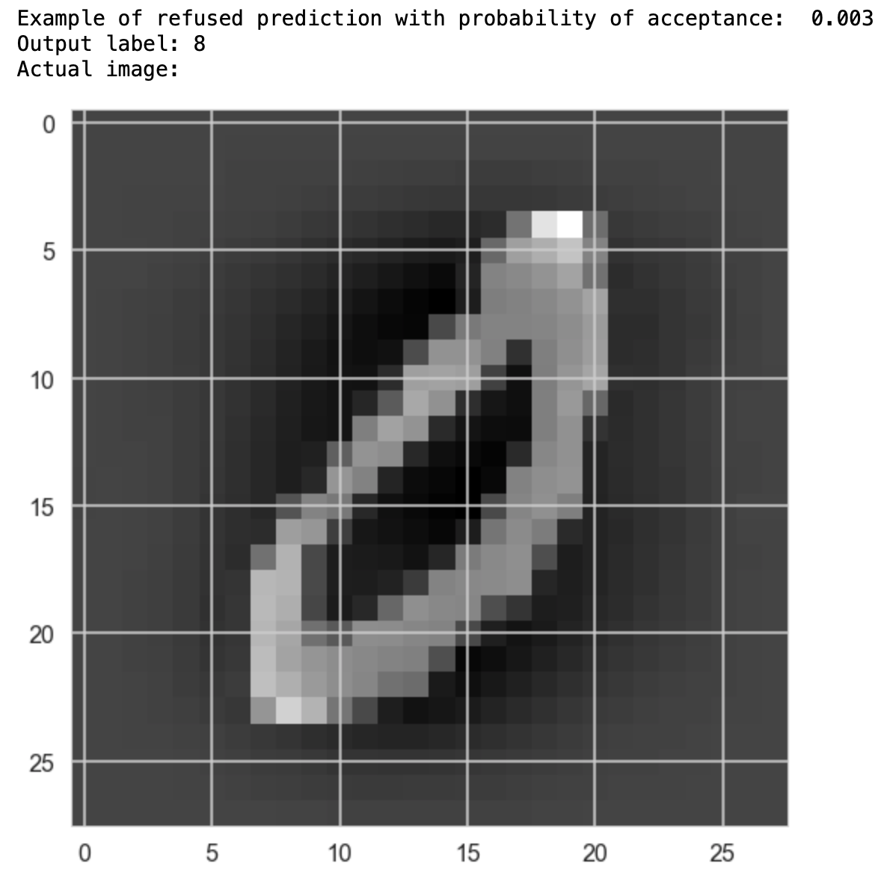
Letter Recognition Example (MNIST)

Slide 19
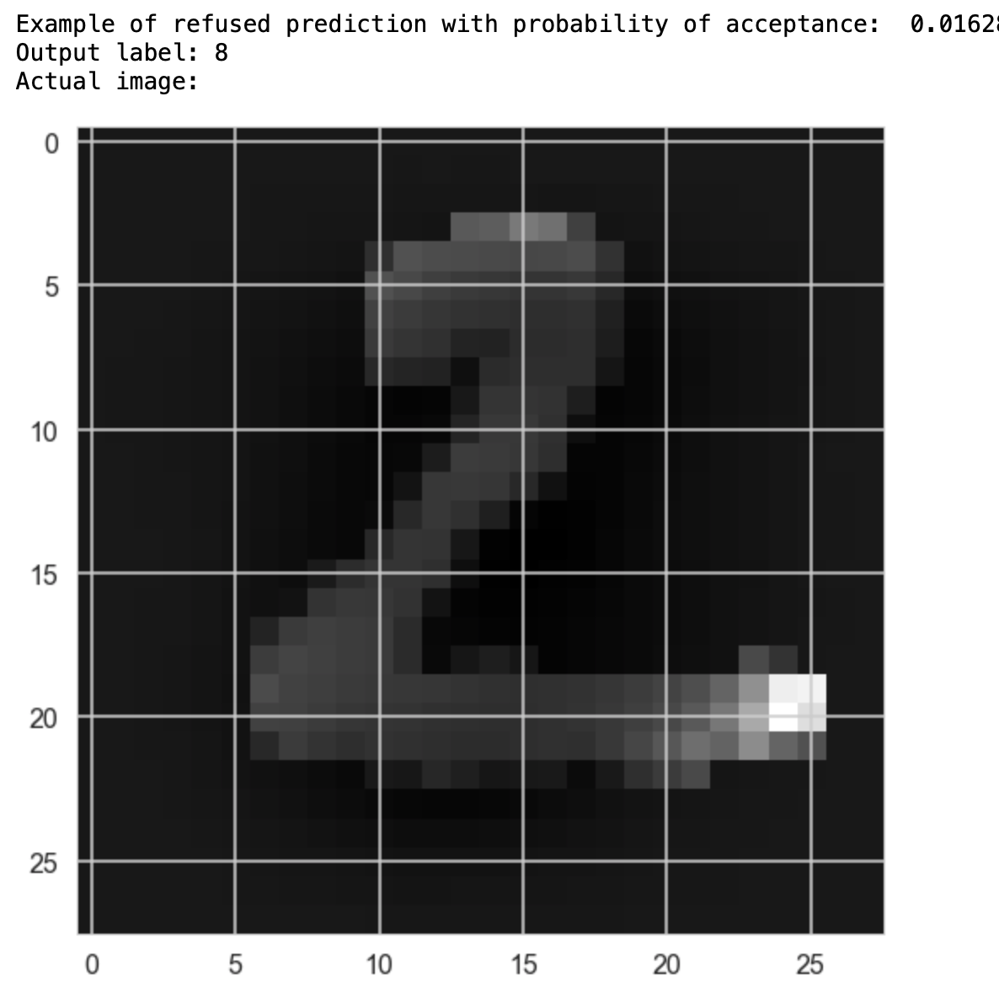
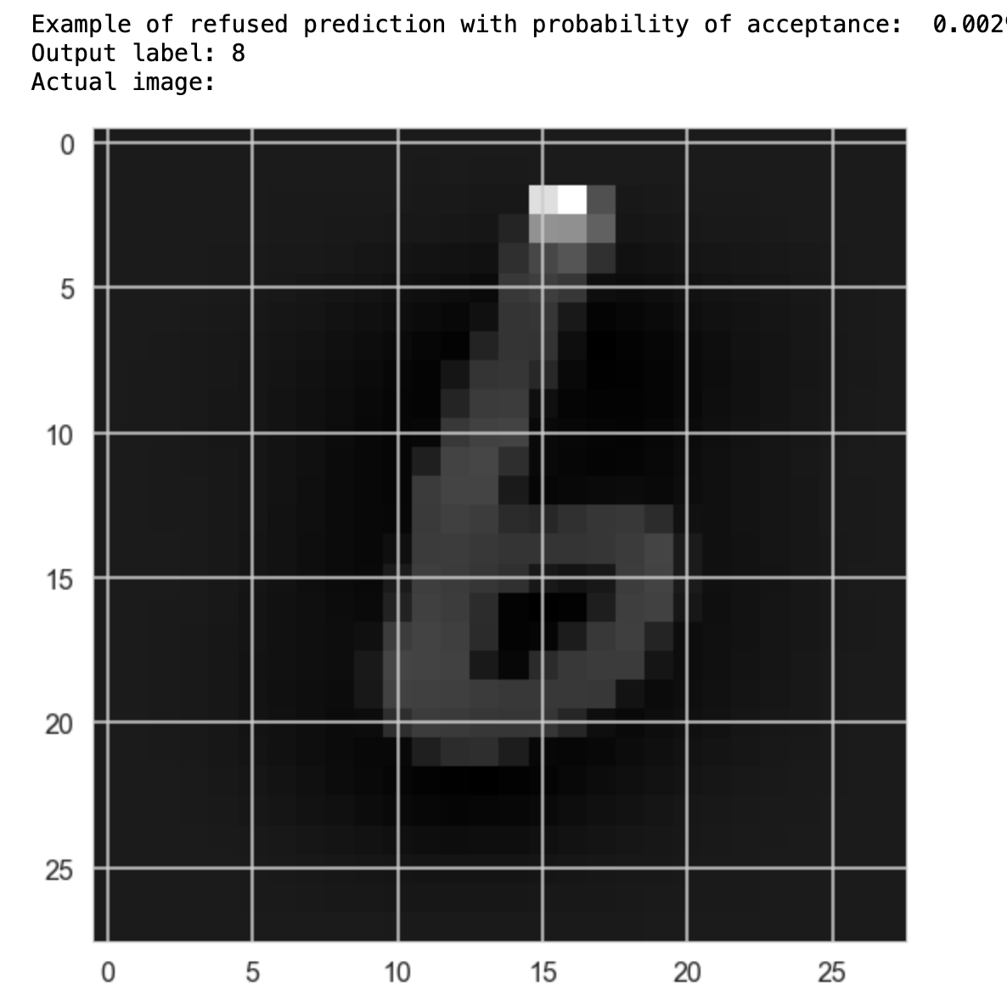
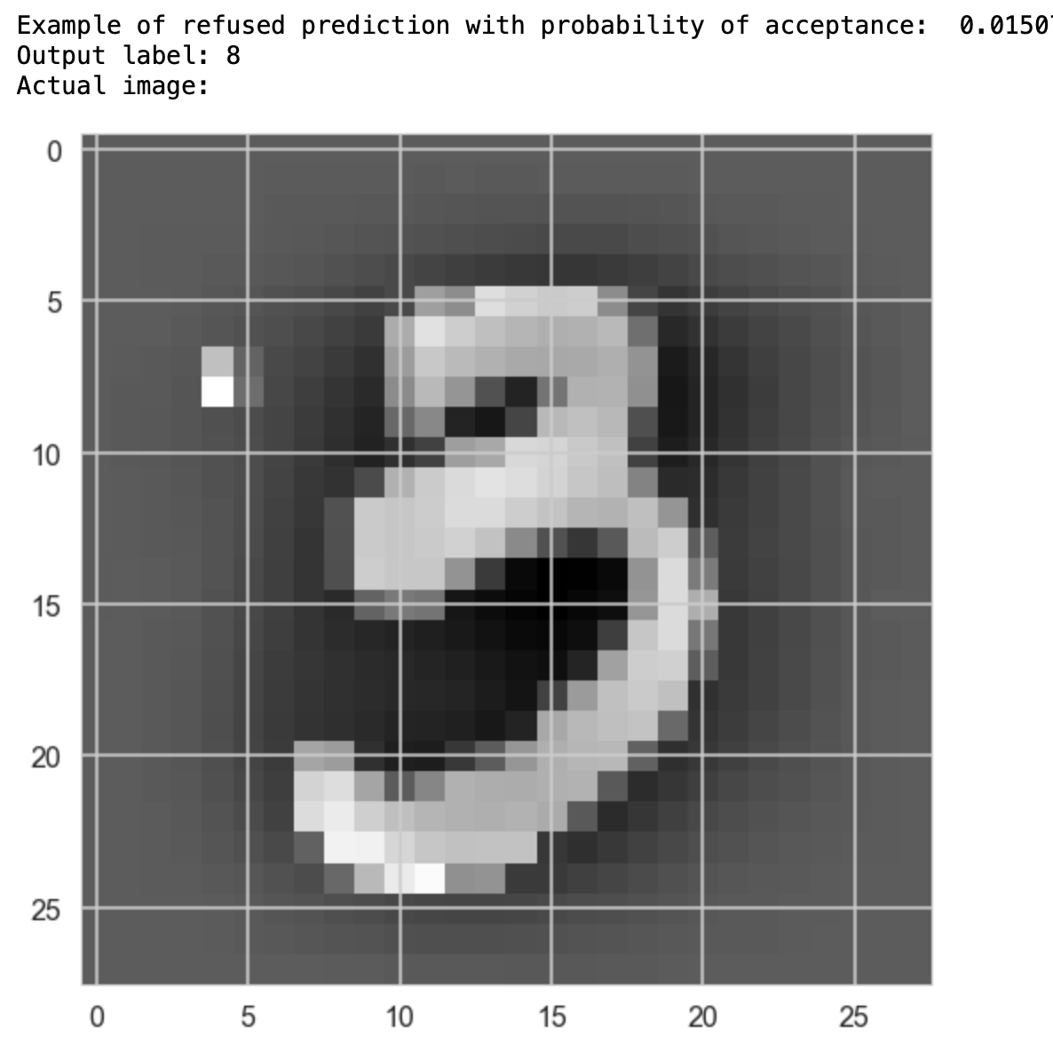
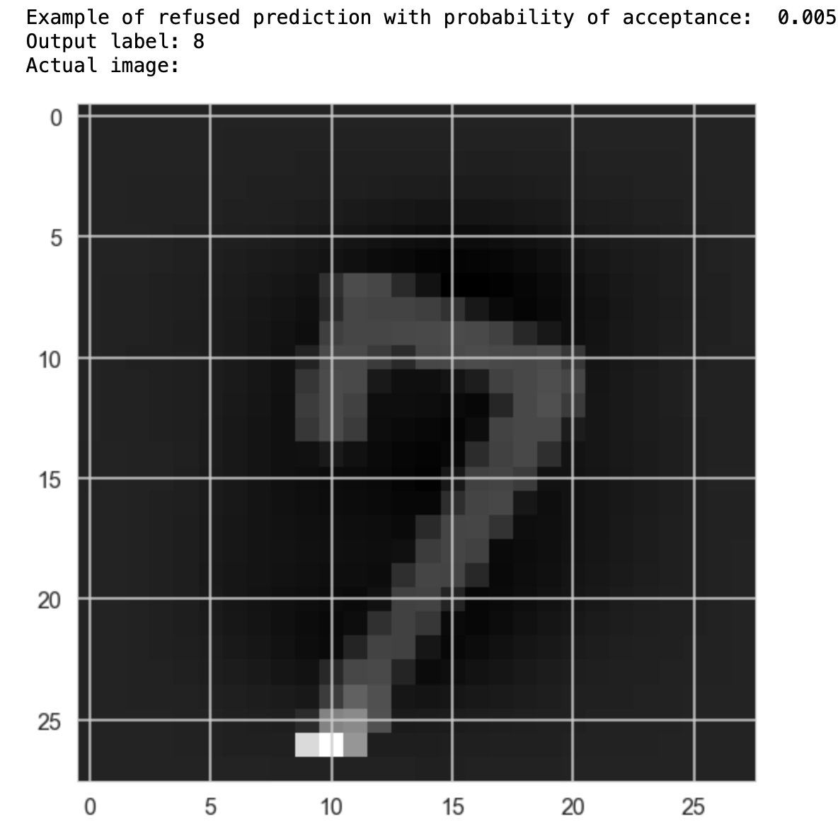
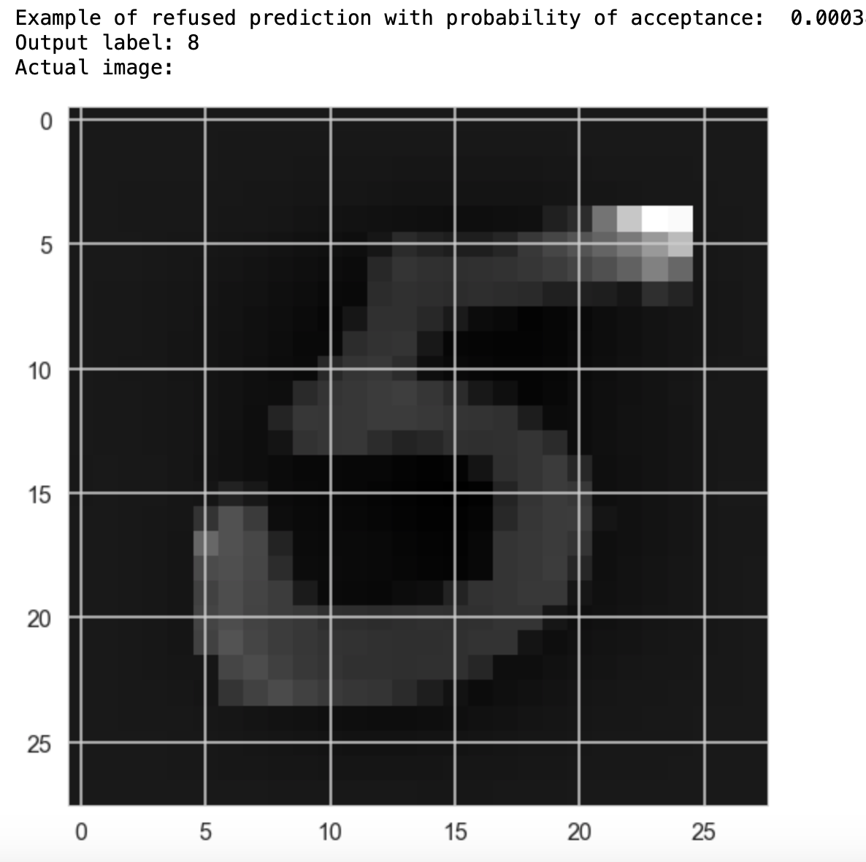
Letter Recognition Example (MNIST)
Refused predictions
Base output: 8
Acceptance probabilities: [0.0003,0.016]

Slide 20
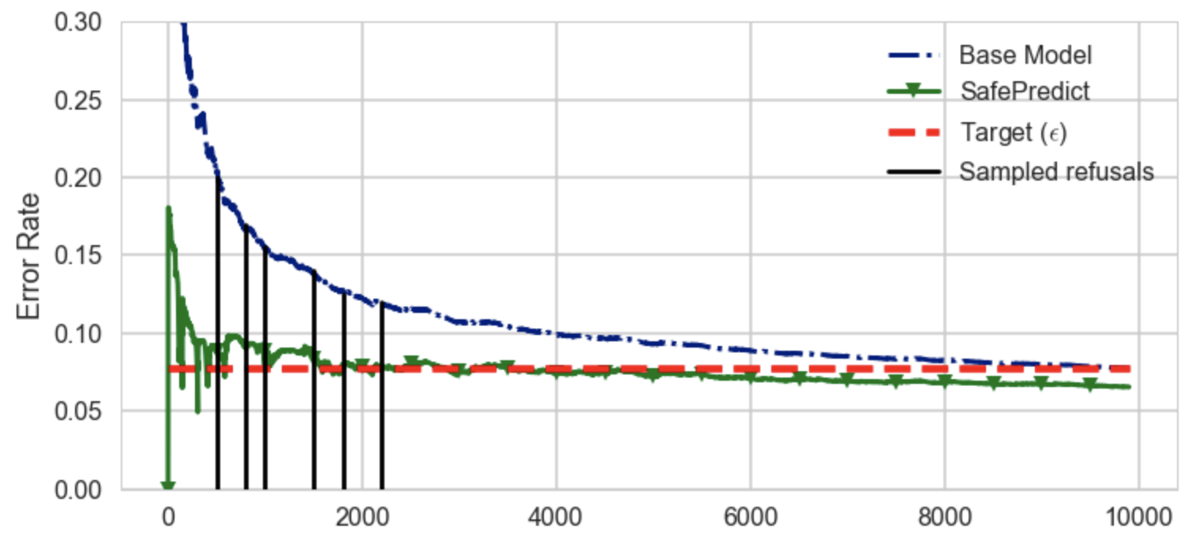
Letter Recognition Example (MNIST)
Predictions are refused based on past performance of base model
Vertical black lines are the samples that were refused in the previous slides due to excess base error rate

Slide 21
SafePredict Implementation
Github repo: https://github.com/ShanJ35/SafePredict
Medium Blog post with example: https://medium.com/@sj2538/safepredict-asymptotic-error-bounds-for-online-learning-c02da4e4b846

Slide 22
Tools at Our Disposal
(i) Machine learning methods that adapt over time.
(ii) Multi-armed bandit style algorithms that can weight different algorithms.
(iii) SafePredict to refuse to predict sometimes.
(iv) Experiments

Slide 23
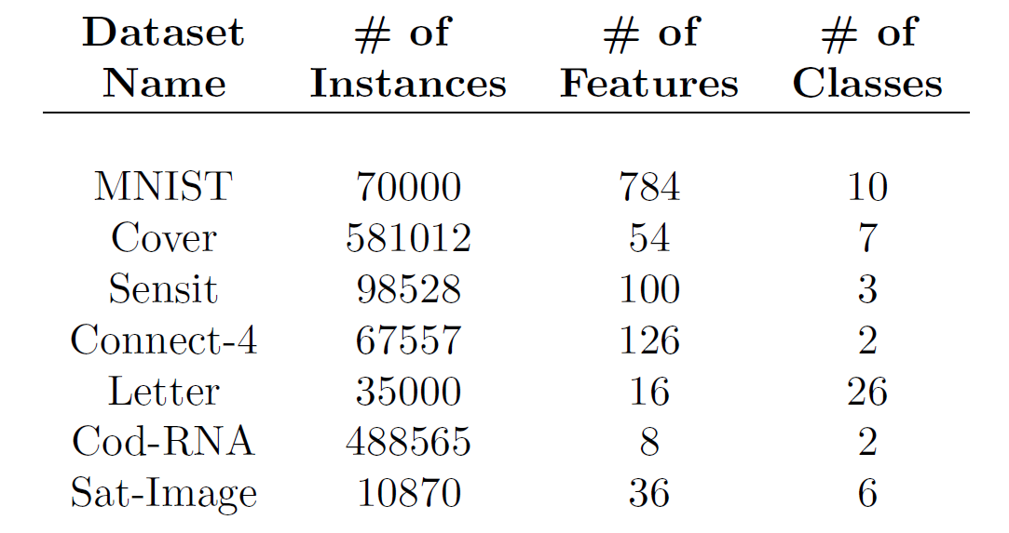
Datasets(independent identically distributed)
Public datasets from Machine Learning Data Set Repository (mldata.org)
MNIST (scanned handwritten digits),
Cover (dominant forest type based on images),
Sensit (vehicle types from WSN),
Connect-4 (outcome of a multiplayer game),
Letter (letter recognition from pixel displays),
Cod-RNA (coding/non-coding parts of RNA),
Sat-Image (soil type based on satellite images)

Slide 24
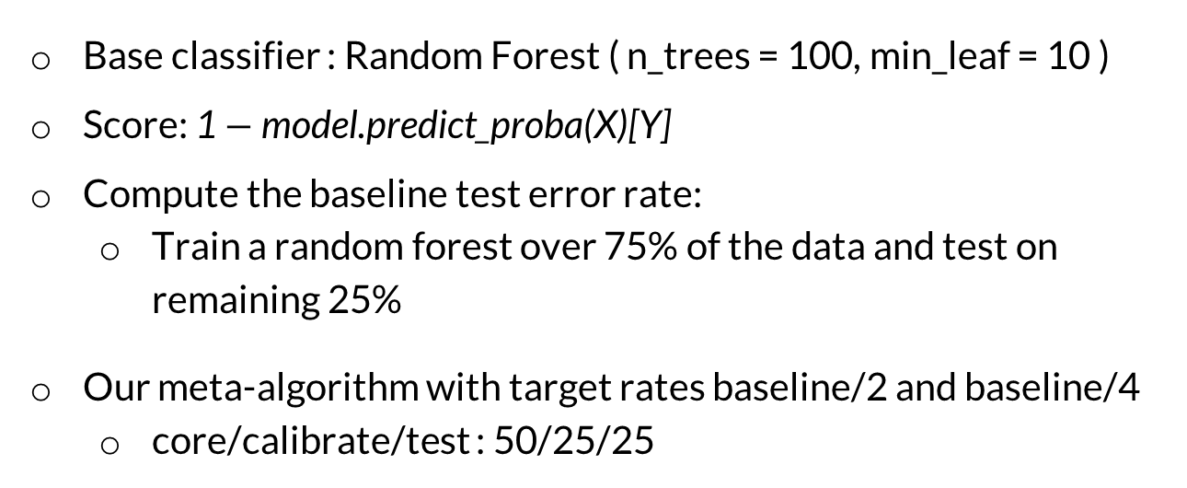
Experimental Setup
Base classifier : Random Forest ( n_trees = 100, min_leaf = 10 )
Score: 1 $−$model.predict_proba(X)[Y]
Compute the baseline test error rate:
  Train a random forest over 75% of the data and test on remaining 25%
Our meta-algorithm with target rates baseline/2 and baseline/4
  core/calibrate/test : 50/25/25

Slide 25
i.i.d. Results
Refusal rate increases as the target error rate decreases
baseline/2: 6-32%,
baseline/4: 12-58%

Slide 26

SafeForecast: Better Forecasting using Machine Learning and Rejection
Concept Drift Experiment
Tested on three base algorithms: adaptive random forest (ARF), Hoeffding adaptive tree (HAT) and neural network.
Evaluation: 1. Effective error rate: $\frac{{∑l}_{t}×a_{t}}{∑a_{t}}$
2. Efficiency: $\frac{∑a_{t}}{T}$
Description: a binary classification task to predict electricity price change (UP or DOWN) from the demand and supply of the market.
Fig 2. evaluation
Notes:
Problems:
Font in model graph is too small.
Bar graph too small font. Lacking x-axis name.
Bar graph no explanation: error rate and efficiency? Explain model names (arf, hat). Change sp to sf.
Include only one dataset (wireless): include plot of error rate.
Stashed text: dataset 2: Input variables are prices and demands in New South Whales and Victoria, and the amount of power transferred between the states.
The class label identifies the change of the transfer price relative to a moving average of the last 24 hours (increase or decrease).

Slide 27
Summary
Concept Drift is an issue in many fields (causal factors can change)
Machine learning algorithms can be made adaptive.
Multi-armed bandit to weight among them.
ConformalPrediction and SafePredict to refuse to predict judiciously.
A lot of work to do…

