Slide 1
Point Pattern Search in Big Data
SSDBM 2018
Fabio Porto (LNCC) ¹, João G. Rittmeyer (LNCC), Edurado Ogasawara (CEFET-RJ), Alberto Krone-Martins (Univ. Lisboa), Patrick Valduriez (INRIA), Dennis Shasha (NYU)
¹ fporto@lncc.br
CEFET/RJ

Slide 2
Agenda
The problem
The Point Pattern Search in Big Data Problem
The Pure Constellation
The isotropic Constellation
The non-isotropic Constellation
Implementation & Experiments
Related Work
Conclusion and Future Work

Slide 3
Three Versions of Our Problem (ignoring errors)
Point set Query
(a) Pure Constellation:
translation, rotation
(b) Isotropic Constellation:
translation, rotation,
scale
(c) Non-Isotropic Constellation:
translation,rotation,
scale, deformation

Slide 4
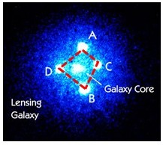
Introduction
Emotive source of our problem: constellations
Einstein cross (roughly square shape)
Viewed from an Earth telescope
Set of light sources around a galaxy
Variation on shapes depending on
Distances <quasar, galaxy, earth>
Angle <quasar, galaxy, Earth>
SDSS DR14
<pointid, ra, dec,photoz, u,g,r,i,z,
err_u, err_g,err_r, err_i, err_z>
Astronomy Datasets

Slide 5
Problem Context
Large Data sets, ex. billion of objects
Each object holds:
Spatial location : ex. (longitude, latitude)
Descriptive attributes: ex. color
A distance function: ex. Euclidean distances
A Query:
Geometry pattern as a set of localized points with constraints on descriptive point attributes

Slide 6
The Solution Approaches
Pure Constellation
Isotropic Constellation
Pattern Query
Non-Isotropic Constellation
Dataset

Slide 7
Pure Constellation
Given:
Geometry pattern Query Q:={q1,q2,...,qk}
Data set of points D:{p1,p2,..,pn}, where :
- n is huge (possibly billions)
- for all i,j , qi, pj are at a certain location
and have a set of attributes
Solution:
Find all sets s={s1,s2,..,sk} s.t.
dist(qi,qj) – ε ≤ dist (si,sj) ≤ dist(qi,qj) + ε /* Distance Match */

Slide 8
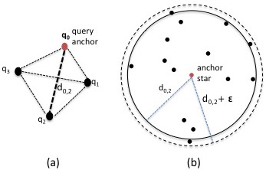
Pure Constellation
Pure Constellation algorithm:
Considers one of the query objects to be na anchor
Efficiently compute neighbors agreeing in the distance match
Apply a k-1 spatial join
Post-process for attribute constraints

Slide 9
Pure Constellation approach
Target 1 : reduce computation time
Parallelize the computation
Partition the data using equipdepth histograms
Balanced data partitions
Index individual partitions using a quadtree (or octree)
Fast computation of neighbors up to a maximum distance
Use the mesoids on the quadtree leafnode as representatives of objects in that node

Slide 10
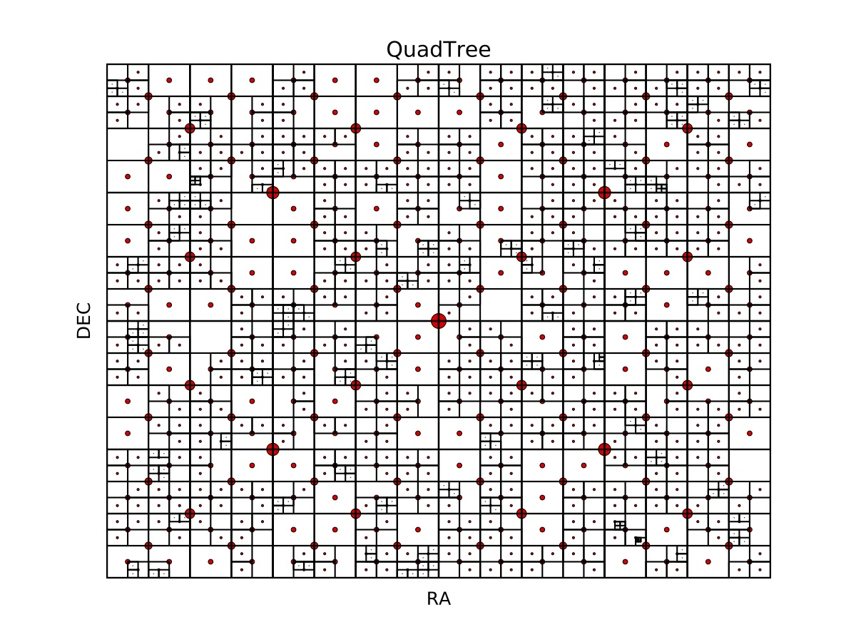
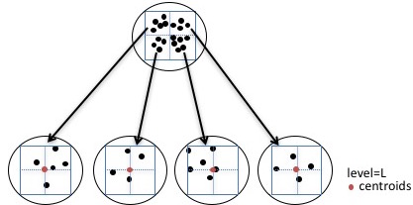
Find Neighbors Efficiently
d2
d1

Slide 11
The Solution Approaches
Pure Constellation
Isotropic Constellation
Pattern Query
Non-Isotropic Constellation
Dataset

Slide 12
Isotropic Constellation
We look for shapes that match a query pattern allowing:
Rotation, Translation, and linear scaling
Lets consider a scaling fact f $∈ℝ$;
Find all sets s={s1,s2,..,sk} s.t. for a given ε
(f x dist(qi,qj)) – ε ≤ dist (si,sj) ≤ (f xdist(qi,qj)) + ε /* Distance Match */

Slide 13
Isotropic Constellation
Candidate Solution s
Query Q
s3
p3
12
12
1
1
p1
p2
s1
s2
1
8
Suppose ε =2
If we take scalefactor f = 8
8 x dist(p1,p2) - 2 ≤ d(s1,s2) ≤ 8 x dist(p1,p2) + 2 = [6,10]
8 x dist(p1,p3) - 2 ≤ d(s1,s3) ≤ 8 x dist(p1,p3) + 2 = [6,10]
12
F. Porto et al.
Point Set Search in Big Data – SSDBM 2018

Slide 14
Isotropic Constellation
Candidate Solution s
Query Q
s3
p3
12
12
1
1
p1
p2
s1
s2
1
8
Suppose ε =2
Now, If we take scalefactor f = 10
10 x dist(p1,p2) - 2 ≤ d(s1,s2) ≤ 10 x dist(p1,p2) + 2 = [8,12]
10 x dist(p1,p3) - 2 ≤ d(s1,s2) ≤ 10 x dist(p1,p3) + 2 = [8,12]
12
F. Porto et al.
Point Set Search in Big Data – SSDBM 2018

Slide 15
Isotropic Constellation
Candidate Solution s
Query Q
s3
p3
12
12
1
1
p1
p2
s1
s2
1
8
The observation is that distances may vary up to 2*ε
A minimum additive error + a maximum additive error
scalebasic x dist(p1,p2) – 2* ε ≤ d(s1,s2) ≤ scalebasic x dist(p1,p2) + 2 *
8 x dist(p1,p3) - 4 ≤ d(s1,s3) ≤ 8 x dist(p1,p3) + 4 = [4,12]
12

Slide 16
Isotropic Constellation
We conceive a procedure to evaluate isotropic matching in the possible existence of an infinite number of scale factors
Checking for false positives:
The solution must offer a factor that satisfies all distance matches
f*d(p1,p2) - ε
f*d(p1,p2) + ε
Any f
Would do
f*d(p1,p3) - ε
f*d(p1,p3) + ε
f*d(p2,p3) - ε
f*d(p2,p3) + ε

Slide 17
Isotropic Constellation
To compute Isotropic Constallations
Use the same procedure as in Pure Constellation
Modify the distance match expression to support the scale fator computation
Add a post-processing step to test for a global satisfying factor
F. Porto et al.
Point Set Search in Big Data – SSDBM 2018

Slide 18
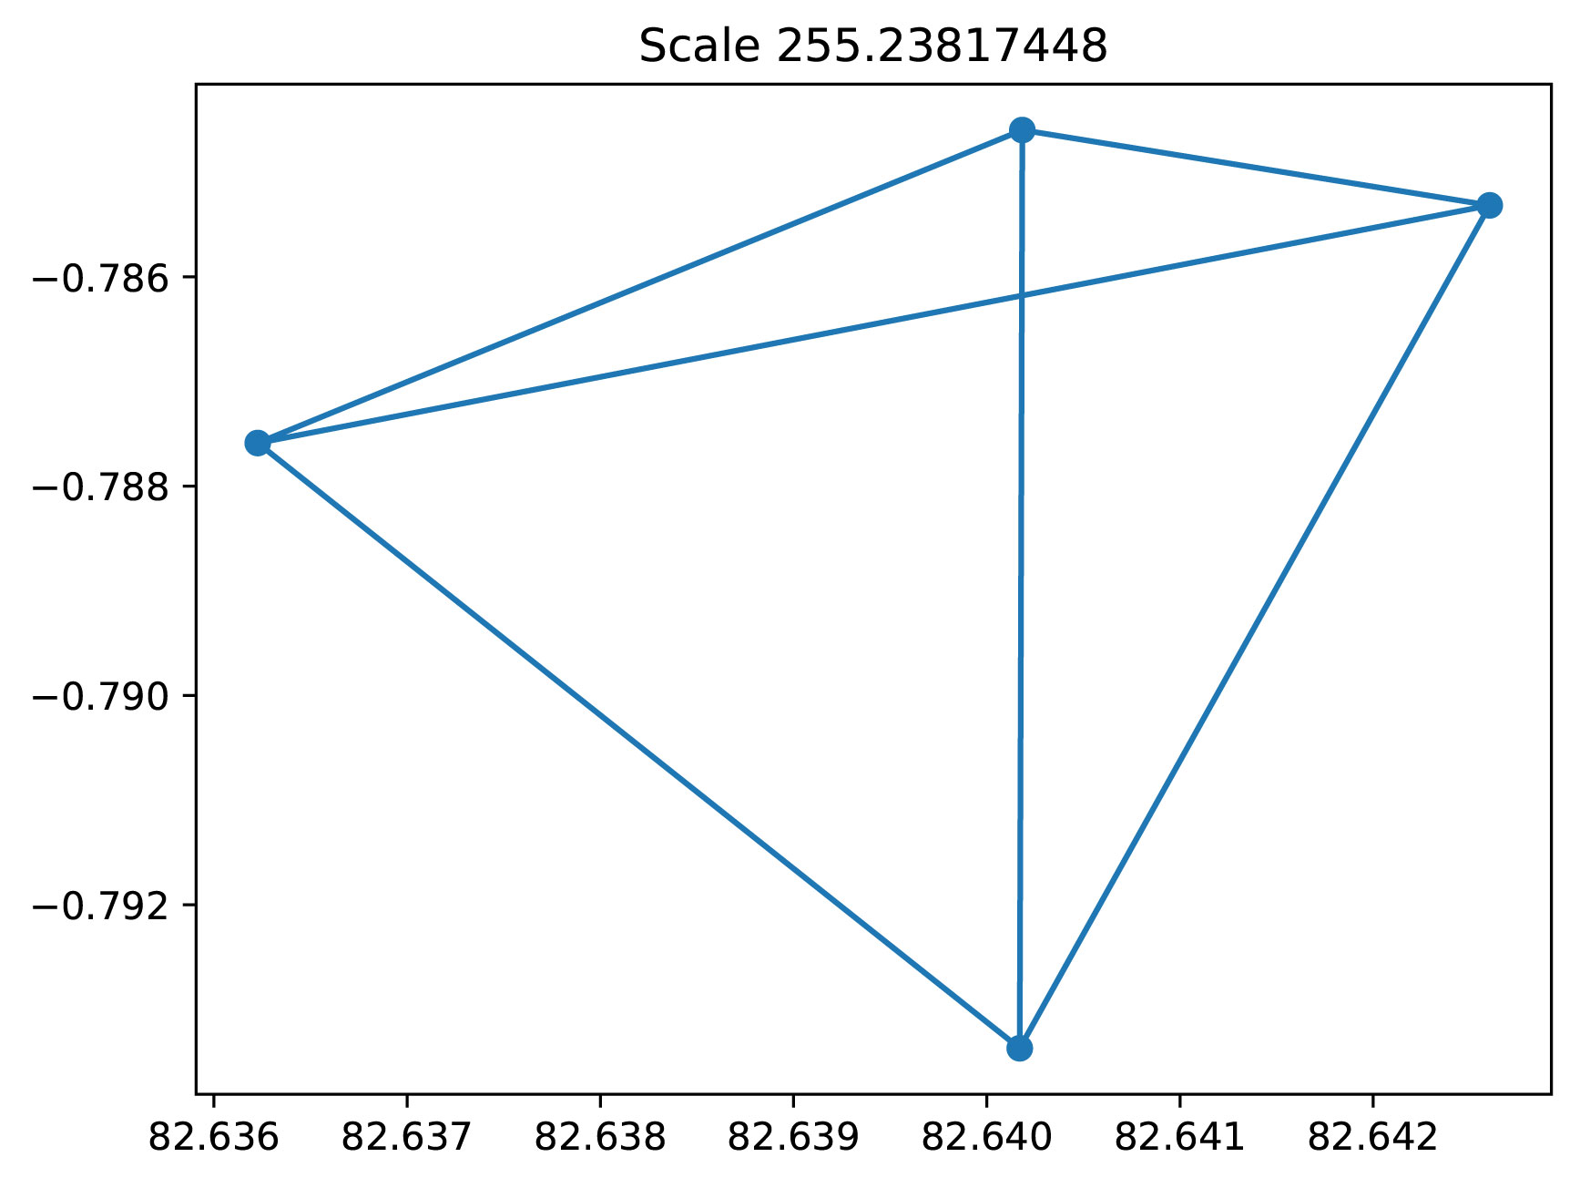
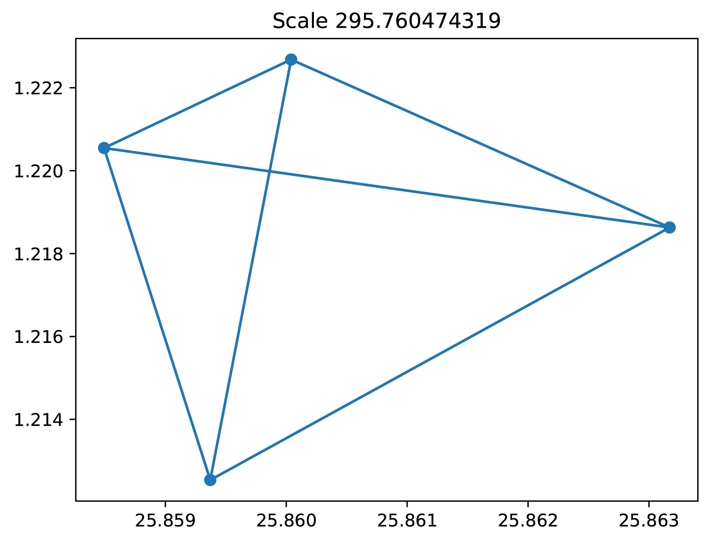
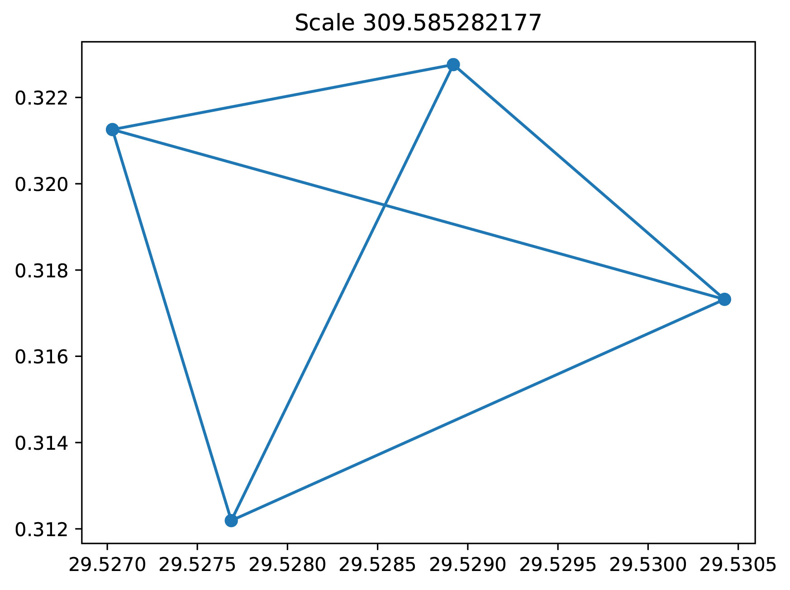
Isotropic Constellation solution examples

Slide 19
The Solution Approaches
Pure Constellation
Isotropic Constellation
Pattern Query
Non-Isotropic Constellation
Dataset

Slide 20
Non-Isotropic Constellation
Non-Isotropic Constellation allows: rotation, translation, linear scaling and deformation
We consider a known deformation matrix M in which each mi,j ≥ 1, so the distance match becomes:
(f x dist(qi,qj)) – ε ≤ dist (si,sj) ≤ (f x mi,j x dist(qi,qj)) + ε
We add the deformation fator to the post-processing step
Thus, the computation of non-isotropic constellation follows the adaptation of isotropic constellation, considering stretching factors in distance match and post-processing
F. Porto et al.
Point Set Search in Big Data – SSDBM 2018

Slide 21
Implementation & Experiments
We implemented the Constellation Queries approach as dataflow:
Spark - Python
We run CQ in the Petrus Big Data Cluster

Slide 22
General Spark Dataflow

Slide 23
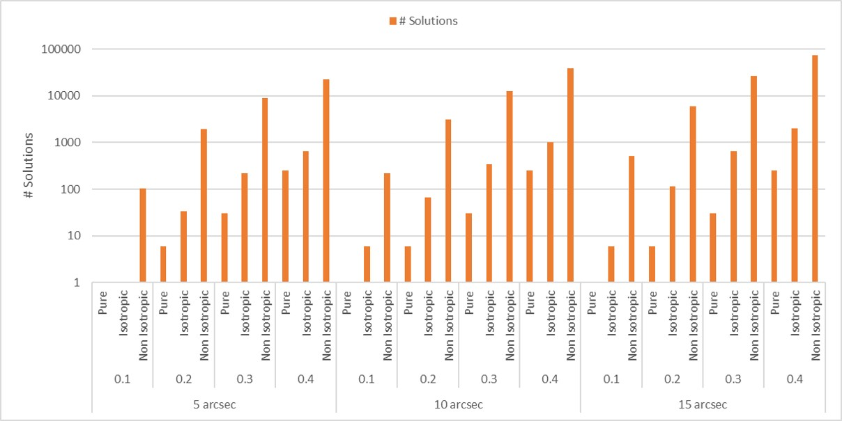
# Solutions by Query Type

Slide 24
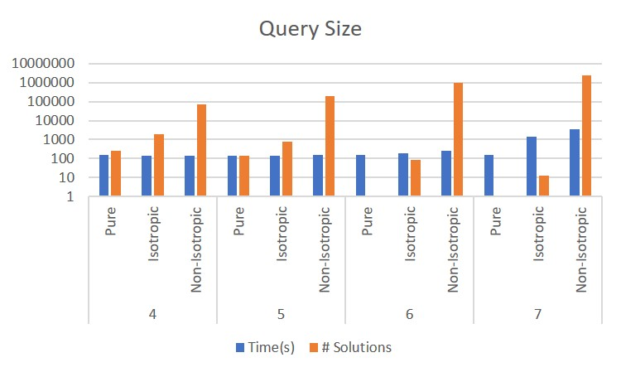
Effect of Query Size

Slide 25
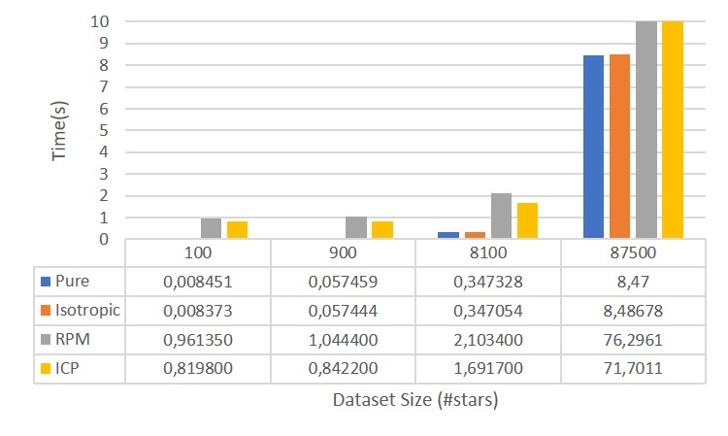
Comparison with Point Set Registration algorithms

Slide 26
Related Work
Package Queries
uses integer linear programming to express constraints on “packages” of tuples in a dataset;
requires a “self” join on the size of the query over large astronomy dataset
Point Set Registration algorithms
Iteractive closest point (ICP)
4PCS is a good candidate for future work
Series of algorithms on graph matching
Spatial Indexing: Metric Indexes
Index distances from a anchor element

Slide 27
Final Comments
Constellation Queries is an interesting Big Data Problem
We will now run our algorithms from models produced by the Lisbon group
Want to extend our approach for generic shapes

Slide 28
Point Pattern Search in Big Data
SSDBM 2018
Fabio Porto (LNCC) ¹, João G. Rittmeyer (LNCC), Edurado Ogasawara (CEFET-RJ), Alberto Krone-Martins (Univ. Lisboa), Patrick Valduriez (INRIA), Dennis Shasha (NYU)
¹ fporto@lncc.br
CEFET/RJ

Slide 29
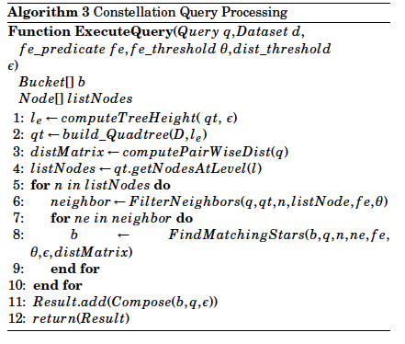
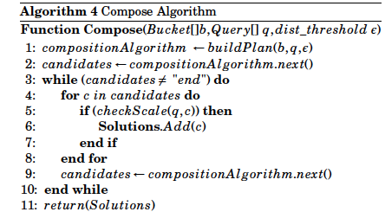
Algorithms Overview

Slide 30
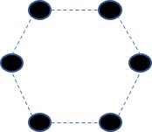
Introduction
Geometric Pattern
Can we find this shape
within a dataset of
points in space?
Set of points S= {p1, p2,.., pn}
each point pi localized <x,y>

Slide 31
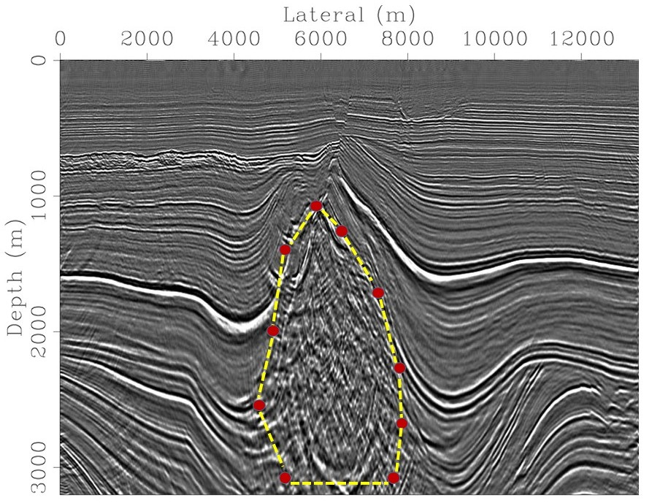
Introduction
Where does this problem appear ?
n data slices
Each slice is a regular matrix
<Sliceid, horizontal position, vertical, value>
Seismic Datasets
Seismic feature defined by its shape

Slide 32
Compute Distance Matches and Spatial Join
Target 2: Find Distance matches and Evaluate attribute constraint
For each mesoid
Look at quadtree for neighbors at max-distance
For each object oi at mesoid node
For each distance
Test for distance-match (oi, neighbor)
Apply k-1 spatial join to form solutions
---
d1
d2
dk-1

