Slide 1
Graph Motifs: query and discover
Dennis Shasha
Joint work with
Misael Mongiovi, Giovanni Micale, Alfredo Ferro, Rosalba Giugno, and Alfredo Pulvirenti

Slide 2
Graph Querying

Slide 3
Definition
Graph Isomorphism
Two graphs G = (V,E) and G₁ = (V _{1,}E₁) are
isomorphic if there exists a bijection f : V V ₁ such that (u,v) ∈ E if and only if (f(u), f(v)) ∈ E₁.
In other words, we can relabel the vertices of G to be vertices of G₁, maintaining the corresponding edges in G and G₁.

Slide 4
Graph matching

Slide 5
Definition
Subgraph Isomorphism, Subgraph Matching. A graph G = (V,E) is subgraph isomorphic to
G₁= (V ₁ ,E₁) if there exists a injective f : V V ₁ such that (u, v) ∈ E only if (f(u),f(v)) ∈ E₁. In other words, we can relabel the vertices of G to be vertices of G₁, maintaining the corresponding edges in G.

Slide 6
Subgraph Matching
D
E
B
C
B
C
A
A

Slide 7
Complexity of
Graph Matching Algorithms
Matching graph of the same size:
  Difficulty, time consuming, but it is not proved to be NP-Complete
Matching a small graph in a big graph
  NP-Complete

Slide 8
Subgraph isomorphism
NP-completeness of problem means that worst-case match times are exponential in number of nodes involved
but average-case match times can be better than this
much effort has been expended on this problem over the past 40+ years

Slide 9
Speeding up subgraph isomorphism
use a faster computer
use tricks to avoid exploring potential solutions that are bound to fail
do most of the work in a pre-processing of the database structures, independently of the query

Slide 10
Backtracking
modification of the brute-force approach
abandons partial solutions part-way through when it can be seen they are bound to fail
worst-case is still exponential in number of nodes, but doesn’t arise very often
  first map an arbitrary pair of nodes
  then map neighbours of these nodes
  if successful, map neighbours of each neighbour, etc.
  if not, backtrack one step, and try a different mapping

Slide 11
Backtracking
algorithm will terminate
  when all query nodes are mapped [MATCH]
  when all alternative mappings for first query node have been tried, and have failed [NO MATCH]

Slide 12
Partitioning (used later)
often used as an adjunct to backtracking
start by partitioning the nodes into sets of possible correspondents
  e.g. nitrogens can only match nitrogens
  iteratively refine the partition on basis of other possible correspondences
    e.g. if F6 is only possible correspondent for Q1 then F6 cannot be a correspondent for Q2
  if the list of possible correspondents for a query node becomes empty, there is no isomorphism

Slide 13
Subgraph isomorphism algorithms
Ray and Kirsch’s algorithm (1957)
  basic backtracking
Sussenguth’s partitioning algorithm (1965)
  relaxation technique called “connectivity property”, with backtracking as fall-back
Figueras’s set reduction algorithm (1972)
Ullmann’s algorithm (1976)
  efficient relaxation and backtracking
von Scholley’s relaxation algorithm (1984)

Slide 14
VF - High Level Description
^{Does M(S) cover all nodes ?}
^{Terminate}
^{Yes}
^{No}
Compute the set P of possible pairs to be chosen next
S’ = New State (M + p)
FOREACH p∈ P
IF M + p is a feasible* set of mapping
^{No}
^{Yes}
* Feasibility means testing whether the mapping represents a partial solution.

Slide 15
Inexact matching Alg.
Define a distance function
The distance between G_{a} and G_{b} is the cost to transform G_{a} in G_{b .} (Isomorphism)
For subgraph isomorphism is the cost to transform G_{a} with a part of G_{b} .
Find all the matching of G_{a} with G_{b} such that d(G_{a} , G_{b}) < threshold

Slide 16
Example: Inexact Matching
A
C
1
7
A
6
5
2
3
B
A
A
G_{b}
G_{a}
A
C
1
7
A
6
5
2
3
B
G
A
G_{b}
G_{a}

Slide 17
GraphGrep
Glide: an interface to represent graphs
inspired by SMILES and XPATH
Fingerprinting: to filter the database
A subgraph matching algorithm
R. Giugno and D. Shasha Graphgrep: A fast and universal method for querying
graphs. Proceeding of the International Conference in Pattern recognition (ICPR),
2002.
D. Weininger, SMILES. Introduction and Encoding Rules, Journal Chemical Information in Computer Science,28-31,1998.
J. Clark and S. DeRose, Xml Path Language (Xpath), http://www.w3.org/TR/xpath, 1999

Slide 18
Glide:query graph language
Node a/
Edge a/b/
Path a/b/c/f/
Branches a/(h/c/)b/
a
a
b
a
b
c
f
a
b
h
c

Slide 19
Glide: query graph language
c
Cycle
c%1/ f/ i%1/
Cycles (c returns to a and starts its own cycle)
a%1/h/c%1%2/d/i%2/
f
i
a
c
d
i
h

Slide 20
Glide: wildcards
. a/./c/
* a/*/c
+ a/+/c/
c
a
a
c
a
c

Slide 21
Query Graphs in Glide
a%1/( ./*/ b/) ?/c/d%1/
a%1/(m/o/o/b/)n/c/ d%1/
a
c
d
b
n
a
c
m
o
d
o
b

Slide 22
Concept
Use small components of the query graph and of the database graphs to filter the database and to do the matching

Slide 23
Index: Sets of “Paths”
B
0
3
C
label_path = { id _paths}
lp = 4
A ={(1)}
AB={(1, 0), (1,2)}
AC ={(1, 3)}
ABC={(1,0,3), (1,2,3)}
ACB={(1, 3, 0), (1,3,2)}
ABCA={(1 ,0 ,3 ,1),(1, 2, 3, 1)}
ABCB ={(1 ,2,3 ,0),(1, 0, 3, 2)}
B ={(0),(2)}
BA={(0,1),(2,1)}
BC={(0,3), (2, 3)}
….…….
A
1
2
B
1
A
1
A
1
A
1
A
lp = 2
0
B
2
B
3
C
3
C
lp = 3
3
C
3
C
B
B
2
0
lp = 4
2
B
0
B
1
A
1
A

Slide 24
Subgraph Matching
A B C A
C B
1
C
B
0
3
C
B
0
2
3
A
1
2
B
A
B
Query
Graph g1
Select the set of paths in g1 matching
the patterns of the query
ABCA = {(1, 0, 3, 1),(1, 2, 3, 1)}
CB = {(3,0),(3,2)}
Combine any list from ABCA with any list of CB when labels correspond to identical nodes (possible exponential)
ABCACB = {((1, 0, 3, 1),(3, 0)),
((1, 0, 3, 1),(3, 2)),((1, 2, 3, 1),(3, 0)),
((1, 2, 3, 1),(3, 2))}
ABCACB ={removed,
((1, 0, 3, 1),(3, 2)),((1, 2, 3, 1),(3, 0)),
removed}
Remove lists if they contains identical nodes when they should not

Slide 25
Complexity: Building the database
Linear in the size of the database |D|
Linear in the number of the nodes in the graphs, n
Polynomial in the valence of the nodes, m
Exponential in the value of lp (small constant!)
O(|D| n m^{lp})

Slide 26
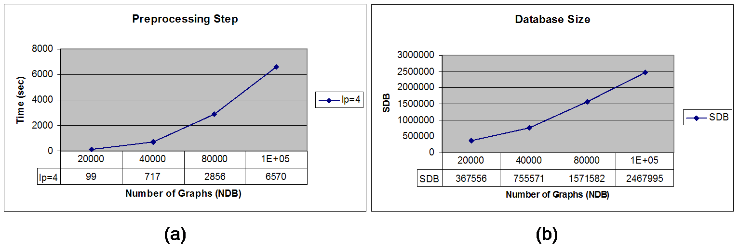
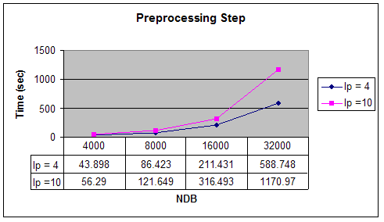
Setup on NCI database: Preprocessing Step
160000
160000
(c)

Slide 27
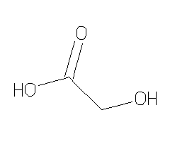
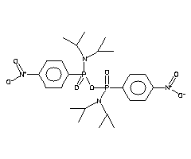
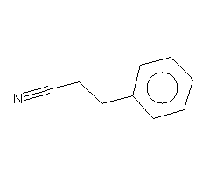
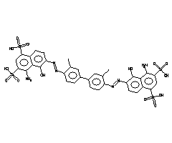
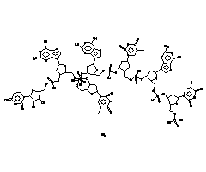
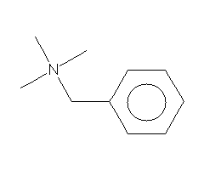
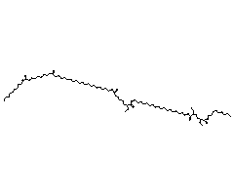
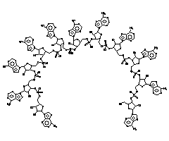
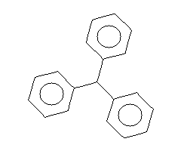
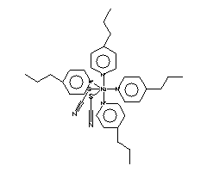
Queries

Slide 28
Results (better when database has longer paths; time in seconds)
Query Q2:
Nodes: 189
Un-Edges: 210
Filtering
Discard 99%
e.g.
|D|=16,000
|D_{f}|=612 for Q2

Slide 29
Summary
Subgraph isomorphism is NP-complete but often subexponential in practice.
Indexes help (paths, treelets, graphlets etc)
With indexes, time can be very fast.
Quick stretch break….

Slide 30
Discovery: What’s the Problem
Find subgraphs of a large graph that are unusually frequent (i.e. statistically significant, small p-value).
Closely related to frequent subgraph problem: find subgraphs that appear t times or more.
Main difference is need to compute a p-value.

Slide 31
Why is Motif-finding interesting?
Think about the causal chain in nature that we might consider the most ubiquitous yet certainly non-random:
  the ubiquity of negative feedback to control an organism’s body temperature, hunger, etc.
Are there others?
Milo et al. in Uri Alon’s group showed several

Slide 32
Example: feed forward
Most famous and surprising (to me at least) is a feed-forward loop, e.g.
A → B, B → C, A → C. If all those edges are inductive (i.e. have positive influence), then this is a kind of runaway amplifier.
However they noticed other kinds:
A → B, B --| C, A → C. So B to C is repressive (negative influence).

Slide 33
Redundancy and Levels
Many example networks provide redundancy giving multiple ways to get the same result.
Example Consequence: knocking out a gene in an organism often has no physiological effect because of such redundancy.
Also, networks can have smaller networks as subcomponents, e.g. feed-back globally with feed-forward component.
Same relationships at different levels of abstraction.

Slide 34
Application: Synthetic Biology
If living organisms have amplifiers, redundancy, and feedback, so perhaps should synthetic biology circuits.
BioFNet project gives catalogue of networks and notes usefulness, e.g. “Addition of a positive feedback loop to a negative feedback loop network enhances the oscillatory behavior generated by the negative feedback”

Slide 35
How to Do It?
You now know what the problem is.
You now know why you might care.
The next question is how. That is the bulk of our paper.

Slide 36
Basic Approach
Given an input graph G, and some notion of constraint C, enumerate subgraphs in G satisfying C and then see if any of these subgraphs (candidate “motifs”) are found more frequently than we would expect.

Slide 37
High Level Issues
What is our notion of constraint?
What is the null hypothesis for our notion of p-value?
What is this p-value thing anyway…? – Time for a quick review of resampling statistics.

Slide 38
Statistics is Easy
Dennis Shasha
From a book co-written with Manda Wilson

Slide 39
Preliminary Remarks
Probability theory: given individual probabilities (e.g. for a die, p(2) = 1/6), find compound probabilities (e.g. for a pair of dice, p(7) = 6/36).
Statistics: given data, try to find probabilities of a null hypothesis and therefore get some hint about an alternative hypothesis.

Slide 40
Is the Coin Fair?
You toss a coin 17 times and it comes up heads 15 out of 17 times.
How likely is it that coin is fair?
Could look up Gaussian approximations to Binomial processes. Maybe you’ve forgotten…
Or…

Slide 41
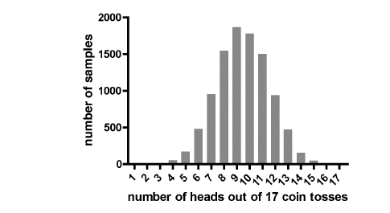
Is the Coin Fair?
You could do the following 10,000 times: toss a fair coin 17 times and count how many times you end up with 15 or more heads.

Slide 42
Is this Practical?
Takes under a second with your computer.
Is this cheating? No, in the spirit of our times: solve differential equations with Euler’s method.
Is it better than assuming distribution? Yes, because more robust, easier to reason about, handles skewed distributions (e.g. average salary of $50,000 with variance of $15,000 gives non-zero probability of negative salary).

Slide 43
What is the Result?
Something like 9 out of 10,000 times, get 15 heads in 17 tosses.
This gives a “p-value” of 9/10000.
P-value is the probability that the outcome observed would have happened by chance if the coin truly were fair.
Smaller p-value means less likely that the “null hypothesis” (coin is fair) is true.

Slide 44
Is the Drug Effective?
Random experiments are a good way to establish causality in the face of uncontrolled variation (e.g. lifestyle, wealth etc.)
Suppose that we do an experiment in which we compare the positive effect of a drug vs. the effect of a placebo.
Placebo: 54, 51, 58, 44, 55, 52, 42, 47, 58, 46
Drug: 54, 73, 53, 70, 73, 68, 52, 65, 65

Slide 45
Is the Drug Effective?
Average for drug is 63.7 and for placebo 50.7.
Is that the end of the story?
Maybe not: perhaps the drug population “just happened” to be better.
Standard statistical approach: assume something about distributions and see how big the overlap among distributions is.

Slide 46
Issues with the standard approach?
Distribution assumption may not hold.
Must be careful about different sizes of one population vs. the other.
Easy to get the technicalities wrong (for non-statisticians).

Slide 47
Resampling/Shuffle Approach
Create a table that associates each outcome with the label D (drug) or P (placebo). Here is the beginning of such a table:
D | D | D | P | P
54 | 73 | 53 | 54 | 51

Slide 48
Using the Table
If we take the table as given, then of course the entries associated with D have an average value of 63.7 and the placebo entries have average 50.7.
But now consider shuffling the labels among the entries. That causes a total loss of the connection between treatment and improvement.

Slide 49
What Does Shuffling Do?
The null hypothesis is that the drug will have no greater effect than the placebo and therefore that the apparent effect we see is just due to chance (i.e. due to the individual characteristics of the people who received the drug).
If that is so, then quite often, any 10-person subset of the experimental subjects will have an average benefit of 13 or more than some other 10-person subset of the experimental subjects.
That’s what shuffling simulates.

Slide 50
Establishing Significance
If, after shuffling, the average of the values of the Drug entries is often (say more than 15% of the time) greater than the average of the values of the Placebo values by 63.7-50.7, then the apparent effectiveness of the drug in the experiment could be entirely due to chance.
If very uncommon, then the drug may be doing something.
In this case p-value is 0.1%.

Slide 51
Different numbers give different results
Placebo: 56, 348, 162, 420, 440, 250, 389, 476, 288, 456.
Drug: 69, 361, 175, 433, 453, 263, 402, 489, 301, 469.
So difference in averages is still 13, but now the p-value is about 40%. Could easily be due to chance.

Slide 52
Significance vs. Importance
Suppose that we try a different drug/placebo experiment on 1 million patients and the drug increases life by 5 years and 3 days whereas the placebo increases life by 5 years alone.
This might, because of the large sample size, give a low p-value (thus statistically significant).
But is it important? Do we care? Please ask this question.

Slide 53
End of Resampling Interlude
Quick stretch break….

Slide 54
Number of Subgraphs
-- why a challenge
The number of subgraphs grows exponentially in size. For graph = (V, E):
|E|*|E| of two edges potentially
|E| * |E| * |E| of three edges
So, if we’re going to build a data structure, we can’t build something that handles overly large graphs unless we use sampling (more later).

Slide 55
What is the Null Hypothesis?
-- technical issue
The null hypothesis is that any motif (subgraph satisfying the constraint) is no more frequent in the input graph than we would find by chance in a similar random graph.
Generate random graphs by swapping edges, e.g. if we have a → b and c → d, then we might swap to get a → d and c → b. This leaves in-degree/out-degree and label distribution the same.

Slide 56
Question to Test Understanding
What is more expensive?
1. Find all motifs up to size say 4 in input graph
2. Determining their p-values based on random graphs.

Slide 57
Answer
If you use random graphs, then the bulk of the time is spent calculating the p-values in the random graphs.
However:
  Maybe we don’t need random graphs (ongoing research)
  Even if we use random graphs, we can perhaps look at only some of the motifs

Slide 58
Iterative p-value Approach
Compute patterns in input graph G that satisfy the constraints.
Locate the ones that are most frequently present in G and test those in the random graphs.
While p-value is low enough, test patterns in the random graphs even when those patterns occur less frequently in target graph.
Goal: minimize work on random graphs.
Problem: false negatives.

Slide 59
Finding Occurrences of Motifs
A pattern is a subgraph on nodes having a multiset of labels where a label is something like N for nitrogen and C for carbon.
So, a pattern might be something like
C --- C --- N --- O, 4 nodes having 2Cs and one O in a line (this makes the label on third node optional)

Slide 60
Basic Idea (ESU algorithm)
Start at a vertex and expand from there always going to larger numbered vertices.
Important that the vertex numbering allows this.

Slide 61
ESU example
(Pedro Ribeiro thesis p. 66)

Slide 62
ESU continued
So every occurrence of a motif (i.e. every specific set of nodes) will be listed once.
Remains to find isomorphic occurrences.
For example it might be that vertices 3, 4, and 5 are C – C – N and 61, 4, 12 are also C – C – N. They would be isomorphic (they also happen to overlap) occurrences of the motif C – C – N

Slide 63
Key Subproblem: Finding isomorphisms fast
Two possibly but not completely overlapping subgraphs S1 and S2 are isomorphic based on mapping f if for all vertices x, y in S1, there is an edge x –--- y iff f(x) –---- f(y) and label(x) = label(f(x)) and label(y) = label(f(y)).
Not completely overlapping means at least one vertex must differ.

Slide 64
Brendan McKay’s Nauty Algorithm
Ref: http://www.math.unl.edu/~aradcliffe1/Papers/Canonical.pdf
Basic idea is to use labels and degrees to partition graph vertices into disjoint sets. (Degree = number of neighbors).
Partitions might be: nodes having label A and degree 2, nodes having label A and degree 3…

Slide 65
Example graph

Slide 66
Nauty Partition Idea
Suppose that the top row are all As, the next all Bs and the third row all Cs.
Then we’d have partitions {1,3}, {2}, {4,6}, {5}, {7,9}, {8}.

Slide 67
Nauty Continued
If motif m1 is isomorphic to m2, then corresponding partitions must be of the same size (e.g. the partition consisting of label A and degree 2).
Further if a vertex v from partition p is connected with a vertex v’ from partition p’ in one motif, then must be so in both.
Great filters for isomorphism checking.

Slide 68
Trie Revisited
Recall that a trie encodes a set of words so that any shared prefix is shared in the tree.
This allows for very fast search by prefix of any string in the set.

Slide 69
Trie Example (Pedro Ribeiro thesis)

Slide 70
GTrie
Generalizes Trie to graphs.
Take advantage of common subgraphs.
Goal is to be able to do queries for multiple subgraphs at the same time.
Can apply to random graphs as well as input graph.

Slide 71
Gtrie (Ribeiro thesis)

Slide 72
Notes on Gtrie
The motif of the parent is a subgraph of the motif of the child.
That is the analogy to trie.
Therefore, all motifs of smaller size are present in the gtrie for a larger size.

Slide 73
When Query is within Size Constraints of Data Structure
Suppose we have gtries up to size 6 and the query constraints say we are looking for motif of size 6 or less.
Then find candidate motifs directly from the gtrie
Check random graphs only for promising candidates (I.e. ones that occur the most often in input graph).

Slide 74
To Sum Up
Form random graphs from the input graph.
Build Gtries for the input graph and all random graphs.
Perform query with constraints on input graph
Test most frequent motifs on the random graphs.
If their p-values are low enough, then check less frequent patterns in input graph (heuristic).
Keep going until p-value gets too high.

Slide 75
Sampling
As we grow the Gtrie, we can assign a probability to every expansion at say level 2. And a lesser probability to expansions at level 3.
We won’t enumerate all subgraphs, but only some of them – hopefully the most popular.

Slide 76
Sampling on Gtrie
(expand nodes only with some prob)

Slide 77
Sampling And Verify
Find popular candidates in sample on input graph.
Find the number of occurrences on the whole input graph.
Check without sampling on random graph using the descending frequency strategy.

Slide 78
Sampling all the way
Just look at those motifs that are popular using sampling
Compute p-value based on a similarly sampled set of random graphs.
Can use a sampled Gtrie for both input and random graphs.

Slide 79
Possible Alternatives to Random Graphs
http://arxiv.org/pdf/1007.1410.pdf Detecting Local Network Motifs by Etienne Birmele
A local motif M, say a star of size 6, would be present if an occurrence of some submotif could be extended, in many ways, to an motif M.

Slide 80
Example of Local Motif:
PDR1. PDR3 extend to many triangles

Slide 81
Our Notion of Constraints
Our constraints are on labels, e.g. we are looking for motifs of size 6 having two As and 3 Bs.
This is a mixture between a query (the constraints are analogous to a where clause in a query language) and motif finding (looking for motifs having low p-value).

Slide 82
New Frontiers
Recall that the data structure (say a Gtrie) grows exponentially. So, we can afford to store one only of size say 4.
What if we get a query with constraints of the form size 6 with three As, two Bs, and a C.
Basic idea: find motifs of size four or less that could be helpful, e.g. a motif containing a D cannot be helpful, nor can one having two Cs, but a motif having two As, a B, and a C, yes.

Slide 83
Extend in Two Ways
Grow from Gtrie motif size to size of the query, e.g. start from potentially useful subgraph of size four and grow out.
Use distance: e.g. motif of size four next to and disjoint from motif of size two which together meet the constraints.

Slide 84
Computing p-values without random graphs
Under certain statistical assumptions, Nemo can http://www.inside-r.org/packages/cran/NeMo/docs/NeMo
Can discover statistically significant unlabeled graphs.
We are extending to our model. Almost done

Slide 85
Higher Level Motifs
Consider the problem of finding a feedforward loop inside a feedback loop.
We’d like to identify patterns described generically in this way.
Requires extensions to our constraint language.
One future avenue that we’re exploring.

Slide 86
Main References
(pedagogically ordered)
http://en.wikipedia.org/wiki/Network_motif
[I know we’re supposed to sneer at wikipedia, but this article is a great overview of the field]
http://www.dcc.fc.up.pt/~pribeiro/pubs/PHD2011.html [Pedro Ribeiro’s beautiful thesis. Introduces gtrie after an excellent review of the state of the art]
http://kurata21.bio.kyutech.ac.jp/cadlive/References/Brief%20Bioinform-2013-Kurata.pdf
[Illustrates usefulness of motifs for synthetic bio]

Slide 87
Main References 2
http://arxiv.org/pdf/1007.1410.pdf [Etienne Birmele’s paper on local motifs. Could give good suggestions of global ones.]

