Slide 1
Locality Optimization for Data Parallel Programs
PhD Thesis Defense Talk
Eric Hielscher

Slide 2
Talk Outline
Motivation – what problem are we trying to solve?
Parakeet – our solution to the general problem
Tiling – an important performance optimization
Our tiling algorithm
Performance Evaluation

Slide 3
Motivation
Efficiency languages such as C++ are far more time consuming and difficult to use than productivity languages such as Python
Parallelism is pervasive, but parallel programming remains difficult and low level
Many numerical programmers are unwilling or unable to devote the time and effort to writing code in efficiency languages

Slide 4
Data Parallelism
Programming paradigm where algorithms are expressed using primitives (map, reduce, and scan) that leave iteration order through data unspecified
Enables auto-parallelization, other optimizations
Widely used – Matlab, NumPy, GPGPU
Very expressive – Linear Algebra, many Machine Learning algorithms (K-Means, SVM, etc.), graphics, stream programs

Slide 5
The NumPy Approach
NumPy is a widely used numerical programming library for Python
NumPy wraps hand-tuned C and FORTRAN library functions for common algorithms for use in Python
Provides an uniform array data type + data parallel semantics, but doesn’t expose map, reduce, and scan directly to programmers

Slide 6
Problems with NumPy Approach
If there is no library function for your specific problem, you get little or no benefit
Can be very wasteful to call out to a library, bring data back into Python, then call out to another library, …

Slide 7
Our Solution: Parakeet
Parakeet is a data parallel, array-oriented language embedded in Python
Parakeet includes a subset of Python, the NumPy array type, and the standard set of data parallel operators we call adverbs (map, reduce, and scan)
Just-in-time compilation and parallelization of adverbs to bring good performance to arbitrary array code

Slide 8
Example Parakeet Program
def add2(x, y):
return x+y
def sum_row(xrow):
return parakeet.reduce(add2, xrow, init=0)
def sum_rows(Xs):
return parakeet.map(sum_row, Xs)

Slide 9
Adverbs
Parakeet supports three classical adverbs: map, reduce, and scan, and allpairs (two nested maps)
Adverbs can be used explicitly or implicitly via library functions or broadcasting semantics
map(transform, a, …, z, axes = axes)
reduce(combine, x, axes = axes,
init = init)
scan(combine, x, axes = axes,
init = init)

Slide 10
Tiling
Tiling is a classic optimization that involves breaking up a computation into smaller pieces
This can allow better use of small, fast memories such as caches or registers by maximizing reuse of data before its eviction
Tiling can be performed hierarchically for multiple levels of memory
We tile for both cache and registers in Parakeet

Slide 11
Sum Rows Cache Behavior
Cache

Slide 12
Sum Rows Cache Behavior
Cache
Hits:
Misses:

Slide 13
Sum Rows Cache Behavior
Cache
Hits:
Misses:

Slide 14
Sum Rows Cache Behavior
Cache
Hits:
Misses:

Slide 15
Sum Rows Cache Behavior
Cache
Hits:
Misses:

Slide 16
Sum Rows Cache Behavior
Cache
Hits:
Misses:

Slide 17
Sum Rows Cache Behavior
Cache
Hits:
Misses:

Slide 18
Sum Rows Cache Behavior
Cache
Hits:
Misses:

Slide 19
Sum Rows Cache Behavior
Cache
Hits:
Misses:

Slide 20
Tiled Sum Rows
Cache
Hits:
Misses:

Slide 21
Tiled Sum Rows
Cache
Hits:
Misses:

Slide 22
Tiled Sum Rows
Cache
Hits:
Misses:

Slide 23
Tiled Sum Rows
Cache
Hits:
Misses:

Slide 24
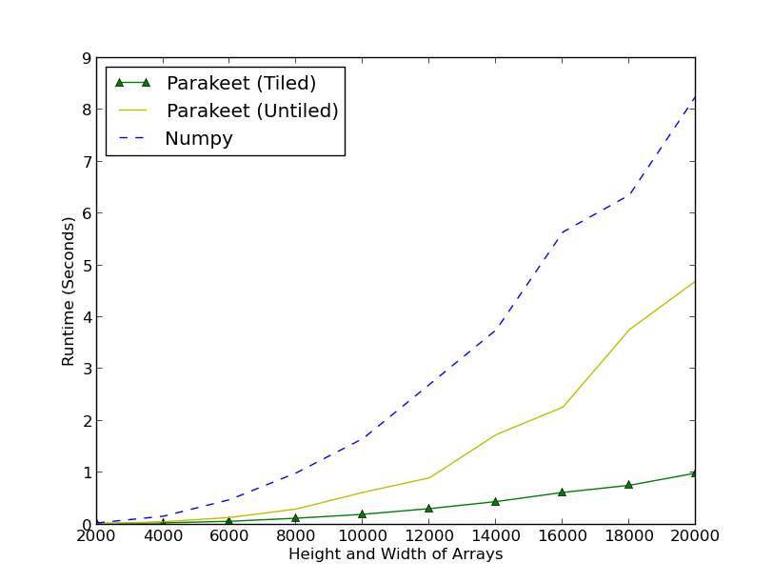
Column-Major Row Sums Runtimes

Slide 25
Tiling State of the Art
By hand, typically in C
The polyhedral model + loops
  Translates loop iteration spaces to matrices and does algebraic transformations on them
  Very general, can do tiling, loop skewing, other opts
  Has high asymptotic complexity (O(n^3 * d) where n is nesting depth, and d is number of statements)
  Not widely deployed in production compilers – even gcc’s support isn’t great

Slide 26
Why we did something new
Parakeet is centrally focused on adverbs, whose iteration patterns are far more constrained than general loops
Thus the polyhedral model is unnecessary for us
In a dynamic compiler, the O(n^3 * d) complexity of the polyhedral model is prohibitive – our algorithm has complexity linear in number of syntax nodes
Our algorithm is much simpler to implement; DSLs are proliferating; may be useful for other DSLs

Slide 27
Tiled Adverbs
Tiled adverbs are generalizations of adverbs that break up their computations into pieces
Tiled adverbs allow us to perform both cache and register tiling at a high syntactic level – easier to implement, good asymptotic complexity
We can also perform adverb fusion on the generated code – an optimization that fuses adverbs to reduce overhead

Slide 28
Tiled Adverbs
tiledmap(transform, a, …, z, axes = axes)
tiledreduce(transform, combine, x,
axes = axes, init = init)
tiledscan(transform, combine, x,
axes = axes, init = init)
Having separate transform and combine functions facilitates consuming tiles and combining partial results
We also do this internally for parallelizing regular adverbs

Slide 29
Tiling Sum Rows

Slide 30
Tiling Sum Rows

Slide 31
Tiling Sum Rows

Slide 32
Tiling Sum Rows

Slide 33
Tiling Sum Rows

Slide 34
Tiling Sum Rows

Slide 35
Tiling Sum Rows

Slide 36
Tiling Sum Rows

Slide 37
Tiling Sum Rows

Slide 38
What Changes
We combine the partial sums of the rows from each tile with the accumulated partial sums from previously processed tiles of these rows
The original map iterated over single 1D rows at a time, while the tiledmap iterates over 2D groups of rows at a time

Slide 39
Overall Algorithm
Clone each function, creating a tiled version of it and replace each adverb in tiled functions with a tiled version of it
Change each variable in the tiled functions to represent tiles of values rather than individual values
Modify the combine functions of the tilereduces and tiledscans to be able to combine tiles of partial results
Use the original tree of functions as the transform function of the innermost tiled adverb to consume the tiles

Slide 40
Parakeet Sum Rows
def add2(x, y):
return x+y
def sum_row(xrow):
return reduce(identity, xrow,
combine=add2,
init=0, axes=[0])
def sum_rows(Xs):
return map(sum_row, Xs, axes=[0])

Slide 41
Tiled Parakeet Sum Rows
def tiled_add2(accumTile, yTile):
return map(add2, accumTile, yTile)
def tiled_sum_row(xrowTile):
return tiledreduce(sum_rows, xrowTile,
combine=tiled_add2,
init=0, axes=[1])
def tiled_sum_rows(Xs):
return tiledmap(tiled_sum_row, Xs, axes=[0])

Slide 42
Tiled Variable Expansions
Tag the tiled version of each variable with the number of extra dimensions that version has with respect to the original
In our example, the xrowTile variable in the tiled_sum_row function is tagged as having 1 extra dimension

Slide 43
Lifted Combine Function

Slide 44
Lifted Combine Function
We wrap the original combine function in a number of maps equal to the number of expansions of the argument to the reduce
This “peels off” the extra dimensions of the tiles, allowing the original combine function to combine the elements one at a time
In the example, the argument to the reduce has been expanded once, so we wrap the original add2 combine function in one map to peel off the extra dimension for the tiledreduce

Slide 45
Tiled Parakeet Sum Rows
def tiled_add2(accumTile, yTile):
return map(add2, accumTile, yTile)
def tiled_sum_row(xrowTile):
return tiledreduce(sum_rows, xrowTile,
combine=tiled_add2,
init=0, axes=[1])
def tiled_sum_rows(Xs):
return tiledmap(tiled_sum_row, Xs, axes=[0])

Slide 46
Limitations of Algorithm
We terminate the tiling transform upon reaching a reduce or scan, as it’s not generally safe to compute on partial results of a reduction (explained in detail in dissertation)
The algorithm as presented thus far can only tile simple nestings of adverbs, with an arbitrary innermost transform function

Slide 47
General Algorithm Additions
We add functionality for updating axes parameters of tiled adverbs properly
We add ability to tile functions that contain any number of non-adverb statements (without control flow)
Details in dissertation

Slide 48
Selecting Cache Tile Sizes
Statically via models vs. dynamically via empirical searching
Empirical searching tends to have the best results offline.
We explored whether empirical searching can have good results online as the program runs

Slide 49
Searching for Tile Sizes
Upper bound (Shirako ’12): optimistic estimator that calculates minimum cache capacity needed to execute a tile without any capacity misses
Lower bound (Ferrante ‘91): pessimistic estimator that calculates the number of distinct cache lines accessed by a tile
Initialize tile sizes at average of two bounds
Choose random nearby tile sizes using a Gaussian with variance (Upper – Lower) / 4

Slide 50
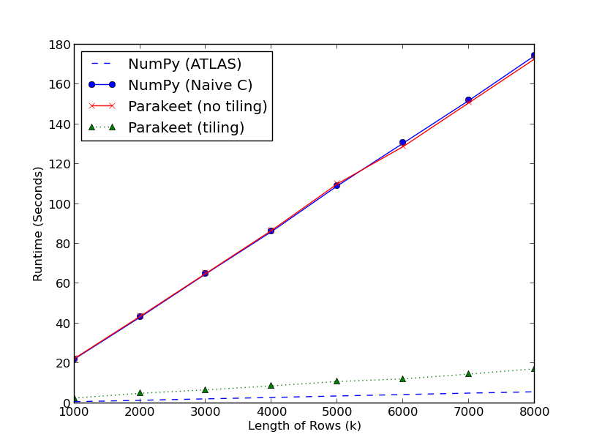
Tiling MM, Bad Layout

Slide 51
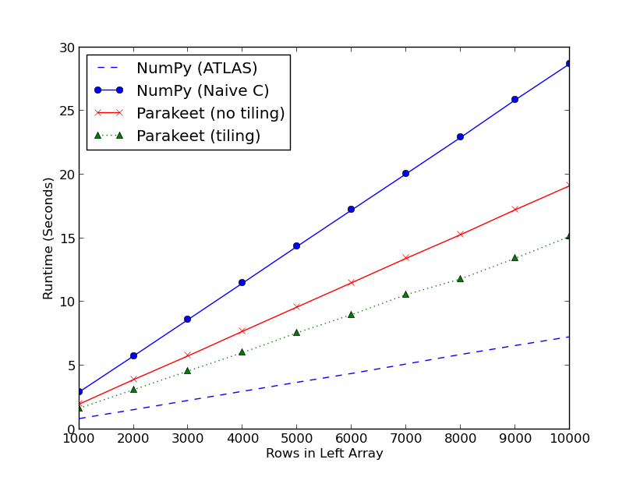
Tiling MM, Good Layout

Slide 52
MM Cache and Reg Tiling
Rows in Left Array | No Tiling | Cache Tiling | Register Tiling
1000 | 22.40s | 2.80s | 2.57s
2000 | 43.56s | 5.69s | 4.95s
3000 | 65.10s | 7.90s | 6.68s
4000 | 86.73s | 10.68s | 8.66s
5000 | 110.10s | 13.22s | 10.91s
6000 | 128.81s | 15.71s | 12.16s
7000 | 150.81s | 18.41s | 14.61s
8000 | 172.84s | 20.55s | 17.26s

Slide 53
K-Means Runtimes
Number of Data Points | NumPy | Parakeet (No Tiling) | Parakeet (Tiling)
10000 | 48.01s | 12.91s | 12.46s
12500 | 59.95s | 16.05s | 15.51s
15000 | 71.83s | 19.16s | 18.51s
17500 | 83.78s | 22.28s | 21.40s
20000 | 97.61s | 25.53s | 24.45s
22500 | 107.62s | 28.54s | 27.35s
25000 | 119.56s | 31.66s | 30.41s
27500 | 131.57s | 34.82s | 33.37s
30000 | 143.32s | 37.89s | 36.42s

Slide 54
Autotuner Evaluation
Array Size | Parakeet (with Search) | Parakeet (Cached Tile Sizes) | DL sizes | ML sizes | Average of DL&ML sizes
3000x3000 | 4.58s | 4.45s | 5.03s | 4.55s | 4.61s
10000x3000 | 15.16s | 15.11s | 16.89s | 15.33s | 15.51s
10000x500 | 2.57s | 2.57s | 2.99s | 2.67s | 2.72s

Slide 55
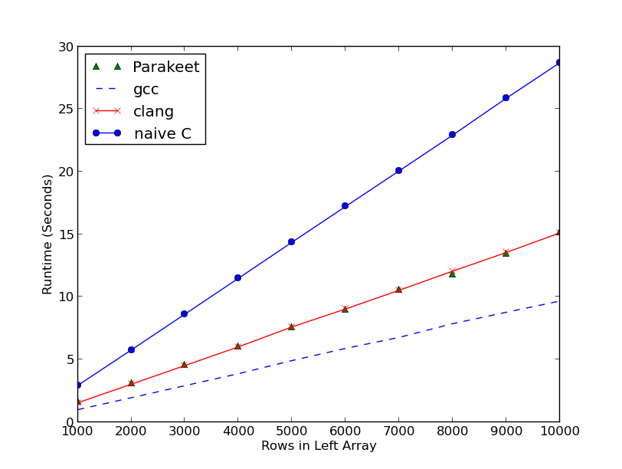
Comparison with other Compilers

Slide 56
Compilation Times
 | Matrix Multiply | K-Means Clustering | Gaussian Blur
No Tiling | 0.19s | 0.10s | 0.21s
Cache Tiling | 0.27s | 0.31s | 0.47s
Cache and Register Tiling | 1.26s | 1.29s | 0.72s

Slide 57
Conclusion
map, reduce, and scan are widely useful data parallel primitives
The semantics of data parallel operators enables a simple (syntactic) tiling algorithm
We present a lightweight tile size search algorithm that improves upon previously-published static estimators to adapt to problems and problems sizes online at runtime
Performance results are very promising – huge improvement over NumPy on general array code

Slide 58
Questions

Slide 60
Safety Slides

Slide 61
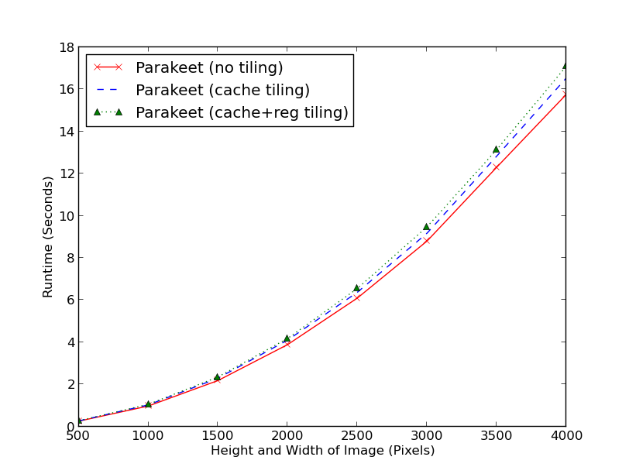
Gaussian Blur Runtimes

Slide 62
Adverb Untyped Representations

Slide 63
Untiled Row Sums C Code
void row_sums(double *Xs, double *sums,
int num_rows, int row_len) {
int i, j;
for (i = 0; i < num_rows; ++i) {
sums[i] = 0.0;
for (j = 0; j < row_len; ++j) {
sums[i] += Xs[i + j*num_rows];
}}}

Slide 64
Tiled Row Sums C Code
void row_sums(double *Xs, double *sums,
int num_rows, int row_len) {
int it, jt, i, j;
for (it = 0; it < num_rows / TILELEN; it += TILELEN) {
for (jt = 0; jt < row_len / TILELEN; jt += TILELEN) {
for (i = 0; i < it; ++i) {
sums[i] = 0.0;
for (j = 0; j < jt; ++j) {
sums[i] += Xs[i + j*num_rows];
}}}}}

Slide 65
Adverb Tiling Algorithm
Need to add the tiled versions of the adverbs
Need to update the combine function of the tiledreduce to be able to combine tiles of partial results
Need to update the axes parameter of the tiled adverbs
  The axis of iteration through arguments to regular adverbs is local to their slice of the data
  Tiled adverbs operate on tiles of the data that are of the same dimensionality as the data itself

Slide 66
Non-Simple Adverb Nesting
def add2(x, y):
return x+y
def sum_row(xrow):
rowPart = xrow[1:]
return parakeet.reduce(add2, rowPart, init=0)
def sum_rows(Xs):
return parakeet.map(sum_row, Xs)

Slide 67
Extensions for non-adverb statements
We can’t simply execute the non-adverb statements in both the tiled and untiled versions of a program
For example, in the program on the previous slide, doing this would amount to slicing off the first column of each row, then slicing off the first column of each tile – clearly incorrect
We thus delete these statements from the untiled versions of the functions, and “lift” them to operate on tiles in the tiled versions

Slide 68
Tiled Parakeet Sum Rows
def tiled_add2(accumTile, yTile):
return map(add2, accumTile, yTile)
def idx(row):
return row[1:]
def tiled_sum_row(xrowTile):
rowPartTile = map(idx, xrowTile)
return tiledreduce(sum_rows, rowPartTile,
combine=tiled_add2,
init=0, axes=[1])
def tiled_sum_rows(Xs):
return tiledmap(tiled_sum_row, Xs, axes=[0])

Slide 69
Local to Global Axes
In order to keep a tiled adverb iterating through the same data elements as its regular counterpart, we have to translate the local axes parameters to reflect which dimensions they were in original data
To do this, we use a “dimensions left” mapping – for each variable, we keep track of which dimensions of the original data of which it is a part are left over after adverbs have sliced some off
We then look up the index in this list equal to the axes parameter for a regular adverb to translate the axes for the tiled adverb

Slide 70
Tiling Sum Rows

Slide 71
Extensions for non-adverb statements
We do this by keeping track of the nesting depths at which each variable was expanded (recall this means having been an argument to an adverb)
We use this information to wrap the scalar statements in a number of maps that “peel off” the extra dimensions added by the expansions
Then the original statement is executed on each element of the tile
All bookkeeping details are in the dissertation

Slide 72
Untiled Matrix Multiply

Slide 73
Untiled Matrix Multiply

Slide 74
Untiled Matrix Multiply
CACHE:

Slide 75
Untiled Matrix Multiply
CACHE:

Slide 76
Untiled Matrix Multiply
CACHE:

Slide 77
Untiled Matrix Multiply
CACHE:

Slide 78
Untiled Matrix Multiply
CACHE:

Slide 79
Untiled Matrix Multiply
CACHE:

Slide 80
Tiled Matrix Multiply
CACHE:

Slide 81
Tiled Matrix Multiply
CACHE:

Slide 82
Tiled Matrix Multiply
CACHE:

Slide 83
Tiled Matrix Multiply
CACHE:

Slide 84
Tiled Matrix Multiply
CACHE:

Slide 85
Tiled Matrix Multiply
CACHE:

Slide 86
Tiled Matrix Multiply
CACHE:

Slide 87
Untiled C Matrix Multiply
void mm(double *A, double *B, double *O,
int rows, int cols, int len) {
int i, j, k;
for (i = 0; i < rows; ++i) {
for (j = 0; j < cols; ++j) {
O[i*cols + j] = 0.0;
for (k = 0; k < len; ++k) {
O[i*cols + j] += A[i*len + k] * B[j + k*len];
}}}}

Slide 88
Tiled C Matrix Multiply
int it, jt, kt, i, j, k;
for (it = 0; it < rows / TILELEN; ++it) {
for (jt = 0; jt < cols / TILELEN; ++jt) {
for (kt = 0; kt < len / TILELEN; ++kt) {
for (i = 0; i < it + TILELEN; ++i) {
for (j = 0; j < jt + TILELEN; ++j) {
O[i*cols + j] = 0.0;
for (k = 0; k < kt + TILELEN; ++k) {
O[i*cols + j] += A[i*len + k] * B[j + k*len];
}}}}}}

