Slide 1

AppSleuth: a Tool for Database Tuning at the Application Level
Wei Cao, Renmin University of China
Dennis Shasha, New York University
AppSleuth

Slide 2
Outline
Background and motivation
Delinquent design patterns
The proposed tool: AppSleuth
A case study
Conclusion and future work

Slide 3
Outline
Background and motivation
Delinquent design patterns
The proposed tool: AppSleuth
A case study
Conclusion and future work

Slide 4


Background
Users
C/C++/Java … programs
PL/SQL, TSQL etc. codes
Application level
SQL Tuning Tr. Mgmt
Index Tuning
DBMS level
Data Buffer Management etc.
File system/caching/…
OS level
Device level

Slide 5
Many excellent tools exist, but why AppSleuth…
Correlating the application and dbms profiling to give tuning suggestions^{[2]}
Partitioning programs code to different servers to reduce roundtrips (Pyxis)^{[3]}
Statically, make the program compilers more DBMS-friendly[^{1]}
Users
C/C++/Java … programs
PL/SQL, TSQL etc. codes
Application level
E.g. Oracle’s SQL tuning advisor^{[4]}, Toad’s codeXpert^{[5]}
Tuning isolation levels, chopping long tx’s to shorter ones^{[10]}.
SQL Tuning Tx. Mgmt
Index Tuning
DBMS level
Automatic physical DB configuration
Tools^{[6-9]}
Data Buffer Management etc.
Endeavors to make memory mgmt. self-adaptive ^{[11-13]}
File system/caching/…

Slide 6
Many excellent tools exist, but why AppSleuth…
Correlating the application and dbms profiling to give tuning suggestions
A tool for performance tuning
Partitioning programs code to different servers to reduce roundtrips (Pyxis)
Statically, make the program compilers more DBMS-friendly
Static analysis
cross multiple sql stmts
Multiple procedures, prgms
Users
Delinquent
Design
Patterns
Delinquent
Design
Patterns
trace analysis
super
C/C++/Java … programs
PL/SQL, TSQL etc. codes
Application level
E.g. Oracle’s SQL tuning advisor, Toad’s codeXpert
Tuning isolation levels, chopping long tx’s to shorter ones.
SQL Tuning Tx. Mgmt
Index Tuning
DBMS level
Automatic physical DB configuration
tools
Data Buffer Management etc.
Endeavors to make memory mgmt. self-adaptive [1], [3], [4]…

Slide 7
Outline
Background and motivation
Delinquent design patterns
The proposed tool: AppSleuth
A case study
Conclusion and future work

Slide 8
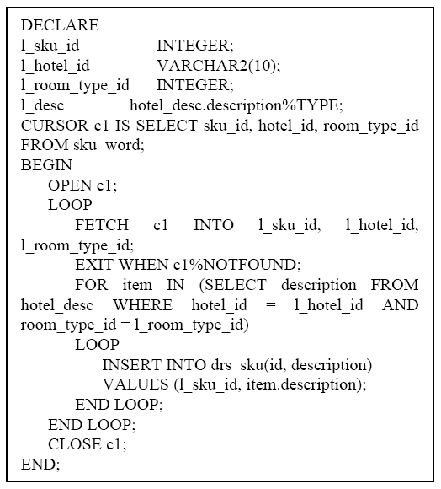
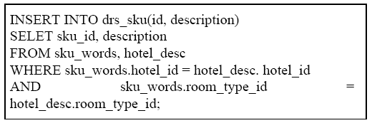
Delinquent Design Patterns
Insert one record at a time vs. an insert-select statement (loop-to-join transformation^{[14]})
The left takes 20+ minutes to finish on the sku_word table with 3 million rows and hotel_desc table with 220,000 rows, over 20 times slower than the following:

Slide 9
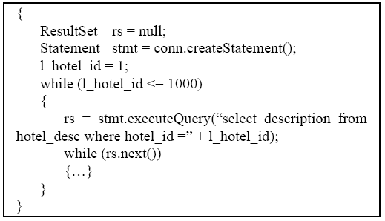
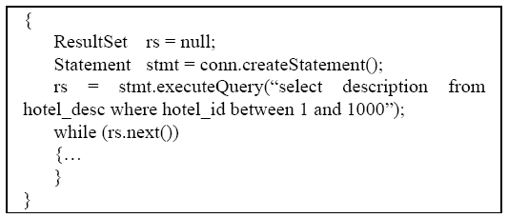
Delinquent Design Patterns
Fetch one record at a time vs. a collection-oriented processing (loop-over-query to loop-over-collection)

Slide 10
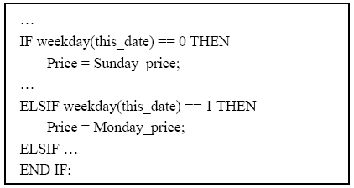
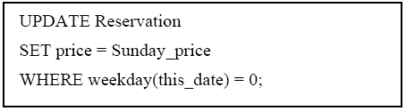
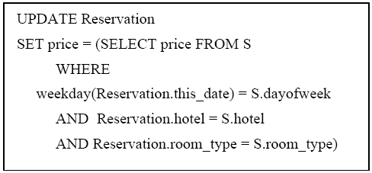
Delinquent Design Patterns
If conditions vs. where clauses
× 6
× 3
The one-record-at-a-time way consumes nearly 300 minutes on the reservation table with 145,000 records.
Using one update statement gets 500 times of improvement with proper index built on the involved table

Slide 11
Delinquent Design Patterns
Denormalized schema design
Convenient for some queries
May hurt the update performance
The delinquent design patterns occur together
Denormalization, record-at-a-time processing, poor use of indexes and excessive use of subqueries
Copying makes this worse
Detect through trace files – WITHOUT LOOKING AT SOURCE FILES!

Slide 12
Outline
Background and motivation
Delinquent design patterns
The proposed tool: AppSleuth
A case study
Conclusion and future work

Slide 13
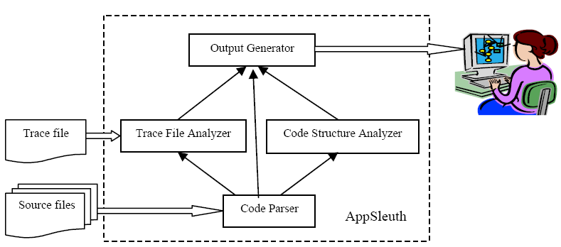
The proposed tool: AppSleuth
(Oracle, SQL Server, etc)

Slide 14
AppSleuth static code analysis
Code parser: Lexer (flex) and parser (bison)
Code analyzer (of SQL code only):
Loops
Subprogram calls
Performance related features (number of SQL statements, unused variables and arguments etc.)

Slide 15
AppSleuth Trace File analyzer
Goal: get insight of delinquent design patterns of app. through profiling information of subprogram calls and SQL statements (#executions, duration, etc. )
Oracle
Hierarchical profiler
SQL trace (relating delinquent design patterns to sp’s or applications)
SQL Server
Different traced events
fn_trace_gettable()

Slide 16
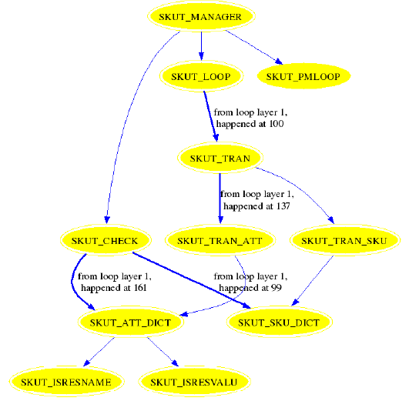

Slide 17
Outline
Background and motivation
Delinquent design patterns
The proposed tool: AppSleuth
A case study
Conclusion and future work

Slide 18
A case study
A web-based multi-lingual travel agency
Hotels (~2000), room_types (~1500)
Customers reservations (sku – some roomtype, some hotel, on a given date - ~250,000)
11 languages supported (English as the base language)
Every roomtype in every hotel has a literal description in English and MUST be translated to other 10 languages

Slide 19
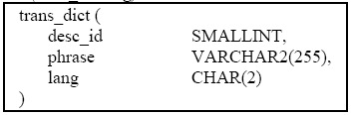
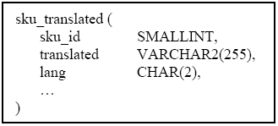
A case study: schema information
stores the dictionary of translations for all descriptions in all languages. PK (desc_id, lang), index on (desc_id)
stores all the already
translated descriptions for the skus. PK (sku_id, lang)

Slide 20
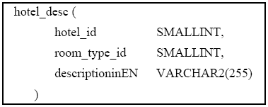
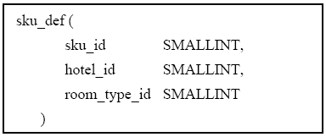
A case study: core procedures
Other tables involved
records descriptions in English for
hotel-roomtype pairs.
PK (hotel_id, room_type_id)
records the mapping from all the
generated skus to hotel – roomtype
pairs. PK(Sku_id), index on (hotel_id,
room_type_id, sku_id)

Slide 21
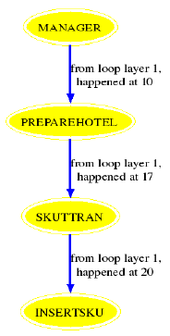
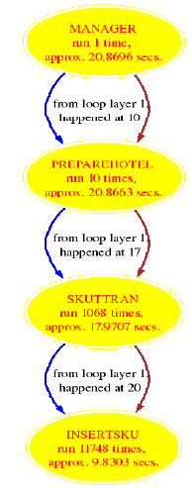
A case study: core procedures

Slide 22
A case study: core procedures
INSERT INTO SKU_TRANSLATED(SKU_ID, TRANSLATED, LANG) VALUES(:B3 , :B2 , :B1 )
appears 11748 times in sql trace.

Slide 23
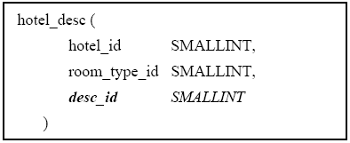
A case study: first optimization
Alter table hotel_desc by replacing descriptioninEN by desc_id

Slide 24
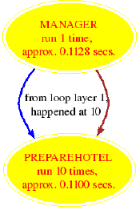
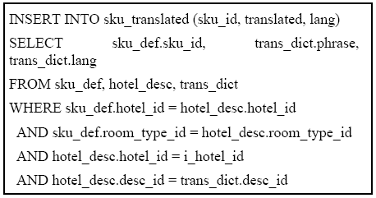
A case study: first optimization and performance
200 × performance improvement

Slide 25
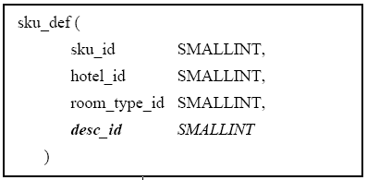
A case study: second optimization
Denormalize table sku_def

Slide 26
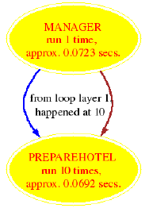
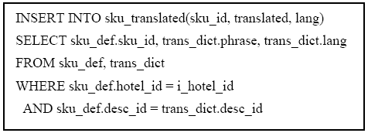
A case study: second optimization and performance
300 × improvement over the original design

Slide 27
Outline
Background and motivation
Delinquent design patterns
The proposed tool: AppSleuth
A case study
Conclusion and future work

Slide 28
Conclusion and future work
AppSleuth parses database engine source code and the trace log.
Trace log reveals problems in Java/C/PHP …
the first global application code analyzer for database tuning ever built.
focused on misuse of loops and other tuning bugs
Interactions with physical design tools (AppSleuth for Oracle currently)

Slide 29
Conclusion and future work
Future work
Generalizing the tool to discover other delinquents
Exploiting the synergy between AppSleuth and other tools
Going beyond the detection of delinquents to suggestions to fix them

Slide 30
References
Arjun Dasgupta, Vivek Narasayya, Manoj Syamala, A Static Analysis Framework for Database Applications, ICDE '09 Proceedings of the 2009 IEEE International Conference on Data Engineering, pp 1403-1414
Surajit Chaudhuri, Vivek Narasayya, and Manoj Syamala, Bridging the Application and DBMS Profiling Divide for Database Application Developers, VLDB '07 Proceedings of the 33rd international conference on Very large data bases, pp 1252-1262
Cheung, A., Arden, O, Madden, S., Myers, A., Automatic Partitioning of Database Applications. In Proceedings of the 38th International Conference on Very Large Data Bases (VLDB’12) (Istanbul, Turkey, August 27th – 31st, 2012). Morgan Kaufmann, San Francisco, CA, 2012, pp 1471-1482
Dageville, B., Das, D., Dias, K., Yagoub, K., Zait, M., Ziauddin, M. Automatic SQL tuning in Oracle 10g. In Proceedings of the 30th International Conference on Very Large Data Bases (VLDB ‘04) (Toronto, Canada, August 31 – September 3, 2004). Morgan Kaufmann, San Francisco, CA, 2004, pp 1110 – 1121.
Quest Software. Toad: SQL Tuning, Database Development & Administration Software. (2012), DOI = http://www.quest.com/toad/, 2012.
Zilio, D., Rao, J., Lightstone, S., Lohman, G., Storm, A. J., Garcia-Arellano, C., and Fadden, S. DB2 Design Advisor: integrated automatic physical database design. . In Proceedings of the 30th International Conference on Very Large Data Bases (VLDB ‘04) (Toronto, Canada, August 31 – September 3, 2004). Morgan Kaufmann, San Francisco, CA, 2004, pp 1110 – 1121.
Agrawal, S., Chaudhuri, S., Koll{\’a}r, L., Mathare, A. P., Narasayya, V. R., and Syamala, M. Database Tuning Advisor for Microsoft SQL Server 2005. In Proceedings of the 30th International Conference on Very Large Data Bases (VLDB ‘04) (Toronto, Canada, August 31 – September 3, 2004). Morgan Kaufmann, San Francisco, CA, 2004, pp 1110 – 1121.
Oracle Corporation. Performance tuning using the SQL Access Advisor. Oracle White Paper. (2007), DOI = http://otn.oracle.com.
Agrawal, S., Chaudhuri, S., Narasayya, V. R. Automated selection of materialized views and indexes in SQL databases. In Proceedings of the 26nd International Conference on Very Large Data Bases (VLDB’00) (Cairo, Egypt, September 10 – 14, 2000). Morgan Kaufmann, San Francisco, CA, 2000, pp 496 – 505.
Shasha, D., and Bonnet, P. Database Tuning: principles, experiments and troubleshooting techniques. Morgan Kaufmann, San Francisco, CA, 2002.
Storm, A. J., Garcia-Arellano, C., Lightstone, S., Diao, Y., and Surendra, M. Adaptive self-tuning memory in DB2. In Proceedings of the 32nd International Conference on Very Large Data Bases (VLDB’06) (Seoul Korea, September 12 – 15, 2006). VLDB Endowment, pp 1081-1092.
Dageville, B., and Zait, M. SQL memory management in Oracle 9i. In Proceedings of the 28nd International Conference on Very Large Data Bases (VLDB’02) (Hong Kong China, August 20 – 23, 2002). VLDB Endowment, pp 962- 973.
Microsoft Corporation. SQL Server 2005 books online: Dynamic memory management. SQL Server product documentation. (September 2007), DOI = http://msdn.microsoft.com/en-us/library/ms178145 (SQL.90).aspx.
D. F. Lieuwen and D. J. DeWitt. A transformation-based approach to optimizing loops in database programming languages. In SIGMOD ’92: poceedings of the 1992 ACM SIGMOD international conference on Management of data, pages 91–100, New York, NY, USA, 1992. ACM.

Slide 31

Any questions
Thank you for your attention!

