Slide 1
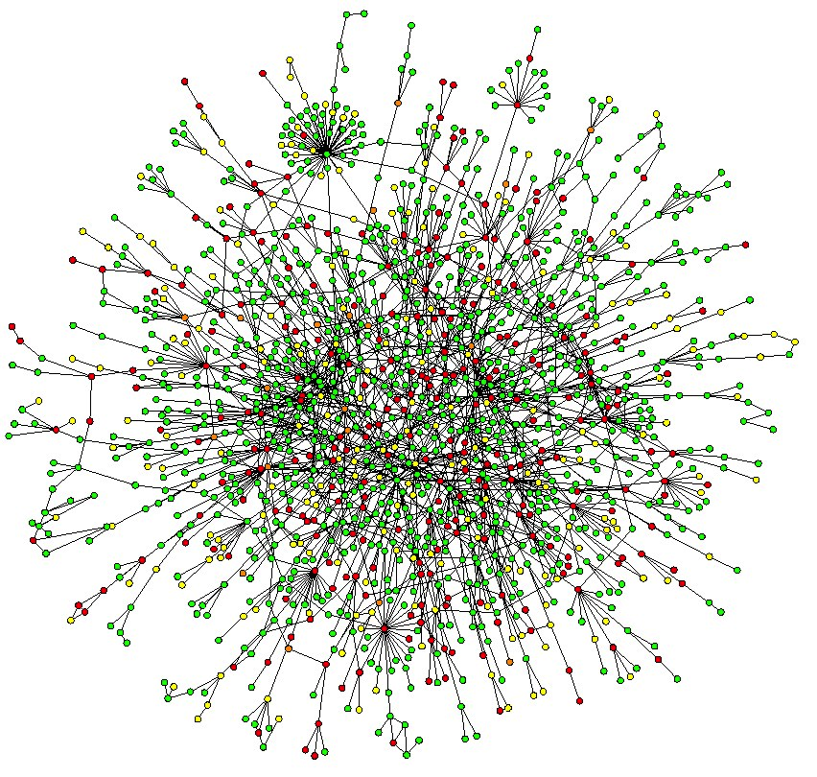
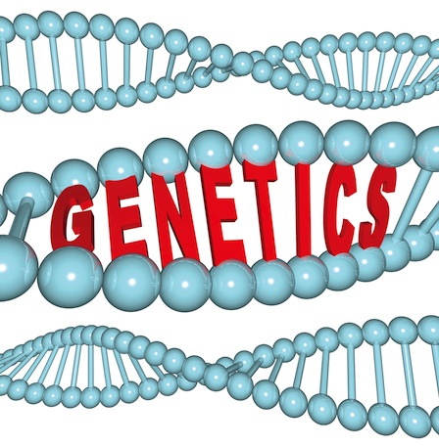

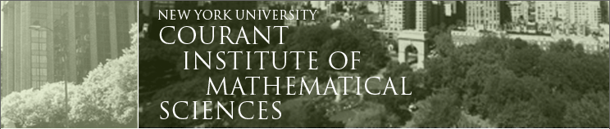
Machine learning for modeling of Gene Regulatory Networks
Jacopo Cirrone
Depth Qualification Exam, Sept. 2015 Advisor: Prof. Dennis Shasha

Slide 2
Outline
Machine learning for modeling of Gene Regulatory Networks
  Problem & Motivation
  Inference Algorithms
    Context Likelihood of Relatedness (CLR)
    The Inferelator
    Dynamic Factor Graph
    Genie 3
  DREAM5 challenge
    Inference methods comparison
    Knowledge-based methods

Slide 3
Outline
Machine learning for modeling of Gene Regulatory Networks
  Problem & Motivation
  Inference Algorithms
    Context Likelihood of Relatedness (CLR)
    The Inferelator
    Dynamic Factor Graph
    Genie 3
  DREAM5 challenge
    Inference methods comparison
    Knowledge-based methods

Slide 4

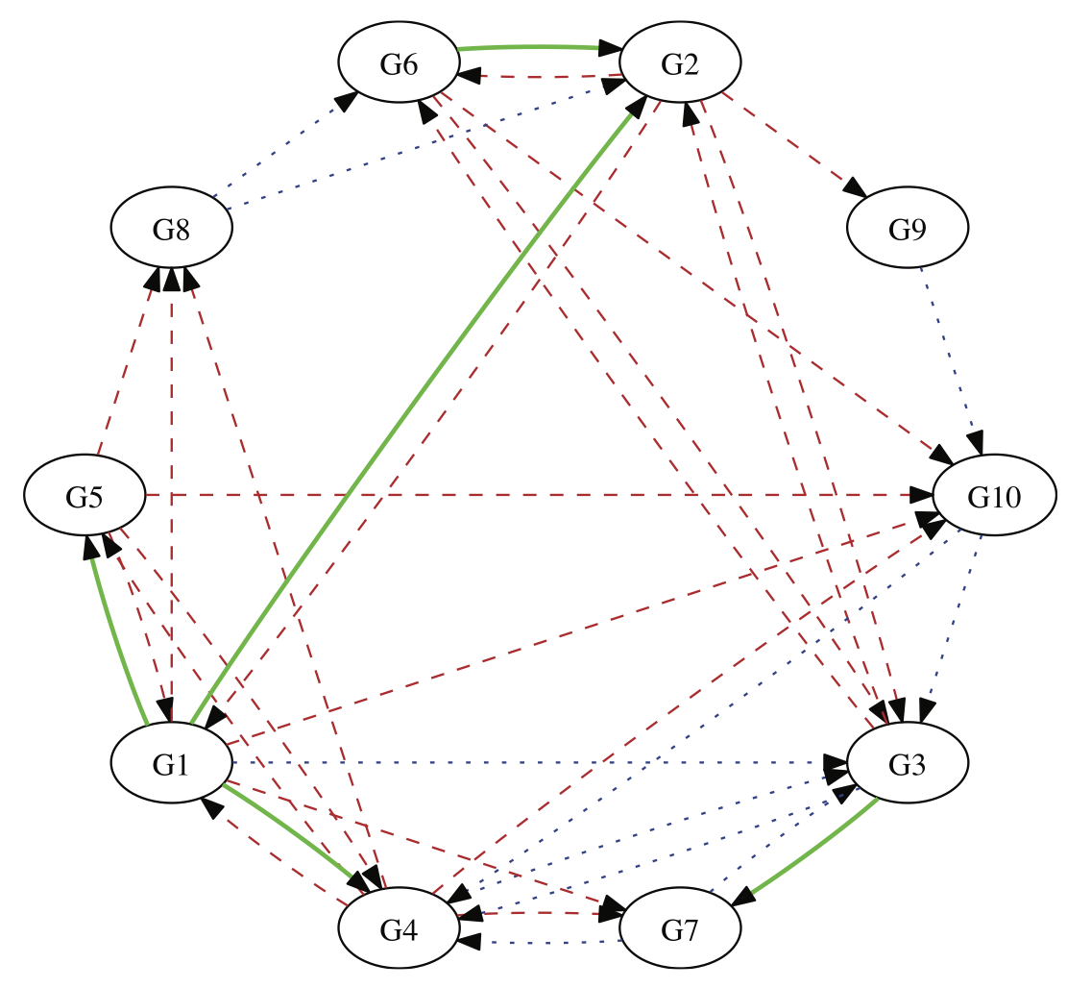
Goal: Causality

Slide 5
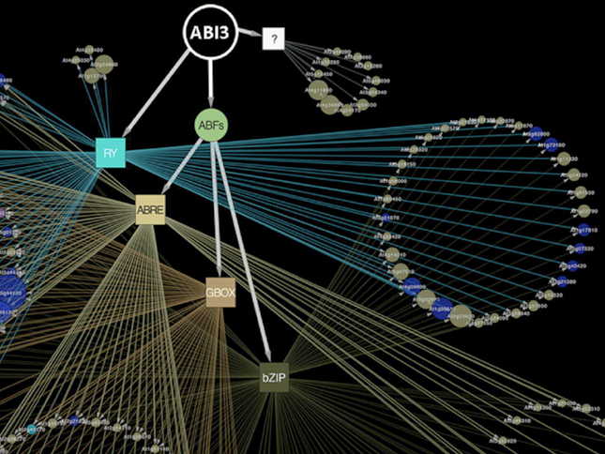
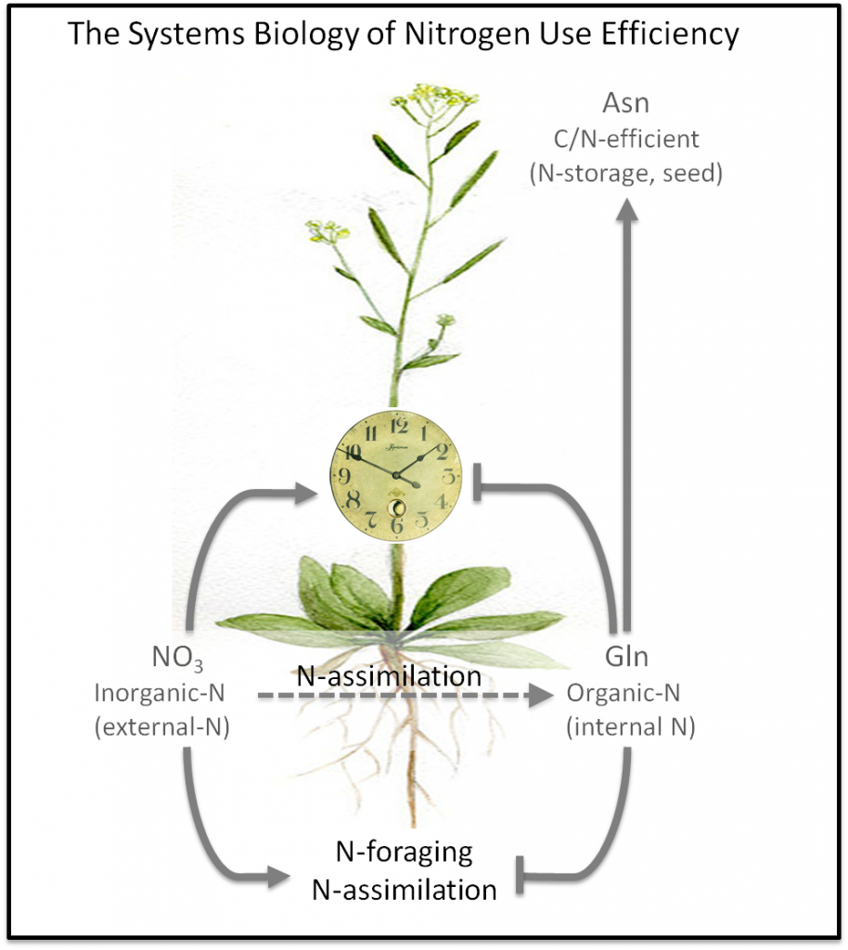
Motivation
e.g. nitrogen use efficiency

Slide 6
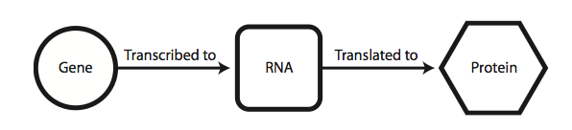
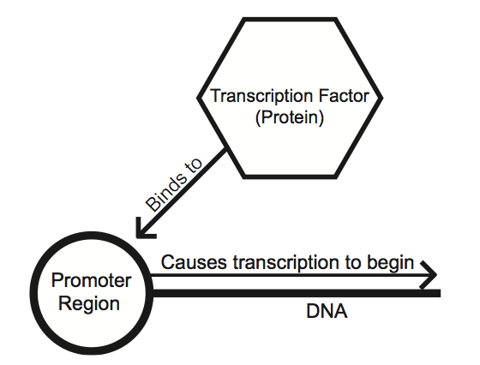
Transcription Factors (TFs) = Source nodes of the gene network
GENE REGULATORY NETWORK
target
TF
TF
TF
target
target
target

Slide 7
Motivation
B
A
A can cause some B to take on a high value
  -where A and B are genes
Preventing B from taking such a value can be done by removing some B or by removing some A
Conversely, making B achieve a higher value can be done by adding more B or adding more A

Slide 8
Biological Approach to finding such causal links:
B
A
Experiments that decrease (or over-express) the quantity of A or knock it out reveal the influence of A
Experiments over a spaced time course to enable inference of the form “the state of A at t may influence B at time t+1”

Slide 9
Outline
Machine learning for modeling of Gene Regulatory Networks
  Problem & Motivation
  Inference Algorithms
    Context Likelihood of Relatedness (CLR)
    The Inferelator
    Dynamic Factor Graph
    Genie 3
  DREAM5 challenge
    Inference methods comparison
    Knowledge-based methods

Slide 10
Inference Algorithms
Top contenders in competitions such as
  DREAM for network inference or CATS for time series prediction.
Infer the topology of the networks as a ranked list of interactions (i.e. a matrix of edge scores)
TFs
S
C
O
R
E
S
G
E
N
E
S

Slide 11
Outline
Machine learning for modeling of Gene Regulatory Networks
  Problem & Motivation
  Inference Algorithms
    Context Likelihood of Relatedness (CLR)
    The Inferelator
    Dynamic Factor Graph
    Genie 3
  DREAM5 challenge
    Inference methods comparison
    Knowledge-based methods

Slide 12
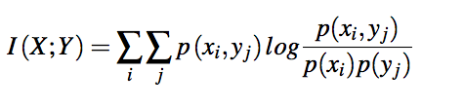

Context Likelihood of Relatedness (CLR)
Faith et al., “Large-scale mapping and validation of Escherichia coli transcriptional regulation from a compendium of expression profiles”, PLoS biology - 2007

Slide 13
Dennis comment: before equations for CLR, need a slide of intuition
What does mutual information do?
Later you should make the point that CLR can be used with other methods.

Slide 14
Outline
Machine learning for modeling of Gene Regulatory Networks
  Problem & Motivation
  Inference Algorithms
    Context Likelihood of Relatedness (CLR)
    The Inferelator
    Dynamic Factor Graph
    Genie 3
  DREAM5 challenge
    Inference methods comparison
    Knowledge-based methods

Slide 15

The Inferelator
Bonneau et al., “Robust data-driven incorporation of prior knowledge into the inference of dynamic regulatory networks”, Bioinformatics - 2013

Slide 16
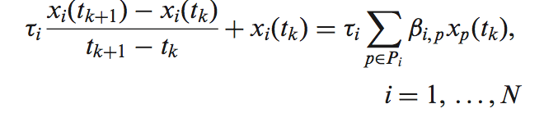
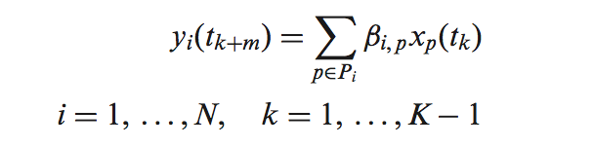
Response and Design variable
Bonneau et al., “Robust data-driven incorporation of prior knowledge into the inference of dynamic regulatory networks”, Bioinformatics - 2013

Slide 17
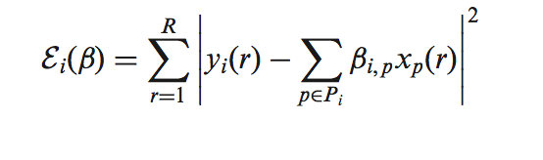
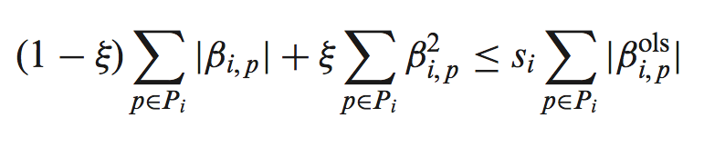
Elastic Net
Bonneau et al., “Robust data-driven incorporation of prior knowledge into the inference of dynamic regulatory networks”, Bioinformatics - 2013

Slide 18
Inferelator procedure
1) Time-lagged context likelihood of relatedness to derive 10 highest regulators for each gene
2) Either one:
  Bayesian Best Subset Regression (BBSR) - 2^10 models for each gene and get the best one.
  Modified Elastic Net (MEN): regularized regression using prior knowledge. (use all 10 TFs for each gene model)
3) from levels of influence to confidence scores.
Bonneau et al., “Robust data-driven incorporation of prior knowledge into the inference of dynamic regulatory networks”, Bioinformatics - 2013

Slide 19
Outline
Machine learning for modeling of Gene Regulatory Networks
  Problem & Motivation
  Inference Algorithms
    Context Likelihood of Relatedness (CLR)
    The Inferelator
    Dynamic Factor Graph
    Genie 3
  DREAM5 challenge
    Inference methods comparison
    Knowledge-based methods

Slide 20
Dynamic Factor Graphs (DFG) – State Space model
Main difference with the inferelator: DFG learns the latent variables as well.
  The latent variables simply correspond to a de-noised(i.e. noise free) version of the observed mRNA expression levels, and DFG models dynamics on idealized hidden variables instead of noisy mRNA.
Krouk et al., “Predictive network modeling of the high- resolution dynamic plant transcriptome in response to nitrate”, Genome Biology 2010

Slide 21
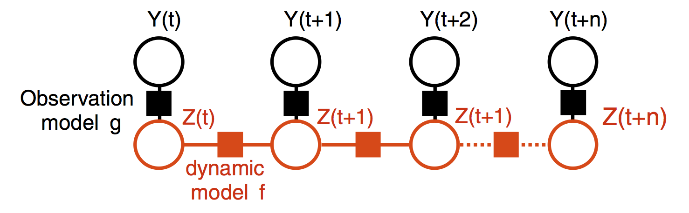
Dynamic Factor Graphs (DFG) – State Space model
2
Expectation-Maximization algorithm:
  Inference step: E-step (inference/relaxation of latent variables Z) using gradient descent
  Learning step: M-step (lars or elastic net or conjiugate descent)
Krouk et al., “Predictive network modeling of the high- resolution dynamic plant transcriptome in response to nitrate”, Genome Biology 2010

Slide 22
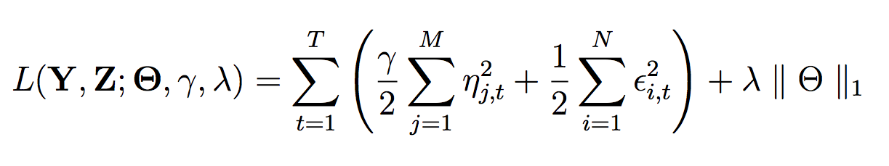

DFG loss function
By enforcing the state-space coefficient = 0 , we obtain regularized linear regression.
Krouk et al., “Predictive network modeling of the high- resolution dynamic plant transcriptome in response to nitrate”, Genome Biology 2010

Slide 23
Outline
Machine learning for modeling of Gene Regulatory Networks
  Problem & Motivation
  Inference Algorithms
    Context Likelihood of Relatedness (CLR)
    The Inferelator
    Dynamic Factor Graph
    Genie 3
  DREAM5 challenge
    Inference methods comparison
    Knowledge-based methods

Slide 24
Genie3– based on regression trees
Group
Group1
Group2
Experiments |  | Genes
 | G1 | G2 | G3 | Target
E1 | 0.7 | 0.25 | 0.7 | 0.8
E2 | 0.1 | 0.2 | 0.2 | 0.85
E3 | 0.2 | 0.4 | 0.1 | 0.9
E4 | 0.3 | 0.6 | 0.9 | 1
E5 | 0.7 | 0.8 | 0.9 | 0.2
E6 | 0.6 | 0.6 | 0.1 | 0.1
E1,E2,E3,E4,E5,E6
Target Tree
G2 > 0.3
False
True
E1,E2
E3,E4,E5,E6
Target Value High
~0.825

Slide 25
Group
Group1
Group3
Group4
Experiments |  | Genes
 | G1 | G2 | G3 | Target
E1 | 0.7 | 0.25 | 0.7 | 0.8
E2 | 0.1 | 0.2 | 0.2 | 0.85
E3 | 0.2 | 0.4 | 0.1 | 0.9
E4 | 0.3 | 0.6 | 0.9 | 1
E5 | 0.7 | 0.8 | 0.9 | 0.2
E6 | 0.6 | 0.6 | 0.1 | 0.1
E1,E2,E3,E4,E5,E6
G2 > 0.3
Target Tree
False
True
E1,E2
E3,E4,E5,E6
Target Value High
~0.825
G1 > 0.5
False
True
Target Value High
~0.95
Target Value Low
~0.15

Slide 26
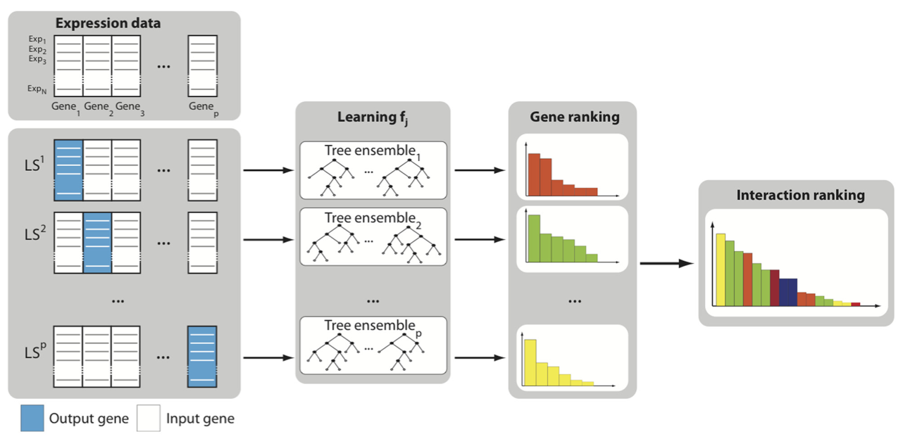
Genie3 – ensemble of regression trees
Huynh-Thu, V.A. et al. , “Inferring regulatory networks from expression data using tree-based methods”. PLoS ONE - 2010

Slide 27
Dennis comment: make point that tools can work together

Slide 28
Outline
Machine learning for modeling of Gene Regulatory Networks
  Problem & Motivation
  Inference Algorithms
    Context Likelihood of Relatedness (CLR)
    The Inferelator
    Dynamic Factor Graph
    Genie 3
  DREAM5 challenge
    Inference methods comparison
    Knowledge-based methods

Slide 29
Best contenders of DREAM 5 challenge
Mutual information (MI): Context Likelihood of Relatedness (CLR)
Meta predictors: Inferelator
Other approaches: Genie3
Best overall method: Genie3.
D. Marbach et al., “Wisdom of crowds for robust gene network inference”, Nature Methods - 2012

Slide 30
DREAM 5: datasets and score
Three gold standards for performance evaluation:
  In silico
  E.coli
  S.cerevisiae
Overall score that summarizes the performance across the three networks
D. Marbach et al., “Wisdom of crowds for robust gene network inference”, Nature Methods - 2012

Slide 31
Outline
Machine learning for modeling of Gene Regulatory Networks
  Problem & Motivation
  Inference Algorithms
    Context Likelihood of Relatedness (CLR)
    The Inferelator
    Dynamic Factor Graph
    Genie 3
  DREAM5 challenge
    Inference methods comparison
    Knowledge-based methods

Slide 32
Inference methods comparison
Trade-off between cascade and feed-forward loops:
  Feed-forward loops by MI-based methods
  Linear cascades by regression methods.
Overall specific categories of inference methods performed better for certain datasets
But performance varied within each category of inference methods
Conclusion: there is no category that is superior. Performance depends on dataset and method implementation
D. Marbach et al., “Wisdom of crowds for robust gene network inference”, Nature Methods - 2012

Slide 33
Outline
Machine learning for modeling of Gene Regulatory Networks
  Problem & Motivation
  Inference Algorithms
    Context Likelihood of Relatedness (CLR)
    The Inferelator
    Dynamic Factor Graph
    Genie 3
  DREAM5 challenge
    Inference methods comparison
    Knowledge-based methods

Slide 34
Knowledge-based methods
A fundamental assumption of GRN: mRNA levels of TFs and their targets tend to be correlated
This is more true for prokariotic datasets than eukaryotic ones
This is due to more complex regulation (e.g. post-transcriptional)
This suggests integration of additional prior knowledge: e.g. promoter sequences and TF-binding.
Inferelator incorporate prior information into the model selection approach:
  Modified Elastic Net
  Bayesian best subset regression with Informative Prior
Zhi-Ping Liu, “Reverse Engineering of Genome-wide Gene Regulatory Networks from Gene Expression Data”, Current Genomics – 2015
D. Marbach et al., “Wisdom of crowds for robust gene network inference”, Nature Methods – 2012
Bonneau et al., “Robust data-driven incorporation of prior knowledge into the inference of dynamic RN”, Bioinformatics – 2013

