Slide 1
Propagation Database Progress
Motivation: Experimental work by NYU WIRELESS produces GB of data every year
Contents: Raw measurement and calibration data, processed Power Delay Profiles (PDPs), per-measurement statistics (excess delay, path loss, …)
Progress this year: Allow each affiliate to use the interface in-house on an ubuntu (linux) server. Also improvements to the interface for querying and updating.

Slide 2
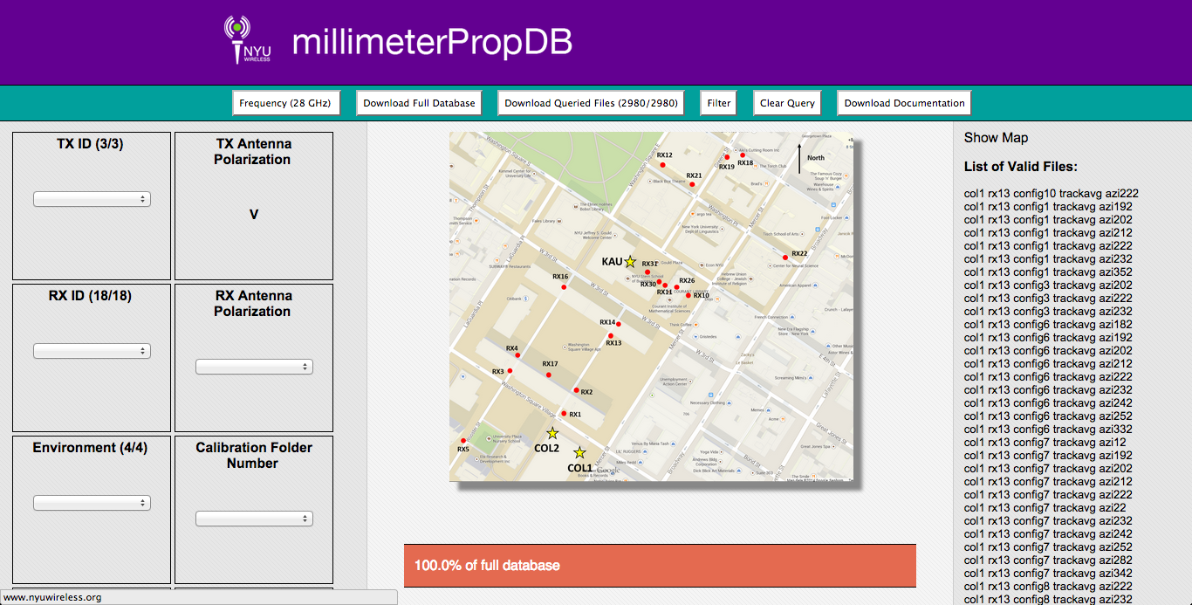
Database Interface

