Slide 1









APRIL 28 2021
© 2021 NYU WIRELESS
1
1

Slide 2
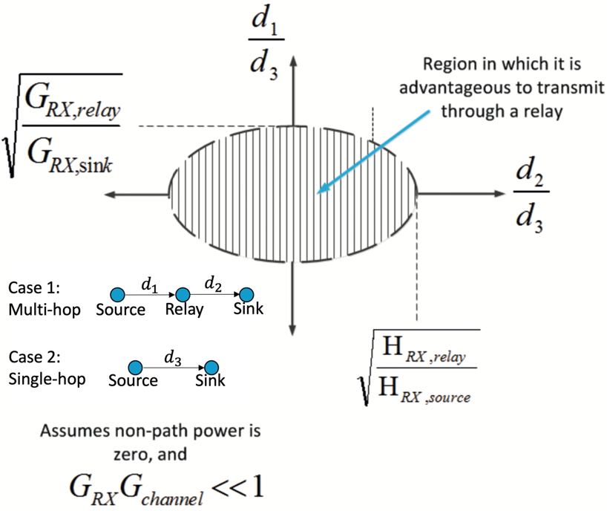
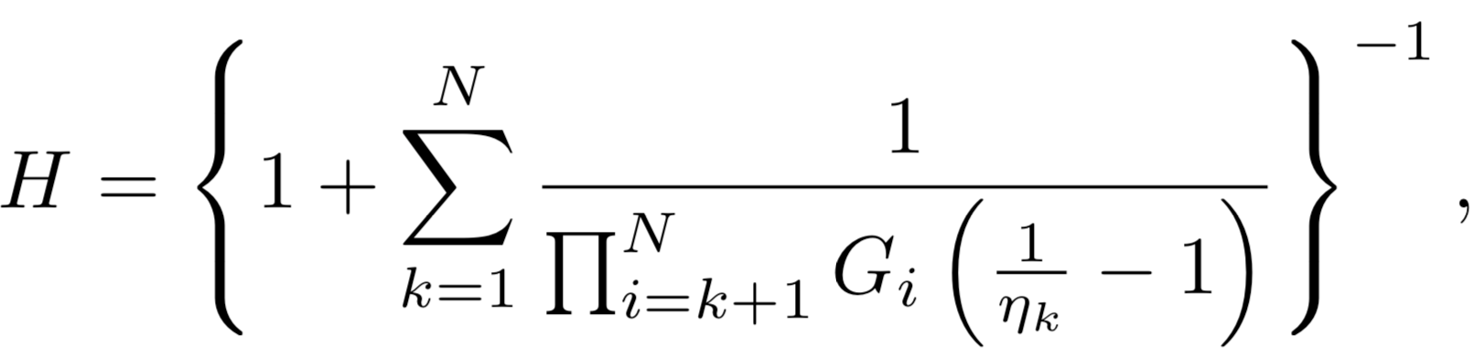
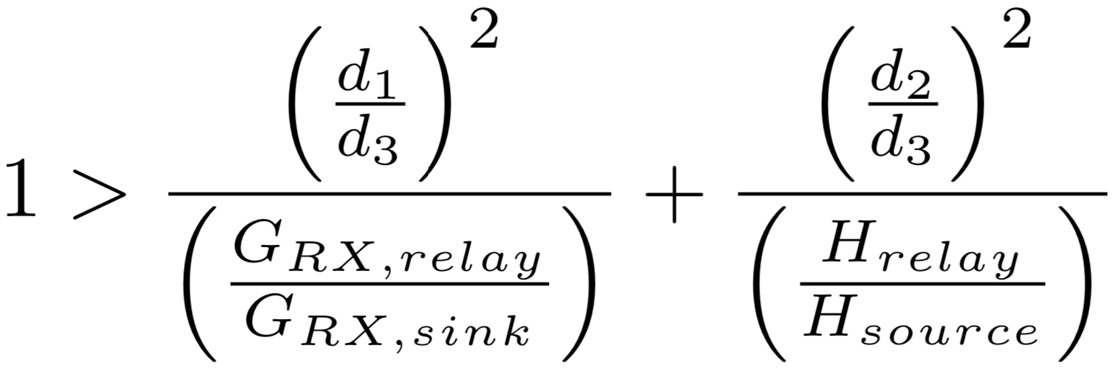
Consumption Factor Theory
Compact theory to quantify and compare power consumption in ANY cascaded system.
Generalized for all communication systems, circuits, networks, and architectures.
The minimum energy consumption per bit required to achieve error-free communication.
The power efficiency factor H of a N-stage cascaded system:
（1）
where H ranges between 0-1 and an H of 1 denotes a perfectly power efficient system that transfers all consumed energy into a radiated signal.
Case 1: Using a Relay vs. Case 2: Without a Relay
When Case 1 (using a relay) is more power efficient, $H_{case1}$ > $H_{case2}$:
（2）
[1] J. N. Murdock and T. S. Rappaport, “Consumption factor and power- efficiency factor: A theory for evaluating the energy efficiency of cascaded communication systems,” in IEEE Journal on Selected Areas in Communications, vol. 32, no. 2, pp. 221–236, Feb. 2014.
[2] T. S. Rappaport and J. N. Murdock, “Power efficiency and consumption factor analysis for broadband millimeter-wave cellular networks,” in 2012 IEEE Global Communications Conference (GLOBECOM), pp.4518-4523, Dec. 2012.

Slide 3
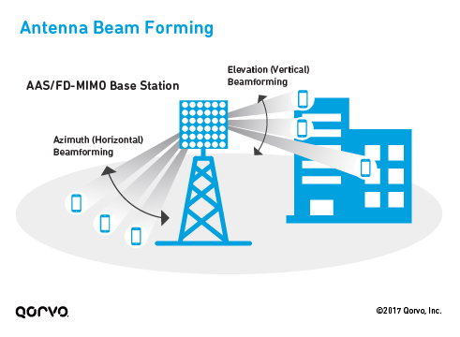

Novel Deep Learning Based Beam Alignment in Uplink mmWave
$b$-slot BA phase
Stage j
A novel BA procedure using DNNs
Channel/feedback noise
Outperform the state-of-the-art
Robust to imperfect CSI
A. Khalili, S. Shahsavari, M. A. Khojastpour, and E. Erkip, “On Single-User Interactive Beam Alignment in Next Generation Systems: A Deep Learning Viewpoint,” ICC 2021 Workshop on Emerging Topics in 6G Communications.

Slide 4
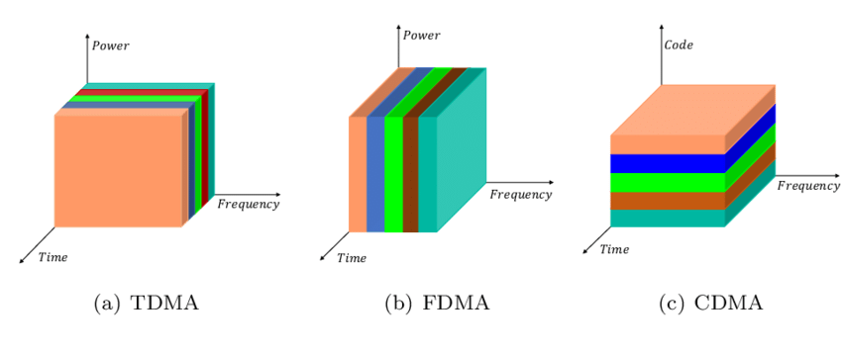
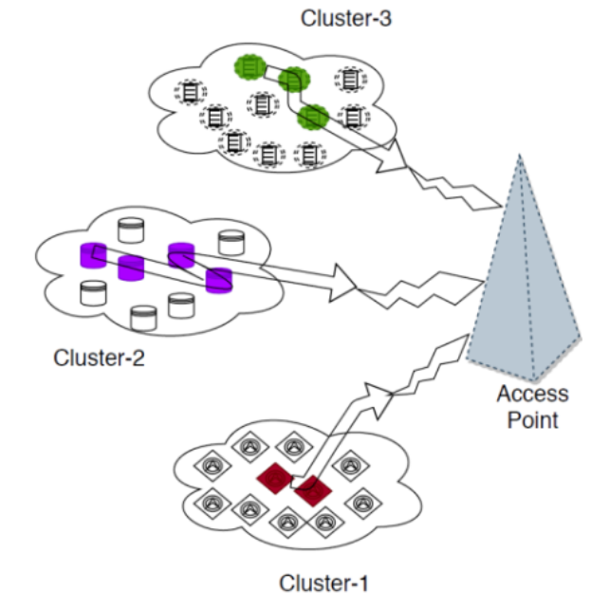
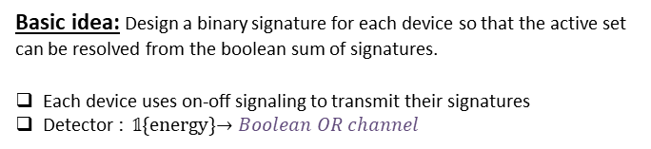
Enabling Sparse Activity Detection & Massive Random Access
IoT interconnect ‘‘Things’’ and enables
machine-to-machine (M2M) communication
Access points require novel strategies!
Our solution: A Group Testing based approach
Basic idea: Design a binary signature for each device so that the active set can be resolved from the boolean sum of signatures.
Each device uses on-off signaling to transmit their signatures
Detector : 𝟙{energy}$→Boolean OR channel$
Sparse & sporadic
Massive
Low energy budgets
Low data rates
Traditional multiple access is inefficient!
Coordinated multiple access Too many subchannels/slots/codes required.
Uncoordinated multiple access
ALOHA: Too many collisions
CS ALOHA: Too many retransmissions
IoT Traffic
Our recent work: Considered a multi-cluster scenario where each cluster of sensors have an energy constraint.
Modified Group Testing strategy to account for the energy constraints.
Derived the optimal sampling probabilities for energy constrained active device discovery.
Jyotish Robin, Elza Erkip, “Sparse Activity Discovery in Energy Constrained Multi-Cluster IoT Networks Using Group Testing,” ICC 2021
12

Slide 5
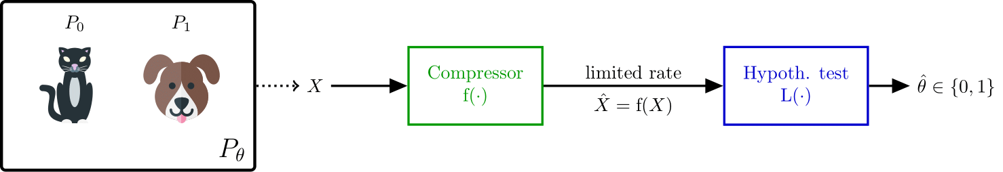
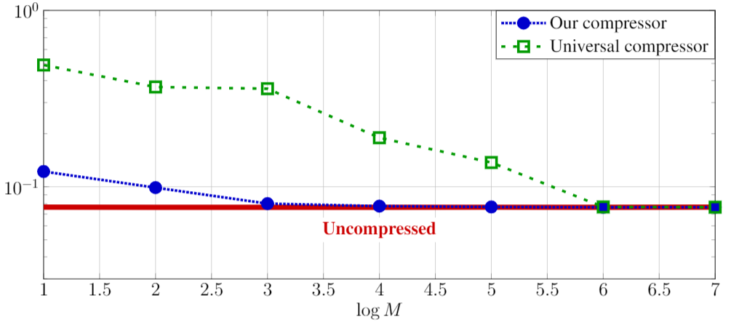
Task-Aware Compression for Edge Computing
Constrained client: collects data sample → compress → send through rate-limited link
Unconstrained cloud server: performs a task based on the received data.
End-to-end error rate
How to design task-aware compressors which provide effective representation of the source data?
Task-unaware compression
Task-aware compression
Compression ratio
Fabrizio Carpi, Siddharth Garg, Elza Erkip
12

Slide 6
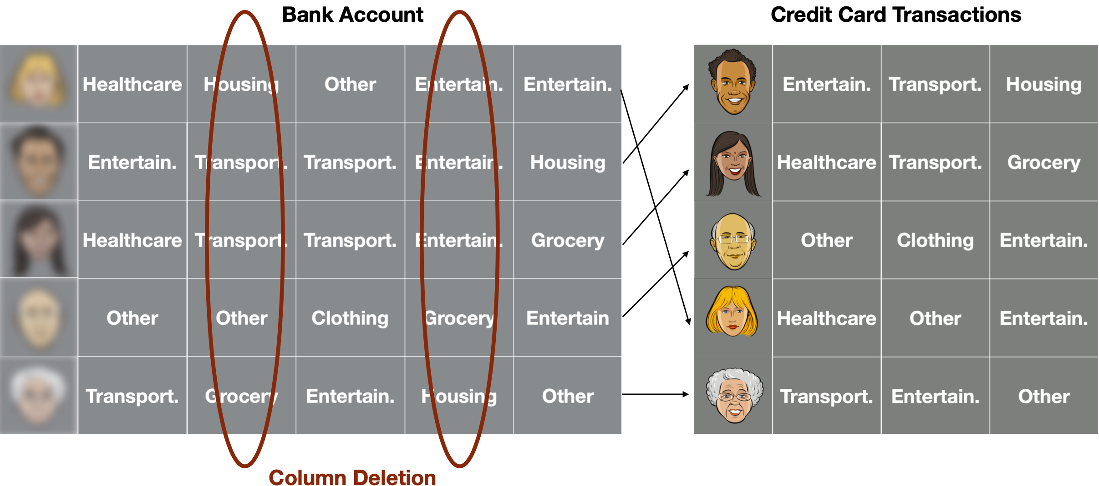
Database Matching Under Column Deletions
Publicly and commercially available anonymized databases can be exploited to leak sensitive personal data.
Database Matching: Finding the identity of a user through the correlation of the attributes in different databases.
Column Deletion: Anonymized databases may miss a subset of attributes due to
privacy concerns,
distributed storage,
synchronization errors in sampling a time series, etc.
Goal: to investigate the information-theoretic bounds on the sufficient and the necessary conditions for successful matching
Serhat Bakirtas, Elza Erkip
12

Slide 7
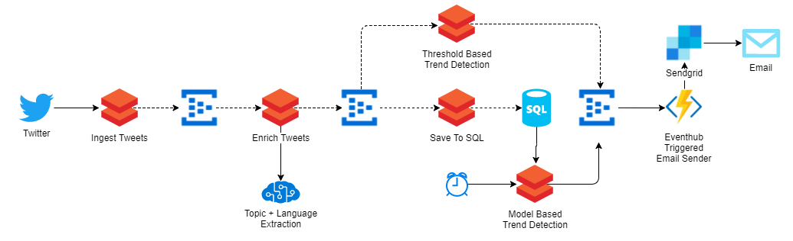
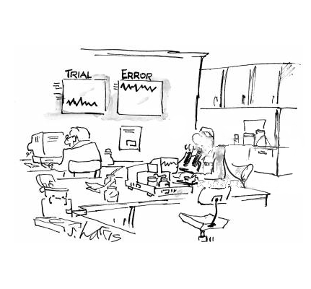
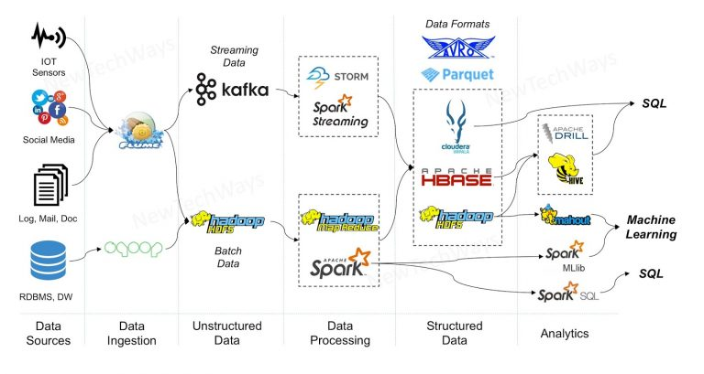
BugDoc – find root causes of Software Bugs
Computational pipelines are widely used in many domains.
A particular execution (instance) of a pipeline involves many components, e.g., input files, black box computational steps, hyperparameters, computational environment.
When an execution fails, BugDoc uses previous and new executions to identify the root cause. Often, linear in number of parameters.
7
https://dingyuliang.me/big-data-pipeline-open-source-technologies/
Notes:
Data Analysis for scientific experiments and enterprises, large scale simulations, and machine learning tasks all entail the use of complex computational pipelines to reach quantitative and qualitative conclusions. If some of the activities in the pipeline produce erroneous or uninformative outputs, the pipeline may fail or produce incorrect results. Inferring the root cause of unexpected behavior is challenging, usually requiring much human effort. Often involving a trial and error phase.

Slide 8
BugDoc Case Study – Major Software Company
Pipelines consisting of dependent data flows . . .
. . . performing predictions, data transformations, analytical tasks.
We found problems in . . .
. . . scripts, data formats, input files.
Very often problems arise because one component “is improved” and that causes other components to fail.

Slide 9
Physics-Based Wireless
Tom Marzetta
Ruth Gebremedhin, PhD student
Amritpal Singh, PhD student
Andrea Pizzo, University of Pisa, post-doc 2019-2020
12

Slide 10
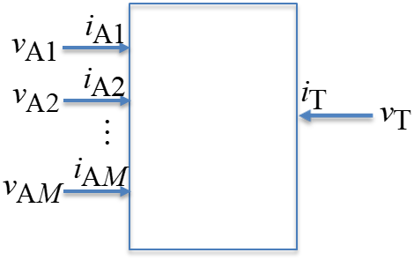
Wireless Power Transfer
Why wireless power?
Because it’s difficult!
A transformative technology: cable-free operating rooms; battery-less drones; factories populated by untethered robots
Basic principles are fully elucidated
Any system of antennas is described by an impedance matrix
Matching a load impedance to the receive-antenna impedance is sub-optimal re efficiency
Efficiency-maximizing current distributions are solutions to generalized eigenvector/eigenvalue problems
12

Slide 11
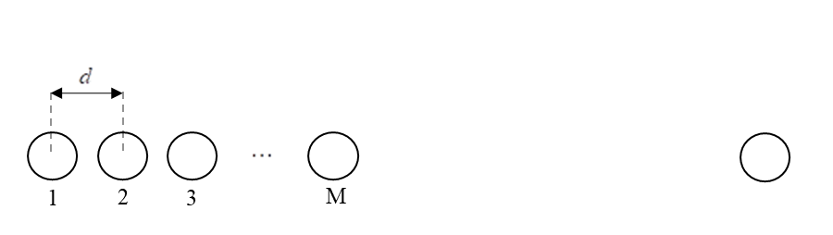
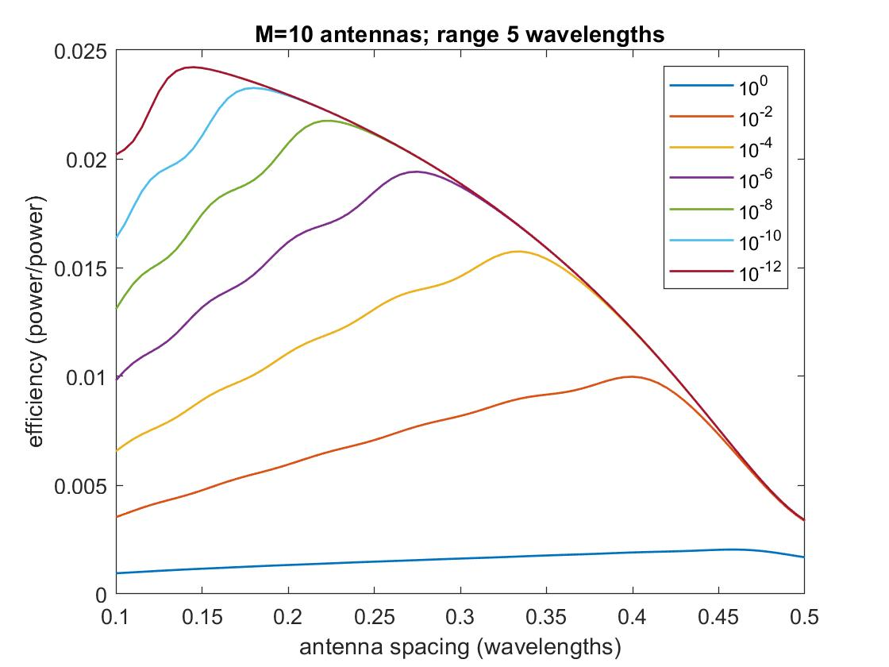
Our understanding of wireless power is very much incomplete; new directions to take:
Metamaterials
Superconductivity
New forms of MIMO
Super-directivity
“Wireless Power Transfer: Principles and Prospects”, NSF CISE Distinguished Lecture Series, May 13, 2021
12

Slide 12
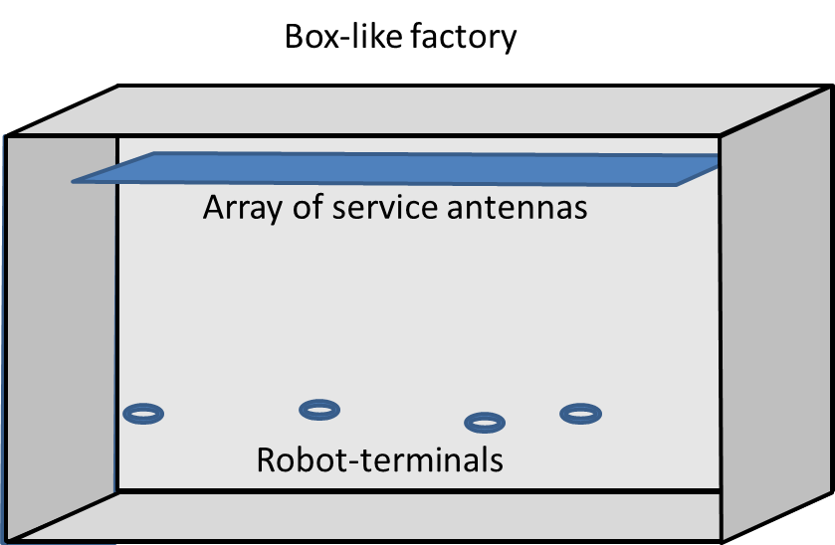
Wireless Communications & Power in Highly-Reverberant Environments (A. Singh)
Our wireless experience is confined, more or less, to free-space
A reverberant propagation environment changes everything
Isolates the interior from exterior: no spectrum-licensing issues!
Minimizes near-far effects
Creates propagation degrees-of-freedom
In principle, a single low-gain antenna can transmit arbitrary power to a single low-gain receive antenna with 100% efficiency
12

Slide 13
Wireless Communications via Heat Conduction (R. Gebremedhin)
Heat equation: a parabolic partial differential equation
We normally consider heat conduction to be slow and sluggish; but decreasing the spatial scale by 1/2 decreases the temporal scale by 1/4 (parabolic!)
Heat conduction over a range of microns is faster than over a range of centimeters
Brand-new information-theoretic problems: capacity of the heat channel; thermal MIMO?
Possible application: Intra-chip communications!
12

Slide 14
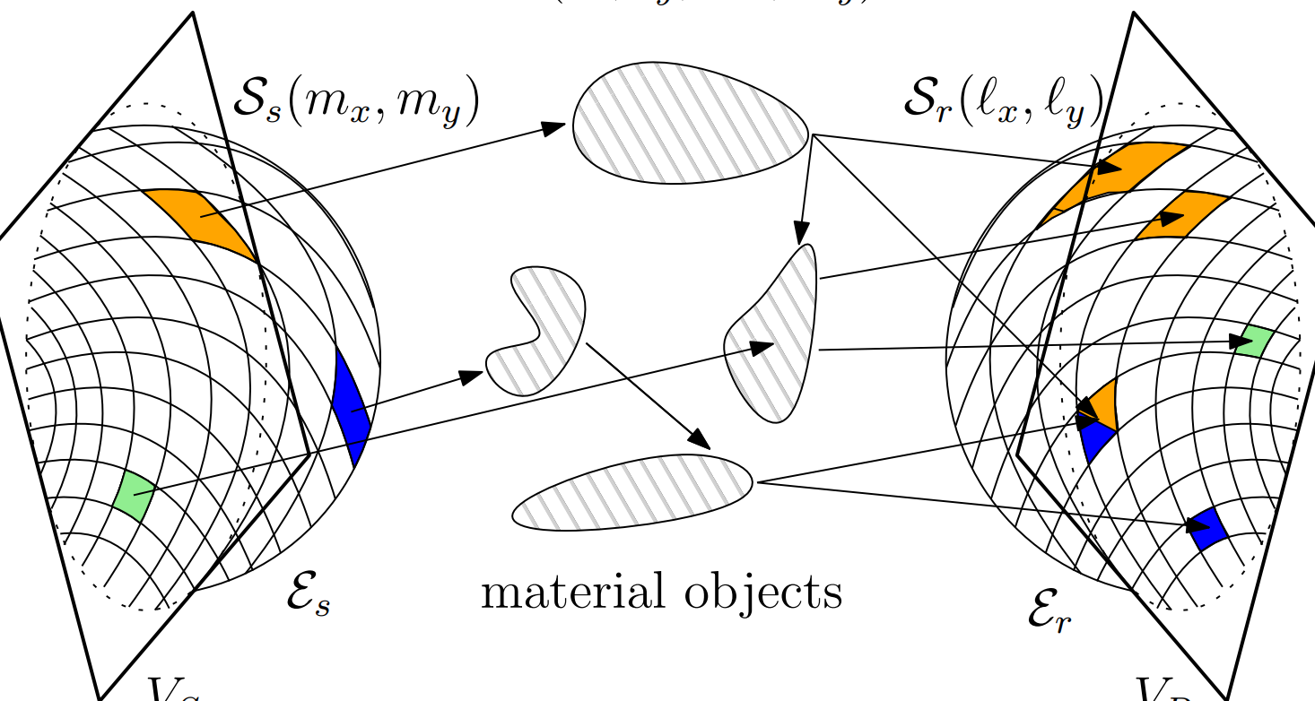
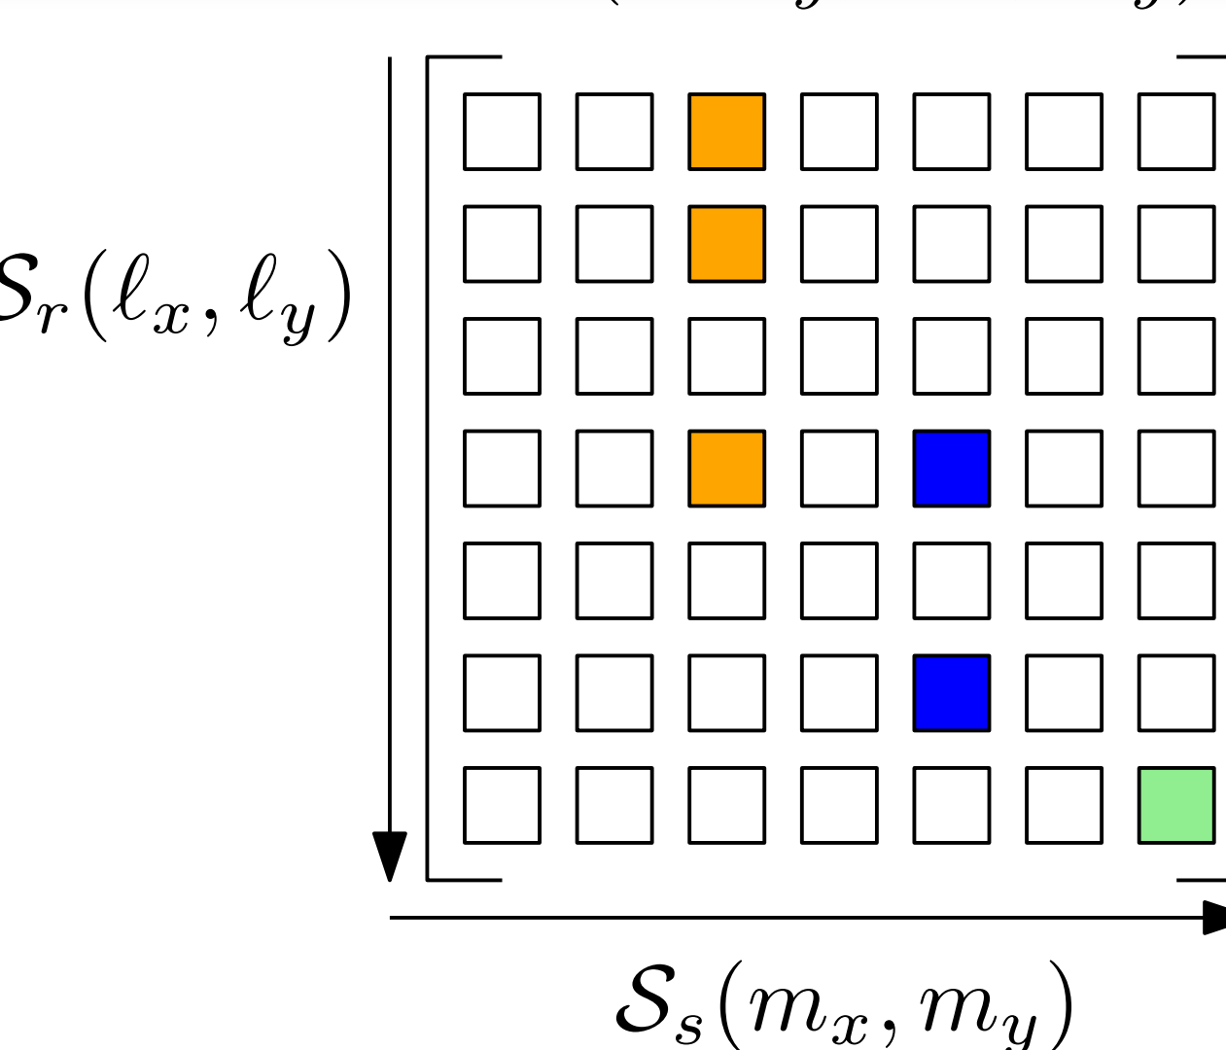
Stochastic Models for MIMO Propagation (A. Pizzo)
All propagation is completely described (no approximation) in terms of:
Generation of plane-waves
Scattering of plane-waves
Detection of plane-waves
Additional assumptions yield spatially-stationary random field
Evanescent waves are negligible
Plane-wave scattering matrix/kernel comprises zero-mean complex Gaussian uncorrelated noise
12

Slide 15
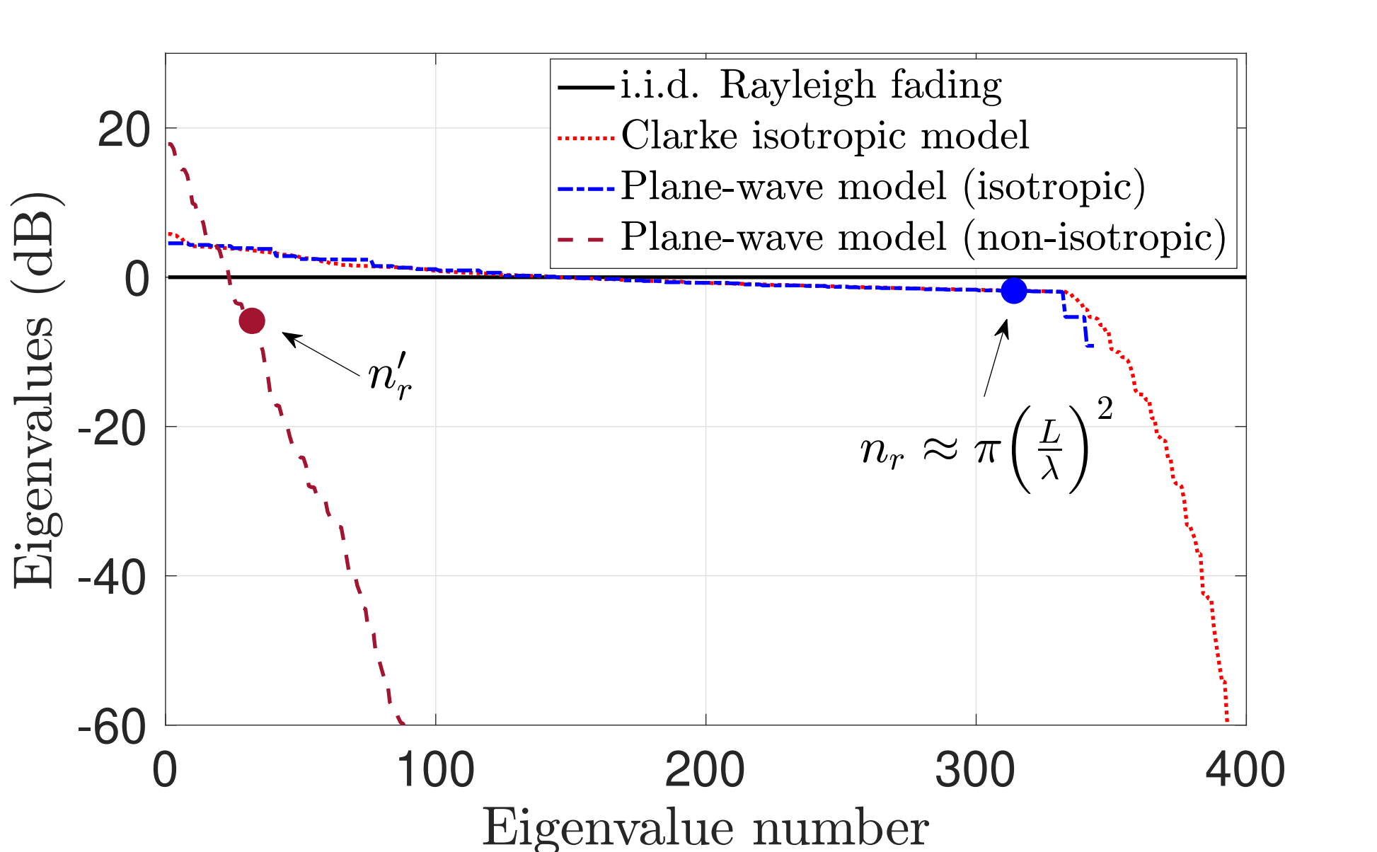
Net number of degrees of freedom limited by three bottlenecks
Most-favorable scattering (closest to iid Rayleigh fading) is isotropic (Clarke model)
Future research: re-analyze MIMO systems using physically-meaningful correlation models
12

Slide 16
New Graduate Course: A Linear System Approach to Wave Propagation
Maxwell
Physicist’s way: Potentials
Spherical coordinates
Separation of variables
Spherical harmonics
Linear system approach: Fourier
12

Slide 17

NYU WIRELESS INDUSTRIAL AFFILIATES

