Slide 1
Comp Bio, Magnetic Resonance Imagery, Public health
Dennis Shasha
Department of Computer Science (collaborations with NYU Bio, NYU Med)

Slide 2
Computational Biology/Synth Bio
Analysis of biological data to discover facts about nature, e.g. which genes or combinations of genes cause a disease.
Engineer changes that will “improve” species, e.g. plants that use less nitrogen.
Synthetic biology: design proteins, use in vivo mutation technology like RNAi, Crispr, etc.

Slide 3
Activist Data Mining (NYU Bio)
Propose initial experiments to explore subspace of some predefined search space
Evaluate the results
Propose new experiments, evaluate, propose, evaluate, propose ….
Iterative and adaptive

Slide 4
Examples
Protein design: design a protein to have a particular geometry.
Use Crispr and time series to infer transcriptional networks (strong use of iteration).

Slide 5
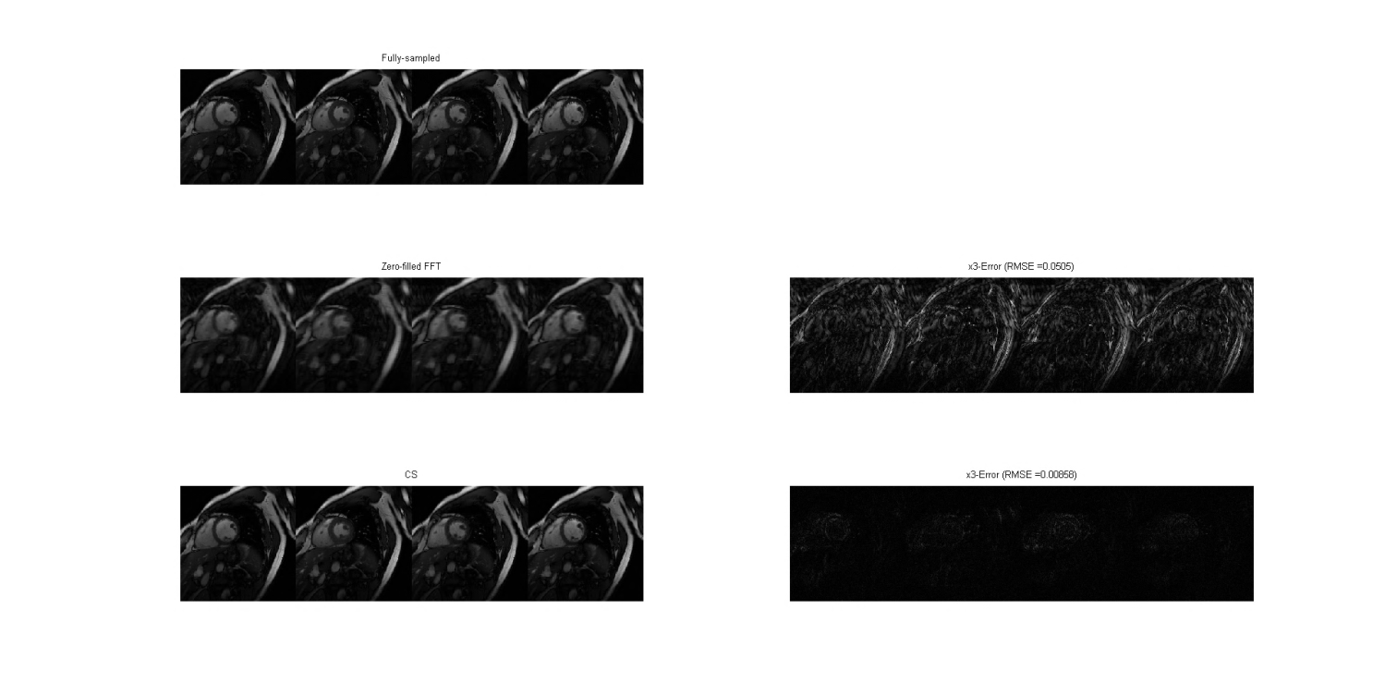
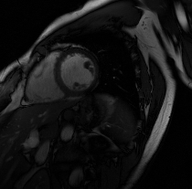
MRI Reconstruction (NYU med)
Fully-sampled
Reconstruction - GPU
Zero-filled FFT
Reconstruction - CPU

Slide 6
MRI Reconstruction
Device | Single-slice | Speed-up | Multiple-slices | Speed-up
CPU Intel E5506 | 308s | 1 x | 2860 s | 1 x
GPU AMD V7800 | 2.54s | 121 x | 42 s | 68 x
GPU GeForce GTX 680 | 0.8s | 385 x | 14 s | 204 x

Slide 7
Public Health Example (NYU Med)
User enters demographic info.
User/nurse adjusts nutritional constraints.
User indicates recipes, foods, allergies.
TastyPlan figures out foods and recipes that can match nutritional constraints if at all possible.
Otherwise, probes for more options.

