Slide 1

Valuation Project
2014
Dublin Fire Brigade

Slide 2
Valuation Project
Scope
A positive metric for DFB
A monetary value of the property we save
Domestic property Only
Similar Schemes
  Calgary, Canada.
  New Zealand
Notes:
Fatalities / Rescues
Turnouts

Slide 3
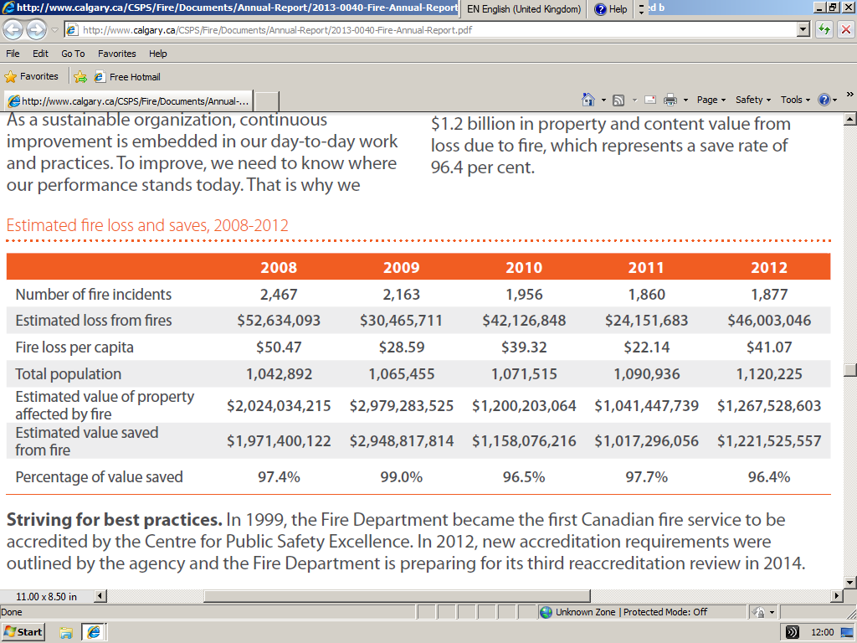
Calgary Fire Department

Slide 4
New Zealand Fire Service
“Estimated Area of Flame Damage to Structural Fabric of Building”
S/O estimates damage in m²,
Quantity Survey Construction Cost/m²
Emphasis on Response Times
Dublin - Keep simple!
Area Damaged x Value of Property

Slide 5
Valuation Project
Area of Flame Damage
  Estimated % of total area – Incident Commander
  Subjective, Experience, Consolidate into Schedule
  NB: General Quality of Form Completion!
Value of property
  SCSI = €1,768/m² (Dublin) - Building and Furnishings
  Residential Property Price Register (PSRA)
  Local Property Tax – Revenue Commissioners
Notes:
SCSI = Complete Rebuild only
PSRA – Property Services Regulatory Authority

Slide 6
Valuation Project
Local Property Tax Valuation
  ‘Agreed’ with Owner
  Reasonably Objective
  Available
  https://lpt.revenue.ie/lpt-web/valuation-guide/index.htm
Notes:
Revenue Commissioners happy that data has settled down

Slide 7
2013 |  | Mid-Point Valuation |  | Damage Valuation | Property Saved | % Saved | Domestic Property Saved Forecast for full year
TOTAL DFB | Fires Charged | 25,475,000 |  | 3,201,500 | 22,273,500 |  | 89,094,000
 | Fires No Fee | 28,200,000 |  | 3,441,500 | 24,758,500 |  | 99,034,000
 | Total | 53,675,000 |  | 6,643,000 | 47,032,000 | 87.6% | 188,128,000
 |  |  |  |  |  |  | -
DCC | Fires Charged | 13,925,000 |  | 1,678,750 | 12,246,250 |  | 48,985,000
 | Fires No Fee | 15,600,000 |  | 1,834,500 | 13,765,500 |  | 55,062,000
 | Total | 29,525,000 |  | 3,513,250 | 26,011,750 | 88.1% | 104,047,000
 |  |  |  |  |  |  | -
DLRCC | Fires Charged | 5,050,000 |  | 488,500 | 4,561,500 |  | 18,246,000
 | Fires No Fee | 3,025,000 |  | 437,500 | 2,587,500 |  | 10,350,000
 | Total | 8,075,000 |  | 926,000 | 7,149,000 | 88.5% | 28,596,000
 |  |  |  |  |  |  | -
FCC | Fires Charged | 1,800,000 |  | 326,250 | 1,473,750 |  | 5,895,000
 | Fires No Fee | 3,825,000 |  | 599,750 | 3,225,250 |  | 12,901,000
 | Total | 5,625,000 |  | 926,000 | 4,699,000 | 83.5% | 18,796,000
 |  |  |  |  |  |  | -
SDCC | Fires Charged | 4,700,000 |  | 708,000 | 3,992,000 |  | 15,968,000
 | Fires No Fee | 5,750,000 |  | 569,750 | 5,180,250 |  | 20,721,000
 | Total | 10,450,000 |  | 1,277,750 | 9,172,250 | 87.8% | 36,689,000

Slide 8
Valuation Test 2013
 |  | Mid-Point Valuation |  | Damage Valuation | Property Saved
 | ALPHA | 14,375,000 |  | 1,382,000 | 12,993,000
 | BRAVO | 14,600,000 |  | 1,752,500 | 12,847,500
 | CHARLIE | 9,500,000 |  | 1,433,500 | 8,066,500
 | DELTA | 7,750,000 |  | 1,345,500 | 6,404,500
 | ECHO | 2,100,000 |  | 150,250 | 1,949,750
 | FOXTROT | 5,350,000 |  | 579,250 | 4,770,750
 | TOTAL: | 53,675,000 |  | 6,643,000 | 47,032,000
Notes:
A=90%, B=88%, C=85%, D=83%, E=93%, F=89%.

Slide 9
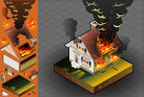
Damage Calculation

Slide 10


No Damage ? 15-25% ? 50%

Slide 11
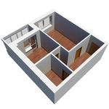

Valuation Pilot Test 2014

Slide 12
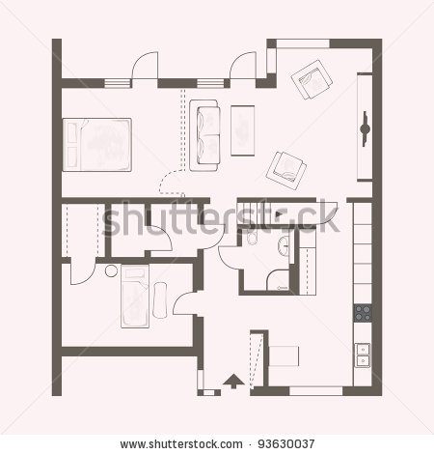

Valuation Pilot Test 2014
Notes:
Apartment - Kitchen

Slide 13

Valuation Pilot Test 2014

Slide 14

Valuation Pilot Test 2014

Slide 15
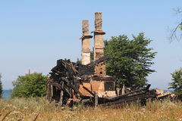
Valuation Pilot Test 2014
Notes:
100% !

