Slide 1
Non-linear Methods for Time Series Prediction
01-20-2015

Slide 2
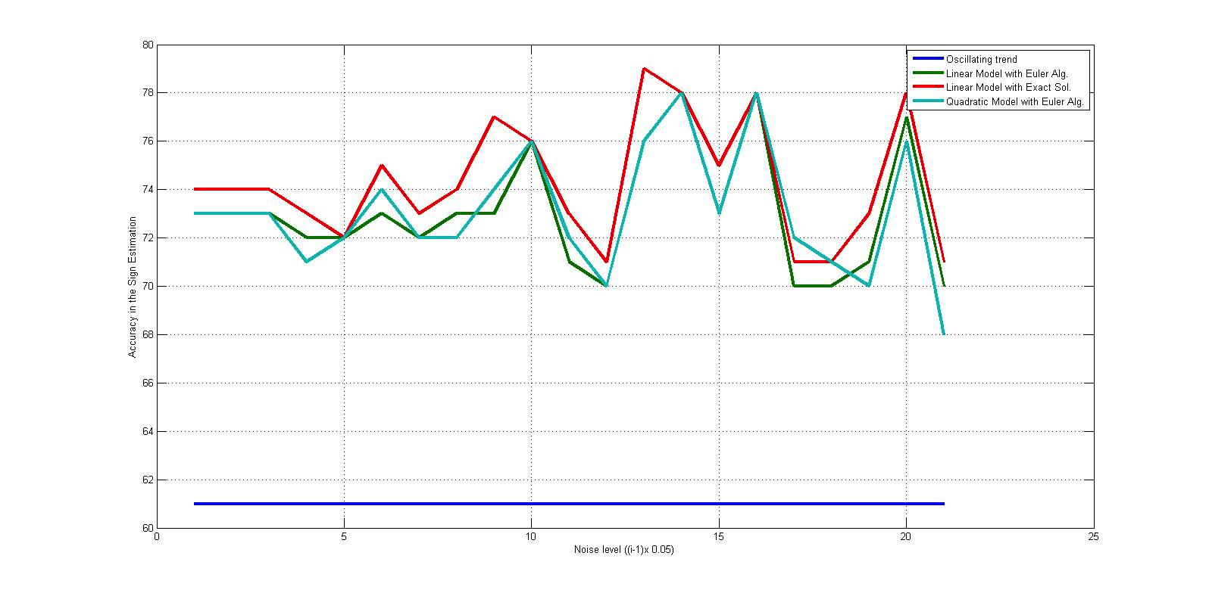
Motivation
Linear dynamical modeling has not done so well for time series prediction
Even if when we know the gold standard network (DREAM)
Anil(NYU-Poly) Figure
Notes:
Linear models doesn’t work: we used the gold standard to predict the last time point using dream data(based on ecoli) but that doesn’t help to improve the prediction of correct signs. Hence we want to use a non-linear model such that if we knew the network and all time points up to t-1 we predict time t.

Slide 3
…Alternative: Non-Linear model
Random Forest (intuitively, a bunch of decision trees)
Genie3 uses Random Forest
We do our own implementation for time series prediction using python sklearn

Slide 4
Training and Test
Leaf dataset composed by 2173 genes where 161 are TFs.
All 2173 genes are considered targets and for each target I build a different RandomForest Classifier.
The time points are 10, hence delta(Δ) values are 9. I train on the first 8 deltas, then I use the model to predict the direction of the last delta value (sign(Δ9)).
The biological replicates of the time series are 3 but the KNO3 combinations we produce are 9. (since we are under the assumption that only 1-st order Markov relations are considered)
-- Training
For a given target tx, a Random Forest Classifier is built using:
as features the following matrix of dim (7 x NumTFs+1)**:
Δ1 values of all TFs & tx(##)
Δ2 values of all TFs & tx
Δ3 values of all TFs & tx
.....
Δ7 values of all TFs & tx
as labels the following vector of dim 7:
sign(Δ2) of target tx
sign(Δ3) of target tx
sign(Δ4) of target tx
.....
sign(Δ8) of target tx
**( In practice num of samples are 7Deltas*9KNO3combinations = 63 samples)
##( Added one more feature representing the target itself (i.e. the delta value
of the target antecedent to its delta value of the label)
-- Test: I use Δ8 values of all TFs to predict sign(Δ9) of target tx
I do that for all 2012 target genes and I compute the % of correctness as follows:
%CorrectSigns = NumCorrectSigns / (9*2012)
Also:
- 100 is the num of trees in the forest
- The classes are 3 up, down and theSame (I estimated that only ~1% of deltas belongs to "theSame" class)

Slide 5
Random Forest Sign Estimation Results
Leaf Amy’s Dataset (2173 genes): 63% (better than HMM)
Gab Root Data (76 genes = 67tfs + 9kegg): ~68% (same result Piotr got, so non-linear is not always better, but often (and not just in our application))

Slide 6
Why We’re Doing This
People spend a lot of time finding networks, but if the networks don’t help in prediction, then networks are too simplistic a model (because they correspond to an additive rather than synergistic model).
Our experiments on DREAM suggest exactly this, because even when we know the network, we get no benefit in predictive power when using a linear model (inferelator family)
Putting in random forests also as good as Piotr.

Slide 7
New Direction
Find a network using state space modeling
Use that network as input to a non-linear model.
Show that the two stage approach is better than simply using the non-linear model on everything.

Slide 8
For next time – Random Forest
Use Random Forest with DREAM dataset where: as features we want to use only TFs affecting target tx (this info is derived from the gold standard) Compare to using all TFs.
Restrict universe:
TFs(161) + Kegg(16) = 177
TFs(161) + EarlyResp(39) = 200
TFs + LateResp
TF Families as predictors (compare results with State Space Modeling)

Slide 9
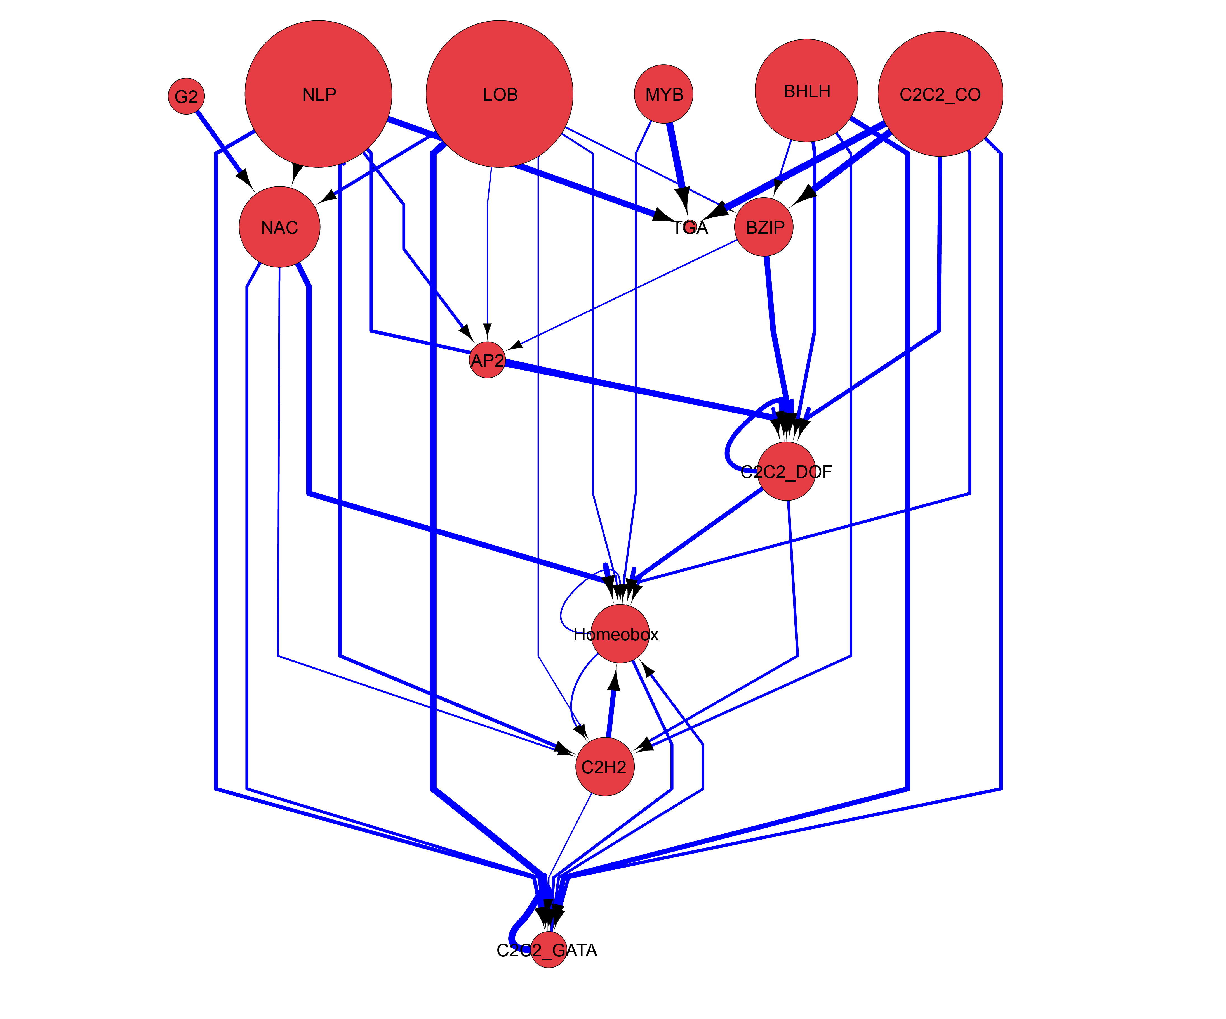
For next time - TFs families as predictors with SSM
-- Look at the literature to see the state of the art of predicting families with families.
-- For publication (we’d like to show whether it’s better using TF families as predictors rather than all TFs): we want to compare the actual results of families as predictors (shown in this figure) with results using subsets from DFG run of all TFs as predictors. If the results are the same, it means that the other TFs cause just noise.
-- Cis analysis for best predicted genes(~200). For instance regarding the case of G2 as predictors, we want to see whether with cis analysis we find NAC as the “buddy”.
-- Mips analysis for best predicted genes (~200)
Notes:
Grant (deadline June 5th):
-- Make the model of the new root data.
-- Cell-specific analysis with the new root data using Birnbaum et al. and Gifford et al.
-- Cell-expression table out of the TFs we are interested in (to see from Gifford which cell the TFs are expressed in)
-- See whether or not linear model isn’t anymore functional at larger scale - Using simulated data do the following: group testing on smaller scale; try a linear model on that, then try a random forest on that. Finally do the same for the bigger scale. Also try multiple size of groups to understand which size is ideal.
-- Figure out how important is “grouping” according to specific sets of TFs. There are no TF families in dream but what we can do is look at correlated TFs - Compare Correlated/Not Correlated/Random.

Slide 10
What’s a Random Forest (Recall Genie3 example)
Group
Group1
Group2
Experiments |  | Genes
 | G1 | G2 | G3 | Target
Δ1 | 0.7 | 0.25 | 0.7 | 1
Δ2 | 0.1 | 0.2 | 0.2 | 1
Δ3 | 0.2 | 0.4 | 0.1 | 1
Δ4 | 0.3 | 0.6 | 0.9 | 1
Δ5 | 0.7 | 0.8 | 0.9 | -1
Δ6 | 0.6 | 0.6 | 0.1 | -1
Δ1,Δ2,Δ3,Δ4,Δ5,Δ6
Target Tree
G2 > 0.3
False
True
Δ1,Δ2
Δ3,Δ4,Δ5,Δ6
Target Value Sign +
+1

Slide 11
Group
Group1
Group3
Group4
Experiments |  | Genes
 | G1 | G2 | G3 | Target
Δ1 | 0.7 | 0.25 | 0.7 | 1
Δ2 | 0.1 | 0.2 | 0.2 | 1
Δ3 | 0.2 | 0.4 | 0.1 | 1
Δ4 | 0.3 | 0.6 | 0.9 | 1
Δ5 | 0.7 | 0.8 | 0.9 | -1
Δ6 | 0.6 | 0.6 | 0.1 | -1
Δ1,Δ2,Δ3,Δ4,Δ5,Δ6
G2 > 0.3
Target Tree
False
True
Δ1,Δ2
Δ3,Δ4,Δ5,Δ6
Target Value Sign+
+1
G1 > 0.5
False
True
Target Value Sign
+1
Target Value Sign-
-1

Slide 12
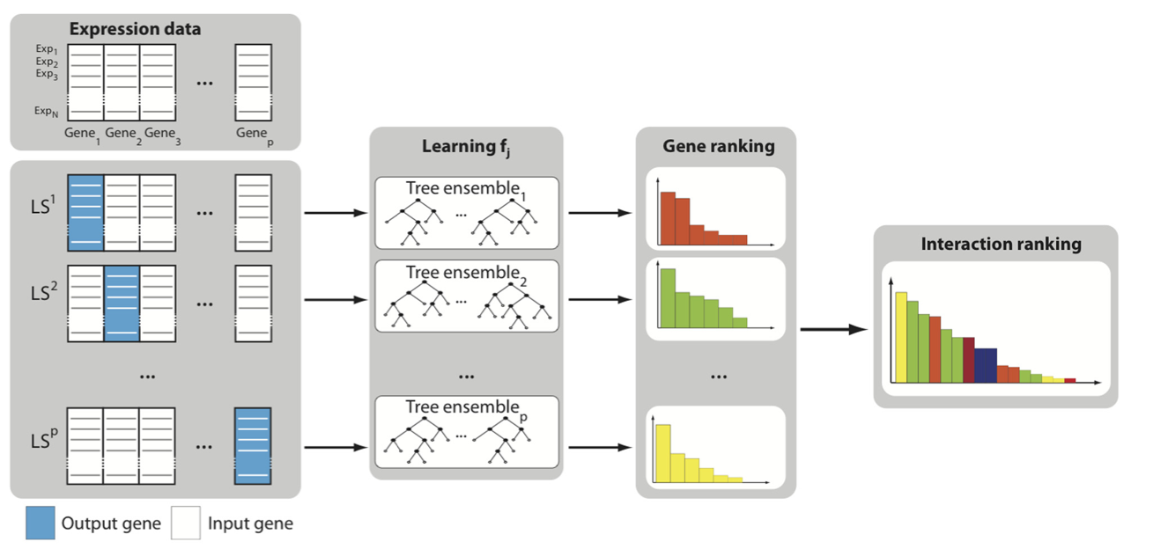
Recall Genie3 – ensemble of regression trees
We instead have an ensemble of classifier decision trees

