Slide 1
Policy optimization in Epidemic
By Mai Le Xuan Anh
Advisors: Azza Abouzied, Dennis Shasha

Slide 2
Motivation and Research Goals
Recent threats to global health and economy: Influenza (2009), Ebola (2013)
Seek algorithms to combat widespread epidemics
Goals:
Use existing models to simulate the spread of diseases as accurately as possible using epidemiological models and social interactions.
Estimate from various references the different costs of disease spread and interventions.
Determine the most cost-effective policy in terms of interventions for controlling epidemics.

Slide 3
SEIR Model
A compartmental model:
Divide the population into homogeneous groups: Susceptible, Exposed, Infectious, Recovered
Probability of transition between each compartment

Slide 4
Interventions
A set of actions that intervene the widespread of the disease
Pharmaceutical:
Vaccination
Antivirals/antibiotics
Non-pharmaceutical:
School closure
Workplace closure
Personal protective equipment

Slide 5
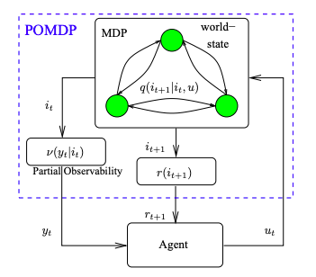
Methodology Partially Observable Markov Decision Process (POMDP)
Epidemic scenario is a partially observable environment
POMDP consists of:
States
Actions
Observations
Cost function: defined as the total of infected population throughout the time series
Use Approximate Dynamic Programming to approximate the cost function
Seek policy that minimizes the cost of interventions while limiting damage as much as possible.

