Slide 1
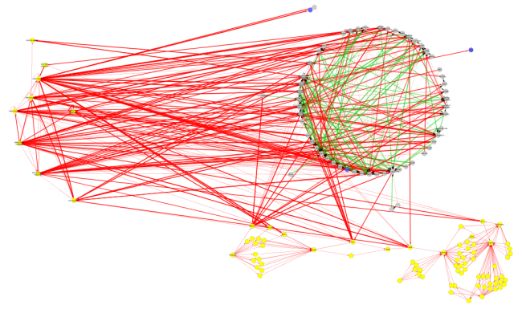
TF Perturbation
High Throughput Experimentation
Aim 3
Aim 1
Aim 1
Aim 1
Aim 3
Network Inference
Data Types
TF Perturbation
Steady State
Time Series
Aim 2
Machine Learning Pipeline
MCZ
Steady State
DFG
Time Series

