Slide 1
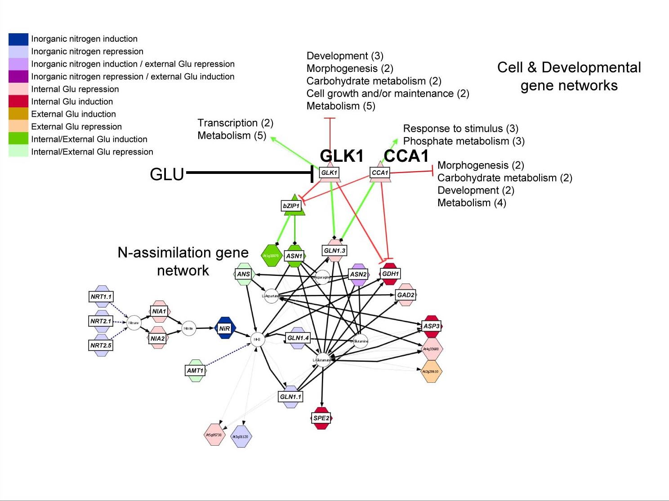
(A)
(C)
Development (3)
Morphogenesis (2)
Carbohydrate metabolism (2)
Cell growth and/or maintenance (2)
Metabolism (5)
Node
Edge
Node
(B)
Functional Relationships
Transcription (2)
Metabolism (5)
Response to stimulus (3)
Phosphate metabolism (3)
Metabolic Reaction
KEGG
Metabolic
Gene
Morphogenesis (2)
Development (2)
Metabolism (4)
Carbohydrate metabolism (2)
Metabolite
Regulatory
Protein
Protein:DNA
Transfac
Target
Gene
Protein
Protein:Protein
‘Interologs’
Protein
miRNA
microRNA:RNA
Target
RNA
Text mining
Geneways
Gene
Gene
Arabidopsis Multi-Network
16,562 nodes
97,423 interactions
Notes:
Figure 3

Slide 2
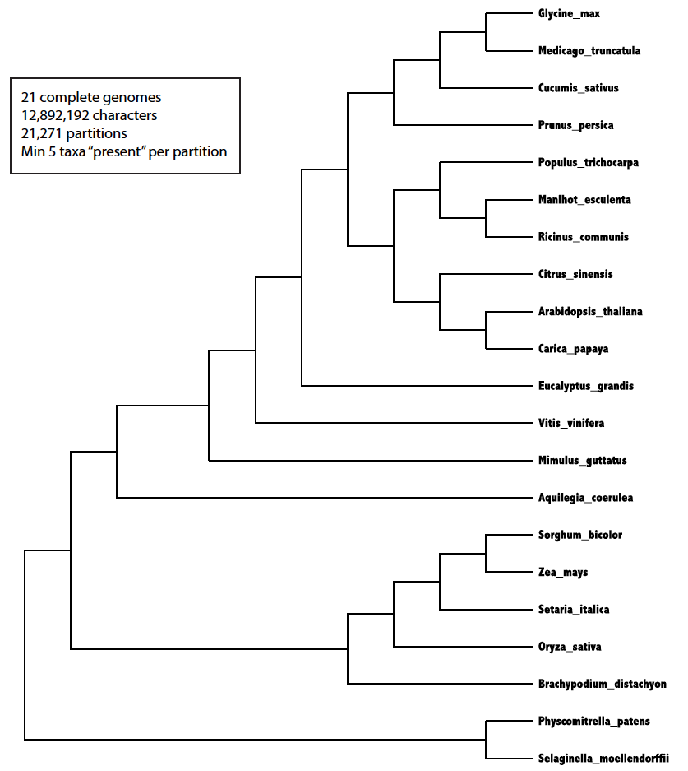
OLD FIGURE: NEED NEW FIGURE FROM KRANTHI
Glycine max
Medicago truncatula
21 complete genomes
12,892,192 characters
21,271 partitions
Min 5 taxa “present” per partition
Cucumis sativus
Prunus persica
Populus trichocarpa
Manihot esculenta
Ricinus communis
Citrus sinensis
Arabidopsis thaliana
Carica papaya
Eucalyptus grandis
Vitus vinifera
Mimulus guttatus
Aquilegia coerulea
Sorghum bicolor
Zea mays
Setaria italica
Oryza sativa
Brachypodium distachyon
Physcomitrella patens
Selaginella moellendorffii

Slide 3



InferNET: A machine learning approach to inferring gene networks
Step 1: Training
Learn Rules on DATA-RICH Species
Learned Rules
EC_{T (per species)}= a₁*MOv + a₂ * Cs + a₃*Ps
and “ Species Combining Rule”
Species 2
Step 2: Network Inference
APPLY RULES TO DATA POOR
Species 1
Species 3
“Species combining Rule”
DATA RICH “SOURCE” SPECIES
Target SPECIES
(e.g. data poor crop)

Slide 4
EC_{T (per species)}= a₁ * MOv + a₂ * Cs + a₃ * Ps
EC_{T} = Estimated Correlation of Target
MOv = Mean of Orthologous values
Cs = Correlation of source pair
Ps = P-val correlation of source pair
a₁, a₂, a₃ = coefficients
Cs, Ps
(e.g. Arabidopsis)
(Source)
g1
g2
LEARN/TRAIN
On Data Rich
Species
APPLY LEARNED RULES to
Data Poor Species
MOv
MOv
EC_{T}
(e.g. Medicago)
(Trainer)
g2’
g1”
g2”
(e.g. Soy)
(Target)
g1’
Predicted
Orthology
Precision/Recall
Experimental Correlation
g1”
g2”
(e.g. Soy)
Experimental
Predicted Correlation

Slide 5
CROP KNOWLEDGE
ARABIDOPSIS KNOWLEDGE
Step 1: Data associated with trait
Step 6. Test mutants in Arabidopsis and test translation to crop mutants
Step 5: Annotate network module
Identify candidate gene sets (e.g. hubs, GO-term associated biomodules, network neighborhoods ….)
Expression data
MUTANTS
mutants or genes associated with trait
(if available)
g1
g2
Trait
g2
g2
Step 4: Network Properties Highly connected cliques,
Hubs, etc.
g3
Step 2:
Crop species drive correlation networks
Step 3: Orthology & “weighted” network
Crop species 1
(e.g. g1, g2 = in Arabidopsis & 2 crops)
g1’
g2’
NETWORKS
Crop species 2
g3’
g3 = only in 2 crops

Slide 7
Predicting networks in Soy (Glycine Max)
Method | Positive Recall | Positive Precision | Negative Recall | Negative Precision
InferNET | 88% (xxx/yyy) | 79% (xxx/yyy) | 73% (xxx/yyy) | 83% (xxx/yyy)
Interolog | 81% (xxx/yyy) | 69% (xxx/yyy) | 65% (xxx/yyy) | 78% (xxx/yyy)
Predicting networks in Medicago
Method | Positive Recall | Positive Precision | Negative Recall | Negative Precision
InferNET | xx% (xxx/yyy) | xx% (xxx/yyy) | xx% (xxx/yyy) | xx% (xxx/yyy)
Interolog | xx% (xxx/yyy) | xx% (xxx/yyy) | xx% (xxx/yyy) | xx% (xxx/yyy)

