Slide 1
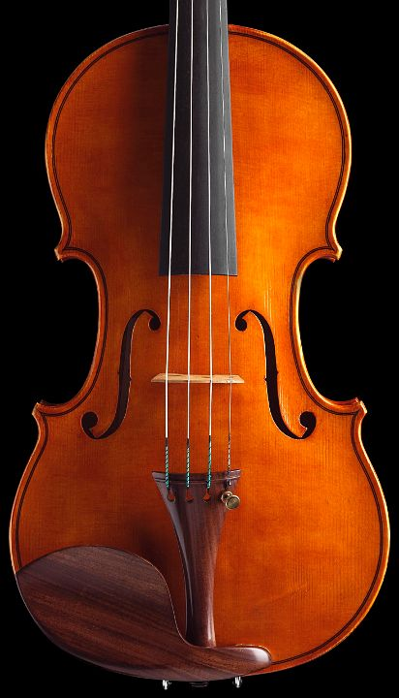

Index Tuning

Slide 2
Outline
Index Utilization
  Heap Files
  Definition: Clustered/Non clustered, Dense/Sparse
  Access method: Types of queries
  Constraints and Indexes
  Locking
Index Data Structures
  B+-Tree / Hash
  LSM Tree / Fractal tree
  Implementation in DBMS
Index Tuning
  Index data structure
  Search key
  Size of key
  Clustered/Non-clustered/No index
  Covering

Slide 3
Heap Files
Rows appended to end of file as they are inserted
  Hence the file is unordered
  Good for scan
Deleted rows create gaps in file
  File must be periodically compacted to recover space
Set
of
records

Slide 4
Index
An index is a data structure that provides efficient access to a set of records
The leaves of the index are (pointers to) records. The internal nodes of the index define its data structure.
Set
of
records
Matching
records
Condition
on
attribute
value
(a>2)
index
search key
(a)

Slide 5
Simple SQL Example
select ssnum,name
from employees
where hundreds2 > 10;
create index nc on
employees (hundreds2);
create index nc1 on
employees (hundreds2, ssnum, name)
create table employees(
ssnum integer not null,
name varchar(20) not null,
lat real, long real,
hundreds1 real,
hundreds2 real
);

Slide 6
Search Keys
A (search) key is a sequence of attributes.
create index i1 on accounts(branchnum, balance);
Types of keys
  Sequential: the value of the key is monotonic with the insertion order (e.g., counter or timestamp)
  Non sequential: the value of the key is unrelated to the insertion order (e.g., social security number)

Slide 7
Clustered / Non clustered index
Clustered index (primary index)
  A clustered index on attribute X co-locates records whose X values are near to one another.
Non-clustered index (secondary index)
  A non clustered index does not constrain table organization.
  There might be several non-clustered indexes per table.
Records
Records

Slide 8
Index-Organized Tables
Clustered indexes organized how data are stored on disk
  Clustered index and storage can be orthogonal
    A clustered index can be dropped in which case the table is organized as a heap file
    A clustered index can be defined on a table (previously organized as a heap table), which is then reorganized
  Index-organized table
    The clustered index defines the table organization. It is required when the table is defined. It cannot be dropped.

Slide 9
Dense / Sparse Index
Sparse index
  Pointers are associated to pages
Dense index
  Pointers are associated to records
  Non clustered indexes are dense
P1
P2
Pi
record
record
record

Slide 10
OLTP: Types of Queries
Point Query
SELECT balance
FROM accounts
WHERE number = 1023;
Multipoint Query
SELECT balance
FROM accounts
WHERE branchnum = 100;
Range Query
SELECT number
FROM accounts
WHERE balance > 10000;
Prefix Match Query
SELECT *
FROM employees
WHERE name = ‘Jensen’
and firstname = ‘Carl’
and age < 30;
Tables are in BNF, derived from entities and relationships

Slide 11
OLTP: Types of Queries
Extremal Query
SELECT *
FROM accounts
WHERE balance =
max(select balance from accounts)
Ordering Query
SELECT *
FROM accounts
ORDER BY balance;
Grouping Query
SELECT branchnum, avg(balance)
FROM accounts
GROUP BY branchnum;
Join Query
SELECT distinct branch.adresse
FROM accounts, branch
WHERE
accounts.branchnum = branch.number
and accounts.balance > 10000;

Slide 12
OLAP
Types of Data
Types of Queries
Multidimensional data
  Cube
Spatio-temporal data
  Time series
  Spatial data
  Sensor data
Cube operators
  Rollup / Drill down
Clustering & similarity
  Nearest neighbors
Preferences
  Top K
  Skyline
See lecture on OLAP tuning

Slide 13
Constraints and Indexes
Primary Key, Unique
  A non-clustered index is constructed on the attribute(s) that compose the primary key with the constraint that values are unique.
Foreign Key
  By default, no index is created to enforce a foreign key constraint.

Slide 14
Locking
Tree locking
  Updating a table, requires updating the index (leaves and possibly internal nodes)
  Concurrent modifications must be scheduled
  Should locking be used to make conflicts between index writes explicit?
Next key locking
  How can indexes be used to implement a form of predicate locking
Records
We will review locking in the context of the B+-tree

Slide 15
Data Structures
Most index data structures can be viewed as trees.
In general, the root of this tree will always be in main memory, while the leaves will be located on disk.
  The performance of a data structure depends on the number of nodes in the average path from the root to the leaf.
  Data structure with high fan-out (maximum number of children of an internal node) are thus preferred.

Slide 16
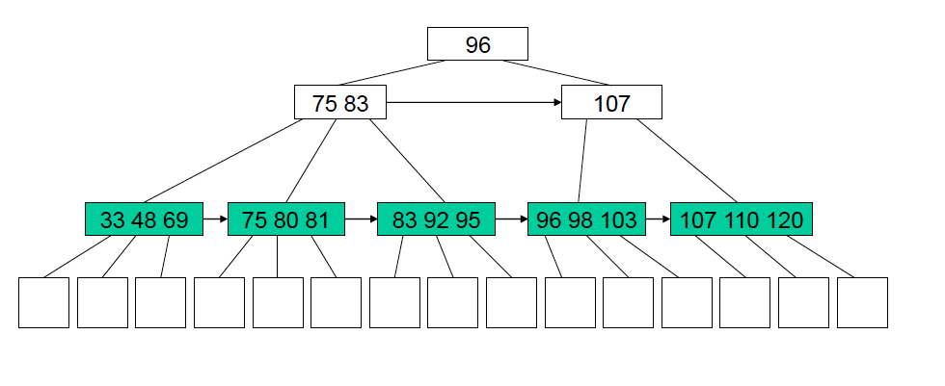
B+-Tree
A B+-Tree is a balanced tree whose nodes contain a sequence of key-pointer pairs.
Depth
Fan-out

Slide 17
B+-Tree
Nodes contains a bounded number of key-pointer pairs determined by b (branching factor)
  Internal nodes: ceiling(b/ 2) <= size(node) <= b
  Root node:
    Root is the only node in the tree: 1 <= size(node) <= b
    Internal nodes exist: 2 <= size(node) <= b
  Leaves (no pointers):
    floor(b/2) <= number(keys) <= b-1
Insertion, deletion algorithms keep the tree balanced, and maintain these constraints on the size of each node
  Nodes might then be split or merged, possibly the depth of the tree is increased.
size(node) = number of key-pointer pairs

Slide 18
B+-Tree Performance #1
Memory / Disk
  Root is always in memory
  What is the portion of the index actually in memory?
    Impacts the number of IO
    Worst-case: an I/O per level in the B+-tree!
Fan-out and tree level
  Both are interdependent
  They depend on the branching factor
      In practice, index nodes are mapped onto index pages of fixed size
      Branching factor then depends on key size (pointers of fixed size) and page utilization

Slide 19
B+-Tree Performance #2
Tree maintenance
  On-line: textbook insertion and deletion algorithms that maintain balanced B+-tree as records are inserted
  Off-line: inserted/deleted records are inserted in a specific data structure and indexes are modified offline (when the DBA requests it, regularly or when some condition is met).
    Log-Structured Merge (LSM)-tree: Records inserted in RAM (C0-tree not necessarily organized as a B+-tree – e.g., sorted table), then merged with disk resident C1-tree pages opportunistically.
    Heap file: insert buffer in MySQL, default mechanism in DB2.
Supports well
  Point queries, Multipoint queries, Range queries, order queries, Extremal queries.
See LSM-Tree paper by Pat O’Neil et al.

Slide 20
B+-Tree Locking
See: VLDB journal survey, ARIES KVL
How to avoid locking the whole table and
schedule concurrent modifications of the
tree?
  Mutexes are used. Top down traversal.
  Mutex released when it is clear that internal
  Node will not be affected by insertion/deletion
  e.g., new level requires holding mutex
  on root; insertion in leaf mutexes can
  be released as internal nodes are
  traversed.
1. How to support predicate-locking?
Next-key locking. A mutex held on a pointer prevents access to all the records that are inserted, or could be inserted, below this pointer or in between this pointer and the next existing pointer. E.g. blue rectangles represent a lock on all records where key >= 80.

Slide 21
Hash Index
A hash index stores key-value pairs based on a pseudo-randomizing function called a hash function
Hashed key | values
0 | R1, R5
1 | R4, R6, R9
…
n
Hash
function
Overflow buckets
Key value
R14, R17, R21
R25

Slide 22
Hash Index Performance
Memory / Disk
  Worst case: 1 IO per bucket
  NOT balanced as number of IOs to reach a record depends on the hash function and key distribution.
Supports very well
  Point queries

Slide 23
Fractal Tree Index
Trees of exponentially increasing size
  (represented as arrays for ease of representation)
  Trees are completely full or completely empty
  Insert into smallest array
  Merge arrays continuously
23
12 | 23
45
12 | 23
6 | 45 | 12 | 23
87
6 | 45 | 12 | 23

Slide 24
Fractal Tree Index Performance
Few, large, sequential IOs on several trees
  Scales with large number of insertions (variation of LSM-tree)
  Potential to leverage SSD parallelism

Slide 25
DBMS Implementation
Oracle 11g
  B-tree vs. Hash vs. Bitmap
  Index-organized table vs. heap
    Non-clustered index can be defined on both
  Reverse key indexes
  Key compression
  Invisible index (not visible to optimizer – allows for experimentation)
  Function-based indexes
    CREATE INDEX idx ON table_1 (a + b * (c - 1), a, b);
See: Oracle 11g indexes

Slide 26
DBMS Implementation
DB2 10
  B+-tree (hash index only for db2 for z/OS)
  Non-cluster vs. cluster
  Key compression
  Indexes on expression
SQL Server 2012
  B+-tree (spatial indexes built on top of B+-trees)
  Columnstore index for OLAP queries
  Non-cluster vs. cluster
  Non key columns included in index (for coverage)
  Indexes on simple expressions (filtered indexes)
See: DB2 types of indexes, SQLServer 2012 indexes

Slide 27
Clustered Index
Benefits of a clustered index:
A sparse clustered index stores fewer pointers than a dense index.
  This might save up to one level in the B-tree index.
A clustered index is good for multipoint queries
  White pages in a paper telephone book
A clustered index based on a B-Tree supports range, prefix, extremal and ordering queries well.

Slide 28
Clustered Index
A clustered index (on attribute X) can reduce lock contention:
  Retrieval of records or update operations using an equality, a prefix match or a range condition based on X will access and lock only a few consecutive pages of data
Cost of a clustered index
Cost of overflow pages
  Due to insertions
  Due to updates (e.g., a NULL value by a long string)

Slide 29
Clustered Index
Because there is at most one clustered index per table, it might be a good idea to replicate a table in order to use a clustered index on two different attributes
  Yellow and white pages in a paper telephone book
  Low insertion/update rate
Alternative is to use covering indexes (to be discussed later).

Slide 30
Non-Clustered Index
Benefits of non-clustered indexes
A dense index can eliminate the need to access the underlying table through covering.
  It might be worth creating several indexes to increase the likelihood that the optimizer can find a covering index
A non-clustered index is good if each query retrieves significantly fewer records than there are pages in the table.
  Where is the tipping point wrt heap file? You must experiment on your own system.

Slide 31
Covering Index - defined
Select name from employee where department = “marketing”
A priori:
  Good covering index would be on (department, name)
  Index on (name, department) less useful.
  Index on department alone moderately useful.
Actual impact depends on underlying DBMS.

Slide 32
Index on Small Tables
Tuning manuals suggest to avoid indexes on small tables
  If all data from a relation fits in one page then an index page adds an I/O
  If each record fits in a page then an index helps performance
However, indexes on small tables allow the DBMS to leverage next key locking and thus reduce contention on small tables.

Slide 33
Key Compression
Use key compression
  If you are using a B-tree
  Compressing the key will reduce the number of levels in the tree
  The system is not CPU-bound
  Updates are relatively rare

Slide 34
Summary
Use a hash index for point queries only. Use a B-tree if multipoint queries or range queries are used
Use clustering
  if your queries need all or most of the fields of each records returned
  if multipoint or range queries are asked
Use a dense index to cover critical queries
Don’t use an index if the time lost when inserting and updating overwhelms the time saved when querying

