Slide 1
Computational Stochastic Optimization:
Policies
October 25, 2012
Warren Powell
CASTLE Laboratory
Princeton University
http://www.castlelab.princeton.edu
© 2012 Warren B. Powell, Princeton University

Slide 2
Outline
The four classes of policies
Myopic policies
Lookahead policies
Policy function approximations
Policies based on value function approximations
Designing policies

Slide 3
Four classes of policies
A policy is a mapping from state to (feasible) action:
  This is why the state variable has to follow our definition.
Four classes of policies:
  Myopic optimization of a cost or cost function approximation
  Lookahead policies (many forms)
  Policy function approximations (see below)
  Policies based on value function approximations.

Slide 4
Four classes of policies
1) Myopic policies
  Take the action that maximizes contribution (or minimizes cost) for just the current time period:
  We can parameterize myopic policies with bonus and penalties to encourage good long-term behavior.
  We may use a myopic cost function approximation:
  The cost function approximation may be designed to produce better long-run behaviors.

Slide 5
Policies
2) Lookahead policies - Plan over the next T periods, but implement only the action it tells you to do now.
  Deterministic forecast
  Stochastic programming (e.g. two-stage)
  Rolling/receding horizon procedures
  Model predictive control
  Rollout heuristics
  Tree search (decision trees), Monte Carlo tree search

Slide 6
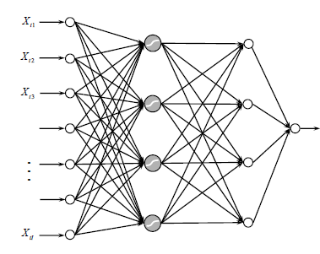
Four classes of policies
3) Policy function approximations
  Lookup table
    Recharge the battery between 2am and 6am each morning, and discharge as needed.
  Parameterized functions
    Recharge the battery when the price is below and discharge when the price is above
  Regression models
  Neural networks

Slide 7
Four classes of policies
4) Policies based on value function approximations
  Using the pre-decision state
  Or the post-decision state:
  This is what most people associate with “approximate dynamic programming” or “reinforcement learning”

Slide 8
Four classes of policies
There are four classes of approximation strategies
  Lookup table
    Given a discrete state, return a discrete action or value
  Parametric models
    Linear models (“basis functions”)
    Nonlinear models
  Nonparametric models
    Kernel regression
    Neural networks
  Semiparametric models
    Local polynomial approximations
    Dirichlet clouds
1
2
3
4
5

Slide 9
Policies
(Slightly arrogant) claim:
  These are the fundamental building blocks of all policies.
Many variations can be built using hybrids
  Lookahead plus value function for terminal reward
  Myopic or lookahead policies with policy function approximation
  Modified lookahead policy
The slides that follow give more in-depth illustrates of these.

Slide 10
Outline
The four classes of policies
Myopic policies
Lookahead policies
Policy function approximations
Policies based on value function approximations
Designing policies

Slide 11
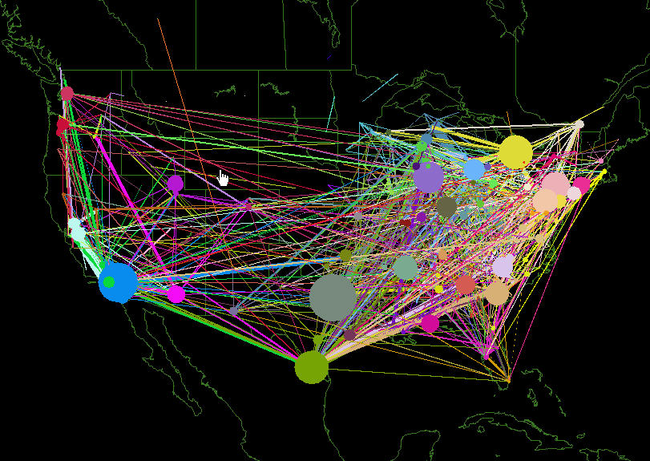
Schneider National

Slide 12
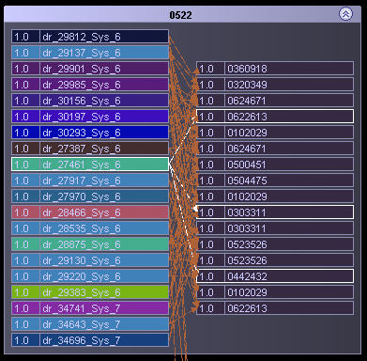
Truckload trucking
Truckload trucking involves assigning drivers (on the left) to loads (on the right).
Ideally, we would like to think about the downstream impact of a decision made now.
The most widely used commercial dispatch system does not consider the downstream impact – it is a myopic policy.
The next slide shows the dispatch center at Schneider National which was the early pioneer of these technologies

Slide 13
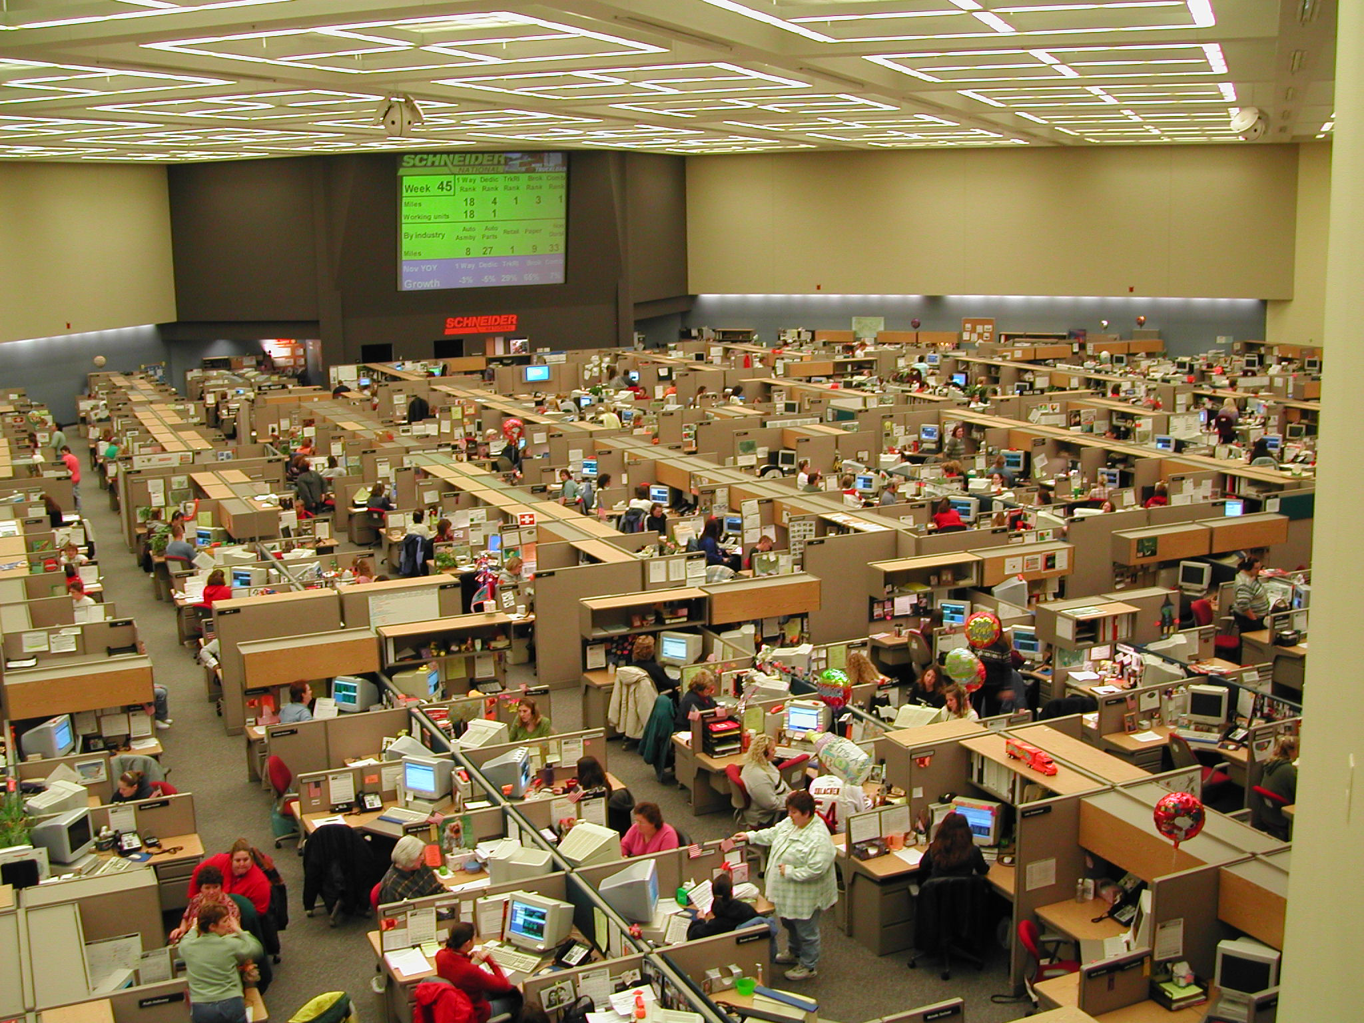
Slide 13
Notes:
13
This is the dispatch room for Schneider National, one of the largest truckload motor carriers in the U.S.

Slide 14
A driver assignment model
Drivers
Demands
Notes:
… to tasks (loads, trains, flights).

Slide 15
A driver assignment model
t
t+1
t+2
The assignment of drivers to loads evolves over time, with new loads being called in, along with updates to the status of a driver.
Notes:
After we make a decision at time t, we then have to do it again at t+1 and t+2

Slide 16
A driver assignment model
A purely myopic policy would solve this problem using
  where
  What if a load it not assigned to any driver, and has been delayed for a while? This model ignores the fact that we eventually have to assign someone to the load.

Slide 17
A driver assignment model
To solve the problem of delayed loads
  We can add a bonus to loads that have been delayed by using a modified cost
  where
  We now solve the modified problem:
  We refer to as a cost function approximation.

Slide 18
A driver assignment model
We can now optimize over this class of policies
  Let
  Represent the policy determined by our cost function approximation, parameterized by .
  We can now optimize , a process known as policy search. We do this by solving
  Note that we cannot compute expectations. More on this below.

Slide 19
Outline
The four classes of policies
Myopic policies
Lookahead policies
Policy function approximations
Policies based on value function approximations
Designing policies

Slide 20
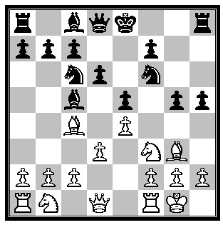


Lookahead policies
Planning your next chess move:
  You put your finger on the piece while you think about moves into the future. This is a lookahead policy, illustrated for a problem with discrete actions.

Slide 21
What is a policy?
We can handle vector-valued decisions by solving linear (or integer) programs over a horizon.
21
Notes:
21
21

Slide 22
What is a policy?
We optimize into the future, but then ignore the decisions that would not be implemented until later.
22
Notes:
22
22

Slide 23
What is a policy?
Assume that this is the full model (over T time periods)
T
23
Notes:
23
23

Slide 24
What is a policy?
But we solve a smaller lookahead model (from t to t+H)
0
0+H
24
Notes:
24
24

Slide 25
What is a policy?
Following a lookahead policy
1
1+H
25
Notes:
25
25

Slide 26
What is a policy?
… which rolls forward in time.
2
2+H
26
Notes:
26
26

Slide 27
What is a policy?
… which rolls forward in time.
3
3+H
27
Notes:
27
27

Slide 28
What is a policy?
… which rolls forward in time.
t
t+H
28
Notes:
28
28

Slide 29
Lookahead policies
A lookahead policy involves solving a lookahead model.
  The lookahead model is a dynamic program that is simplified in some way:
    Shorter horizon H
    Sampled outcome space instead of full set of outcomes
    Coarse discretization of the state variable
  Solving the lookahead model is a policy for solving the original model.
  An optimal solution of the lookahead model is generally not an optimal policy.

Slide 30
Lookahead policies
Lookahead policies are the trickiest to model:
  Planning horizon t,…,t+H
  Exogenous outcomes may be approximated:
    Deterministically
    Using sampled scenario trees:
  We create “tilde variables” for the lookahead model:

Slide 31
Lookahead policies
Lookahead policies are created by solving a lookahead model.
  Deterministic lookahead – We replace uncertain future events using a deterministic approximation
  Stochastic lookahead
    We can create a lookahead model where uncertainties are captured using a sampled scenario tree:

Slide 32
Lookahead policies
Lookahead policies peek into the future
  Optimize over deterministic lookahead model
The lookahead model
. . . .
The real process

Slide 33

Lookahead policies
Lookahead policies peek into the future
  Optimize over deterministic lookahead model
The lookahead model
. . . .
The real process

Slide 34

Lookahead policies
Lookahead policies peek into the future
  Optimize over deterministic lookahead model
The lookahead model
. . . .
The real process

Slide 35

Lookahead policies
Lookahead policies peek into the future
  Optimize over deterministic lookahead model
The lookahead model
. . . .
The real process

Slide 36
Lookahead policies
Probabilistic lookahead
  We can approximate the information model by discretizing the outcomes:
  … but this is limited to scalar random variables.
High
demand
0.3
0.4
0.3
Low
demand

Slide 37
Lookahead policies
Probabilistic lookahead
  Here, we approximate the information model by using a Monte Carlo sample to create a scenario tree:
  We can try to solve this as a single “deterministic” optimization problem. This is a direct lookahead policy.

Slide 38
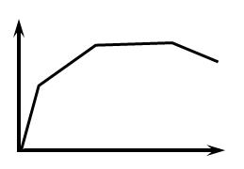
Lookahead policies
Probabilistic lookahead
  We can also solve the lookahead model using convex value function approximations (“dynamic programming”)

Slide 39
Lookahead policies
Probabilistic lookahead
  We can also solve the lookahead model using convex value function approximations (“dynamic programming”)

Slide 40
Lookahead policies
Probabilistic lookahead
  We can also solve the lookahead model using convex value function approximations (“dynamic programming”)

Slide 41
Lookahead policies
Probabilistic lookahead
  We can also solve the lookahead model using convex value function approximations (“dynamic programming”)

Slide 42
Lookahead policies
We can then simulate this lookahead policy over time:
The lookahead model
. . . .
The real process

Slide 43
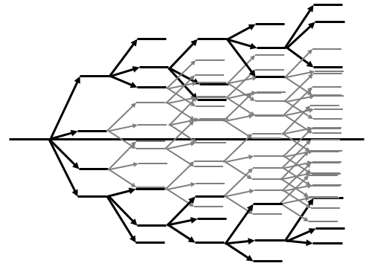
Lookahead policies
We can then simulate this lookahead policy over time:
The lookahead model
. . . .
The real process

Slide 44
Lookahead policies
We can then simulate this lookahead policy over time:
The lookahead model
. . . .
The real process

Slide 45
Lookahead policies
We can then simulate this lookahead policy over time:
The lookahead model
. . . .
The real process

Slide 46
Lookahead policies
Notes:
  The lookahead model is a dynamic program but it is restricted (the horizon) and simplified (the representation of the stochastic process).
  Solving a stochastic lookahead model, however, can still be computationally demanding.
  As with other policies, you should simulate the policy to test the effect of the horizon, number of samples in the tree and the handling of stages.
  Very important: an optimal solution of even a stochastic lookahead policy is not an optimal policy!
  A lower bound on the solution of a lookahead model is not a bound on the performance of a policy.

Slide 47
Outline
The four classes of policies
Myopic policies
Lookahead policies
Policy function approximations
Policies based on value function approximations
Designing policies

Slide 48
Policy function approximation
Policy function approximations are how most people solve problems. They include:
  Rule-based (lookup table) functions – “When in this state, take this action”
  Parametric functions
    Sell when the price is over some number.
    Set the speed of the robot arm u to
    “Affine policies” are linear functions of the form:
  Nonparametric/semi-parametric functions
    Semi-parametrics are popular in engineering – Use a linear (affine) function defined over a pre-defined region of the state space.

Slide 49
Policy function approximation
Managing a water reservoir

Slide 50
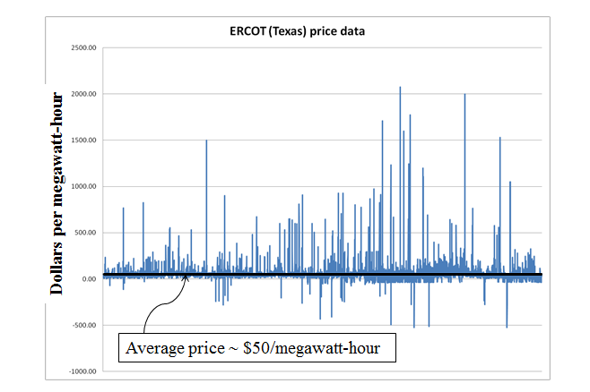
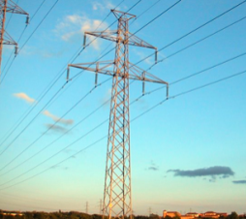
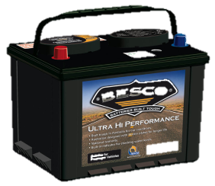
Policy function approximation
Battery arbitrage
  Store energy in the battery when the price is low, discharge when the price is high.
  Spot prices can be incredibly volatile.

Slide 51
Policy function approximation
A simple policy is to charge when prices are below one number, and discharge when the price is above another point.
  This policy is simple to implement and simulate.

Slide 52
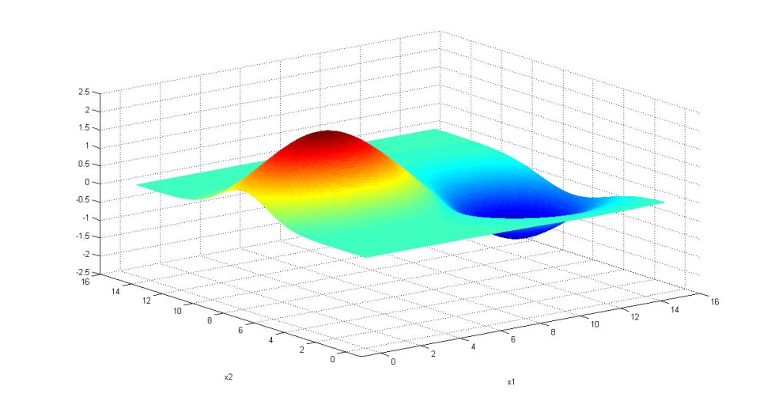
Policy function approximation
We would write our policy in the form
  We seek to find the value of that solves
  We need to find the maximum of the surface

Slide 53
Policy function approximation
Generally, we cannot compute
Instead, we simulate it.
  Either as a single, long simulation:
  …or by averaging across sample paths:

Slide 54
Policy function approximation
Policy search is form of stochastic search, which fits the following general model:
  Here, the deterministic vector “x” refers to the parameters in the policy.
  There is a substantial literature on this problem that falls under names including:
    Stochastic search
    Simulation-optimization
    Optimal learning
    Ranking and selection (off line learning)
    Multiarmed bandit problems (online learning)

Slide 55
Outline
The four classes of policies
Myopic policies
Lookahead policies
Policy function approximations
Policies based on value function approximations
Designing policies

Slide 56
Policies based on value functions
The use of value functions is widely associated with “dynamic programming.”
Many people assume that if you are using “dynamic programming,” that you are using Bellman’s equation (with a value function) to develop an optimal or near-optimal policy.
Yet, it is also widely recognized that this works only for very small problems.
Here, we illustrate the application of approximate dynamic programming (with value functions) to the optimization of locomotives at Norfolk Southern Railroad. For other very large scale, industrial applications, go to
  http://adp.princeton.edu
  And click on Applications at the bottom of the page.

Slide 57
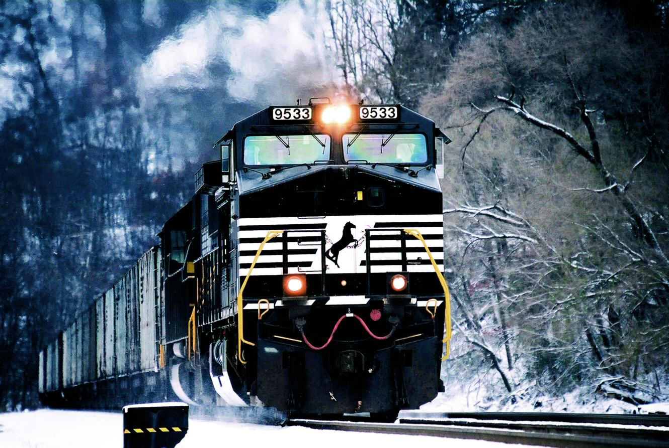



Slide 58
Locomotive optimization using VFA
Traditional model optimizes over a deterministic future

Slide 59
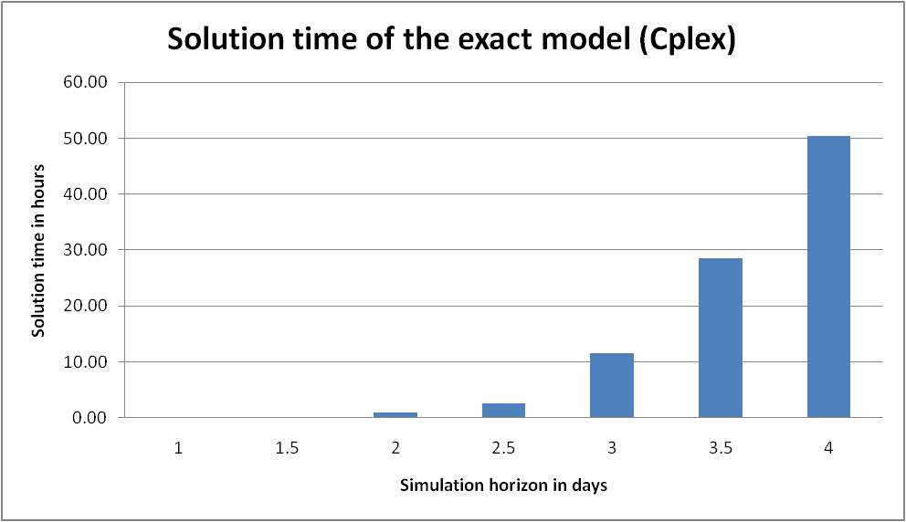
Locomotive optimization using VFA
The curse of time horizons
(50 hrs)
(29 hrs)
(12 hrs)
(1 hr)
(2.5 hrs)
(3 secs)
(1 min)
Simulation horizon (days)

Slide 60
Locomotive optimization using VFA
In the slides that follow, we are going to step through the construction of the single-period optimization problem for assigning locomotives to a single train.
We will use value functions to capture the value of locomotives in the future. These value functions have to be estimated iteratively.

Slide 61
Locomotive optimization using VFA
We begin by showing the assignment of individual locomotives to individual trains.
Atlanta
Locomotives
Trains
Yards
Baltimore
Jacksonville

Slide 62
Locomotive optimization using VFA
The assignment model has to handle a variety of complex operational issues such as grouping locomotives into consists.
Horsepower
Locomotives
4400
4400
6000
4400
5700
4600
6200
Consist-breakup costs
Shop routing bonuses/ penalties
Leader logic

Slide 63
Locomotive optimization using VFA
Locomotives may be hooked together; there is a cost to breaking locomotive consists apart.
Horsepower
Locomotives
Locomotives coming in on same train
4400
4400
6000
4400
5700
4600
6200

Slide 64
Locomotive optimization using VFA
We use a nonlinear function to capture the value of assigning locomotives to a train.
Train reward function
Horsepower
Locomotives
4400
4400
6000
4400
5700
4600
6200

Slide 65
Locomotive optimization using VFA
The train reward function
  Our train reward function puts a slight penalty if we use too much power. But our value functions will capture the benefit of moving extra locomotives to a downstream location.
Train reward
Repositioning
Power
Goal
Minimum

Slide 66
Locomotive optimization using VFA
This forms a decision problem which, by itself, would represent a myopic policy.
Horsepower
Locomotives
4400
4400
6000
4400
5700
4600
Train may need 12,130 horsepower. Solutions:
4400 + 4400 + 6000 = 14,400
4400+4400+4400 = 13,200
6000+6200 = 12,200
6200

Slide 67
Locomotive optimization using VFA
We then introduce value functions to capture the value of locomotives in the future.
Locomotive
buckets
Horsepower
Locomotives
4400
4400
6000
4400
5700
4600
6200
The value of locomotives in the future is captured through nonlinear approximations.

Slide 68
Locomotive optimization using VFA
We solve this integer program, across all the locomotives at Norfolk Southern, using Cplex (in about 3 seconds).
4400
4400
6000
4400
5700
4600
6200

Slide 69
Approximate dynamic programming
We estimate the value functions using the algorithmic framework of approximate dynamic programming.
Value functions are approximated using separable, piecewise linear functions which are easy to use within Cplex.
Approximate dynamic programming simulates forward in time, gathering information about the value functions in the form of dual variables from the LP relaxation (for this application).

Slide 70
Approximate value iteration
  Step 1: Start with a pre-decision state
  Step 2: Solve the deterministic optimization using
  an approximate value function:
  to obtain .
  Step 3: Update the value function approximation
  Step 4: Obtain Monte Carlo sample of and
  compute the next pre-decision state:
  Step 5: Return to step 1.
Deterministic
optimization
Recursive
statistics
Simulation
Notes:
70
This is the basic algorithmic strategy. We start with the previous state R^x_{t-1}. Now simulate our way to R_t (one Monte Carlo simulation). Now find the value of being in state R_t. Finally use this to update the value of being in state R^x_{t-1} at time t-1.
For problems in transportation and logistics, you do not implement this literally. For resource allocation, we need the marginal value of an additional driver (etc). The value function here could be Benders cuts, and the updating mechanism could be stochastic decomposition. See chapter 12 of the current version of my book.

Slide 71
Approximate value iteration
  Step 1: Start with a pre-decision state
  Step 2: Solve the deterministic optimization using
  an approximate value function:
  to obtain .
  Step 3: Update the value function approximation
  Step 4: Obtain Monte Carlo sample of and
  compute the next pre-decision state:
  Step 5: Return to step 1.
Deterministic
optimization
Recursive
statistics
Simulation
Notes:
71
This is the basic algorithmic strategy. We start with the previous state R^x_{t-1}. Now simulate our way to R_t (one Monte Carlo simulation). Now find the value of being in state R_t. Finally use this to update the value of being in state R^x_{t-1} at time t-1.
For problems in transportation and logistics, you do not implement this literally. For resource allocation, we need the marginal value of an additional driver (etc). The value function here could be Benders cuts, and the updating mechanism could be stochastic decomposition. See chapter 12 of the current version of my book.

Slide 72
Approximating value functions
Approximations for resource allocation problems
  Linear (in the resource state):
  Piecewise linear, separable:
  Indexed PWL separable:
  Benders cuts

Slide 73
ADP for the locomotive application
The slides that follow illustrate the adaptive learning of value functions from solving sequences of locomotive assignment problems.
The underlying graphic is from a package called Pilotview developed at CASTLE Lab.
The graphic shows the problem decomposed into individual yards. In this particular project, we decomposed the problem in two ways:
  Optimizing regions as a single problem
  Optimizing the entire company as a single problem (at a point in time).

Slide 74
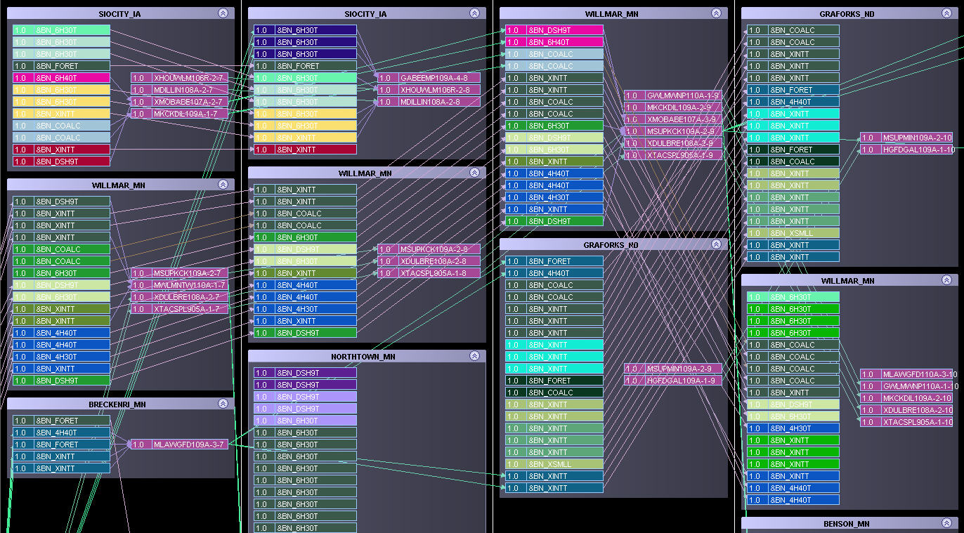
Notes:
These slides are from an industrial example (locomotives, but could be drivers or jets or box cars).

Slide 77
© 2008 Warren B. Powell
Slide 77
Notes:
77

Slide 78
Approximate dynamic programming
Objective function
Iterations
With luck, your objective function improves

Slide 79
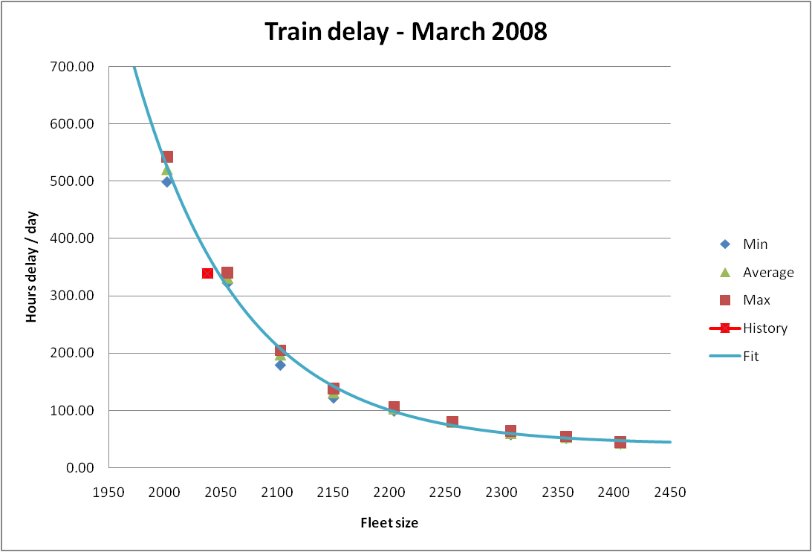
Model calibration
Train delay curve – March 2008
  The model was found to calibrate closely with history.
History
Delay hours/day
Fleet size

Slide 80
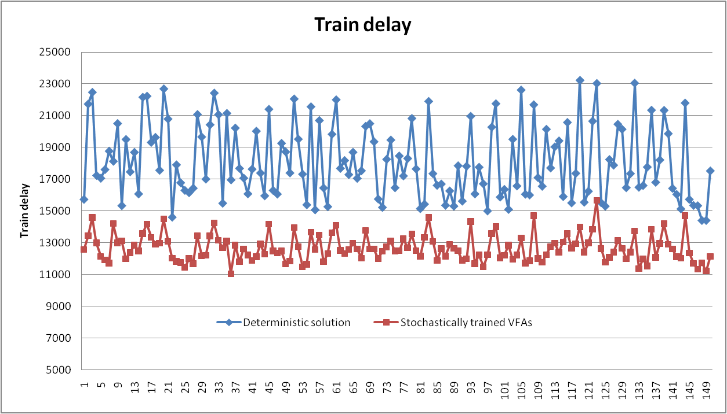
Laboratory testing
Train delay with uncertain transit times and yard delays
  Training value functions using stochastic data produces a more robust policy than value functions trained with deterministic data.
Train delay using deterministically trained VFAs
Train delay
Train delay using stochastically trained VFAs
For more information see http://www.castlelab.princeton.edu/plasma.htm

Slide 81
Locomotive optimization
This project illustrates the potential of using value functions for very large industrial problems.
We have used this logic in a variety of applications in transportation.
These applications demonstrate that value function approximations can be used for certain very large scale problems. But, our success here can be attributed to the finding that this problem could be approximated very effectively using separable, piecewise linear approximations.
  For more on the locomotive application, see
    http://www.castlelab.princeton.edu/plasma.htm

Slide 82
Outline
The four classes of policies
Myopic policies
Lookahead policies
Policy function approximations
Policies based on value function approximations
Designing policies

Slide 83
Choosing a policy
Lookahead or value function approximation?
  A deterministic lookahead
  … or a stochastic lookahead:
  … or a value function:

Slide 84
Choosing a policy
When to use a value function approximation
  When it is easy to estimate!!! If you think you can capture the important properties of the future in a fairly simple statistical model, you should definitely use it.
  For many problems, this is not possible. When there are complex interactions between different dimensions of the state variable, it may be hard to get an effective statistical model. This is when a lookahead policy is generally called for.
  But you pay a price for this generality – lookahead models can be expensive to compute.
  Do not ignore the ability to use hybrids…

Slide 85
Choosing a policy
We can create hybrids:
  We can use a VFA as a terminal reward:
  This still requires we use a deterministic model for time periods t,…,t+H.
  … or we can use a simultaneous overlay:
Correction terms introduced within the lookahead model

Slide 86
Choosing a policy
Combining cost-based and “rule-based” policies
  There are many problems where problem structure can be (partially) captured in an exogenous function.
  We can combine this source of information with a cost-based policy using:
Exogenously specified function
Scaling parameter
Aggregation function

Slide 87
Choosing a policy
The super hybrid policy
  We can finally combine all of these into a single super hybrid policy:
  The challenge now is to learn how much weight to put on each one of these elements.

Slide 88
Closing notes
Some observations:
  A dynamic program is a sequential (and for us, stochastic) decision process.
  Bellman’s equation is a way of a) characterizing an optimal policy and b) a basis for developing a class of policies (but only one class). We need to stop equating “dynamic programming” with Bellman’s equation.
  A policy is a mapping (any mapping) from state to (feasible) action, given the information available in the state.
  Given a proper state variable, all processes are Markovian. There is no need to distinguish between Markovian and history-dependent processes (of course, there are problems where the state is the entire history).
  Finding an optimal solution to a lookahead model (no matter how difficult this is) is not an optimal policy.

