Slide 1


Capturing Computational Workflows Across Science
Juliana Freire and Dennis Shasha
juliana.freire@nyu.edu shasha@cs.nyu.edu

Slide 2
Science Today:
Data Intensive
Big and small data, complex computations
Trial-and-error process to formulate and test hypotheses
Easy to get lost---derive a result and not remember how you got there
Data
Computation
Data
Product
Perception &
Cognition
Knowledge
Specification
Exploration
Manipulation
User
Figure modified from J. van Wijk, IEEE Vis 2005
Notes:
Science has become data rich. The abundance of data opens up new opportunities but also brings many challenges. In particular, making sense of data is difficult. To analyze data, scientists need to go through a long, iterative process. As they formulate and test hypotheses, they often have to manipulate multiple data sets and use a plethora of tools. As a result, it is easy for them to get lost: arrive at a promising result and not remember exactly how they got there, e.g., the exact version of the input data or the combination of values for configuration parameters.
Notes:
Data-intensive is the 4th paradigm of science (Jim Gray), after experimentation, theory, and computer simulation
Although empirical, analytical, and simulation methods have provided answers to many questions, a new scientific methodology driven by data- intensive problems is now emerging—the “fourth paradigm.”

Slide 3
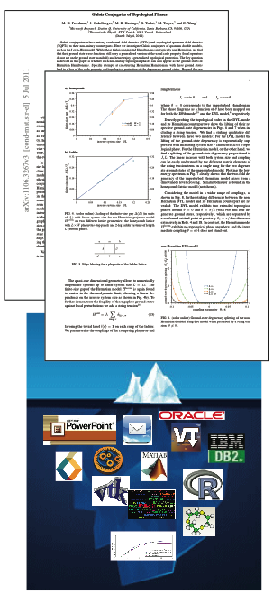
Science Today:
Incomplete Publications
Scientific record is incomplete
Can’t (easily) reproduce or re-use
results
Notes:
This problem is propagated to publications. Currently publications that include computational results are often incomplete – they show just the tip of the iceberg and lack details of how the results were generated. Consequently, there is little hope that others will be able to reproduce, verify, or re-use these results. And this greatly hinders scientific progress.

Slide 4
Virtues of
Computational Provenance
Essential for science: systematically track how data is created and transformed during its life cycle
Interpret and reproduce results: Understand the trail followed to produce a result, assess its quality
More easily extend/modify previous work
“If I have seen further, it is by standing on the shoulders of giants.”
Isaac Newton
Data
Manipulation
Data
Product
Exploration
Provenance
Notes:
To address these problems, it is crucial that provenance be at the center of the scientific process. Provenance of scientific explorations must be systematically captured. And once you have provenance, not only you can reproduce the results, but you can also reason about the trail followed to obtain them and assess their quality. Furthermore, it becomes easier (and possible!) to extend and modify previous work.

Slide 5
A Possible Future:
Capture/Use Workflows
Automatically capture all files that are used in a computation and their workflow.
Wrap them in a virtual machine.
Make that virtual machine available to future users who can
modify experiments
combine different workflows to create new ones

Slide 6
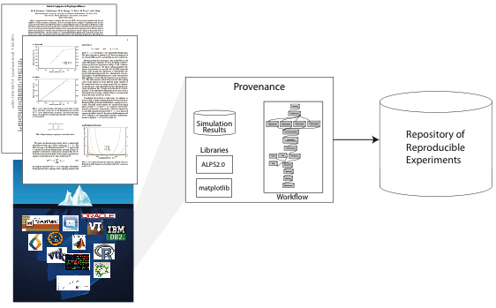
Science Tomorrow:
Reproducible Results

Slide 7
Science Tomorrow:
Sharing and Re-Using Results

