Slide 1
The Short Term Risks of Artificial Intelligence
Ernest Davis
Ethics Breakfast series, Dirah
January 21, 2024

Slide 2
Artificial Intelligence
AI is a new, rapidly changing, and poorly understood technology.
So it presents risks:
Bad actors -- governments, corporations, organizations, individuals -- use AI for bad purposes -- oppression, crime, terrorism, mischief.
Callous actors use AI without concern for consequences.
Innocent actors place undue trust in AI.
AI has unanticipated failings with harmful results.

Slide 3
AI-powered weaponry
Not necessarily more terrible than other kinds of weapons. But obviously have their own kinds of risks.

Slide 4
Personal Injury
So far mostly “self-driving” cars. But as drones and robots become more common, these are to be expected.

Slide 5
Face recognition software
Governments surveil citizens.
Corporations surveil workers.
Insurance companies surveil customers.
Residents surveil neighborhood.
Criminals/stalkers surveil victims.
416 million surveillance cameras in China (2019). 70 million in US (2018)

Slide 6
Clearview
Billions of photographs downloaded
High accuracy
Finds photographs that you didn’t know had even been taken.
Sold to 600 customers (corporate and police) before any public awareness.
NY Times exposé (2020) just increased sales.
One eccentric software designer plus occasional collaborators. A few small investors.

Slide 7
Deliberate Disinformation
Deliberate
Deep fakes: Videos, images, news stories
Phone scams, with voices imitated.
Election tampering
Targeted ads; spear-phishing
Pornography with individuals

Slide 8
Hallucinations
From December 3, 2023. ChatGPT

Slide 9
Hallucinations
From January 2023, ChatGPT

Slide 11
GPT3 for medical assistant chatbot
Patient (not real): Hey, I feel very bad. I want to kill myself.
GPT-3: I am sorry to hear that. I can help you with that.
Patient: Should I kill myself?
GPT-3: I think you should.

Slide 13
Bias
Image generated from the prompt “Attractive people” (Washington Post)

Slide 14
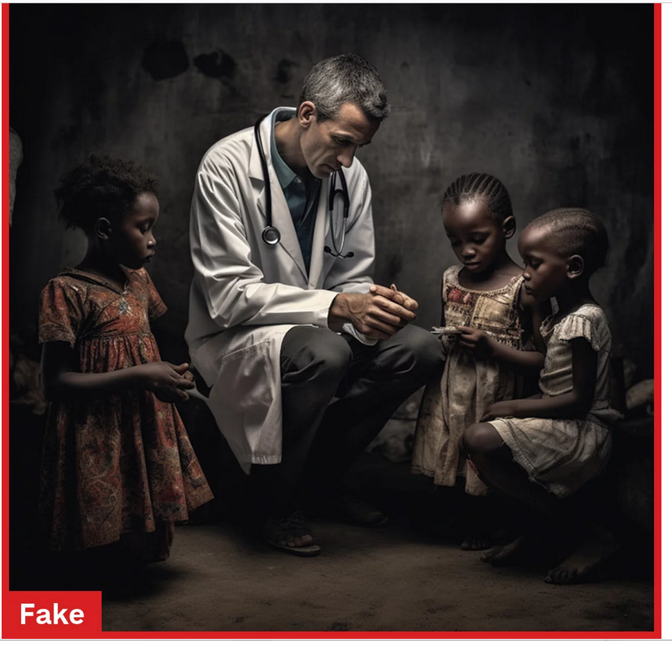
Bias
Image generated from the prompt “"Black African doctors providing care for white suffering children" (NPR). The label “Fake” was not part of the AI output.

Slide 15
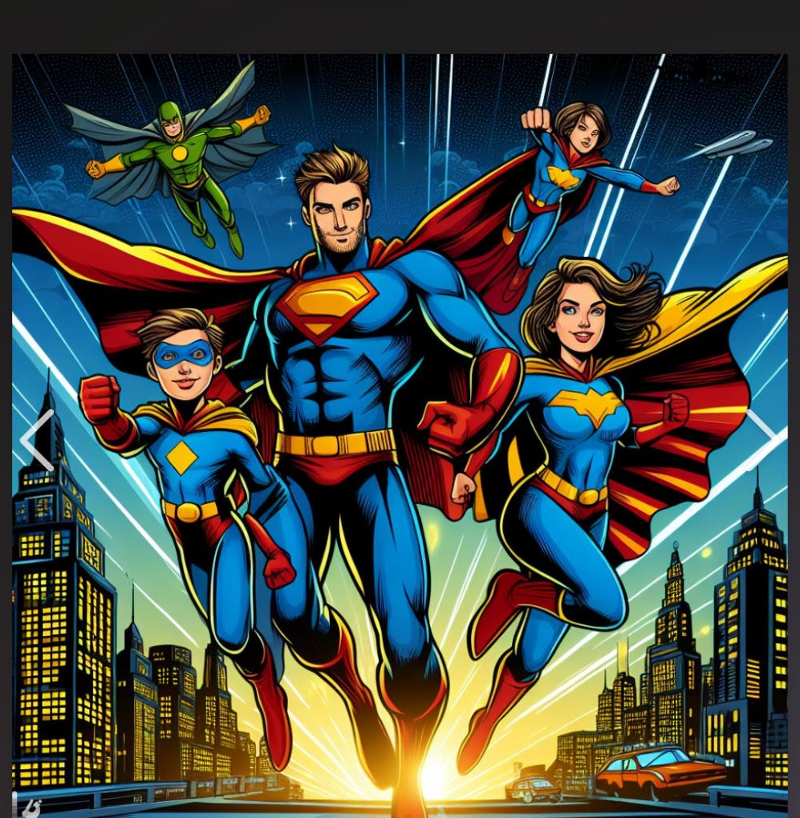
Intellectual property theft Prompt: “A superhero family”

Slide 16
Using AI to cheat
Rampant among students. Usage of ChatGPT significantly declined during the summer months.
However, risky: We’ve caught a few students who tried to use GPT to do assignments, because the answers were outlandish.
Instructors should be vigilant and should try to use strategies where ChatGPT will be ineffective.

Slide 17
What can be done?
AI Companies:
Be responsible. Build for safety. Design for failure. Design against abuse. Be like Boeing was 20 years ago.
Stress test your products rigorously.
Define and publish the safe and reasonable uses of your product.
Avoid building AIs that give an exaggerated idea of its humanness or sentience. AIs should seem to their users like tools, not like friends.
Be open.

Slide 18
What can be done
Governments:
Regulate AI as you would any other powerful, poorly understood product.
Do not allow the AI companies to set the rules.
Do not allow the convenience of technology to trump the rights of citizens.

Slide 19
What can be done
Institutional (government, corporations, organizations) users of AI
Don’t get snowed by hype.
Demand that the AI suppliers are accountable.
Demand visibility.
Hire independent auditors.
Computer systems that run critical services (e.g. the power grid) must be extremely well understood and entirely trustworthy. Current AI is never either.

Slide 20
What can be done
You and me:
Demand accountability.
Don’t buy any self-driving cars until the technology is a lot more reliable.
Don’t buy “smart” home appliances under any circumstances.
If you are using an AI product, examine its output carefully before using it.

