Slide 1
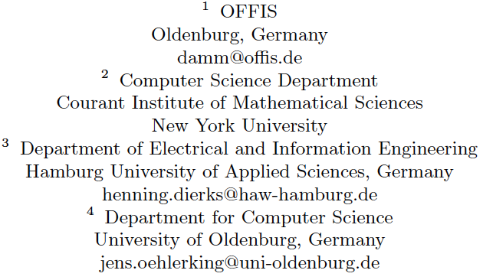
Towards component based design of hybrid systems
W.Damm¹, H. Dierks³, J. Oehlerking⁴, A. Pnueli²

Slide 2
Structure of Presentation
Motivation and Industrial Context
Hybrid Interface Specifications
Component Based Design of Hybrid Systems: Assuring Safety and Stability
Conclusion
This presentation is based on a publication which will appear in the LNCS memorial volume dedicated to
Amir Pnueli

Slide 3
Motivation and industrial context

Slide 5
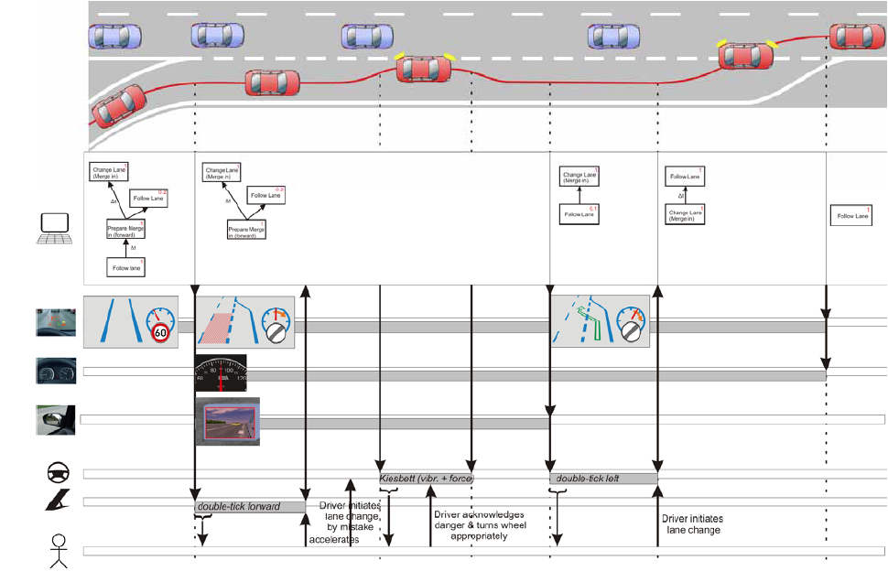

Slide 6
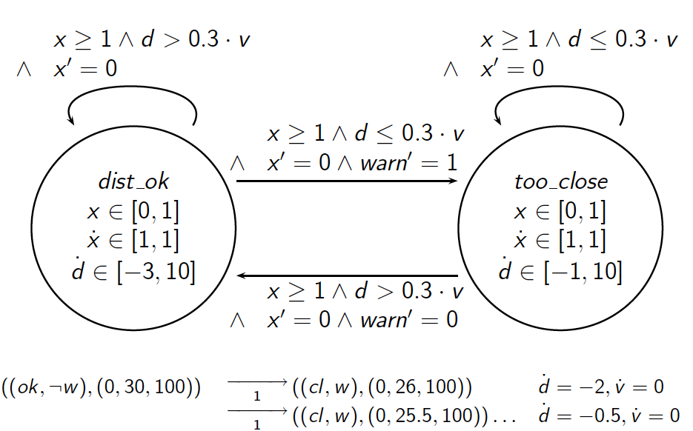
The underlying mathematics: hybrid automata

Slide 7
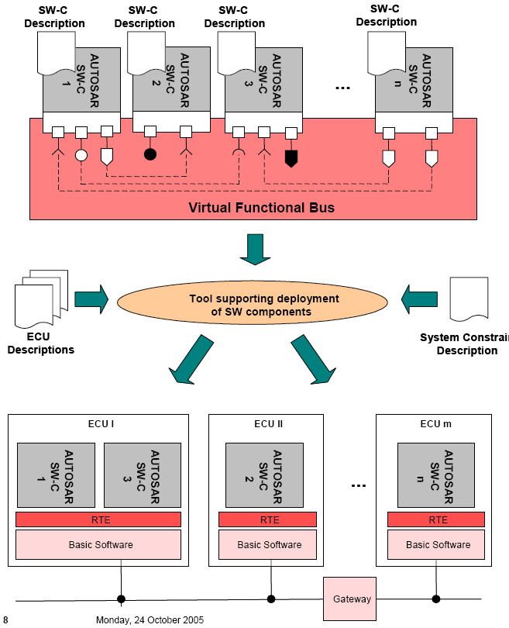
Autosar Approach
Answers requirement to decouple growth in number of functions from decoupling number of ECUs:
  SW components of different functions can be allocated to one ECU
  Allows SW components of one function to be distributed over multiple ECUs (to optimize overall architecture)
Components can correspond to different modes or subsystems of hybrid controllers
Induces distributed execution
Mode switching can cause task switching

Slide 8
Towards component based design of hybrid controllers
Can we propose a component model for hybrid controllers
… supporting re-use of components in multiple application contexts?
  Characterizing stability and safety properties in specified environments through hybrid interface specifications
… supporting incremental construction of hybrid controllers
  From a library of controller models
  by composing controllers through transition composition
  automatic verification of hybrid interface specification of composed system from interface specifications of subsystems
… allowing to bridge the gap between specification and design
  Specification models with idealized time behaviour
  Distributed implementation with induced impurities such as latencies in mode-switching

Slide 9
Hybrid Interface Specifications

Slide 10
Requirements on Hybrid Interface Specifications
Characterize plant regions for which safety and stability is guaranteed
Support compositional reasoning for safety and stability
Support transition from specification models to design
  Specification models
    Focus on nominal behaviour
    Assume instantenous observability and controllability of plant
  Design models
    control-laws become tasks: support activation/suspension of components
    provide exception handling adressing antitipated risks or failures
    cater for task-switching latencies

Slide 11
The inner envelope design paradigm
Consider a safety property ϕ given as conjunction of linear constraints. We identify an inner envelope ϕº with the following properties
any only slightly perturbed trajectory originating in ϕº stays there forever
whenever a sampled trajectory leaves ϕº , then there is a time window of length at least Δ until ϕ is violated when extrapolating the current dynamics even taking into account the specified worst-case dynamics for unmodelled disturbances

Slide 12
… and how we apply it
Choose as entry condition an inner envelope of ϕ_{safe} such that all slightly disturbed trajectories originating in it will converge to (inner envelope) region of stability within specified bound
Similarly for ϕ_{stable}
ϕ_{safe}⁰
ϕ_{stable}
ϕ_{stable}⁰
¬ϕ_{safe}
set-point

Slide 13
Raising alarms along bad trajectories

ϕ_{safe}⁰


ϕ_{stable}

ϕ_{stable}⁰
¬ϕ_{safe}
set-point

Slide 14
A Component Lifecycle: three roles
Control under nominal conditions
  Ensure plant safety
  Enforce convergence of plant according to stability requirements (asymptotic stability, drive plant into specified region within given time bound)
Deviations from nonimal conditions:
  Detect risks for endangering safety and stability
  Raise alarm early to provide for safe transition of control
Offering help
  Check for raised alarms and offer help if component spec can adress dynamics causing alarm

Slide 15
Approach
Components provide
  Inports:
    To invoke nominal service
    To offer help
    To specify plant conditions for which help can be offered
  Outports
    To raise alarms
    To characterize plant conditions causing alarm
Components can raise multiple alarms
Conditions causing alarm can disappear

Slide 16
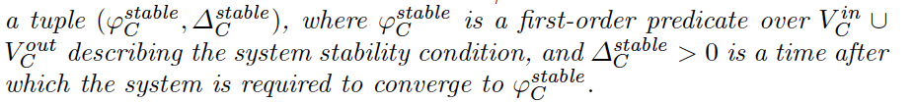
Specification of nominal behaviour
Stability requirements
  this subsumes asymptotic stability
  the controller is required to meet the stability requirements unless an alarm is raised
Safety requirements
  the controller is required to meet the plant safety requirement unless an alarm is raised

Slide 17

Being helpful: specification of inports
Is given by
where
c_{β} signals an incoming alarm
λ_{β} is the latest reaction time for granting acceptance
take_{β} signals acceptance of alarm
start_{β} is the verdict of the distributed alarm resolution protocol to become the hero
Mmm is the entry predicate required to be satisfied when control is transferred to the component over this port

Slide 18


Asking for help: specification of outports
Is given by
where
b_{α} is the outgoing alarm signal
        is the plant condition causing the alarm
μ_{α} is the minimal persistency of the alarm
Δ_{α} is the duration following the alarm for which safety and stability is still guaranteed
take_{α} signals that at least one helper is available
switch_{α} signals delegation of control to helper
Mmm overapproximates plant state at switch time

Slide 19

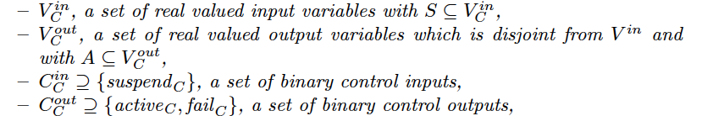
Static interface
  Data
  Control

Slide 20
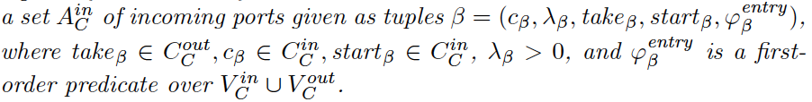
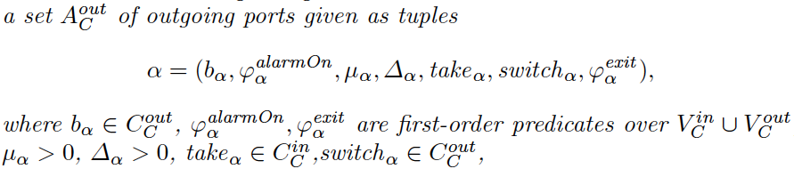
Inport specifications
Outport specifications

Slide 21
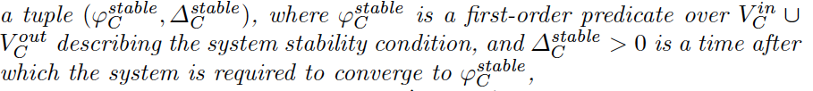
Stability requirements
Assumptions
Promises

Slide 22
Hierarchical component based design
and verification

Slide 23
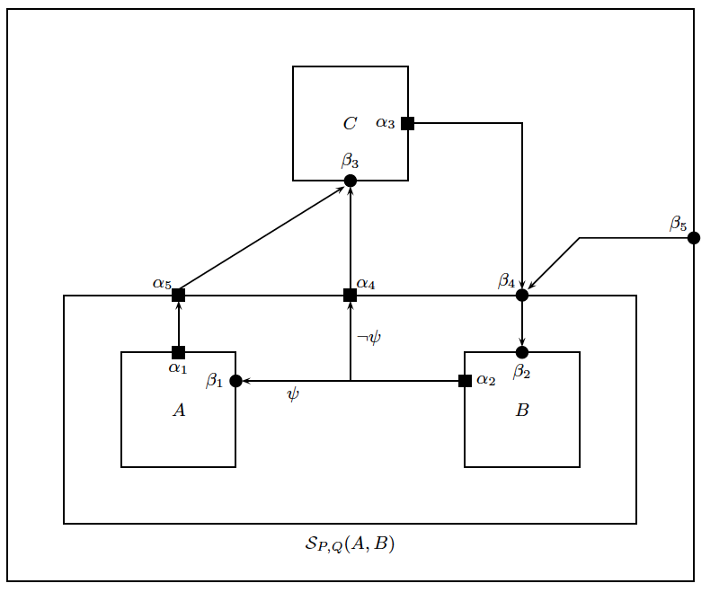
Hierarchical construction of controllers
sensors
actuators
Plant

Slide 24
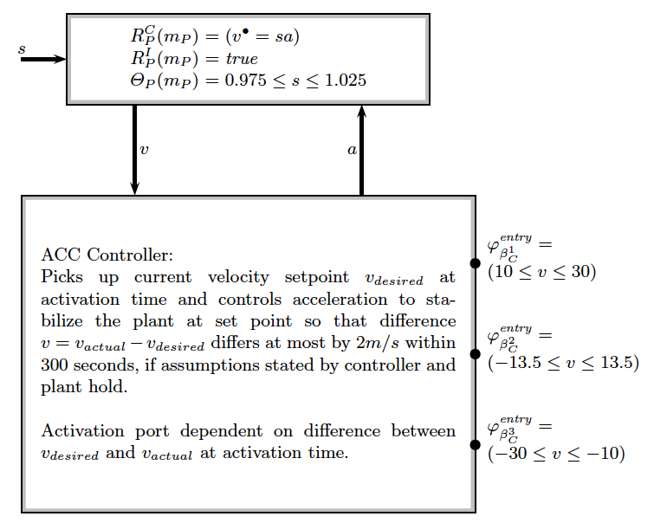

Slide 25



Slide 26


Slide 27


Slide 28


Slide 29


Slide 30
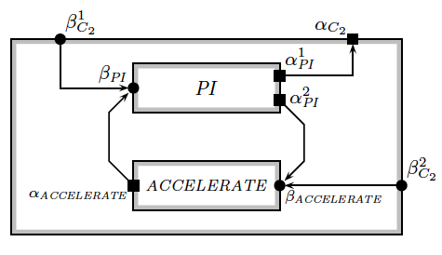

Slide 31
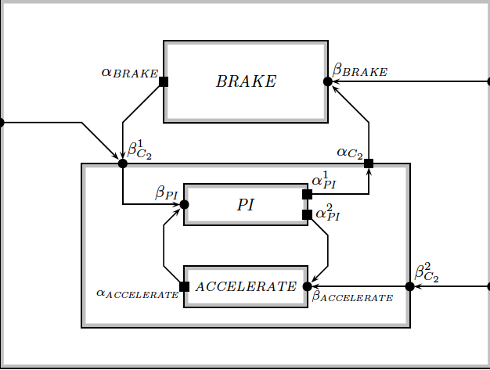

Slide 32
Sequential composition of components
Pragmatics
All subsystems offer alternate ways of controlling same plant
Choice of subsystem dependent on current dynamics
if current subsystem is no longer able to ensure stability and safety objectives, a warning is raised using one of its exits
Control then either switches to other subsystem, or warning is passed to enclosing hierarchy level
Hence all subsystems share same static interface and safety and stability requirements relate to same equilibrium

Slide 33
Finding the hero among all offering help
In a context of incremental distributed controller desing, all of these might offer help
  5 neighbours on the same level of the hierarchy, but allocated on different Electronic Control Units
  Some not yet known friend in a so-far unspecified environment of the component
Need distributed agreement protocol to ensure unique transfer of control
  Wrapper for each component
  Negotiates with other components who will be the hero using protocol on control-signals
    Alarms, I can take this, Please do so, Activate, Suspend
    Specified for each inport

Slide 34
Real-time requirements for negotiation
Negotiations must be closed before system becomes unsafe
  Critical component promises to maintain safety and stability for fixed time period after raising alarm
  taking into account costs for context switches
  Alarms must ensure minimal persistency to guarantee distributed idenfication of helper
  Helpers must provide offer in given time window
  Once helper is selected, it still takes tau time units to perform context switch

Slide 35
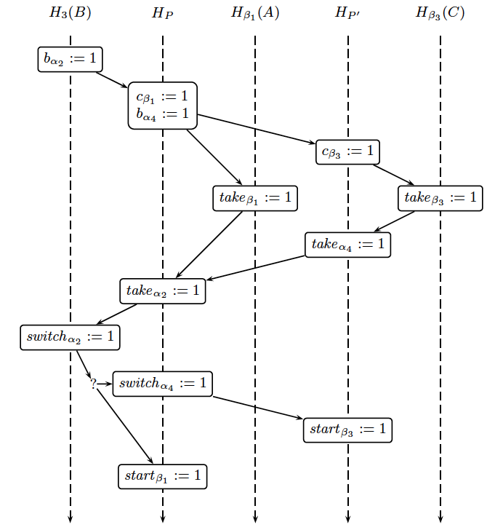
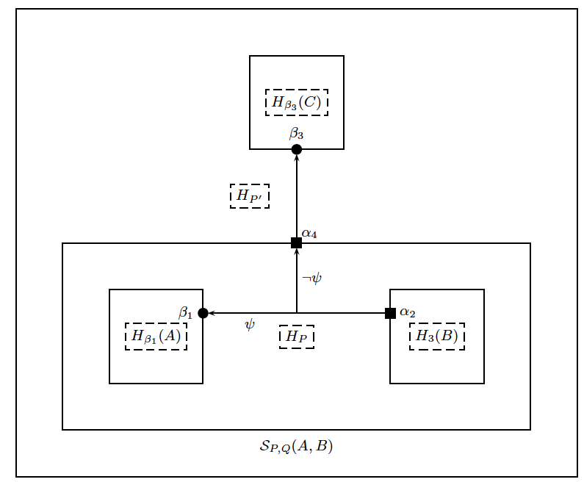
Distributed agreement on heroes ...

Slide 36

Semantics of transition composition
Let [[C_{i}]] denote hybrid automata expressing the semantics of subsystem C_{i} .
We define the semantics [[C]] of the transition composition C = S_{(P,Q)}(C₁,...,C_{n}) as the parallel composition of hybrid automata
  [[C_{i}]] representing the semantics of its subcomponents
  H_{C} propagating activation and failures: it implements
  H_{Q} propogating control signals from inports: it implements
  H_{P} implementing distributed identification of hero

Slide 37


Distributed identification of heroes ...
Automaton
codes in its state set
internally raised alarms
if for such an alarm helpers are available all such pairs (alarm, helper)
Collects to this end all control signals from local outports and control signals of local inports and external outports based on P-Port connection

Slide 38
Compositional Verification of stability - Approach
In a white-box view we would consider the composed Lyapunov functions V(θ)
X |→ if in(C_{j}) then V_{j}(θ,X)
as a candidate Lyapunov function for the composed system and prove, that this function is decreasing
A key ingredient in this proof is, that criticality does not increase in mode switching

Slide 39
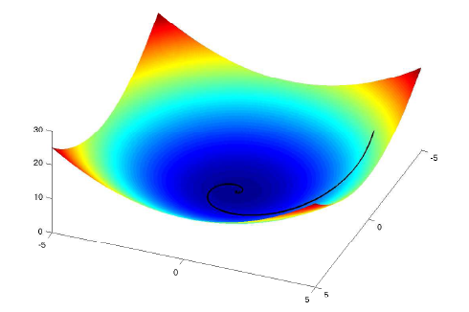
Lyapunov functions demonstrate convergence to equilibrium
Lyapunov function provide measures of criticality of states of the closed loop H||P: red states are far from point of equilibrium
Lyapunov functions are witnesses of stability: any trajectory originating in entry-region of controller will converge to equilibirum

Slide 40

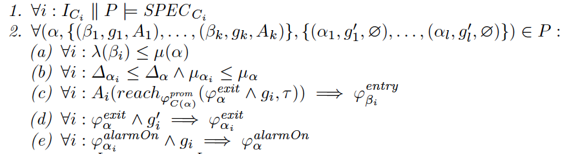
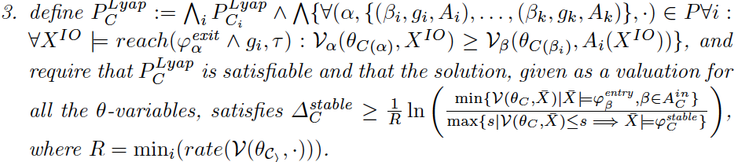
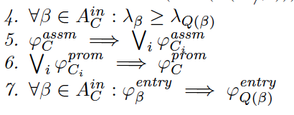

Slide 41
Turning a hybrid automata into a basic component implementation
Have to provide for activation and suspension
Have to provide wrapper supporting distributed agreement protocol
Leads to hybrid automata defining component semantics
Can verify with automated verification techniques that hybrid automata meets component interface specifications
  Nominal: safety and stability
  Specifications of inports (partly guaranteed by wrapper automata)
  Specifications of outports (partly guaranteed by wrapper automata)

Slide 42

Semantics of basic components
Let
be a hybrid automata admissable for component specification C and plant P. We define the semantics of the induced component implementation I [[C(H)]] as the parallel composition of hybrid automata
with
H₁ allowing for chaos when I is not active
H₂ providing for activation and suspension of H
H₃ supporting distributed agreement on handling all alarms
H_{β} supporting protocols for inports

Slide 43
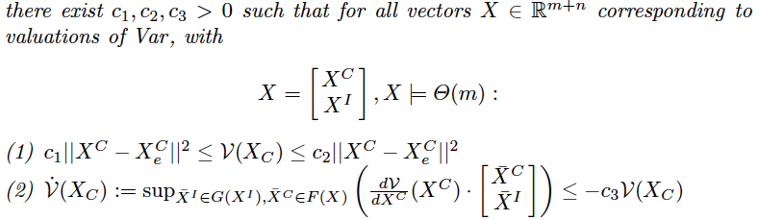
Interface verification of basic components (I)
Let
denote the hybrid automata inducing the basic component implementation, and consider the closed loop H ||P .
Recall that a Lyapunov function for H||P is a function
meeting the following requirements

Slide 44
Verification conditions for basic components (1)
No chattering – no immediate alarms
where reach refers to the linear(!) closed loop dynamics of H||P
Tools for establishing verification conditions:
- using barrier certificates/Lyapunov functions
- using forward reachability analysis tools such as PHAVER

Slide 45




Verification conditions for basic components (2)
Asymptotic stability
  Generate family of Lyapunov functions to provide more flexibility when composing systems
  for H||P
Time bounded convergence
  We exploit that any linear combination of a Lyapunov functions is again a Lyapunov function
  Let and

Slide 46
Verification conditions for basic components (3)
Exit conditions are established within escape period
Promises are met
Theorem
If all verification conditions are satisfied, then
H||P satisfies its hybrid interface specification

Slide 47
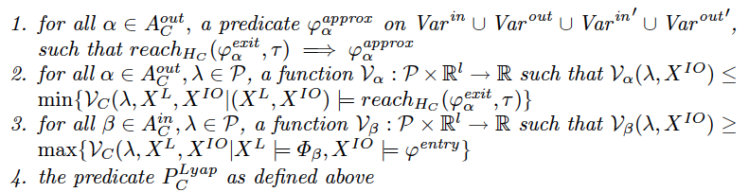

Inductive Assertions
As a basis for compositional grey box verification, we must provide the following „invariants“ inductively at the interface of components
Additionally, parameter dependent constants for computing convergence rates must be made visible

Slide 48
Conclusion and Future Work

Slide 49
Conclusion
Have proposed theoretical foundation for component based design of hybrid control supporting compositional verification of nominal and exception handling requirements
Verification conditions both for basic and composed systems can be discharged automatically
Future work
  Extensions to parallel composition
  Bridging the gap between idealized plant models and physical plants

Slide 50

Thanks, Amir

