Slide 1




Architecture-aware Analysis of Concurrent Software
Rajeev Alur
University of Pennsylvania
Amir Pnueli Memorial Symposium
New York University, May 2010
Joint work with
Sebastian Burckhardt Sela Mador-Haim Milo Martin

Slide 2

Amir’s Influence on My Own Research
A really temporal logic, FOCS 1989
Joint work with Tom Henzinger
Written while visiting Weizmann in Spring 1989
Extension of LTL with real-time bounds
Always ( p -> Eventually_{<5} q)

Slide 3
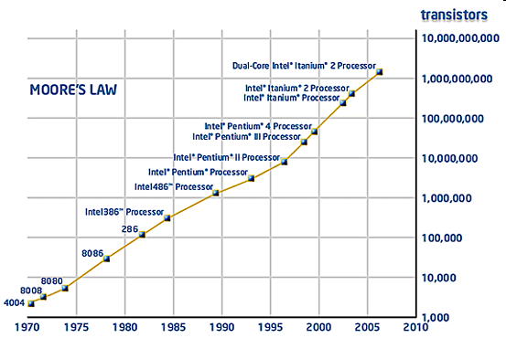

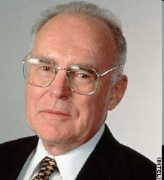
Engine behind Computing Power
Moore’s Law: Transistor density doubles every 2 years

Slide 4
Software Challenge:
How to assure increased performance?
Past:
More transistors per chip and faster clock rate
Same program would execute faster on new processor
Emerging Trend and Future:
Parallel hardware (multi-cores)
Programs must be concurrent
Applications must be reprogrammed to use parallelism
The free lunch is over:
A fundamental turn towards concurrency in software
Herb Sutter

Slide 5


Challenge: Exploiting Concurrency, Correctly
Multi-threaded Software
Shared-memory Multiprocessor
Concurrent Executions
Bugs
How to specify and verify shared-memory concurrent programs?
Notes:
Architecture is pushing multicore hardware,
software ready for concurrency? not quite...

Slide 6
Concurrency on Multiprocessors
Initially x = y = 0
thread 1
x = 1
y = 1
thread 2
r1 = y
r2 = x
Standard Interleavings
x = 1
y = 1
r1 = y
r2 = x
r1=r2=1
x = 1
r1 = y
y = 1
r2 = x
r1=0,r2=1
x = 1
r1 = y
r2 = x
y = 1
r1=0,r2=1
r1 = y
x = 1
y = 1
r2 = x
r1=0,r2=1
r1 = y
x = 1
r2 = x
y = 1
r1=0,r2=1
r1 = y
r2 = x
x = 1
y = 1
r1=r2=0
Can we conclude that if r1 = 1 then r2 must be 1 ?
No! On “real” multiprocessors, possible to have r1=1 and r2=0
Notes:
Implemenations are plenty... choose one that has typical features

Slide 7
Architectures with Weak Memory Models
A modern multiprocessor does not enforce global ordering of all instructions for performance reasons
Lamport (1979): Sequential consistency semantics for multiprocessor shared memory
Considered too limiting, and many “relaxations” proposed
  In theory: TSO, PSO, RMO, Relaxed …
  In practice: Alpha, Intel x86, IBM 370, Sun SPARC, PowerPC, ARM …
cache
Main Memory
Notes:
Implemenations are plenty... choose one that has typical features

Slide 8
Programming with Weak Memory Models
Concurrent programming is already hard, shouldn’t the effects of weaker models be hidden from the programmer?
Mostly yes …
  Safe programming using extensive use of synchronization primitives
  Use locks for every access to shared data
  Compilers use memory fences to enforce ordering
Not always …
  Non-blocking data structures
  Highly optimized library code for concurrency
  Code for lock/unlock instructions
Notes:
Implemenations are plenty... choose one that has typical features

Slide 9
Simple
Usable by programmers
Programs (multi-threaded)
Application level concurrency model
System-level code
Concurrency libraries
Architecture-aware
Concurrency Analysis
Architecture level concurrency model
Highly parallel hardware
-- multicores, SoCs
Complex
Efficient use of parallelism
Notes:
9
So far I have been unspecific about how exactly the ordering and atomicity of loads and stores are being relaxed in common arch
for a good reason: it’s not the same on all platforms.
For algorithm designers this is not acceptable... they program for SC
program for Relaxed

Slide 10
Effect of Memory Model
Initially flag1 = flag2 = 0
Ensures mutual exclusion if architecture supports SC memory
Most architectures do not enforce ordering of accesses to different memory locations
    Does not ensure mutual exclusion under weaker models
Ordering can be enforced using “fence” instructions
    Insert MEMBAR between lines 1 and 2 to ensure mutual exclusion
thread 1
thread 2
1. flag1 = 1;
2. if (flag2 == 0)
crit. sect.
1. flag2 = 1;
2. if (flag1 == 0)
crit. sect.
Notes:
Implemenations are plenty... choose one that has typical features

Slide 11
Relaxed Memory Models
A large variety of models exist; a good starting point:
Shared Memory Consistency Models: A tutorial
IEEE Computer 96, Adve & Gharachorloo
How to relax memory order requirement?
  Operations of same thread to different locations need not be globally ordered
How to relax write atomicity requirement?
  Read may return value of a write not yet globally visible
Uniprocessor semantics preserved
Typically defined in architecture manuals (e.g. SPARC manual)
Notes:
Implemenations are plenty... choose one that has typical features

Slide 12
Unusual Effects of Memory Models
Initially A = flag1 = flag2 = 0
thread 1
thread 2
flag1 = 1;
A = 1;
reg1 = A;
reg2 = flag2;
flag2 = 1;
A = 2;
reg3 = A;
reg4 = flag1;
Result reg1 = 1; reg3 = 2; reg2 = reg4 = 0
Possible on TSO/SPARC
    Write to A propagated only to local reads to A
    Reads to flags can occur before writes to flags
Not allowed on IBM 370
    Read of A on a processor waits till write to A is complete
Notes:
Implemenations are plenty... choose one that has typical features

Slide 13
Memory Model Specifications in Practice
Intel Architecture Manual (2008)
Intel 64 memory ordering obeys following principles
1. Loads are not reordered with other loads
2. Stores are not reordered with other stores
3. Stores are not reordered with older loads
4. Loads may be reordered with older stores to different locations but not with older stores to same locations
4 more rules +
Illustrative examples
Notes:
Implemenations are plenty... choose one that has typical features

Slide 14
Which Memory Model should a Verifier use?
RMO
PSO
TSO
390
SC
Alpha
IA-32
Relaxed
Notes:
So far I have been unspecific about how exactly the ordering and atomicity of loads and stores are being relaxed in common arch
for a good reason: it’s not the same on all platforms.
For algorithm designers this is not acceptable... they program for SC
program for Relaxed

Slide 15
Formalization of Relaxed
Program Order: x <_{p} y if x and y are instructions belonging to the same thread and x appears before y
Execution over a set X of accesses is correct wrt Relaxed if there exists a total order < over X such that
  If x <_{p} y, and both x and y are accesses to the same address, and y is a store, then x < y must hold
  For a load l and a store s visible to l, either s and l have same value, or there exists another store s’ visible to l with s < s’
  A store s is visible to load l if they are to the same address and either s < l or s <_{p} l (i.e. stores are locally visible)
Constraint-based specification that can be easily encoded in logical formulas
Notes:
Implemenations are plenty... choose one that has typical features

Slide 16
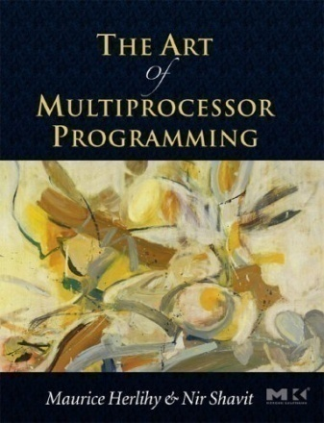
Verification Target: Concurrent Data Structures
Low-level high-performance concurrency libraries are essential
infrastructure for multi-core programming
Intel Threading Building Blocks
Java Concurrency Library
Challenging and tricky code
Sets, queues, trees, hash-tables
Designing such algorithms is publishable research!
Subtle bugs in algorithms and/or implementation
Libraries released by Sun
Published code in textbooks
Complexity not in # of lines of code but in concurrent interactions
Notes:
16
- linked list. concurrent access. ex (multiple prod, multiple cons)
- compare-and-swap instead of locks.

Slide 17


Non-blocking Lock-free Queue
Michael and Scott, 1996
boolean dequeue(queue *queue, value *pvalue)
{
node *head;
node *tail;
node *next;
while (true) {
head = queue->head;
tail = queue->tail;
next = head->next;
if (head == queue->head) {
if (head == tail) {
if (next == 0)
return false;
cas(&queue->tail, tail, next);
} else {
*pvalue = next->value;
if (cas(&queue->head, head, next))
break;
}
}
}
delete_node(head);
return true;
}
Queue is being possibly updated concurrently
Atomic compare-and-swap for synchronization
Fences must be inserted to assure correctness
on weak memory models
Notes:
17
- linked list. concurrent access. ex (multiple prod, multiple cons)
- compare-and-swap instead of locks.

Slide 18
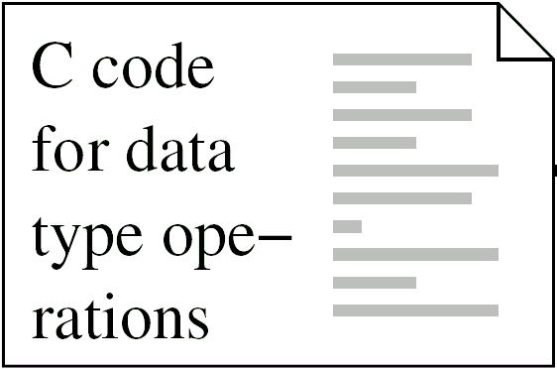
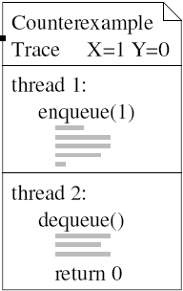
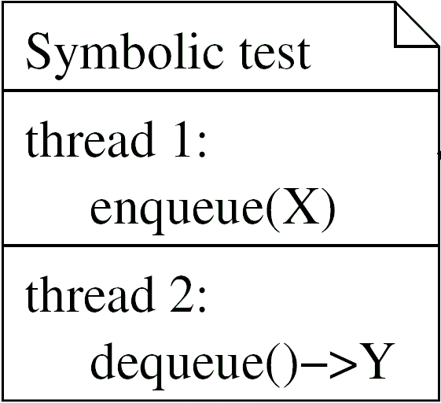
Bounded Model Checker
Pass: all executions of the test are observationally equivalent to a serial execution
Fail:
CheckFence
Inconclusive:
runs out of time
or memory
Memory
Model Axioms
Notes:
black-box view 3 inputs (green) red output
code: e.g. nonbl queue code;
symb. test (shown simplest, two threads, one op each)

Slide 19
Why symbolic test programs?
1) Make everything finite
State is unbounded (dynamic memory allocation)
... is bounded for individual test
Checking sequential consistency is undecidable (AMP 96)
... is decidable for individual test
2) Gives us finite instruction sequence to work with
State space too large for interleaved system model
.... can directly encode value flow between instructions
Memory model specified by axioms
.... can directly encode ordering axioms on instructions

Slide 20
Correctness Condition
Data type implementations must appear
sequentially consistent to the client program:
the observed argument and return values must be consistent with some interleaved, atomic execution of the operations.
Observation Witness Interleaving
enqueue(1)
enqueue(2)
dequeue() -> 1
dequeue() -> 2
enqueue(1)
dequeue() -> 2
enqueue(2)
dequeue() -> 1
Notes:
- operation-level sequential consistency
- an implementation is CORRECT if illusion is successful.

Slide 21
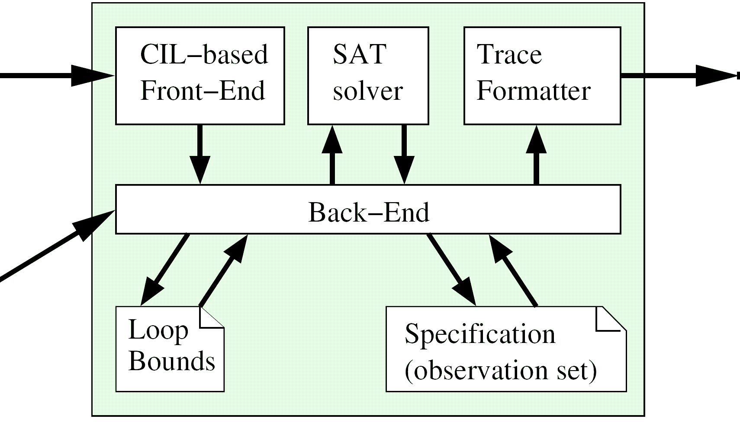
Tool Architecture
Trace
C code
Memory model
Symbolic Test
Symbolic test gives exponentially many executions
(symbolic inputs, dynamic memory allocation, ordering of instructions).
CheckFence solves for “incorrect” executions.

Slide 22
Example: Memory Model Bug
1
2
3
head
Processor 1
links new node into list
Processor 2
reads value at head of list
...
3 node->value = 2;
...
1 head = node;
...
...
2 value = head->value;
...
Processor 1 reorders the stores!
memory accesses happen in order 1 2 3
--> Processor 2 loads uninitialized value
adding a fence between lines on left side prevents reordering

Slide 23
Algorithms Analyzed
Type | Description | LOC | Source
Queue | Two-lock queue | 80 | M. Michael and L. Scott (PODC 1996)
Queue | Non-blocking queue | 98
Set | Lazy list-based set | 141 | Heller et al. (OPODIS 2005)
Set | Nonblocking list | 174 | T. Harris (DISC 2001)
Deque | “snark” algorithm | 159 | D. Detlefs et al. (DISC 2000)
LL/VL/SC | CAS-based | 74 | M. Moir (PODC 1997)
LL/VL/SC | Bounded Tags | 198

Slide 24
Results
  snark algorithm has 2 known bugs
  lazy list-based set had a unknown bug
  (missing initialization; missed by formal correctness proof
  [CAV 2006] because of hand-translation of pseudocode)
  Many failures on relaxed memory model
    inserted fences by hand to fix them
    small testcases sufficient for this purpose
Type
Description
regular
bugs
# Fences inserted
Store
Store
Load Load
Dependent
Loads
Aliased
Loads
Queue
Two-lock queue
1
1
Queue
Non-blocking queue
2
4
1
2
Set
Lazy list-based set
1 unknown
1
3
Set
Nonblocking list
1
2
3
Deque
original “snark”
2 known
Deque
fixed “snark”
4
2
4
6
LL/VL/SC
CAS-based
3
LL/VL/SC
Bounded Tags
4

Slide 25
Ongoing Work
Generating litmus tests for contrasting memory models
(CAV 2010)
  Developing and understanding formal specs of hardware memory models is challenging (frequent revisions, subtle differences…)
  Two distinct styles: operational and axiomatic
  Tool takes two specs and automatically finds a litmus test (small multi-threaded program) that demonstrates observable difference between the two
  Litmus tests upto a specified bound systematically explored (with many reductions built in to reduce # of explored tests)
  Feasibility demonstrated by debugging/contrasting existing specs
Open question: Is there a bound on size of litmus tests needed to contrast two memory models (from a well-defined class of models)

Slide 26
Memory-model Aware Software Verification
A problem of practical relevance
Formal approaches can be potentially useful
Not well-studied

